Slide 1
SAYAKA_AMR Notes
Xiaosong Sun
2018/05/28

Slide 2
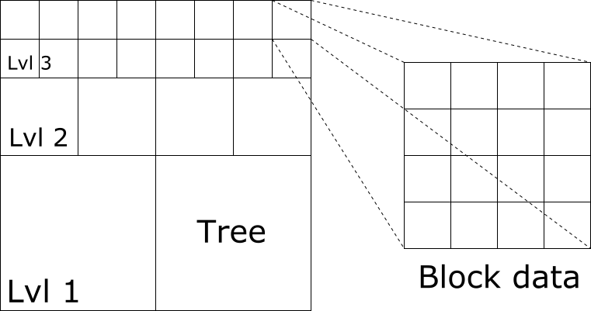
SAYAKA’s strategy: tree/block mixed AMR grid
Tree representation of refine levels
Quad-tree (2D) and Oct-tree (3D)
Tree node
Parent node
Leaf node
Block data in each tree node
Uniform grid
Refined by a factor of two each level

Slide 3
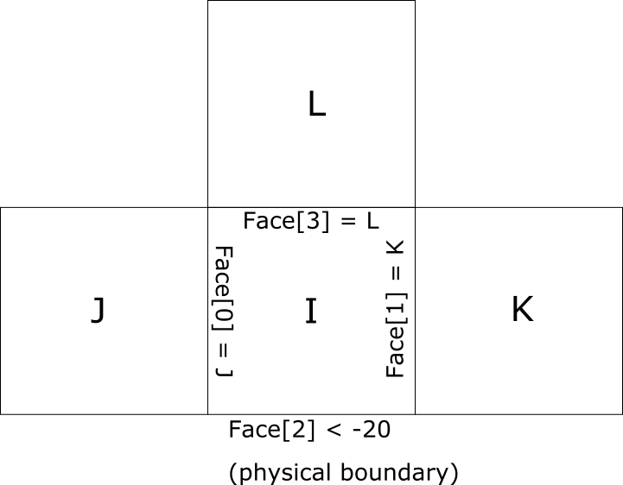
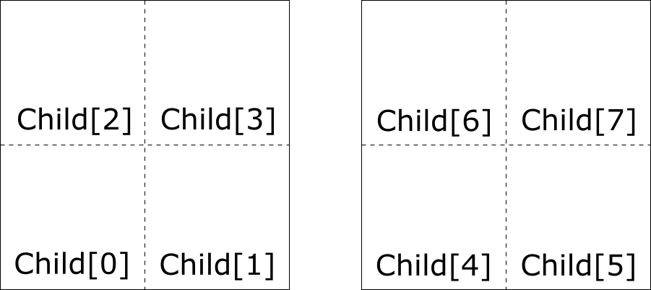
Tree node
Faces x6 (or 2*ndim)
Children x8 (or 2^ndim)

Slide 4
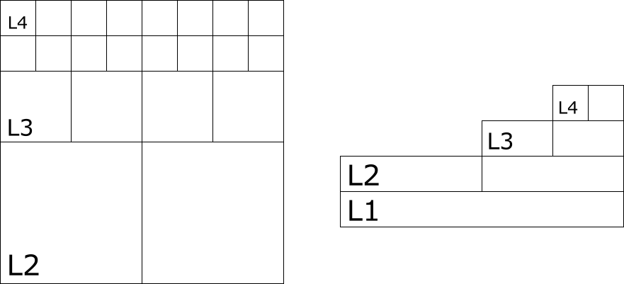
Tree level
Blocks with the same refinement
Level limits:
Min level: static refine up to this level
Max level: dynamic refine no over this level
Finest level: current existing level the finest
Possible range: [1, max level]
NOTE beginning from 1 is designed
Level 0 is left for future development

Slide 5
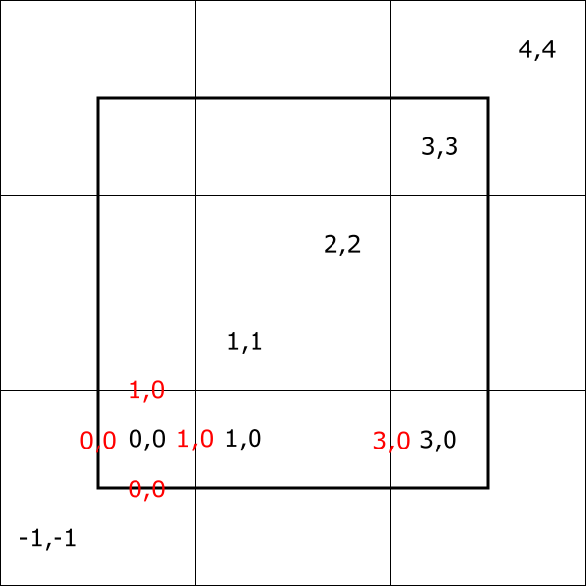
Block data
Variable location
Integer encoding the index type
Cell: <0,0,0>
Face: <1,0,0>, <0,1,0>, <0,0,1>
Node: <1,1,1>
Index box
Two integer vectors (low & high ends)
Closed range of index
Allows minus index

Slide 6
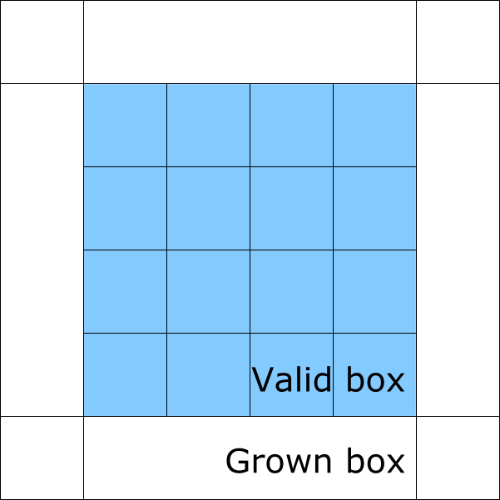
Block data
Data buffer
Valid part: true data
Ghost part
Data from neighbor block
Data from coarser level
Data from physical boundary
Access by data(I,J,K,component)
Staggered data may have overlap between two adjacent blocks -> need proper treatment

Slide 7
Build a tree: root level

Slide 8
Build a tree:

Slide 9
Filling valid cell
Prolong
Coarse -> Fine
Injection
Center difference
Restrict
Fine -> Coarse
Average
Sum

Slide 10
Filling ghost cell
Intra-level operations
Fill block boundary on same level
Fill physical boundary
Inter-level operations
Fill coarse-fine boundary

Slide 11
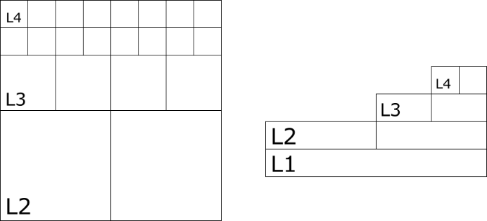
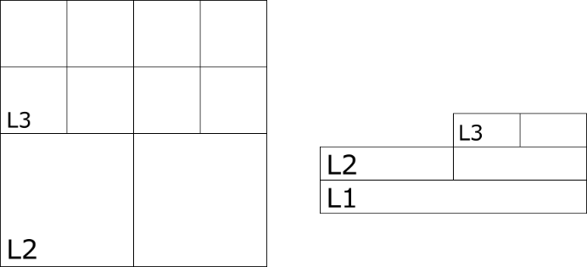
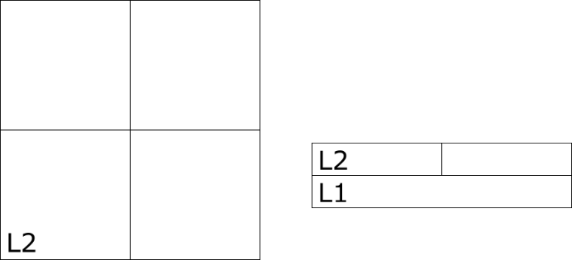

Concept of ‘Tower’
Set of uncovered blocks
The highest tower is simply the collection of all leaf blocks
The i-th tower is made by erasing top level of the (i+1)-th tower
What is tower for?
Valid blocks need solving
Manage coarse-fine face flux
Natural multi-level grids

Slide 12
MAC solver
Extensively use Tower
Only first-order at coarse/fine face
Can help compute flux of solution
MG precondition
Levels of towers as multigrids
GS as smoother, bottom use CG
CG solver

Slide 13
Output and visualization
H5 Chombo file
Paraview: choose *.h5 file -> select format “CHOMBO AMR file”
The HDF5-1.8.20 library is pre-compiled
If you wish, may also dump data to ASCII file in a level-by-level and block-by-block manner

Slide 14
Helpful references
PARAMESH library
Fortran code, the original idea of this tree/block model
Unfortunately, project already obsolete, no longer maintained

