Slide 1
SAYAKA_AMR Notes
Xiaosong Sun
2018/05/28

Slide 2
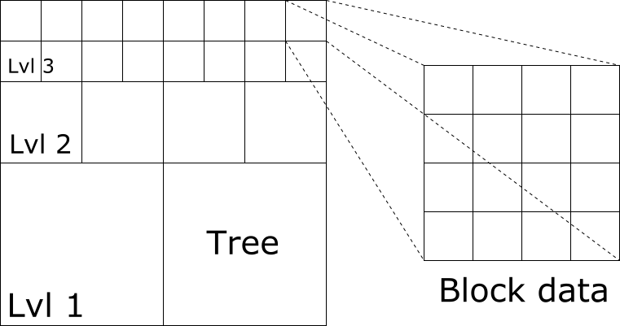
SAYAKA’s strategy: tree/block mixed AMR grid
Tree representation of refine levels
Quad-tree (2D) and Oct-tree (3D)
Tree node
Parent node
Leaf node
Block data in each tree node
Uniform grid
Refined by a factor of two each level

Slide 3
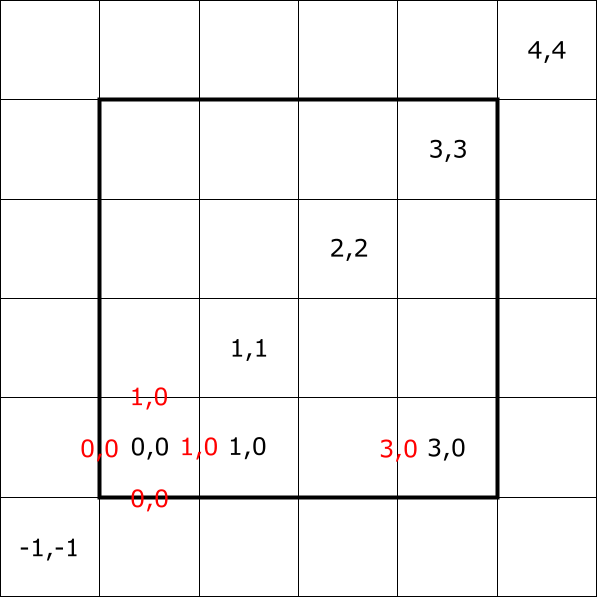
Block data
Variable location
Integer encoding the index type
Cell: <0,0,0>
Face: <1,0,0>, <0,1,0>, <0,0,1>
Node: <1,1,1>
Index box
Two integer vectors (low & high ends)
Closed range of index
Allows negative index

Slide 4
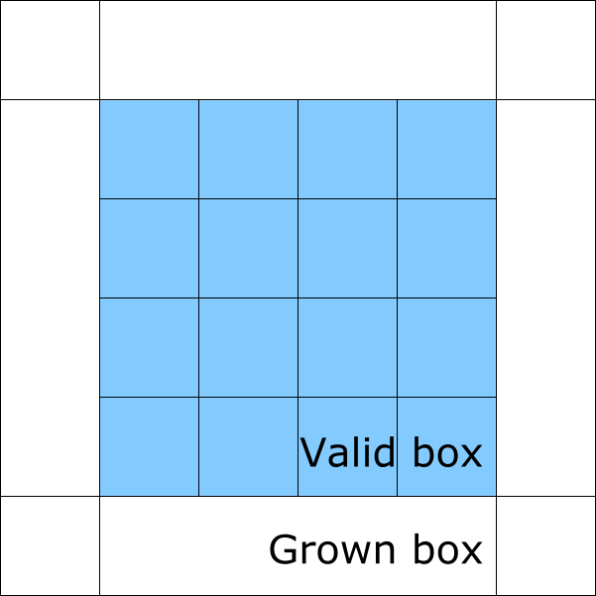
Block data
Data buffer
Valid part: true data
Ghost part
Data from neighbor block
Data from coarser level
Data from physical boundary
Access by data(I,J,K,component)
Staggered data may have overlap between two adjacent blocks -> need proper treatment

Slide 5
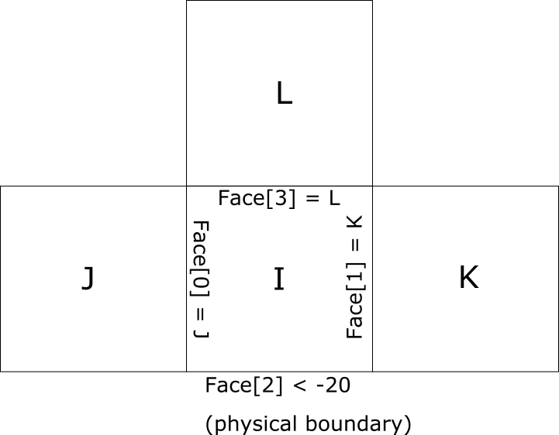
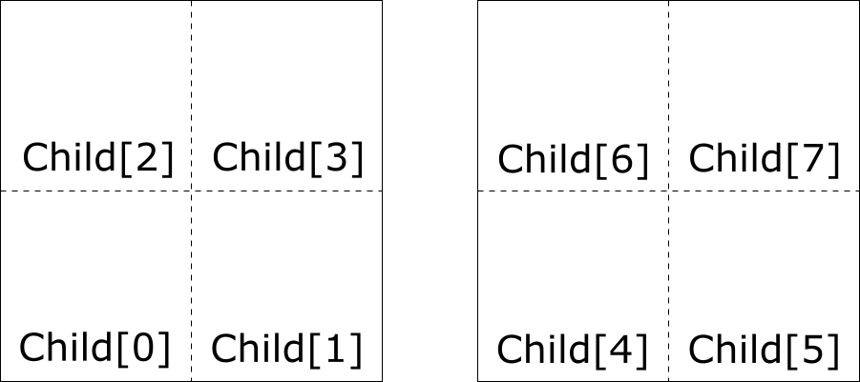
Tree node
Faces x6 (or 2*ndim)
Children x8 (or 2^ndim)

Slide 6
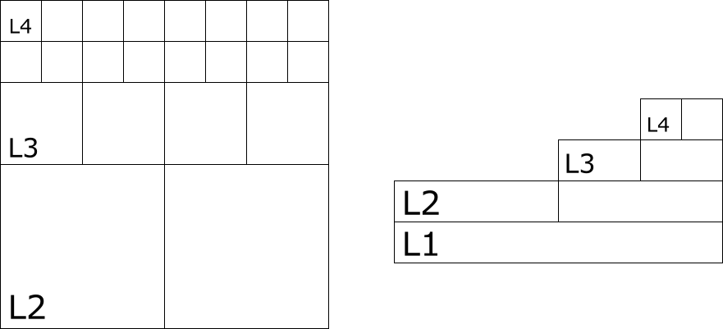
Tree level
Blocks with the same refinement
Fine level must be covered completely by its coarse level
Level limits:
Min level: static refine up to this level
Max level: dynamic refine no over this level
Finest level: current existing level the finest
Possible range: [1, max level]
NOTE beginning from 1 is designed
Level 0 is left for future development

Slide 7
Build a tree: initialize root level
In general, the root level (level = 1) must be initialized by user.
Data to set
Nodes number
Domain length
Boundary condition
Node-to-node links
If the root level is rectangular, use the following easy method
m_tree->initUniformRootLevel( { n0x,n0y,n0z }, // number of nodes probbox, // problem domain probbc, probperiodic); // BC type

Slide 8
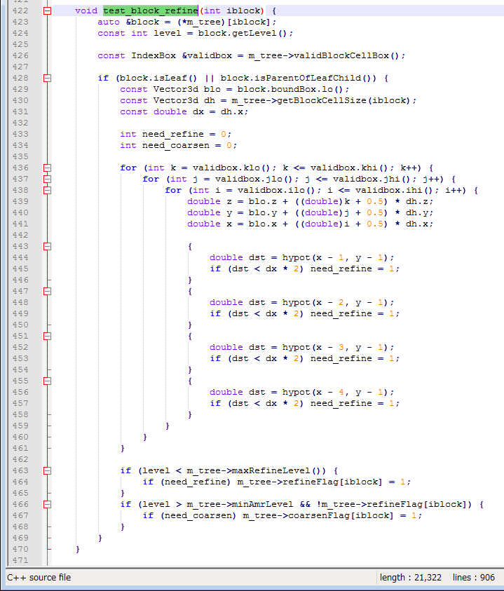
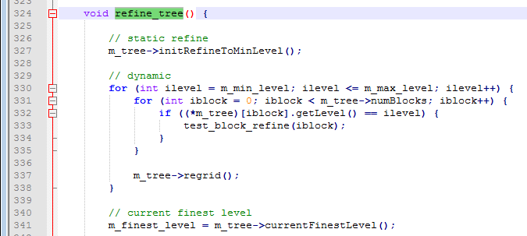
Build a tree: populate fine levels
The library will automatically manipulate the tree structure
The user should just specify “where to refine”

Slide 9
Computation using SAYAKA
In most cases, the user can forget about the “tree”
Instead, one should focus on the block data on each node
Just a (small, e.g. 8x8x8) Cartesian grid
So the core algorithm keeps almost the same
What the library does for you?
Synchronize data between fine and coarse levels -> data in valid cells
Fill ghost cells for nodes on each level -> data in ghost cells

Slide 10
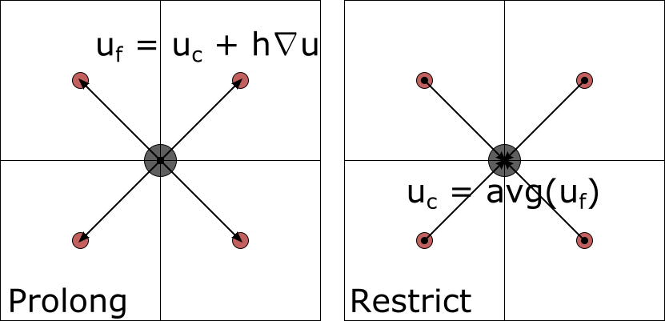
Filling valid cell
Prolong
Coarse -> Fine
Direct injection
Center difference
Restrict
Fine -> Coarse
Average
Sum

Slide 11
Filling ghost cell
Physical boundary
Intra-level operations
Fill block boundary on same level
Fill physical boundary
Inter-level operations
Fill coarse-fine boundary
Same-level boundary
Coarse-fine boundary

Slide 12
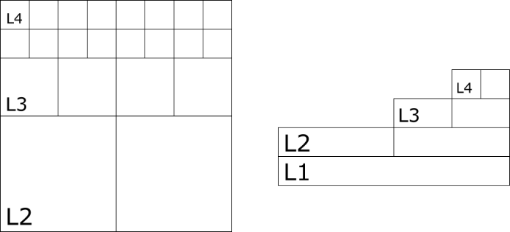
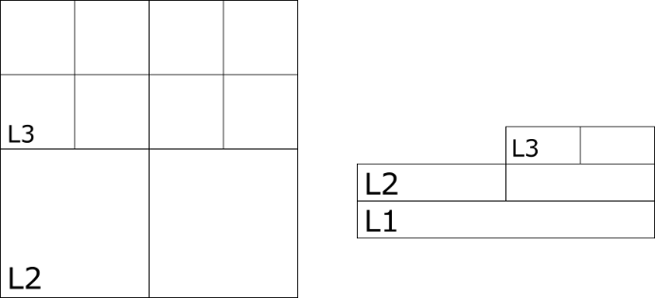
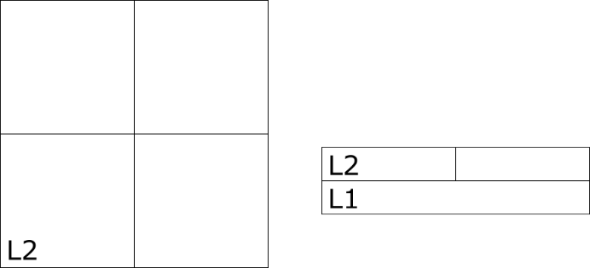

Concept of ‘Tower’
Set of uncovered blocks
The highest tower is simply the collection of all leaf blocks
The i-th tower is made by erasing top level of the (i+1)-th tower
What is tower for?
Valid blocks need solving
Manage coarse-fine face flux
Natural multi-level grids

Slide 13

MAC solver
The MAC equation:
$$aAx−b∇⋅\left(B∇x\right)=r$$
X: cell-centered unknown
a, b: scalar (e.g. time step)
A: cell-centered coefficient (e.g. pseudo-compressibility)
B: face-centered coefficient (e.g. reciprocal of density)
Extensively use Tower
Only first-order at coarse/fine face
Can help compute flux of solution
MG precondition
Levels of towers as multigrids
GS as smoother, bottom use CG
CG solver

Slide 14
Output and visualization
H5 Chombo file
Paraview: choose *.h5 file -> select format “CHOMBO AMR file”
The HDF5-1.8.20 library is pre-compiled
If you wish, may also dump data to ASCII file in a level-by-level and block-by-block manner

Slide 15
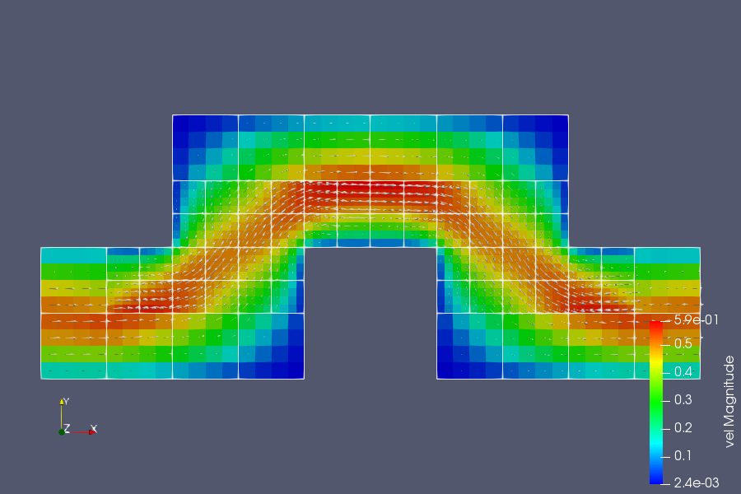
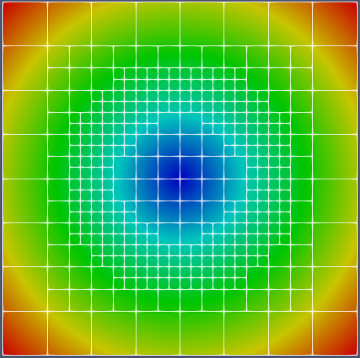
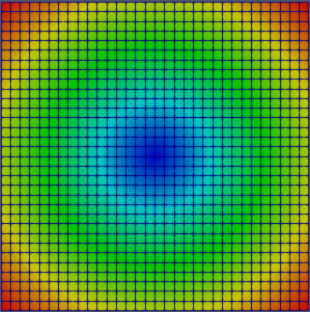
Examples
Test 8: generate a function on the AMR tree and interpolate it to a simple grid.
This shows how to search data point in a tree.
Test 7: time-dependent Stokes flow in an elbow channel.
This is a simple flow simulation without convection term.

Slide 16
Helpful references
Download the newest code from my GitHub:
https://github.com/haloless/SayakaAmr.git
Remember to use VS2017
PARAMESH library
Fortran code, the original idea of this tree/block model
Unfortunately, project already obsolete, no longer maintained

