Slide 1
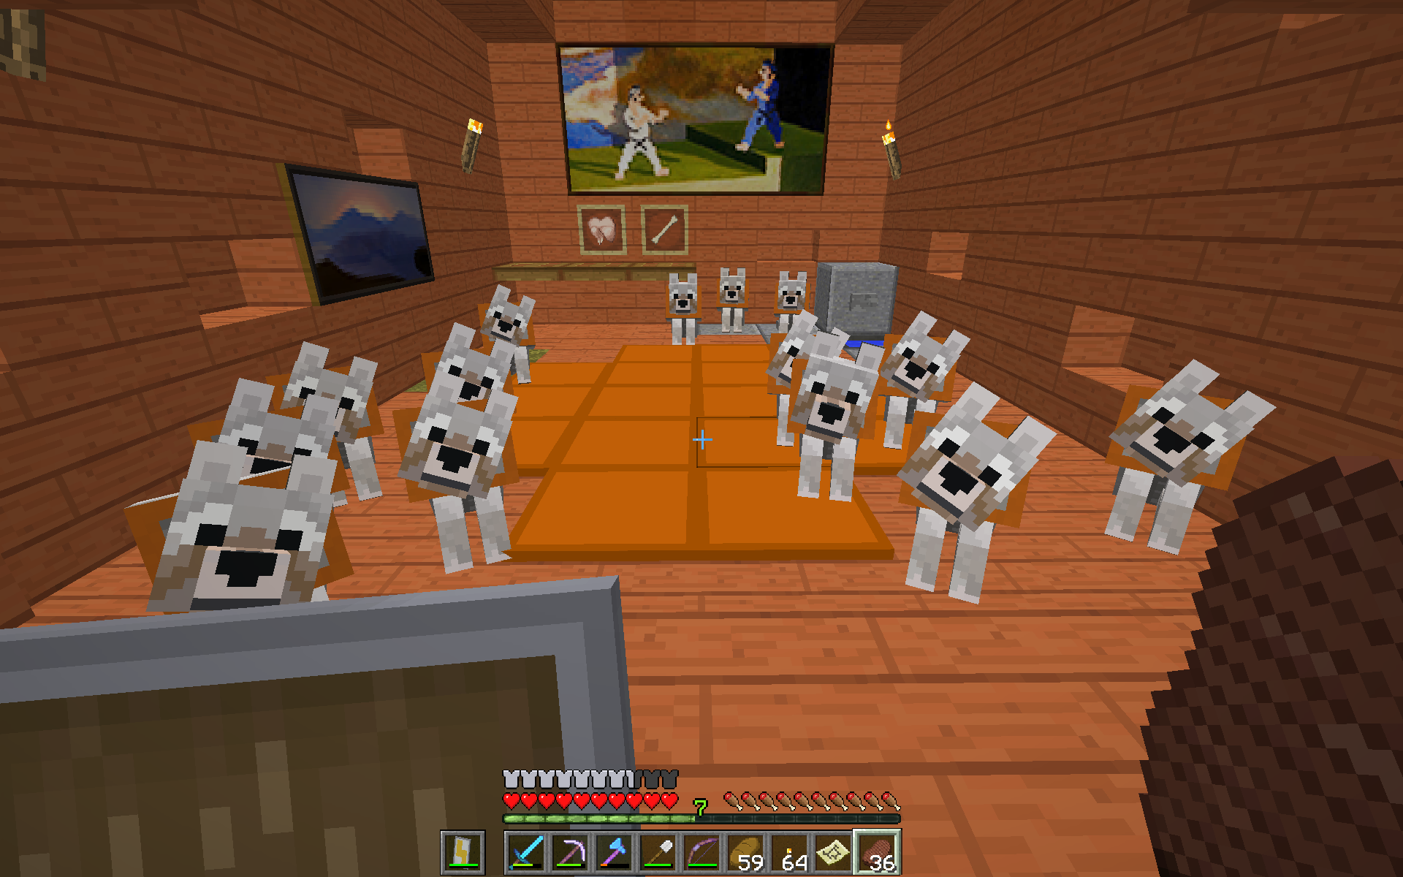
Dog Breeding and capturing
Skycam and DakotaPonderosa are breeding and taming dogs for fun and protection, as dogs will fight any mob that harms the player who tamed the dogs.
July 10, 2018 – Current Day

Slide 2
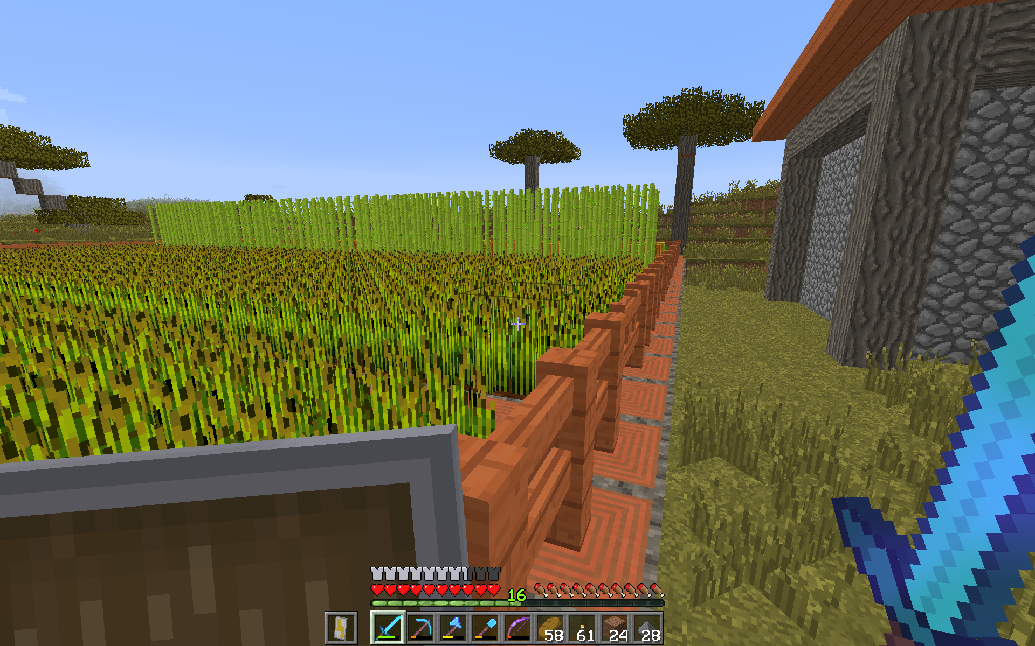
Farming
Skycam and DakotaPonderosa both have successful farms and live off a steady food supply.
Skycam lives mostly off of bread from his wheat farm pictured here, while DakotaPonderosa lives off of pumpkin pie from his sugarcane and pumpkin farms and Skycam’s egg farm.
Date Unknown

Slide 3
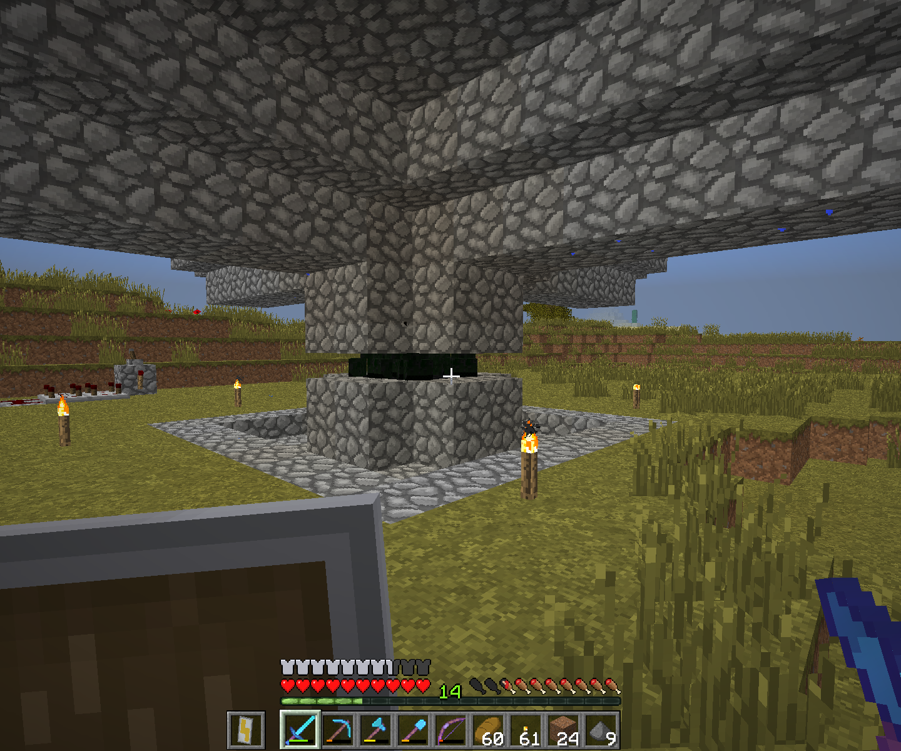
Rudimentary base building
No further information currently available
May 25, 2018 – July 14, 2018

