Slide 1
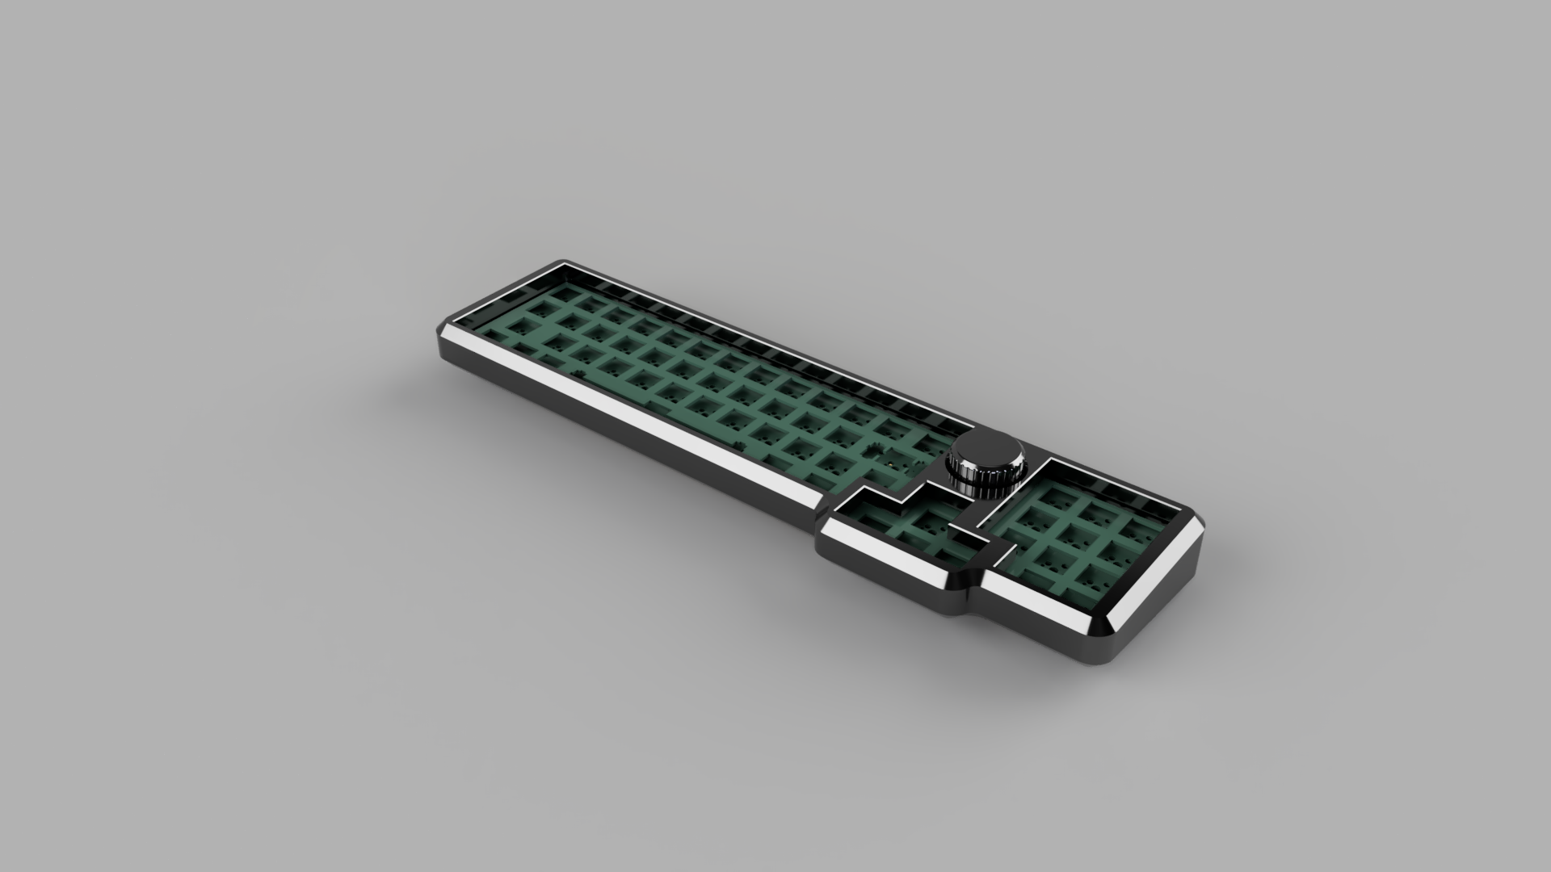
TrashTruck
By: Skycode22
https://github.com/Skycode22/HIDs

Slide 2
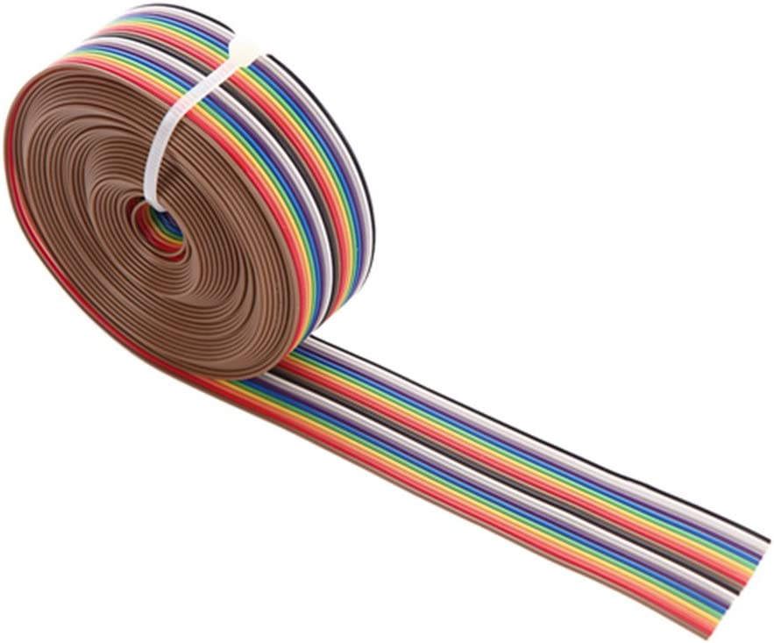
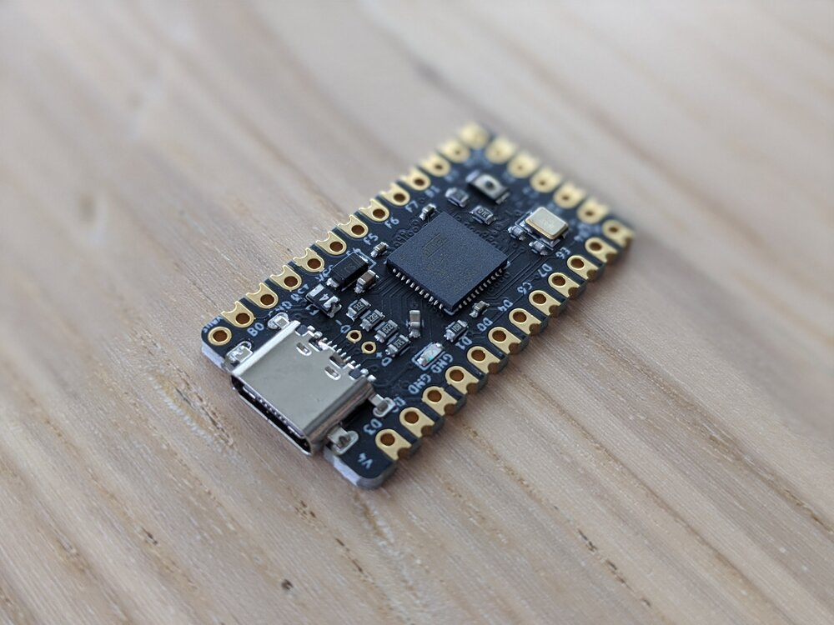
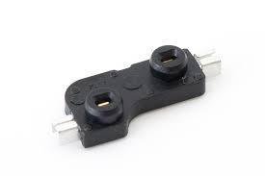
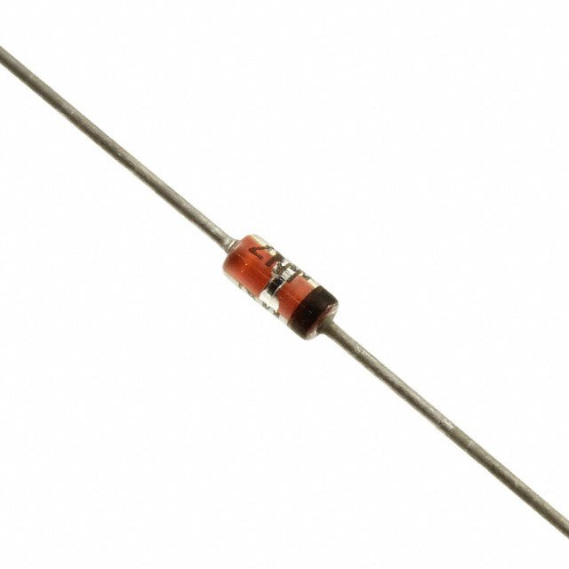
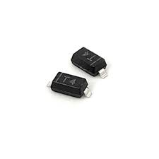

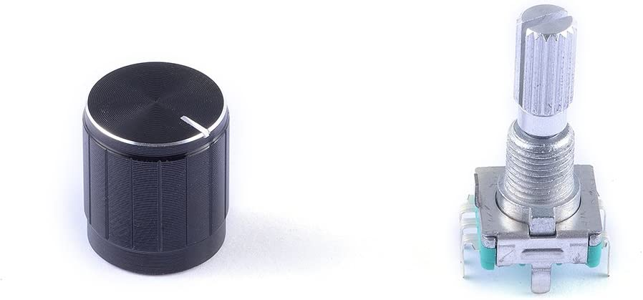
TrashTruck supplies
Supplies needed (other than PCB, 3D printed microcontroller holder,and case):
-Elite-C microcontroller
-Kailh hotswap sockets x58
-Diodes x58 (either THT 1N4148 or SMD SOD-123)
-ribbon cable or any other wire to solder the pcb to the Elite-C
-Rotary encoder
https://www.amazon.com/Cylewet-Encoder-Digital-Potentiometer-Arduino/dp/B07DM2YMT4/ref=sr_1_6?crid=3CTP70L8ADU7H&keywords=encoder&qid=1683396917&sprefix=encoder%2Caps%2C156&sr=8-6
Case screws:
https://www.amazon.com/gp/product/B09ZHHSY92/ref=ox_sc_act_title_11?smid=A3KEIBWKST18IS&psc=1
-x2 25mm 2M machine screws
-x2 15mm 2M machine screws

Slide 3
PCB and Case
The gerber files are included in the repo; use the zipped file named “gerbers” (I used JLCPCB to fabricate mine)
If you don’t like the silkscreen graphic on the pcb you can remove it in kicad and then regenerate the gerber, drill, and map files; Instructions for this can be found online
The case can be found in the “production files” folder inside the “3-D” folder in the repo
Depending on your fabrication process they will need either a STL or STEP file
If you want to print this at home, there is a folder named “Elegoo Mars Printable” that has the case “cut” into 3 sections that can then be put together after printing *(be aware that the tolerances with 3D printing can vary from printer to printer, so be sure to check your measurements after the final model is printed)
If the models are a little too long (which is the common error) then sand down the center pieces and measure frequently to achieve the correct size
If you send the model as a whole to a fab house then you don’t have to worry about that error that commonly occurs when printing it at home

Slide 4
Firmware Instructions
Firmware does not currently have VIA or VIAL enabled, I plan on including that and/or a reset button to the V2 design
The .hex file is included in the repo; use QMK toolbox to flash
If you want to make modifications to the keymap then you can go into the keymap file to make your modifications, recompile the .hex file, and reflash
The QMK firmware source code is in the JSON format which incorporates the .mk file, config, .c, and .h files all inside the info.json; you need the most up to date versions of the qmk toolbox and the QMK MSYS to recompile*
Reference the documentation on QMK to see the process for compiling with MSYS; https://docs.qmk.fm/#/newbs_getting_started

Slide 5
Overview
Solder diodes
Solder Hotswap sockets
Solder encoder to pcb
Solder ribbon cables to pcb
Solder other end of ribbon cables to corresponding pins on the Elite-C
Reference “Pinout Diagram” slide for wiring diagram
Reference “Case Assembly” slide for the rest of the build (make sure firmware is flashed to the Elite-C before assembling the rest of the build)

Slide 6

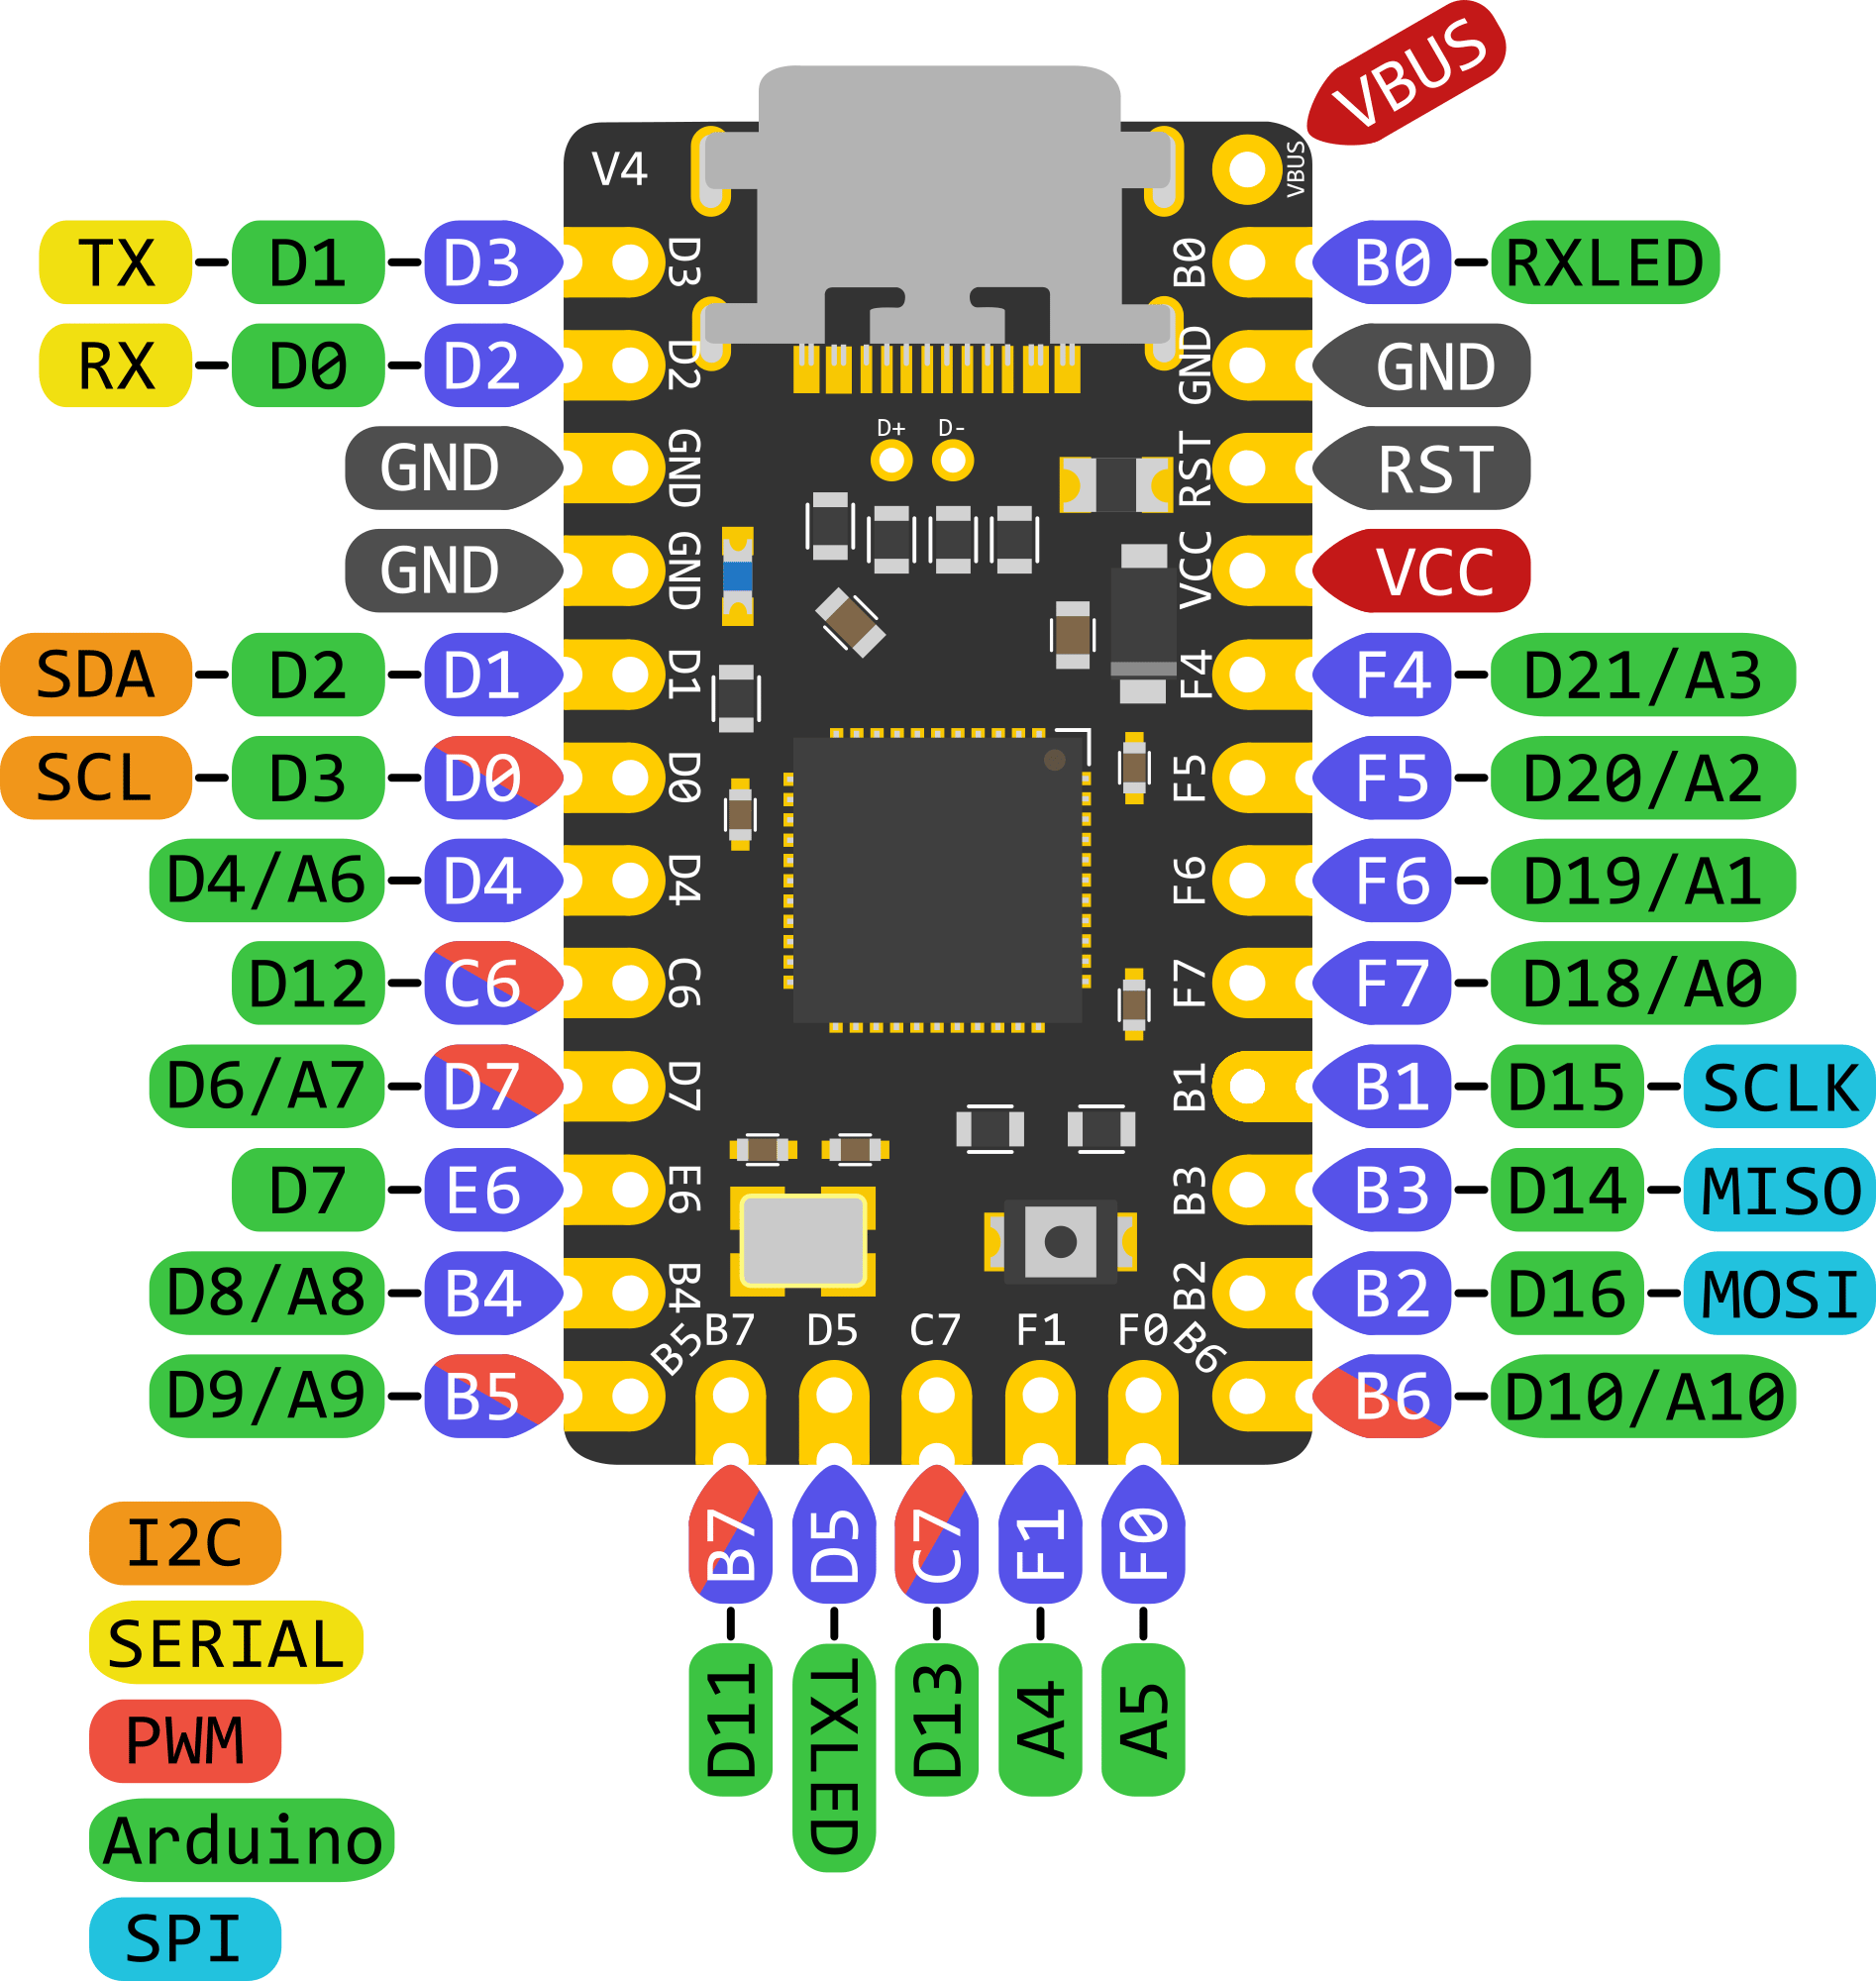
Pinout Diagram
Columns
Encoder pin A-
Encoder pin B-
Encoder pin GND-
-Row3
-Row2
-Row1
-Row0

Slide 7
Case Assembly
Place foam in the case, ensuring that a cut is made in the foam so the ribbon cable fits through
Put adhesive gaskets along the edges of the case where the pcb will make contact
Put Elite-C into the 3D printed holder, it should snap into place and if it doesn’t you can secure it with a small drop of adhesive(hot glue works well)
Secure the Elite-C in its slot under the foam in the center of the case
Guide the ribbon cable along the channel until it meets up with the keyboard pcb
Place the pcb securely into the case
Put the top of the case on and screw in from the bottom with the machine screws

