Slide 1
PM5 Presentation
Team Octo
Aaron Ye, Rodrigo Pardini Azzolin,
Wills McGraw
Notes:
Rod: Hello everyone, I’m Rodrigo, these are Wills and Aaron, and we’re team Octo. We’ll be giving a lightning talk on our semester-long project.

Slide 2
Problem Statement
“Software development teams grow disorganized over time, requiring constant oversight and correction.”
Notes:
Rod: To recap from last time, long-run productivity is one of the most important metrics for a product that will ship successfully and on time–working in bursts of productivity is not good work ethic. Unfortunately, team disorganization is a common factor that prevents teams from achieving this kind of productivity. It can be difficult to keep track of what everyone in a team is doing, especially as projects grow in complexity and manpower, which we summarize in our problem statement: software development teams grow disorganized over time, requiring constant oversight and correction.

Slide 3
Solution Requirements
Must improve organization in team scenarios.
Must promote workflow efficiency.
Must allow team members to collaborate from anywhere on the globe.
Must be easily accessible: free or minimal pricing.
Notes:
Rod: After a brainstorming session, we settled on these requirements for whatever solution we came up with: most importantly, the solution must improve organization in team scenarios. Secondly, the solution must promote workflow efficiency while allowing team members to collaborate synchronously from anywhere on the globe. Lastly, the solution must be easily accessible: we’re making something for all kinds of development teams, not just giant corporate ones.

Slide 4
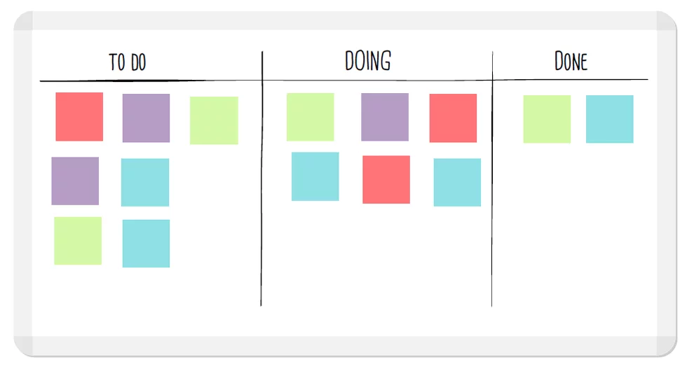
Chosen Methodology
Kanban is a method of efficiently organizing and tracking tasks through a physical board.
Each card represents a task, with its color indicating priority.
Each list represents a completion status.
Notes:
Rod: Our chosen methodology for our solution is Kanban. Kanban is a practice for efficiently organizing and tracking tasks, traditionally through a physical board. In this setup, each card represents an individual task, with its color indicating the task priority–for example, green can mean low priority while red means urgent. The board has a number of lists that represent completion status, as we can see on the example here. The simplicity of Kanban makes it super useful and flexible, which is why we chose it.

Slide 5
Proposed Solution
Our proposal is a minimalist Kanban board manager.
Allows synchronous creation and management of boards, lists, and cards.
Allows sharing of boards with team members.
Allows instant communication between team members.
Completely free of charge!
Notes:
Wills: Our proposed solution is a minimalist Kanban board manager for desktop. It will allow synchronous creation and management of boards, lists, and cards. Users will be able to share boards with team members, and the app will feature a built-in messaging service to streamline communication. Finally, the app will be free of charge, making it accessible for everyone.

Slide 6
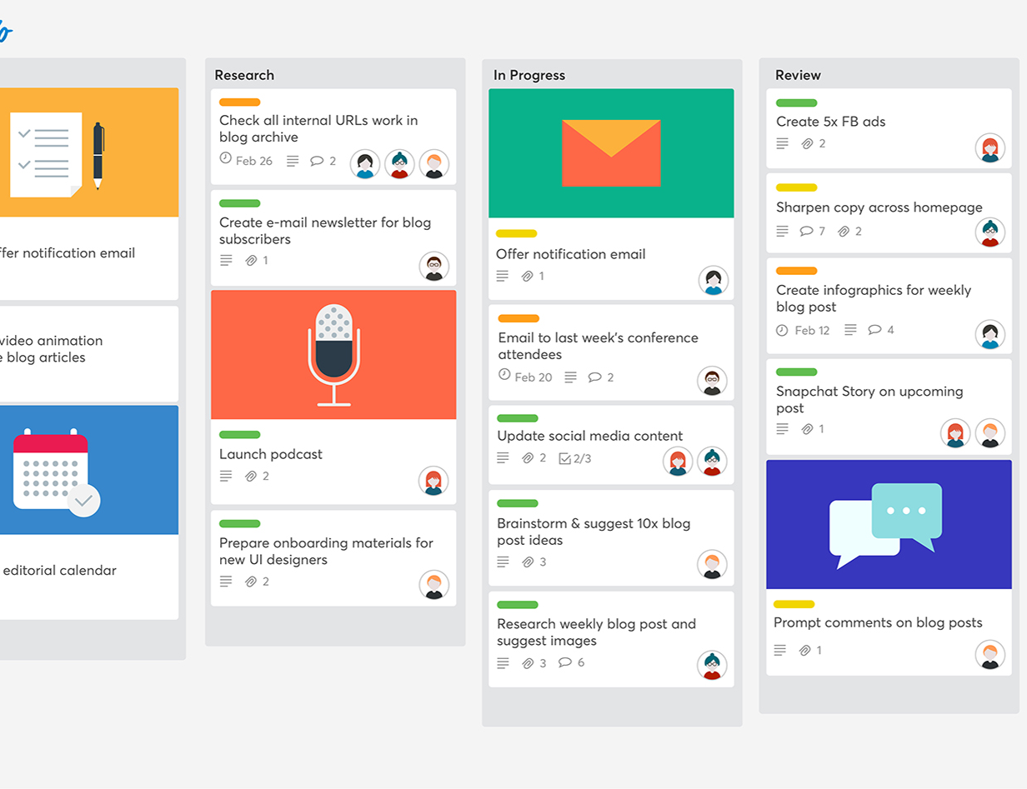
Related Work: Trello
Card-based organization system
Feature-rich… but most functionality is paywalled
Lacking in communication tools
Notes:
Wills: It’s worth mentioning that there already exists software with premises similar to Kanban: the biggest and most notable one is Trello, which is a card-based organization system. While it’s a wonderful piece of software, a lot of its functionality is gated behind a paywall. It also has close to zero communication support, meaning team members have to use at least one other service to keep in touch. Drawbacks like these provide space for our product in the market.

Slide 7
Limitations
The synchronous nature of the app means we have to constantly upkeep servers for our users.
Supports a relatively small number of operations.
Notes:
Aaron: Naturally, our system faces a few limitations. The most important is that the synchronous nature of the app means that we have to constantly upkeep servers for our users: since we have no direct stream of revenue, we have to micromanage the amount of data that users can own. This means that users can only own a few boards at a time. Additionally, our boards implement the most basic form of Kanban, so there is a bit of functionality missing compared to competitors.

Slide 8
Future Work
Allowing users to host the service on their own servers, granting them ownership of their data (and lowering server costs for us).
Supporting additional operations, such as checklists per card.
Expand to mobile.
Notes:
Aaron: Luckily, there are ways to solve these problems in the future. The first thing would be to make our server architecture more local: instead of hosting all of the data ourselves, we could distribute dedicated server software that people can host on their own, providing the option of moving the responsibility from us to them. Users would then completely own their data, and we would be free to expand our board functionality without having to incur large data costs. Finally, it would be nice to make a mobile application for the service, so as to allow developers to make changes on the go.

Slide 9
Things We Learned
Agile is effective for creating software iteratively.
Requirement gathering can be overkill.
Good storyboards/prototypes are essential for communication of ideas.
Notes:
Aaron: We learned a lot during this project. Most importantly, we learned that Agile is effective for creating software in an iterative manner: we had multiple opportunities to check in with the state of the project during development, and they allowed us to adjust our goals accordingly. We also learned that the full requirement gathering process isn’t always useful: there are multiple steps in the process, ranging from elicitation to prioritization, and all of that takes time. We knew what kind of app we wanted to make right from the get-go, so we could’ve shrunk this step a bit. And lastly, we learned that creating good storyboards and prototypes is essential for communicating ideas to other team members effectively.

Slide 10
Questions?
Notes:
Aaron: Any questions?

