Slide 1
EE4308 Turtlebot Project
Advances in Intelligent Systems and Robotics Academic Year 2016-2017
Preben Jensen Hoel A0158996B
Paul-Edouard Sarlin
A0153124U

Slide 2
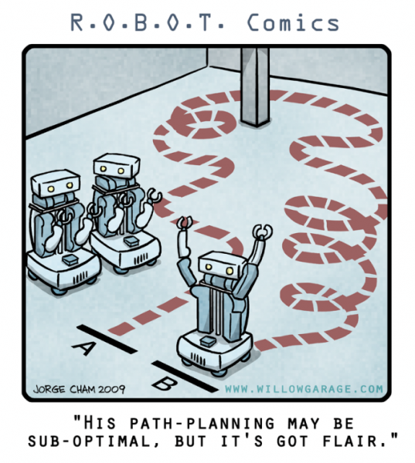
What will be discussed
Problem statement
Overview of the solution
Information gathering
Global planning
Local planning
Demonstration

Slide 3
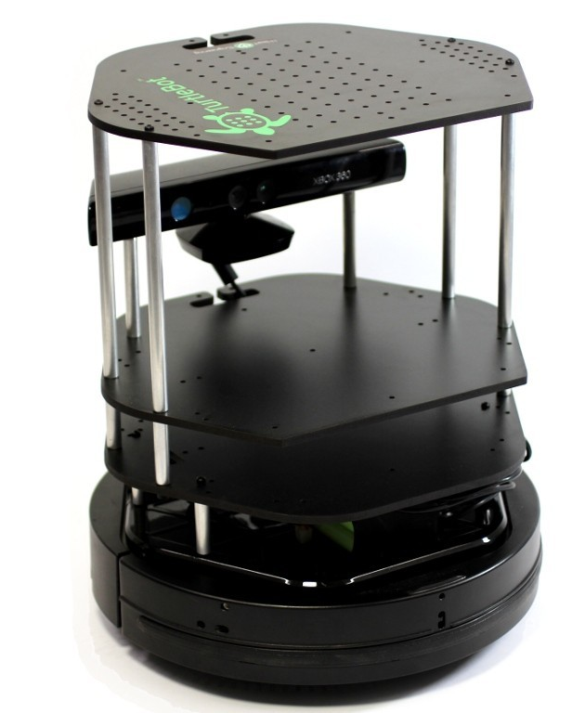
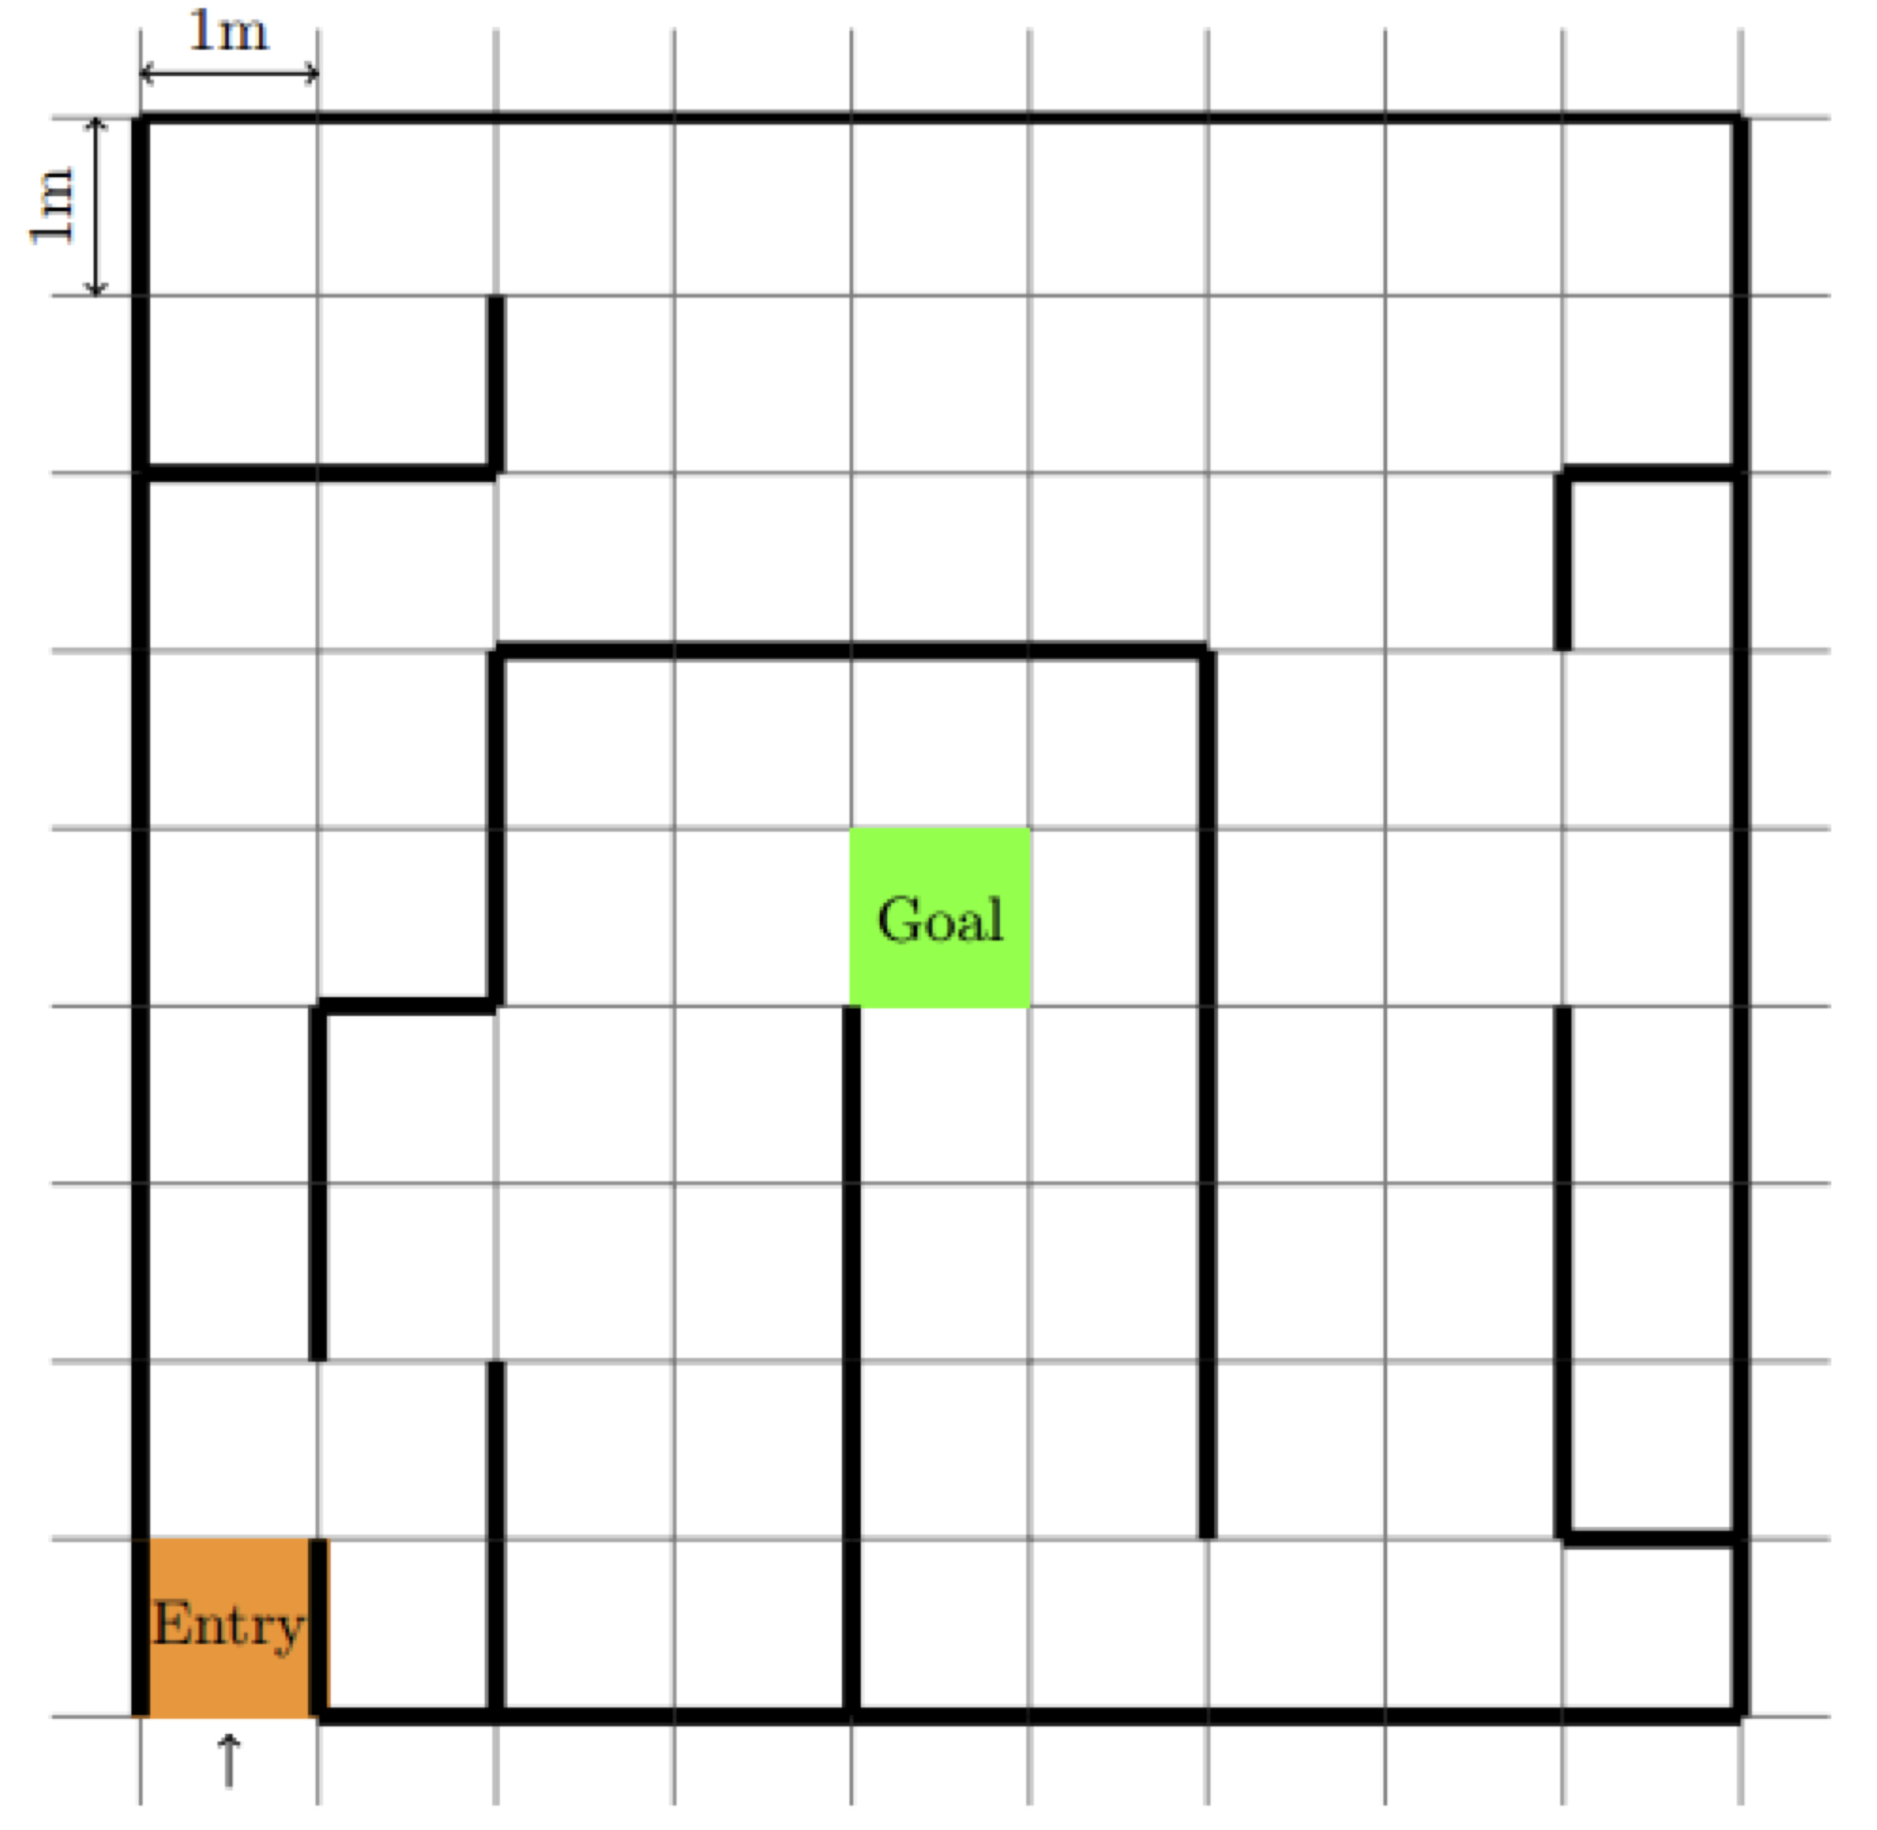
What is to be achieved
1. Problem statement
Design a navigation system for a mobile robot
Autonomously navigate from start to goal
Environment is not necessarily known
Realistic simulation
Easy task for a human,
but complex for a robot…
→ need to divide in sub-problems

Slide 4
Sub-systems
2. Overview
Map prior: what is known beforehand (a priori) of the environment

Slide 5
Sub-systems
2. Overview
Kinect: a depth camera, returns a point cloud (PC)

Slide 6
Sub-systems
2. Overview
Odometry: the position of the robot in the maze

Slide 7
Sub-systems
2. Overview
Map updater: process the data to build and update an internal map of the environment

Slide 8
Sub-systems
2. Overview
Global planner: compute a path from start to goal using the map

Slide 9
Sub-systems
2. Overview
Local planner: ensure that the robot actually follows the path, computes the velocity commands

Slide 10


Implementation
2. Overview
Navigation system = ROS node, in Python
Callbacks trigg. by new Kinect/Odometry data

Slide 11
How to efficiently store information about the environment ?
3. Information Gathering
y
x
Use the constraints on the maze: walls only at boundaries of cells
→ only store the coordinates
of the centres of the walls !
One of the two coordinates is an integer:
x → horizontal wall
y → vertical wall
(1.5,7)
(8,6.5)

Slide 12
How to extract walls from the Kinect ?
3. Information Gathering
Extract a row of the 2D PC
Define a ROI with tolerances:
For each point: check if in any possible ROI
If enough points are assumed to belong to a wall → add it to the map
horizontal
vertical
y
x

Slide 13
4. Global planning
Global planner:
1. Find a path from S to G with A*
5+5
=10
6+4
=10
8+2
=10
Expand cost from S:
f = g + h
g move cost from S h Manhattan dist. to G
Can dis/encourage turns/lines by tuning g
4+4
= 8
5+3
= 8
8+2
=10
7+1
= 8
8+0
= 8
G
3+5
= 8
4+4
= 8
5+3
= 8
6+2
= 8
2+6
= 8
3+5
= 8
4+4
= 8
5+3
= 8
1+7
= 8
2+6
= 8
5+5
=10
6+4
=10
S
3+7
=10

Slide 14
4. Global planning
Global planner:
2. Smooth
Minimise J with Gradient Descent

Slide 15
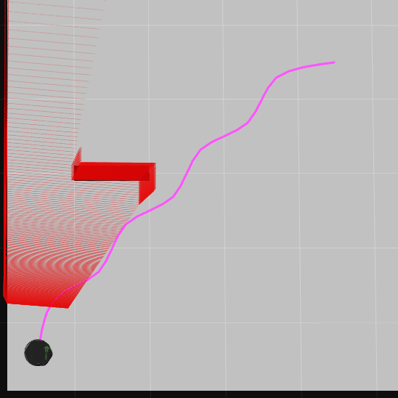
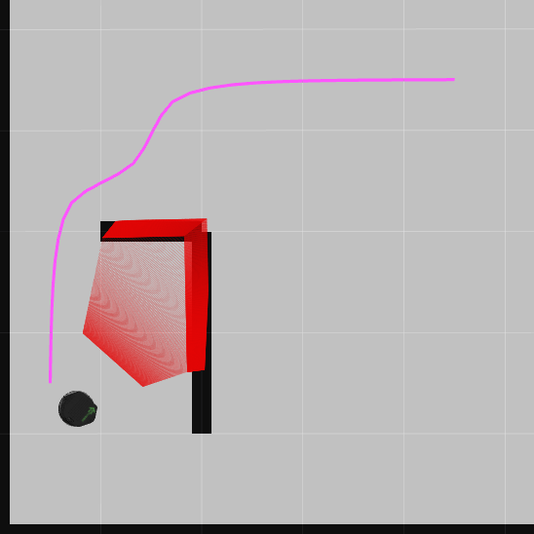
4. Global planning
Known or unknown environment ?
(1)
If no map prior:
Assume there are no walls (1)
Add some as you discover them
Update the path if necessary (2)
(2)

Slide 16
5. Local planning
Local planner: following the path
PI controller for linear and angular velocities
Weighted average of the errors on the next k points:
Orientation error
Distance error
Act as a local smoothing
Limit speed + anti wind-up
j current point
w_{i} weights

Slide 17
5. Local planning
Local planner: choosing the next point
Find the closest point to the current position (here i)
Compute the angle 𝛼 :
If smaller than 90° then i+1 is the next
Otherwise i

Slide 18
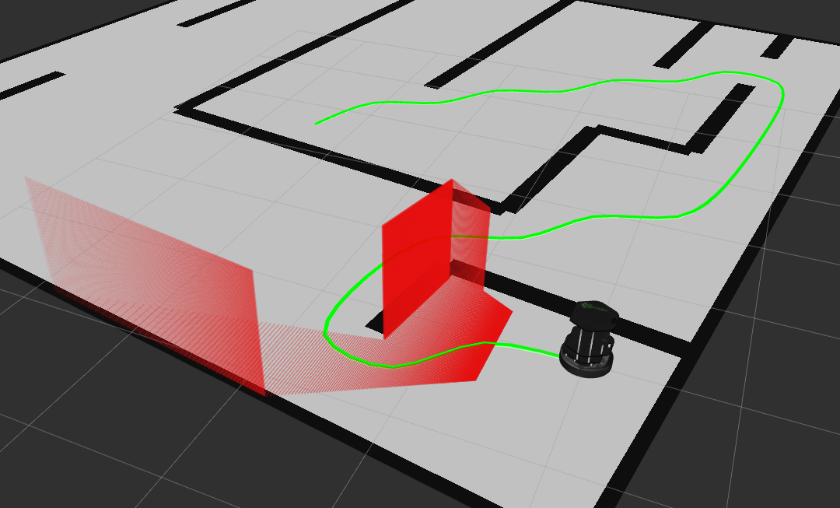
6. Demonstration
Show time!

