Slide 1
Netball101
An App for Coaches and Players!

Slide 2
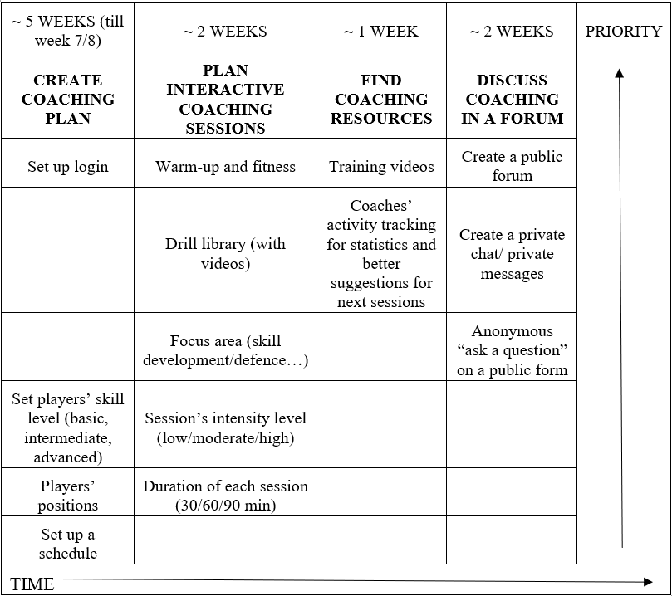
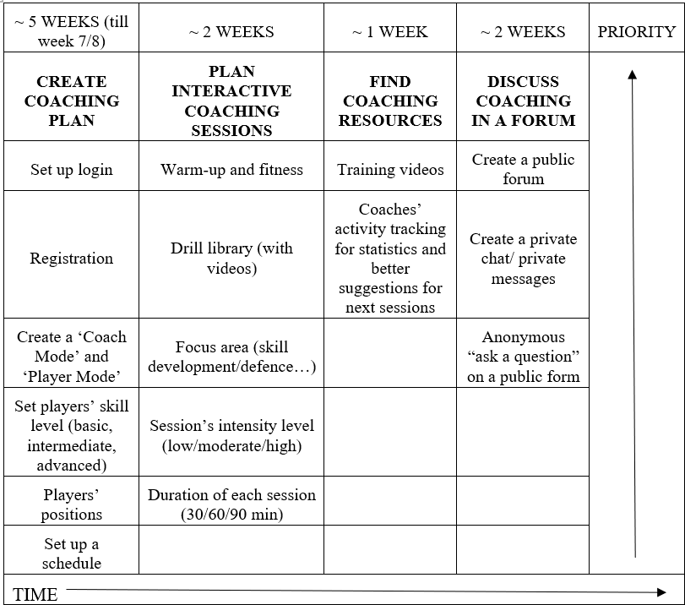
I- Product Backlog
The First Sprint Backlog
Created at the beginning of the project.
The Second Sprint Backlog
Features such as “Registration” and “Create a ‘Coach Mode’ and ‘Player Mode’” have been added.

Slide 3

II- USER STORIES

Slide 4

FEATURE 1 : LOGIN
USER STORY
"I want the application to have a login section for users.”
Progress metrics: 48h

Slide 5

Acceptance Criteria
● During login, the user must choose if they are a “Player” or “Coach”.
● During login the user must provide a valid email address and username (email address), if they are a player, and a valid email address, username, and pin, if they are a coach to prevent players from trying to force the application into believing they are coaches.
● During login the user has 5 tries to input the correct password before the login button is greyed out and becomes unclickable, with an increasing time limit.
● During login all details must be completed correctly before the user can move past the page.
● During login the user should be able to reset their password, if necessary, with an email being sent to their email address, only after completing either 2 security questions or inputting some personal information. The email received should only be active for 24 hours from the moment it was sent to the user.
● During login the user should have a button (possibly in the top right-hand corner) explaining what the page in front of them does and what the necessary details are.
● During login the application should tell the user, if the email address is not recognised, to instead continue to register on the application.

Slide 6
Acceptance Test
● When inputting the correct details, the application should see me as logged in and put me into the landing page of the application.
● When inputting the wrong password, the application should tell me that whilst the email has been recognised, the password for this account is wrong.
● When inputting the wrong email address, the application should tell me that the email is not recognised and prompt me to both check if the email has been correctly written and ask if I want to register instead.
● When inputting the wrong password more than five times for the same email address, the application should grey out the Login button rendering me unable to click login. essentially blocking my access for 5 minutes, with increasing times.
● If I click the “forgotten password” the application should ask a couple of questions, which if answered correctly, would send me an email prompting me to reset my password.
● If I click the question bubble in the top right corner it should tell me what information is required on the page.
● The necessary information on the login page should be easily readable and accessible.

Slide 7
FEATURE 2 : REGISTRATION
USER STORY
"As a user I would like to create an account within the application by clicking on a “Register” button to be able to access all features.”
Progress metrics: 48h

Slide 8
Acceptance Criteria
During registration, the user must set his name, email address, ID and a new password. Both the email and password must be inputted twice to ensure that they are not wrongly entered.
During registration, the user has to fill all the required fields which could include questions like: how often does he play, a quick survey to calculate the user level of knowledge about the game, some data about his height and weight, his preferred position.
During registration, if the user is a coach, a pin will be given proving that the account isn’t a scam only if some conditions are met like proof of certification.
During registration the application should detect if an email address is already registered and prompt the user to move to the login page instead.
During registration the user should be able to decline sharing any sensitive information that they are not willing to share, without the usability of the application being impeded.

Slide 9
Acceptance Test
When inputting all the required information, my account should be created, I should be pushed back to the login page and I should be able to login with the details that I have just created
When inputting wrong information on the form (such as differing passwords or email addresses), the application should prompt me to check the information I have entered.
If there are fields that I do not want to complete for whatever reason (personal information not ok to share, personal preference, do not know the answer) I should be able to let the application know that this is something that I do not want to share.
If I enter an email that is already registered with the application. I should get a prompt explaining this to me and an option to go back to the login page.
The necessary information on the login page should be easily readable and accessible.

Slide 10
FEATURE 3: Coach & Player Mode
USER STORY
“As a member, I should be able to switch from Coach Mode to Player Mode and have a different set of options unlocked according to selected Mode.”
Progress metrics: 24h

Slide 11
Acceptance Criteria
After Login, a new page will appear to ask the user which Mode he would select.
During Mode Selection, the user must select the button Coach if he wants to be seen as such and have access his allowed features
During Mode Selection, the user must select the button Player if he wants to be seen as such and have access to his allowed features.

Slide 12
Acceptance Test
In the event of a problem, a pop-up notification should be displayed with the relevant information regarding the occurred problem along with a contact support button.
After Mode Selection, the user in Coach Mode will be able to view other accounts' shared profiles
After Mode Selection, the user in Coach Mode will be able to follow other Coaches and Players,
After Mode Selection, the user in Coach Mode will be able to create sessions,
After Mode Selection, the user in Coach Mode will be able to post content on their profile for his followers to see,
After Mode Selection, the user in Coach Mode will be able to create his own learning platform and advertise his teaching methods in it.
After Mode Selection, the user in Player Mode will be able to view other accounts' shared profiles,
After Mode Selection, the user in Player Mode will be able to follow Coaches and Players,
After Mode Selection, the user in Player Mode will be able to join sessions,
After Mode Selection, the user in Player Mode will be able to post content on their profile for the public to see,
After Mode Selection, the user in Player Mode will be able to subscribe and to access the coaches’ learning platforms.
After Mode Selection, the user can’t use other Player Modes features if he’s in Coach Mode
After Mode Selection, the user can’t use other Coach Modes features if he’s in Player Mode

Slide 13
FEATURE 4 : SETTING PLAYERS SKILL LEVEL
USER STORY
“As a player, I want to know the skill level I belong to, so that I can adjust the training to my skills.”
Progress metrics: 24h

Slide 14
Acceptance Criteria
When I click on my skill level, I should be able to choose the skill level I fit in.
When I click on my skill level, I should access the different skills for each level, select my focus area and session time and date if possible.
When I click on my skill level, I should find useful resources on the skill I intend to learn.
When I click on my skill level, i should see my progress chart and my rating while learning the skill

Slide 15
Acceptance Test
Given that I’m logged in, when I click on ‘my skill level’ I can choose the level I belong to and set up my training.
Given that I’m logged in, when I click on ‘my skill level’ the I can access the different skills for each level
Given that I’m logged in, when I click on ‘my skill level’ I can find useful resources on the skill I intend to learn.
Given that I’m logged in, when I click on ‘my skill level’ I can see my progress chart and how I am rated while learning the skills.

Slide 16
FEATURE 5 : PLAYER POSITION
USER STORY
"As a user I would like to know what the different positions in the netball game are so that I can choose the best for me.”
Progress metrics: 20h

Slide 17
Acceptance Criteria
When I am not logged in I would be able to register. When I click on ‘Positions’ it takes me to the registration page.
When I log in, I’d like to be able to see ‘Positions’ in the menu and be able to click on it
When I click on ‘Positions’, it should show me different tabs which include Help, Skills, check and also one tab for each position.
When I click on ‘Help’ it will take me to a page which has detailed descriptions of each position.
When I click on ‘ Skills’ it will take me to a page that gives the basic skills needed for each position and also the physical condition preferred for these positions.
When I click on ‘Check’ it will take me to a page that asks certain questions like which position do I prefer. It will also have a tab which allows me to have a training section directly with a coach so that the coach would be able to suggest which position suits me the best.
When I click on a position name for example goalkeeper. When I click on ‘Goal Keeper’ it will take me to a page which has resources related to that position. It includes videos, training tips from coaches, names and details of the coaches available and also it has a section called ‘personal training’ which will directly take me to the schedule page where I can arrange my schedules and start training.

Slide 18
Acceptance Test
The user must be registered with the application.(no guest user can get this information, if the user is not registered it goes to the registration tab so they can create their login id and password).
Given that I'm not logged in, when I click on “Positions” , it will directly get me to the registration page. Then I can register.
Given that I'm logged in, when I click on “Positions”, it will take me to a page where I can click on ‘Help’. Then it will give detailed descriptions on each position which will help me in deciding which suits me the best.
Given that I'm logged in , when I click on “Positions” , it will take me to a page where I can click on ‘skills’. Then it will show the skills and physical conditions needed in a specific position.

Slide 19
USER STORY
"As a user I would like to know what the resources are available in a specific position so that I can improve my skills in that position”
Progress metrics: 20h

Slide 20
Acceptance Criteria
When I am not logged in I would be able to register. When I click on ‘Positions’ it takes me to the registration page.
When I log in, I’d like to be able to see ‘Positions’ in the menu and be able to click on it
When I click on ‘Positions’, it should show me different tabs which include Help, Skills, check and also one tab for each position.
When I click on ‘Help’ it will take me to a page which has detailed descriptions of each position.
When I click on ‘ Skills’ it will take me to a page that gives the basic skills needed for each position and also the physical condition preferred for these positions.
When I click on ‘Check’ it will take me to a page that asks certain questions like which position do I prefer. It will also have a tab which allows me to have a training section directly with a coach so that the coach would be able to suggest which position suits me the best.
When I click on a position name for example goalkeeper. When I click on ‘Goal Keeper’ it will take me to a page which has resources related to that position. It includes videos, training tips from coaches, names and details of the coaches available and also it has a section called ‘personal training’ which will directly take me to the schedule page where I can arrange my schedules and start training.

Slide 21
Acceptance Test
The user must be registered with the application.(no guest user can get these information, if the user is not registered it goes to the registration tab so they can create their login id and password)
Given that I'm not logged in, when I click on “Positions” , it will directly get me to the registration page. then I can register.
Given that I'm logged in, when I click on “Positions”, it will take me to a page where I can click on a certain position then it will take me to a new tab which gives certain resources in that position.

Slide 22
USER STORY
"As a user I would like to know if I am suitable for a specific position so that I can stick on to a position or change that position and choose the best which suits me”
Progress metrics: 20h

Slide 23
Acceptance Criteria
When I am not logged in I would be able to register. When I click on ‘Positions’ it takes me to the registration page.
When I log in, I’d like to be able to see ‘Positions’ in the menu and be able to click on it
When I click on ‘Positions’, it should show me different tabs which include Help, Skills, check and also one tab for each position.
When I click on ‘Help’ it will take me to a page which has detailed descriptions of each position.
When I click on ‘ Skills’ it will take me to a page that gives the basic skills needed for each position and also the physical condition preferred for these positions.
When I click on ‘Check’ it will take me to a page that asks certain questions like which position do I prefer. It will also have a tab which allows me to have a training section directly with a coach so that the coach would be able to suggest which position suits me the best.
When I click on a position name for example goalkeeper. When I click on ‘Goal Keeper’ it will take me to a page which has resources related to that position. It includes videos, training tips from coaches, names and details of the coaches available and also it has a section called ‘personal training’ which will directly take me to the schedule page where I can arrange my schedules and start training.

Slide 24
Acceptance Test
Given that I'm not logged in, when I click on “Positions” , it will directly get me to the registration page. Then I can register with the app.
Given that I'm logged in, when I click on “ Positions” , it will take me to a page where I can click on “Check”. Then this will take to a new tab that will ask certain questions like which position do you prefer, experience level in that position and also it will have an additional tab to have a trial section with a coach so that the coach can decide which position suits him the best.

Slide 25
FEATURE 6 : SET SCHEDULE
USER STORY
“As a user, I’d like to be able to set up my schedule, so that I can choose the date and time that suits me best and create the most efficient routine.”
Progress metrics: 30 to 50h

Slide 26
Acceptance Criteria
When I log in, I’d like to be able to see ‘My Schedule’ in the menu and be able to click on it.
When I click on ‘My Schedule’, it should show me my training sessions calendar.
If I don’t have a calendar or none of the days are highlighted, I should be able to create my first schedule.
My calendar should have highlighted days (training session days) and non-highlighted days (no session days).
When I click on the highlighted day, I should be able to see my scheduled training sessions, including the time and name of my coach.
When I click on the highlighted day, I should be able to have an option to postpone or cancel my training session.
When I click on the non-highlighted day, I should be able to see an option to add my training session.
When I click on the “Add my training session” I should be redirected to the schedule set up form.
After I’ve sent the form, I should receive a notification if the session was approved by a coach or not.
The app calendar should be synchronised with my phone’s calendar so that I can see my sessions even when I’m not logged in.

Slide 27
Acceptance Test
Given that I’m logged in, When I click on ‘My Schedule’, Then the system opens the page with an option to create a schedule.
Given that I’m logged in, When I click on ‘My Schedule’, Then the app opens the page with a calendar with highlighted training days.
Given that I’m logged in, when I click on ‘my skill level’ I can find where I stopped my training and continue.
Given that I’m logged in, When I click on one of the highlighted days on the calendar, Then I can see my planned schedule, including date and time and coach’s name.
Given that I’m logged in, When I click on the days that are not highlighted in the calendar, Then it gives me an option to create a training session for a given day.
Given that I’m logged in and have my schedule planned, When I click on ‘My Schedule’, Then I have an option to cancel or postpone it.
Given that I’ve created my training session for a given day, then I receive a notification with information if it was approved by a coach or not.
Given that I’ve created my sessions, When I log out, Then my phone’s calendar should synchronise with the app’s calendar.

Slide 28
USER STORY
“As a coach, I’d like to be able to set up my availability, so that players know when they can schedule a training session with me.”
Progress metrics: 30 to 50h

Slide 29
Acceptance Criteria
When I log in, I’d like to be able to see ‘My Schedule’ in the menu and be able to click on it.
When I click on ‘My Schedule’, it should show me my training sessions calendar.
If I don’t have a calendar or none of the days are highlighted, I should be able to create my first schedule.
When I click on the “Add my training session” I should be redirected to the schedule set up form.
In the set up form I should be able to set my availability for a given day, so that players can see it and plan their sessions accordingly.
My calendar should have highlighted days (training session days) and non-highlighted days (no session days).
When I click on the highlighted day, I should be able to see my scheduled training sessions, including the time, my availability for the day and the names of players that book a session for this day.
When I click on the highlighted day, I should be able to have an option to postpone or cancel my training session.
When I cancel or postpone the training session, it should send a notification for all the players that booked their training for the day.
When the player cancels or postpones their training session with me, I should receive a notification.
The app calendar should be synchronised with my phone’s calendar so that I can see my sessions even when I’m not logged in.

Slide 30
Acceptance Test
Given that I’m logged in, When I click on ‘My Schedule’, Then I can see my calendar and on which days I’m not available (not highlighted days) and on which ones I’m available (highlighted days) along with availability times.
Given that I don’t have any training days, When I click on the non-highlighted day, Then the create a session form will appear with an option to pick an availability.
Given that I’m in the ‘My Schedule’ section, When I click on the highlighted day, Then I can cancel or reschedule my availability.
Given that I’m in the ‘My Schedule’ section, When I cancel or postpone a session, Then the players that booked a session for a given day will receive a notification.
Given that I have a session planned for a given day, When one of the players cancels their session with me, Then I will receive a notification.
Given that I’m in the Schedule section, When I click on one of the highlighted days, Then I can see if any of the players booked a session with me and how many players booked it in total.
Given that I’ve created my sessions, When I log out, Then my phone’s calendar should synchronise with the app’s calendar.

Slide 31
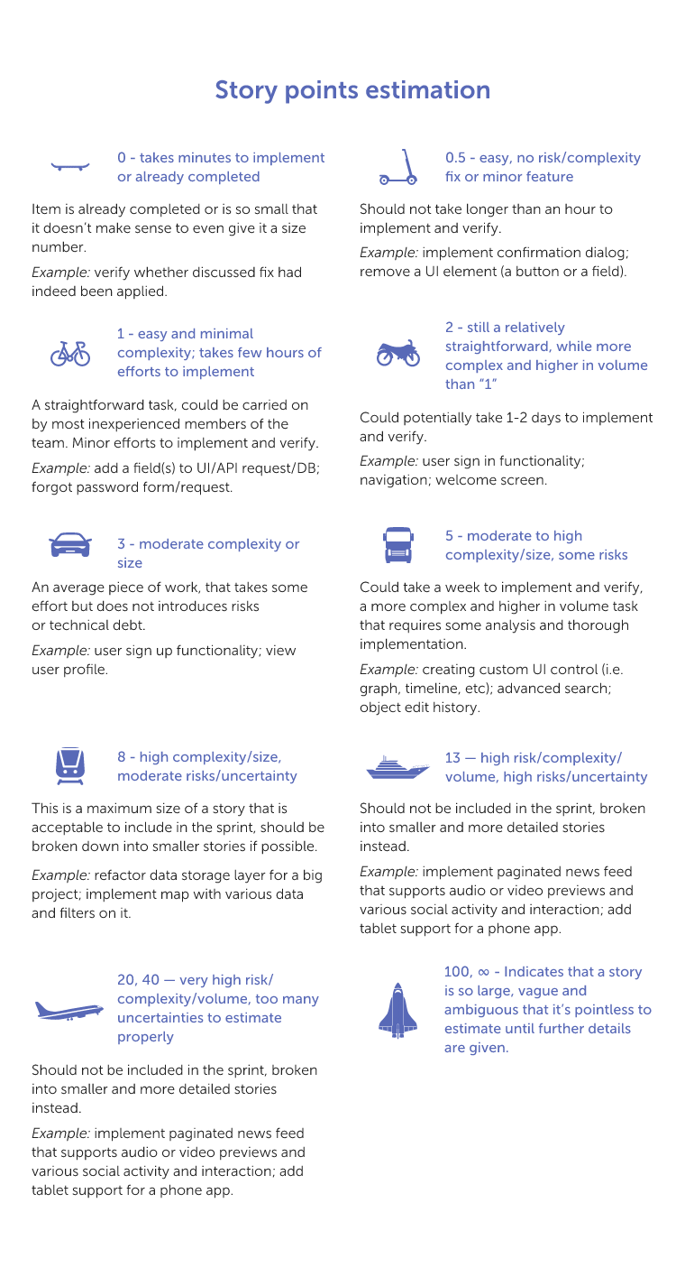
III- PROGRESS METRICS
Each User Story has been divided into a subtask with assigned Story Points.
The Story Points have been assigned using the diagram below

Slide 32

"I want the application to have a login section for users.”

Slide 33
"As a user I would like to create an account within the application by clicking on a “Register” button to be able to access all features.”

Slide 34
"“As a member, I should be able to switch from Coach Mode to Player Mode and have a different set of options unlocked according to selected Mode.”

Slide 35
“As a player, I want to know the skill level I belong to, so that I can adjust the training to my skills.”

Slide 36
"As a user I would like to know what the different positions in the netball game are so that I can choose the best for me.”

Slide 37
“As a user, I’d like to be able to set up my schedule, so that I can choose the date and time that suits me best and create the most efficient routine.”

Slide 38

IV- SPRINT BACKLOGS

Slide 39
SPRINT BACKLOG 1 - (16/02/2022)
The first Sprint’s purpose was to discuss the project’s plan and divide the work. Because the team does not have much time during weekly meetings, all the members agreed to divide the work and complete it in everyone’s free time.
The application will be developed using Android Studio, using Java as it has much more documentation available compared to Kotlin, which we see as an advantage should we reach an impasse in coding.
‘Registration’ and ‘Create a Coach Mode’ and ‘Player Mode’ have been added to the Product Backlog.

Slide 40
Forecast for the next Sprint:
Now that we know our team’s capacity, we should be able to start working on a development of another feature. It is also possible that we will start working on it earlier and try to put it all together/get some advice or help on the next Sprint.

Slide 41
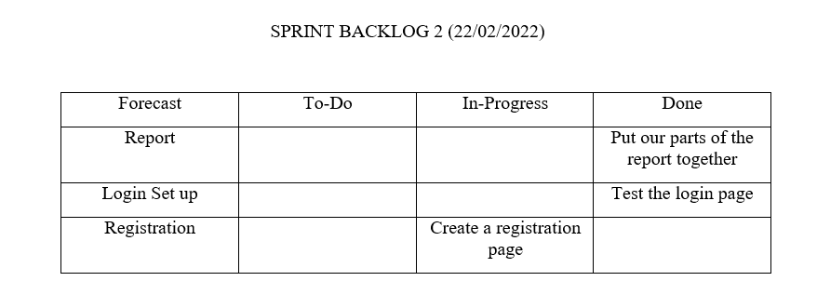
SPRINT BACKLOG 2 - (22/02/2022)
On the Sprint, the team managed to complete the tasks that were planned for the meeting, although the Registration feature is still in progress, the team should make progress by the end of the next Sprint.

Slide 42
Forecast for the next Sprint:
Based on the progress we have made so far, it should be possible to quickly progress on the Registration feature development. It may not be entirely possible to complete it on the next Sprint, but definitely a lot of work can be done in this direction.

Slide 43
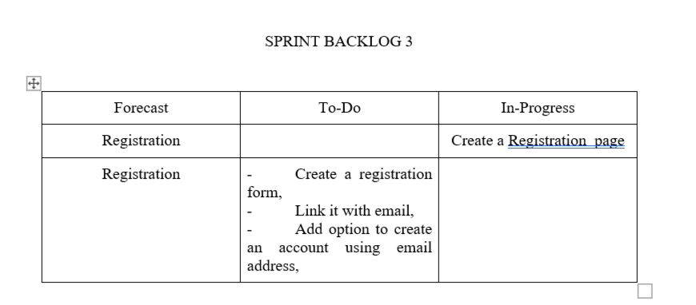
SPRINT BACKLOG 3 - (02/03/2022)

Slide 44
Forecast for the next Sprint:
The goal of this Sprint is to make progress on the Registration feature in Android Studio.

Slide 45

V- OVERALL PROGRESS
The table below shows the progress of the group so far.
The tasks have been divided and they were completed mostly in the free time before each Sprint.

Slide 46
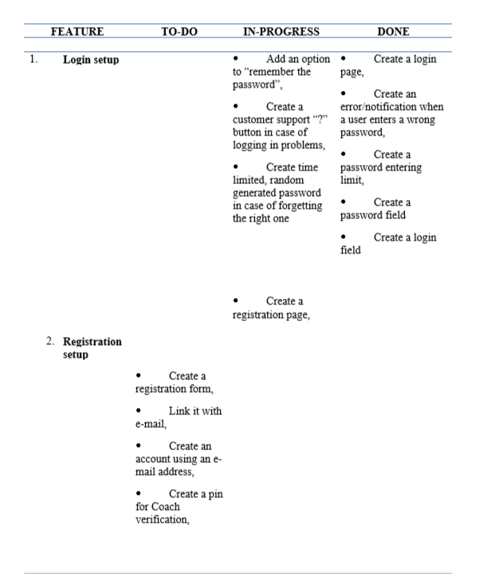

Slide 47
Thank You :)

