Slide 1
Team: G.O.A.T presents Quantum Walks and Monte Carlo
Sno. | Name | Enrollment ID
1. | Jason Gomez | gst-lw1aEEEAapaEX8L
2. | Tanya Adlakha | gst-VusimuxPaOvsT6p

Slide 2

Index
Sno. | Topic | Page no.
1. | Problem statement: a) What is our project about? b) What problem are we addressing? | 3,4
2. | Summary of Universal Statistical Simulator | 5,6
3. | Our solution: a) What approach did we take? b) What tools or techniques did we use? | 7,8,9
4. | Results & impact: How does our work contribute to the field of Quantum Science or AI? | 10
5. | Future scope: What could be done next to extend your project? | 11
6. | Limitations | 12
7. | References | 13
WISER Quantum Project

Slide 3
Problem statement: What is our project about?
Exploring how quantum circuits can simulate complex systems through a Galton Box-style Monte Carlo problem, an approach relevant to high-dimensional challenges like particle transport and quantum systems.
This project builds on the foundations of the Quantum Fourier Transform and its potential for exponential speed-up over classical methods.
WISER Quantum Project

Slide 4
Problem statement: What problem are we addressing?
Classical Monte Carlo simulations for high-dimensional problems (e.g., particle transport, quantum systems) are computationally expensive and scale poorly.
Efficiently simulating stochastic processes and probability distributions in complex systems remains a challenge.
Quantum computing offers the potential to speed up these simulations via quantum walks and the Quantum Fourier Transform.
We aim to develop a quantum circuit-based universal statistical simulator that models an n-level Galton Board to:
Reproduce classical distributions like Gaussian and Exponential.
Implement quantum dynamics through Hadamard quantum walks.
Ultimately, we address how to leverage quantum algorithms to improve simulation efficiency for complex, high-dimensional problems.
WISER Quantum Project

Slide 5
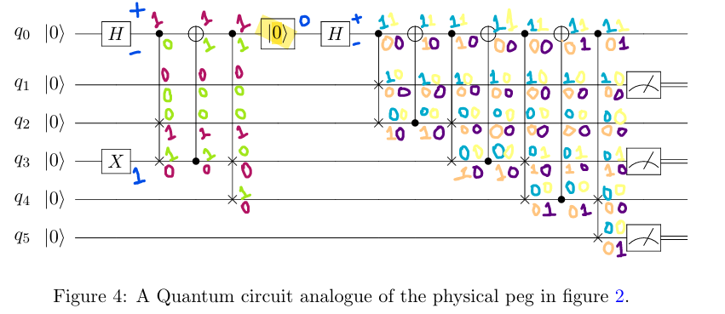
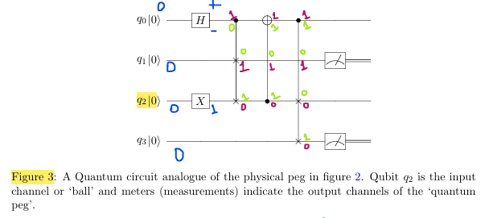
Summary: Galton Board logic as per Universal Statistical Simulator
Classical peg: In the classical GB an ideal ball hitting the ideal peg produces a 50% probability of going left or right, then hitting another peg on the board. To mimic this, we take a set of 0 initialized qubits, and invert the middlemost qubit using an X gate. We then construct a series of superposed SWAPs that this ball can be selectively fall through mimicking the action of a real ball through an array of pegs on a Galton board mimicking the action of a real ball through an array of pegs on a Galton board.
WISER Quantum Project

Slide 6
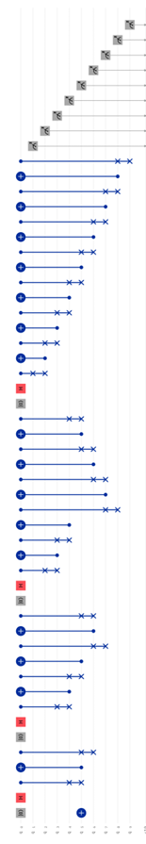
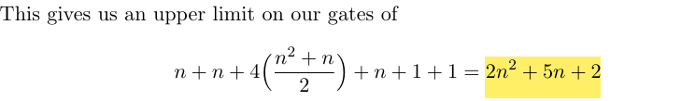
Summary:
The additional CNOT after our peg module circuit we described previously is needed to re balance the control qubit for the successive gates. The requirement for a mid-circuit reset on the control qubit is also required for every successive level of the circuit. Thus, we can expect for every peg we want to model, we require at most 4 gates, with optional local optimizations of only needing 3-gates
We require n Hadamard gates, and n reset (0) gates for a Galton board of n-many levels, plus one X gate for the ball.
We require 4 gates per peg, the total number of which is governed by triangle numbers. • We require n+1 measurement gates.
N+1-many output bits, this equates to
n levels of a Galton board.
(Refer to the code for implementation, and solution slides for visual representation of the logic)
WISER Quantum Project

Slide 7
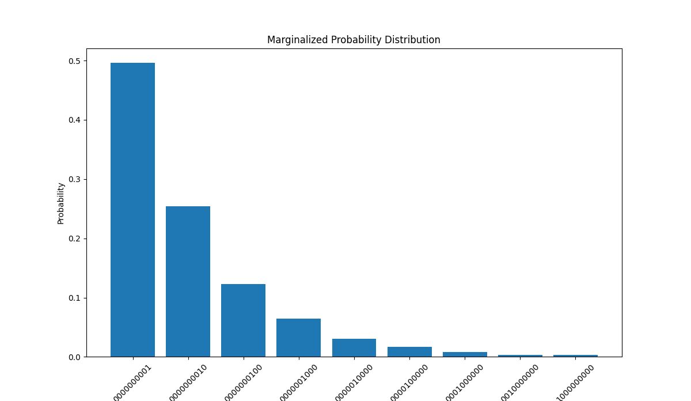
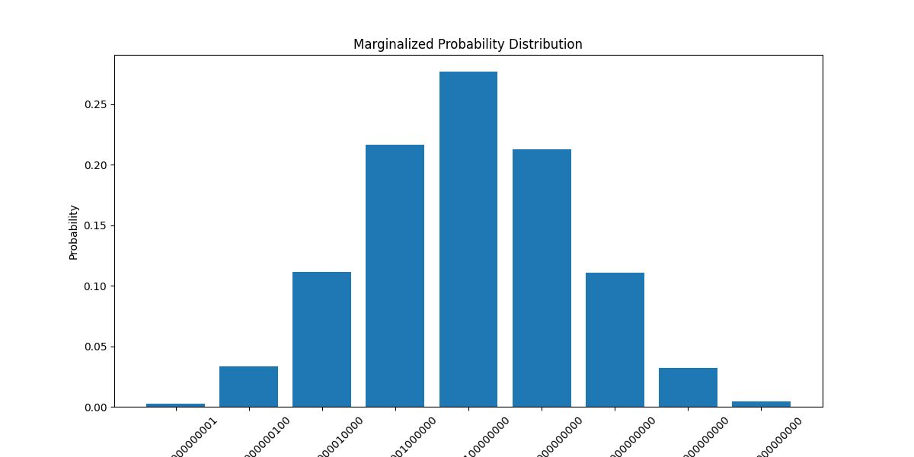
Solution: Our approach
Develop a general quantum circuit algorithm that models an n-level Galton Board for flexible simulation depth.
Use the quantum circuit to simulate classical probability distributions like Gaussian and Exponential via controlled quantum operations.
Implement Hadamard quantum walks within the circuit to simulate quantum stochastic processes.
Leverage Quantum Fourier Transform and multi-controlled gates to efficiently encode and process complex probabilities.
WISER Quantum Project

Slide 8
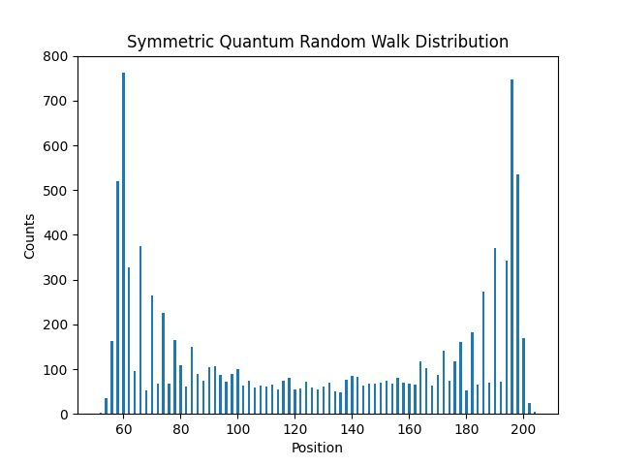
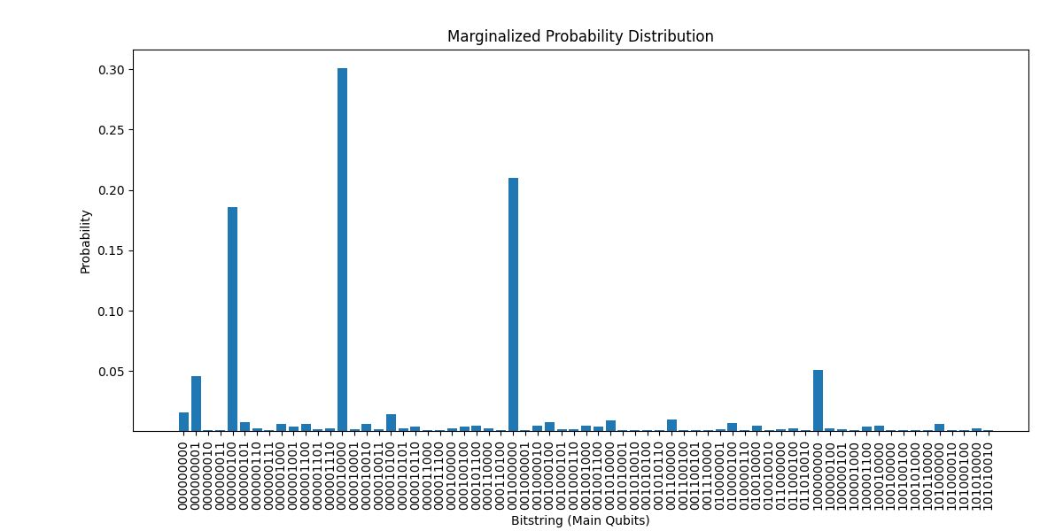
Solution: Our approach
Provide a universal statistical simulator framework that bridges classical Monte Carlo methods and quantum computing for scalable, efficient simulations.
Maximized the accuracy and number of board layers using quantum hardware noise model for the simulations.
Reduced the number of operational gates in the system in order to reduce the computational time and enhance efficiency.
WISER Quantum Project

Slide 9
Solution: Tools & Techniques
Quantum programming frameworks like Qiskit.
Multi-controlled quantum gates and Quantum Fourier Transform
Circuit design for layered, scalable quantum walks
Simulation and visualization of quantum and classical distributions
WISER Quantum Project

Slide 10
Results & impact: Contributions
We have built a universal quantum circuit algorithm that can simulate an n-level Galton Board, generating classical distributions like Gaussian and Exponential, as well as quantum dynamics via Hadamard walks.
This bridges the gap between classical Monte Carlo techniques and emerging quantum computing capabilities.
Reduced number of gates increase overall performance and reduce runtime as well.
Simulated quantum walks so that it could be modified so as to get the desired outcome distribution.
WISER Quantum Project

Slide 11
Future scope: Next steps
Expand the quantum circuit algorithm to handle larger n-level Galton Boards with optimized gate efficiency.
Maximize the accuracy and number of board layers.
Test and validate simulations on real quantum hardware to assess noise impact and scalability.
Explore advanced quantum algorithms (e.g., more complex quantum walks, error mitigation) to improve accuracy and speed.
WISER Quantum Project

Slide 12
Limitations:
Current quantum hardware limitations: noise, decoherence, and limited qubit counts restrict circuit depth and accuracy.
Simulation complexity grows with the number of levels, requiring careful optimization to remain feasible.
Translating Monte Carlo problems into quantum circuits can be challenging and may not always yield exponential speed-ups.
Some classical distributions and quantum phenomena might require more sophisticated models beyond the current framework.
WISER Quantum Project

Slide 13
References:
M. Carney and B. Varcoe, “Universal Statistical Simulator,” arXiv, Feb. 2022. [Online]. Available: https://arxiv.org/abs/2202.01735
Nayak, A., & Vishwanath, A. (2000). Quantum walk on the line. arXiv:quant-ph/0010117. Retrieved from https://arxiv.org/abs/quant-ph/0010117
C. M. Chandrashekar, "Generic quantum walk using a coin-embedded shift operator," Phys. Rev. A, vol. 78, no. 5, p. 052309, Nov. 2008. doi: 10.1103/PhysRevA.78.052309.
J. Kempe, "Quantum random walks: An introductory overview," Contemporary Physics, vol. 44, no. 4, pp. 307–327, 2003. Available: https://arxiv.org/abs/quant-ph/0303081
Quantum Walks. Cirq, Google Quantum AI. Available: https://quantumai.google/cirq/experiments/quantum_walks
S. Aaronson and A. Arkhipov, "The computational complexity of linear optics," Theory of Computing, vol. 9, no. 4, pp. 143–252, 2013. Available: https://theoryofcomputing.org/articles/v009a004/v009a004.pdf
WISER Quantum Project

Slide 14
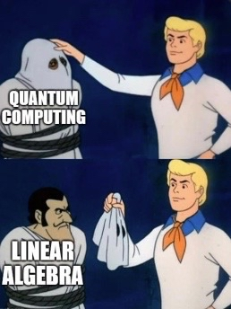
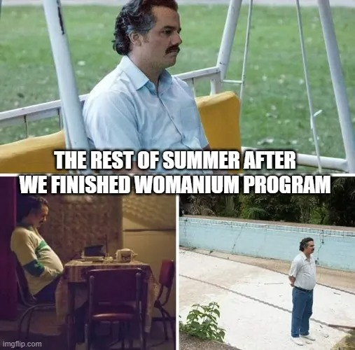
Thank you!
WISER Quantum Project
P.S. MEME CREDITS @ WISER community

