Slide 1
Lead Score for X education system

Slide 2
Problem Statement
An education company named X Education sells online courses to industry professionals. On any given day, many professionals who are interested in the courses land on their website and browse for courses.
The company markets its courses on several websites and search engines like Google. Once these people land on the website, they might browse the courses or fill up a form for the course or watch some videos. When these people fill up a form providing their email address or phone number, they are classified to be a lead. Moreover, the company also gets leads through past referrals. Once these leads are acquired, employees from the sales team start making calls, writing emails, etc. Through this process, some of the leads get converted while most do not. The typical lead conversion rate at X education is around 30%.
Now, although X Education gets a lot of leads, its lead conversion rate is very poor. For example, if, say, they acquire 100 leads in a day, only about 30 of them are converted. To make this process more efficient, the company wishes to identify the most potential leads, also known as ‘Hot Leads’. If they successfully identify this set of leads, the lead conversion rate should go up as the sales team will now be focusing more on communicating with the potential leads rather than making calls to everyone.
X Education has appointed you to help them select the most promising leads, i.e. the leads that are most likely to convert into paying customers. The company requires you to build a model wherein you need to assign a lead score to each of the leads such that the customers with higher lead score have a higher conversion chance and the customers with lower lead score have a lower conversion chance. The CEO, in particular, has given a ballpark of the target lead conversion rate to be around 80%.

Slide 3
Approach to solve the Business Problem
Importing Data
Inspecting the Dataframe
Data Preparation (Encoding Categorical Variables, Handling Null Values)
EDA (univariate analysis, outlier detection, checking data imbalance)
Dummy Variable Creation
Test-Train Split
Feature Scaling
Looking at Correlations
Model Building (Feature Selection Using RFE, Improvising the model further inspecting adjusted R-squared, VIF and p-vales)
Build final model
Model evaluation with different metrics Sensitivity, Specificity

Slide 4
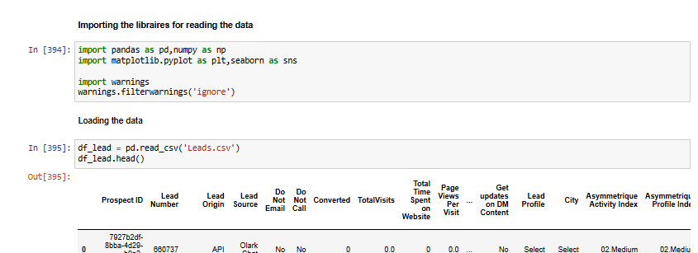
Importing the data

Slide 5
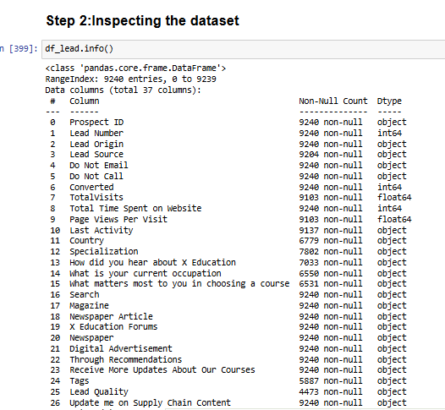
Inspecting the dataframe

Slide 6
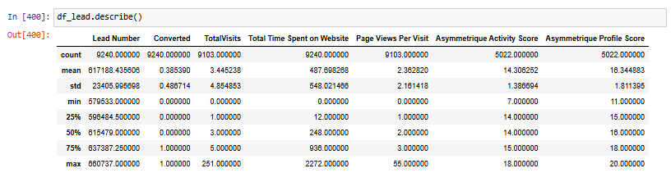

Slide 7
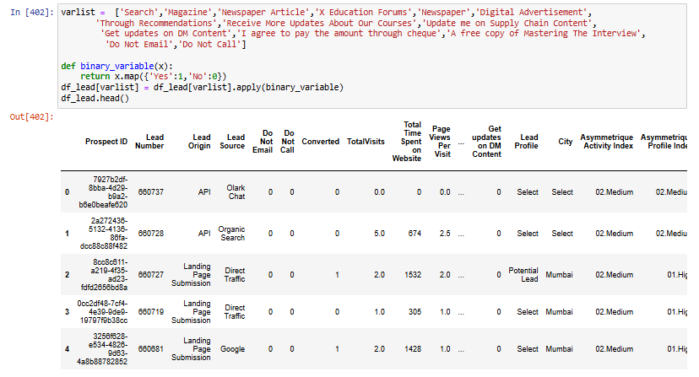
DataProcessing

Slide 8
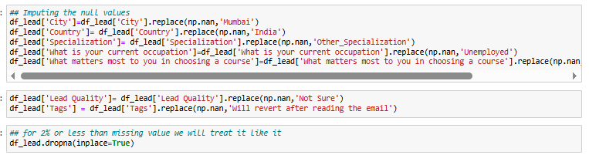

Slide 9
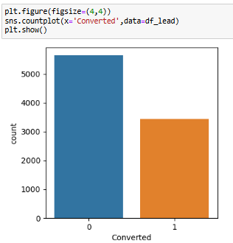
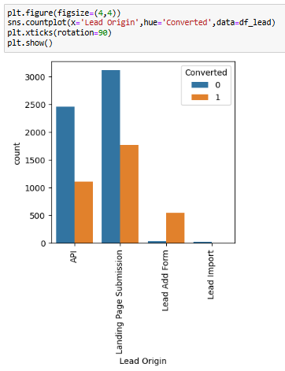
EDA Analysis of Data Set

Slide 10
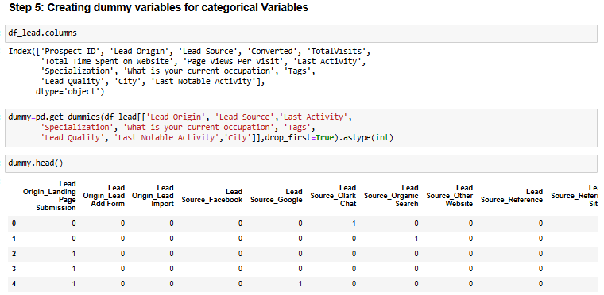
Creating Dummy variable

Slide 11
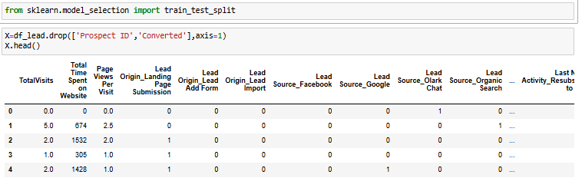
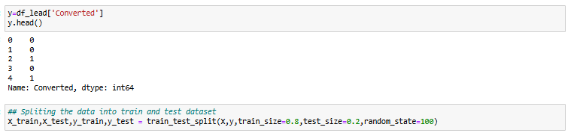
Splitting the Data into Train and test set

Slide 12
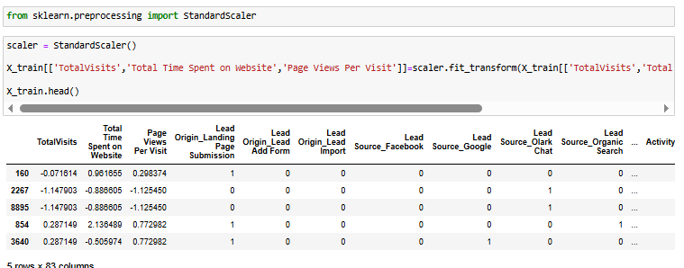
Feature Scaling of the Data

Slide 13
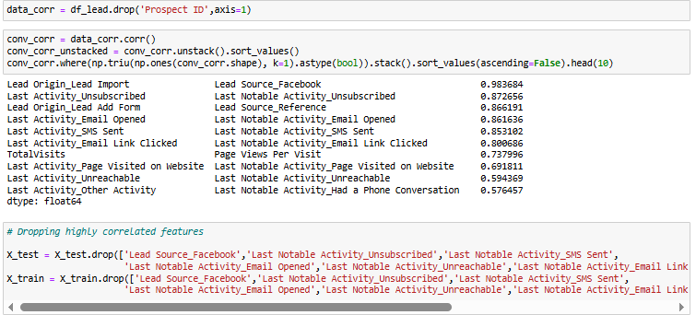
Analyzing the Correlations

Slide 14
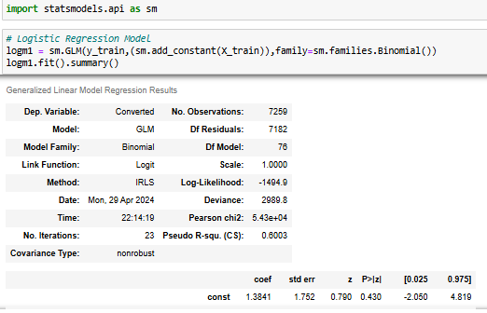
Model Building

Slide 15
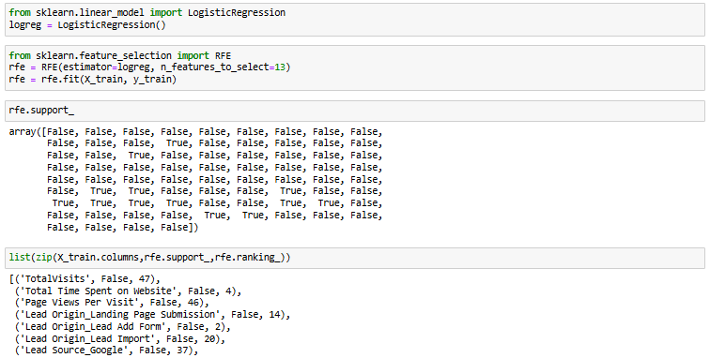
Feature Selection Using RFE

Slide 16
Creating ROC Curve
An ROC curve demonstrates several things:​- It shows the tradeoff between sensitivity and specificity (any increase in sensitivity will be accompanied by a decrease in specificity).
The closer the curve follows the left-hand border and then the top border of the ROC space, the more accurate the test.
The closer the curve comes to the 45-degree diagonal of the ROC space, the less accurate the test.

Slide 17
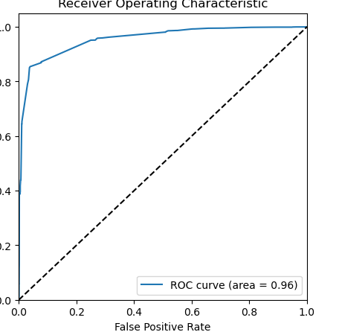
ROC Curve

Slide 18
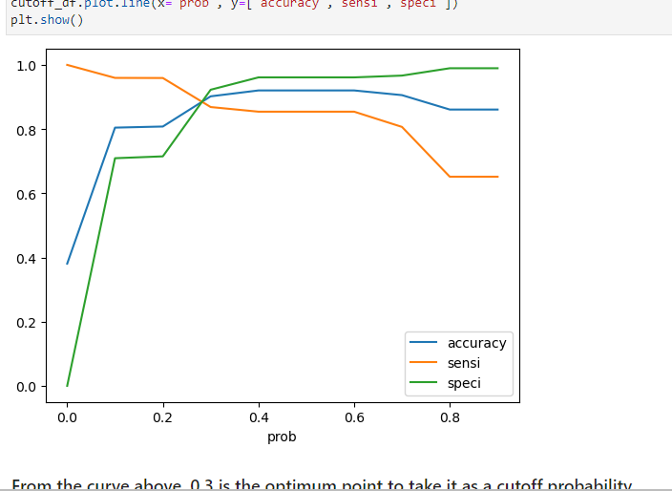
Finding the optimal cut-off point

Slide 19
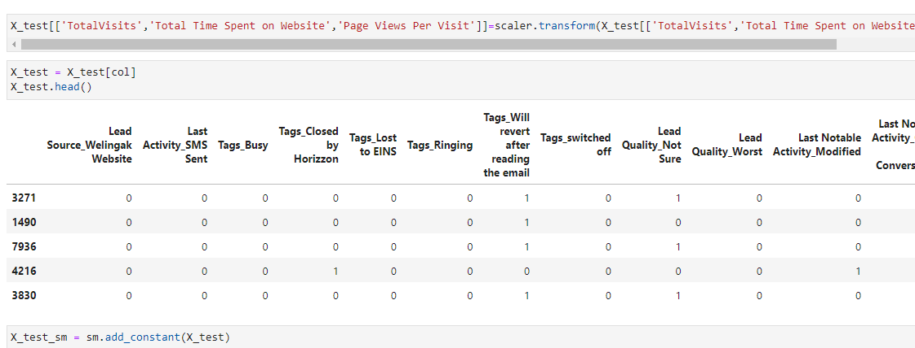
Making prediction on final test set

Slide 20
Conclusion
The logistic regression model predicts the probability of the target variable having a certain value, rather than predicting the value of the target variable directly. Then a cutoff of the probability is used to obtain the predicted value of the target variable.
Here, the logistic regression model is used to predict the probabilty of conversion of a customer.
Optimum cut off is chosen to be 0.27 i.e. any lead with greater than 0.27 probability of converting is predicted as Hot Lead (customer will convert) and any lead with 0.27 or less probability of converting is predicted as Cold Lead (customer will not convert)
Our final Logistic Regression Model is built with 14 features.
Features used in final model are ['Do Not Email', 'Lead Origin_Lead Add Form', 'Lead Source_Welingak Website', 'Last Activity_SMS Sent', 'Tags_Busy', 'Tags_Closed by Horizzon', 'Tags_Lost to EINS', 'Tags_Ringing', 'Tags_Will revert after reading the email', 'Tags_switched off', 'Lead Quality_Not Sure', 'Lead Quality_Worst', 'Last Notable Activity_Modified', 'Last Notable Activity_Olark Chat Conversation']
The top three categorical/dummy variables in the final model are ‘Tags_Lost to EINS’, ‘Tags_Closed by Horizzon’, ‘Lead Quality_Worst’ with respect to the absolute value of their coefficient factors.

