Slide 1
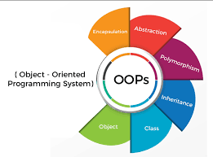
Lecture 9: Object-Oriented Programming

Slide 2
OO Design
Modelling real world problems
Test Question Problem
Design Principles
Encapsulation
Class definitions
Abstraction
Hiding details of methods from users
Classes
inheritance, and polymorphism.
Inheritance
Dynamic binding

Slide 3
Introduction to Classes
A “class” is a user-defined data type.
It contains (or encapsulates) certain “members”
member data
every class object will have these data items
member functions (also called methods)
actions a class object can perform
Class inheritance
If a class is a specialization (or sub-type) of a more general class, it is said to inherit from that class
this can give a class access to a parent class' member data/functions

Slide 4
Python Classes
The general concepts of Python classes are basically the same as C++, Java, etc.
Classes are built into Python from the beginning.
For object-oriented programming (i.e., programming using classes), Python is superior in this sense to many other programming languages
Everything is an Object approach

Slide 5
Class definition
General format
class <class name> :
<class var 1> = <value> #class variable
<class var 2> = <value>
#instance variable defined in methods
…
def <class method 1> (self, arg1, arg2, …) :
<body of method 1>
def <class method 2> (self, arg1, arg2, …)
<body of method 2>
…

Slide 6
Simple format (without class variables)
class className :
def method1 ()
…
def method2 ()
…
…

Slide 7
Example: Defining a Point class
Point.py
class Point :
‘class that represents points in plane’
def setx (self, xc):
self.x = xc
def sety (self, yc):
self.y = yc
def get(self) :
return (self.x, self.y)
def move (self, dx, dy) :
self.x += dx
self.y += dy
Two instance variables: x, y
No class variables
Key: the use of “self”

Slide 8
Creating class objects and invoking methods
Once class Point defined, execute the class definition by running the Point.py module
Now, try this
a = Point() #Here Point() cannot take argument
a.setx(5) #b = Point (5, 3) wrong
a.sety(3)
print(a.get())
print (a.x) #okay? Private or public?
Python’s instance variables are public.
To restrict public access to instance variables, Python use __x indicates x is a private member.

Slide 9
Calling methods
p = Point()
p.setx(3)
p.sety(-4)
p.move(1, 5)
Point.move(p, 1, 5) #same as above
#the second call format illustrates the self in move definition
def move (self, dx, dy) :

Slide 10
Constructor
Optional, but encouraged to use
class Point :
def __init__ (self, x0, y0) :
self.x = x0
self.y = y0
#now you may create objects with parameters
p1 = Point(5, 3)
print((p1.x, p1.y))
#Note: print(p1) -- what would be displayed ?

Slide 11
Constructor with default values
Optional, but encouraged to use
class Point :
def __init__ (self, x0=0, y0=0) :
self.x = x0
self.y = y0
def display (self) :
print((self.x, self.y)) #print out a tuple (x,y)
#now you may create objects in several ways
p1 = Point(5, 3)
p2 = Point() #take default value
p3 = Point (4) #y takes default value, i.e. (4, 0)
p1.display() #(5, 3)
p2.display() #(0, 0)
p3.display() #(4,0)
Note: one constructor only; Python does not do overloading

Slide 12
Print Objects
If we use print() to display an object
>>> print(p1) #Possible output: <Point object at 0x1052e69e0>
So, we need to define a method, e.g.
def display (self ) :
print((self.x, self.y))
And call the method as
>>> p1.display()
Are there better way to display an object?

Slide 13
Special method __str__
class Point :
def __init__ (self, x0=0, y0=0) :
self.x = x0
self.y = y0
def __str__ (self) :
return '(' + str(self.x) + ', ' + str(self.y) + ')' #must return a string
#better way: return "({0},{1})".format(self.x,self.y)
p1 = Point(5, 3)
print(p1) #(5, 3)
#without __str__ method, displayed <Point object at 0x1052e69e0>

Slide 14
Special method __str__
Default __str__ implementation
Returns a string with the class name and instance address
e.g. print(p1) may display <Point object at 0x1052e69e0>
__str___ method must return a string
equivalent to Java toString method

Slide 15
Class Variables
class Point:
x = 0 #class variables
y = 0
def set_location(self, x0, y0):
self.x = x0 #x and y here are instance variables
self.y = y0
def distance_from_origin(self):
return sqrt(self.x * self.x + self.y * self.y) #from math import *
def distance(self, other):
dx = self.x - other.x
dy = self.y - other.y
return sqrt(dx * dx + dy * dy)
def display (self) :
print((self.x, self.y))

Slide 16
Calling methods
p1 = Point()
p1.set_location(3, -4)
p1.display()
p2 = Point()
p2.display() #what’s the location of p2? why?
print("distance = ", p1.distance(p2))
#distance between p1 and origin (0, 0)

Slide 17
Point class: Case Study
from math import *
class Point:
x = 1 #class variables, suppose to be (0, 0)
y = 1 #here, intentionally changed to (1, 1)
def set_location(self, x0, y0):
self.x = x0 #instance variables
self.y = y0
def distance_from_origin(self):
return sqrt(self.x * self.x + self.y * self.y)
def distance(self, other):
dx = self.x - other.x
dy = self.y - other.y
return sqrt(dx * dx + dy * dy)
def display (self):
print( (self.x , self.y))
def __str__(self):
return "({0},{1})".format(self.x,self.y)
p = Point()
p.display() #what’s point location?
p.set_location(3, -4)
p.display()
p1 = Point()
print("distance = ", p.distance(p1))
print(p)
Output:
>>>
== RESTART: point.py ==
(1, 1)
(3, -4)
distance = 5.385164807134504
(3,-4)
>>>

Slide 18
A Class and Its Namespace
A namespace is associated with every Python class
The name of the namespace is the name of the class
class point namespace
x
y
get
move
setx
sety
0
0

Slide 19
Object and its Associated Namespace
Every object has its own, separate namespace
>>> a = Point ()
>>> a.x = 3
>>> b = Point()
Object a’s namespace Object b’s namespace
What will be printed out?
a.display()
b.display()
x
3

Slide 20
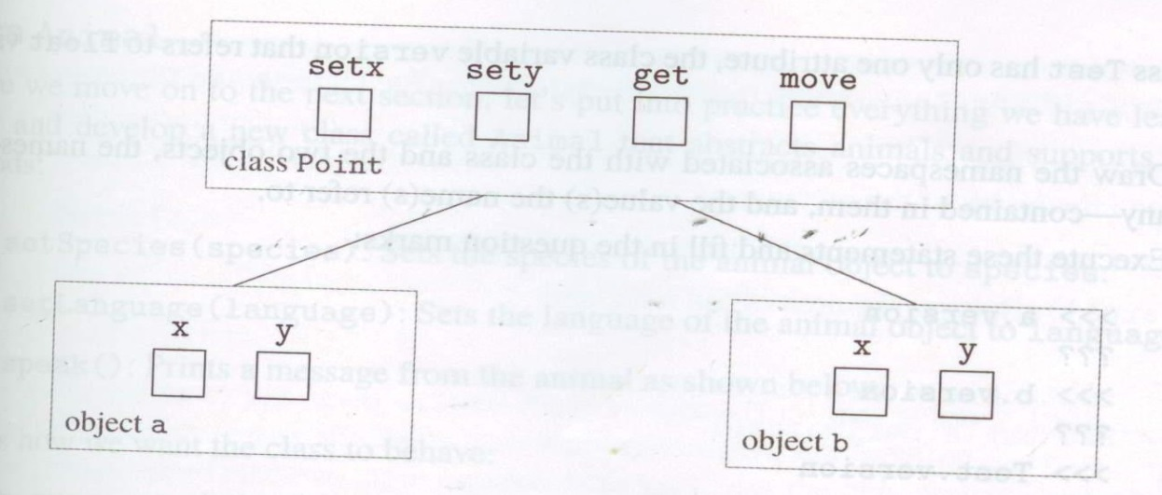
Instance Variables
Variables x and y in the Point object a or b are called Instance variables.
Every instance (object) of a class will have its own namespace and therefore its own separate copy of instance variables.

Slide 21
Instance variables vs. Class variables
class Student:
course = "CS 2520" #Course: class variable
def __init__(self, name, test1=0, test2=0):
self.name = name #self.name, self.test1, … instance variable
self.test1 = test1
self.test2 = test2
def compute_average(self) :
return (self.test1+self.test2)*0.5
def print_data(self):
print ("The grade for ", self.name, "in ", self.course, "is ", self.compute_average())
#vs. print ('The grade for ', self.name, 'in ', Student.course, 'is ', self.compute_average())
David = Student("David", 90, 100)
David.course = 'CS 2990’
#David now has an instance variable course, same name as class variable
David.print_data() #self.course here is David’s instance variable
print(Student.course) #this prints out class variable
Bob=Student("Bob", 60, 80)
Bob.print_data()
print(Student.course)

Slide 22
Member Data Scope
Class attributes defined in the class definition itself are common to the class, i.e. common to all objects of the class
The code block in a class definition actually runs the first time the class definition is encountered, and not when class objects are instantiated
Instance attributes defined for a specific object of a certain class are held only with that particular object
often set using the “self” keyword as in previous example

Slide 23
Class Variables vs. Instance Variables -- Comment on Student class
The course name is kept common to all Student objects (all instances of the class)‏
Can be accessed via className or self
e.g. Student.course or self.course
However, the student name as well as two test grades are specific to each Student object
Accessed via self.variable, e.g. self.test1
However, once a specific object overwrites the class variable (e.g. David.course = ‘CS 2990’) it actually creates a new instance variable
Now, Student.course and self.course are different

Slide 24
Case Study
Design and implementation of a Planet class
build a model for the solar system
data: name, radius, mass, distance
methods:
constructor
getName
getRadius
getMass
getDistance
getVolume
getSurfaceArea
getDensity

Slide 25
Constructor method
Planet class with a constructor
class Planet :
def __init__ (self, iname, irad, im, idist) :
self.name = iname
self.radius = irad;
self.mass = im;
self.distance = idist
Note: __init__ method is optional, but encouraged to use

Slide 26
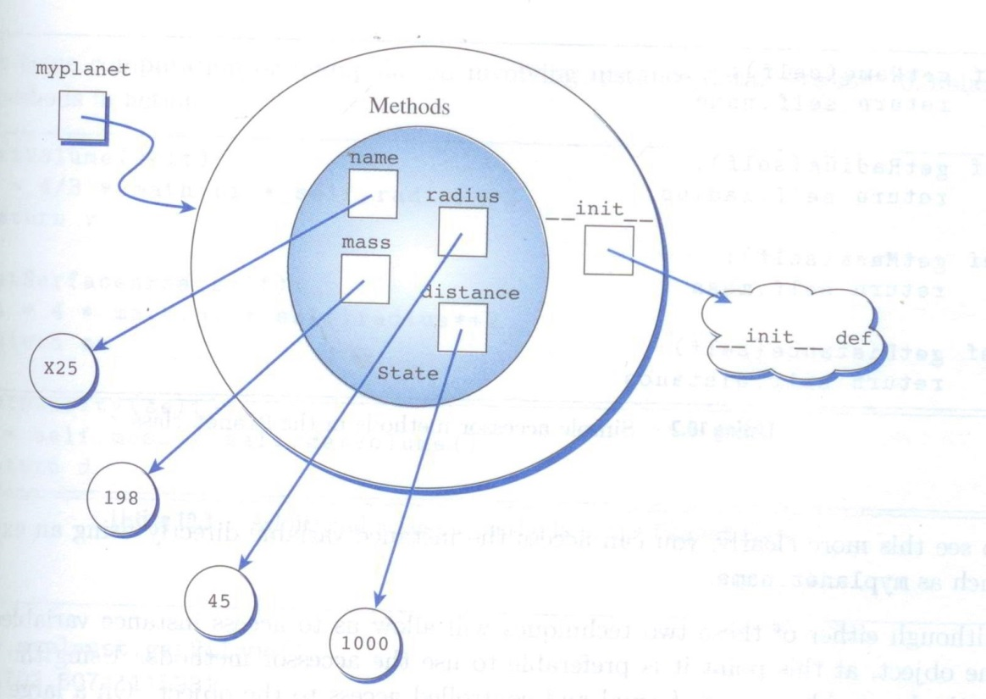
Use of Constructor
>>> myplanet = Planet (“X25”, 45, 198, 1000)
creates an object (referenced by myplanet) as shown

Slide 27
Simple accessor methods
Accessor method
access the instance variables of the object
def getName (self) :
return self.name
def getRadius (self) :
return self.radius
def getMass (self) :
return self.mass
def getDistance (self) :
return self.distance

Slide 28
Use of ‘self’
By convention, the first argument of any Python class method is called self.
Similar to the reserved word this in Java/C++
but self is not a reserved word in Python, merely a naming convention (a very strong naming convention)
i.e. please don't call it anything but self
In the __init__ method, self refers to the newly created object;
In other class methods, it refers to the instance whose method was called.
You need to specify self explicitly when defining the method
you do not specify it when calling the method;
Python will add it for you automatically.

Slide 29
Additional accessor methods
def getVolume (self) :
v = 4/3 * math.pi * self.radius ** 3
return v
def getSurfaceArea (self) :
sa = 4 * math.pi * self.radius ** 2
return sa
def getDensity (self) :
d = self.mass / self.getVolume()
return d

Slide 30
Mutator methods
Mutator methods are procedures that change an object in some way
def setName (self, newName) :
self.name = newName

Slide 31
Adding a __str__() method
#class Planet:
def __str__(self) :
return self.name
myplanet = Planet (“X25”, 45, 198, 1000)
print(myplanet) #X25

Slide 32
More special methods
__getitem__ #index ([]) operator
__setitem__ #see example next slide
__len__ #len operator
…

Slide 33
# create our custom list class
class CustomList:
def __init__(self, elements=1): # constructor self.my_custom_list = [0] * elements #a list
def __str__(self):
return ‘Contents: ' + str(self.my_custom_list)
def __len__(self) :
return elements
# For setting the value
def __setitem__(self, index, value):
self.my_custom_list[index] = value
# For getting the value from our custom_list
def __getitem__(self, index):
return self.my_custom_list[index]

Slide 34
# Create my_custom_list with 12 elements
obj = CustomList(12)
# Set value at index 0 to 1, at index 1 to 5
obj[0] = 1
obj[1] = 5
# print value at index 0, index 1 respectively
print(obj[0]) #note: the use of obj[0], obj[1]
print(obj[1])
# print the whole my_custom_list
#note: the list is displayed due to the __str__() method
print(obj)
# Output:
1
5
[1, 0, 0, 0, 0, 0, 0, 0, 0, 0, 0, 0]

Slide 35
Operator Overloading
Certain operators (like ==, +, -, *) can be overloaded to work on user-defined datatypes (classes) as well as built-in types like integers
Example
Overload the == operator to test if two objects are equal
This is done by defining the __eq__ function for the class
implement a function which can compare two instances of your user-defined datatype (class).

Slide 36
class Point:
def __init__(self, x=0, y=0):
self.x = x
self.y = y
def __eq__(self, other):
return self.x == other.x and self.y == other.y
a = Point()‏
b = Point(1,1)‏
print (a==b) #using overloaded == operator

Slide 37
Overloading other comparisons
method in class operator overloaded
__lt__(self, other) x < y __le__(self, other) x<= y __eq__(self, other) x == y __ne__(self, other) x != y __ge__(self, other) x >= y __gt__(self, other) x > y
Compare and contrast w/
Java and C++

Slide 38
Operator Overloading Special Functions
Operator | Expression | Internally
Addition | p1 + p2 | p1.__add__(p2)
Subtraction | p1 - p2 | p1.__sub__(p2)
Multiplication | p1 * p2 | p1.__mul__(p2)
Power | p1 ** p2 | p1.__pow__(p2)
Division | p1 / p2 | p1.__truediv__(p2)
Floor Division | p1 // p2 | p1.__floordiv__(p2)
Remainder (modulo) | p1 % p2 | p1.__mod__(p2)
Bitwise Left Shift | p1 << p2 | p1.__lshift__(p2)
Bitwise Right Shift | p1 >> p2 | p1.__rshift__(p2)
Bitwise AND | p1 & p2 | p1.__and__(p2)
Bitwise OR | p1 | p2 | p1.__or__(p2)
Bitwise XOR | p1 ^ p2 | p1.__xor__(p2)
Bitwise NOT | ~p1 | p1.__invert__()

Slide 39
Comparison Operator Overloading
Operator | Expression | Internally
Less than | p1 < p2 | p1.__lt__(p2)
Less than or equal to | p1 <= p2 | p1.__le__(p2)
Equal to | p1 == p2 | p1.__eq__(p2)
Not equal to | p1 != p2 | p1.__ne__(p2)
Greater than | p1 > p2 | p1.__gt__(p2)
Greater than or equal to | p1 >= p2 | p1.__ge__(p2)

Slide 40
A note on Python overloading
In other languages like C++/Java, we can overload member functions to behave differently depending on how many arguments (and what types of arguments) are passed to the function
Python doesn't work like this: the last function defined with a given name is the one that will be used: class A: def method(self, x): … def method(self, x, y): #this definition overrides the previous one
#this also explains why one constructor only

Slide 41
Inheritance
A class can inherit from another class, allowing a class hierarchy
If class A inherits from class B, then class B is a superclass of class A, and class A automatically has access to all the member data and member functions of class B
If class A redefines some member function or member data which is also present in class B, then the definition in A takes precedence over that in class B

Slide 42
Example
Prior to Python 3.0 there are two kinds of strings "plain strings" and "unicode strings".
Plain strings (str) cannot represent characters outside of the Latin alphabet .
Unicode strings (unicode) can represent characters from any alphabet including some fictional ones.
Why have two kinds of strings? Would it be better to just have Unicode?
Python was created before Unicode was the preferred method for representing strings.
Python 3.0 it is finally the case that all strings are Unicode.
The inheritance hierarchy of Python strings pre-3.0 is:
object
|
|
basestring
/ \
/ \
str unicode
'basestring' introduced in Python 2.3 can be thought of as a step in the direction of string unification as it can be used to check whether an object is an instance of str or unicode

Slide 43
>>> string1 = "I am a plain string"
>>> string2 = u"I am a unicode string"
>>> isinstance(string1, str)
True
>>> isinstance(string2, str)
False
>>> isinstance(string1, unicode)
False
>>> isinstance(string2, unicode)
True
>>> isinstance(string1, basestring)
True
>>> isinstance(string2, basestring)
True

Slide 44
A Simple Example
class Point3D(Point): # Point3D extends Point
z = 0
...

Slide 45
Calling superclass methods
methods: class.method(object, parameters)
constructors: class.__init__(parameters)
class Point3D(Point):
z = 0
def __init__(self, x, y, z):
Point.__init__(self, x, y)
self.z = z
def translate(self, dx, dy, dz):
Point.translate(self, dx, dy)
self.z += dz

Slide 46
class Class1: #Class1: superclass
def __init__(self, data=0):
self.data = data
def display(self):
print (self.data)
class Class2(Class1): #Class2 inherits from Class1
def square(self):
self.data = self.data * self.data
a = Class2(5)‏
a.square() # method specific to Class2
a.display() # inherited method from Class1

Slide 47
class A :
def __init__(self, data=0) :
self.data= data
def display(self) :
print(self.data)
class B(A) :
def __init__(self, data, data2) : #create own constructor
A.__init__(self, data) #by calling superclass constructor
self.data2 = data2
def square(self) :
self.data = self.data * self.data
def display(self) : #redefine superclass methods
print((self.data, self.data2))
a = B(5, 3)
a.square()
a.display() #which display will be called? (25,3)
Dynamic binding or static binding?

Slide 48
Alternative Syntax for Method Calls
Normal way Alternative way
a = Class2(5) a = Class2(5)‏
a.square() Class2.square(a)
a.display() Class1.display(a)

Slide 49
Multiple Inheritance
Python also supports multiple inheritance
class name(superclass, ..., superclass):
statements
Note: if more than one superclass has the same field/method, conflicts are resolved in left-to-right order

Slide 50
Use of Built-in super()
The super() built-in method returns a proxy object (temporary object of the superclass) that allows us to access methods of the base class.
In Python, super() has two major use cases:
Avoid using the base class name explicitly
Working with Multiple Inheritance

Slide 51
super() in Single Inheritance
class Mammal(object):
def __init__(self, mammalName):
print(mammalName, 'is a warm-blooded animal.')
class Dog(Mammal):
def __init__(self):
print('Dog has four legs.')
super().__init__('Dog')
d1 = Dog()
# Output:
Dog has four legs.
Dog is a warm-blooded animal.

Slide 52
super() in Multiple Inheritance
Animal
class Animal:
def __init__(self, Animal):
print(Animal, 'is an animal.');
class Mammal(Animal):
def __init__(self, mammalName):
print(mammalName, 'is a warm-blooded animal.')
super().__init__(mammalName)
class NonWingedMammal(Mammal):
def __init__(self, NonWingedMammal):
print(NonWingedMammal, "can't fly.")
super().__init__(NonWingedMammal)
Mammal
NonWingedM
NonMarineM
Dog

Slide 53
class NonMarineMammal(Mammal):
def __init__(self, NonMarineMammal):
print(NonMarineMammal, "can't swim.")
super().__init__(NonMarineMammal)
class Dog(NonMarineMammal, NonWingedMammal):
def __init__(self):
print('Dog has 4 legs.');
super().__init__('Dog’) #here, which parent class it refers to?
d = Dog()
print('')
bat = NonMarineMammal('Bat')

Slide 54
Output:
Dog has 4 legs.
Dog can't swim.
Dog can't fly.
Dog is a warm-blooded animal.
Dog is an animal.
Bat can't swim.
Bat is a warm-blooded animal.
Bat is an animal.

Slide 55
Method Resolution Order (MRO)
A method in the derived class is always called before the method of the base class.
d = Dog()
Dog.__init__(…) called first
In multiple inheritance, super() calls parent class first, then grand parent
NonMarineMammal.__init__(…) and NonWingedMammal__init__(…) are called before Mammal, which is called before Animal, and Animal class is called before the object.
If there are multiple parents, the one listed first (from left to right) is invoked first, e.g.
class Dog(NonMarineMammal, NonWingedMammal) :
NonMarineMammal.__init__(…) called first

Slide 56
Abstract Class in Python (optional)
The 'abc' module in Python library provides the infrastructure for defining custom abstract base classes.
marking methods of the base class as abstract by @absttractmethod decorator.
A concrete class which is a sub class of such abstract base class then implements the abstract base by overriding its abstract methods.
The abc module defines ABCMeta class which is a metaclass for defining abstract base class.

Slide 57
import abc
class Shape(metaclass=abc.ABCMeta):
@abc.abstractmethod
def area(self):
pass
class Rectangle(Shape):
def __init__(self, x,y):
self.l = x
self.b=y
def area(self): #overriding
return self.l*self.b
r = Rectangle(10,20)
print ('area: ',r.area())
#simply
class Shape(abc.ABC):
@abc.abstractmethod
def area(self):
pass

Slide 58
Practice
Implement a class Polygon that abstracts regular polygon (of n sides) and supports at least the following two methods
perimeter()
area()
Implement a class Worker to handle weekly worker’s pay (including overtime pay).

Slide 59
Learning Objectives
After Lecture 9, students should be able to
Describe and write object oriented programs in Python, including but not limited to: class definitions, methods, class and instance variables, private and public instance variables, constructors, accessors and mutators, …
Express operator overloading
Explain Python’s handling in method overloading
Design class inheritance
Write derived classes, describe method binding
Explain Python’s implementation of multiple inheritance

Slide 60
Python ”underscore” usage
Single underscore in interpreter
>>> 6+12
>>>18
>>>_
>>>18 #repeat last executed value
Single underscore in code
for _ in range(10): #don’t care about variable name
print(“Go! Broncos!”) #and, ignoring value
Single post underscore (at the end of a name)
def fun (item = 0, class_ = Calculate) : …
#avoid name conflicts with keywords

Slide 61
Single pre underscore (beginning of a name)
class Calculate :
def __init__ (self, x, y) :
self.a = x
self._b = y #weak private, no enforcement
Single underscore between numeric digits
>>>lotto = 10_000_000_000.0 #improved readability
>>>lotto
>>>10000000000.0
>>>mips_instr = 0b_0011_1111_0100_0110_0000_1100_0011_1010

Slide 62
Double pre underscore
class Calculate :
def __init__ (self, x, y, z) :
self.a = x
self._b = y
self.__c = z
c = Calculate (5, 10, 8)
print(self.a)
print(self._b) #weak private, okay
print(self.__c) #error
#private, not for inheritance
#Python name mangling
class Calculate :
def __init__ (self, x, y, z) :
self.a = x
self._b = y
self.__c = z
def display (self) :
print(self.__c)
c = Calculate (5, 10, 8)
c.display()

Slide 63
Double pre & post underscores
if __name__ == __main__ :
…
class Calculate :
def __init__(self, x, y) :
…
#special methods, also used in operator overloading
#magic/dunder methods

