Slide 1
CS 331 HW4
Q.1 Compute C(i,j)
1. Compute the C(i, j)’s for all i < j
d₀ = 20, d₁ = 3, d₂ = 10, d₃ = 30, d₄ = 5
size 1: C(i,i) = 0 ∀ i
size 2: C(1,2) = d₀ × d₁ × d₂ = 20 × 3 × 10 = 600
C(2,3) = d₁ × d₂ × d₃ = 3 × 10 × 30 = 900
C(3,4) = d₂ × d₃ × d₄ = 10 × 30 × 5 = 1500
Size 3:
C(1, 3) = min _{k=1,2} {C(1,1) + C(2, 3) + d₀ × d₁ × d₃, C(1,2) + C(3, 3) + d₀ × d₂ × d₃}
= min {0 + 900 + 20 × 3 × 30, 600 + 0 + 20 × 10 × 30}
= min {2700, 6600} = 2700₁
C(2, 4) = min _{k=2,3} {C(2,2) + C(3, 4) + d₁ × d₂ × d₄, C(2,3) + C(4, 4) + d₁ × d₃ × d₄}
= min {0 + 1500 + 3 × 10 × 5, 900 + 0 + 3 × 30 × 5}
= min {1650, 1350} = 1350₃
Size 4:
C(1, 4) = min _{k=1,2,3} {C(1,1) + C(2, 4) + d₀ × d₁ × d₄,
C(1,2) + C(3, 4) + d₀ × d₂ × d₄,
C(1,3) + C(4,4) + d₀ × d₃ × d₄}
= min {0+1350+20×3×5, 600+1500+20×10×5, 2700+0+20×30×5}
= min {1650, 3100, 5700} = 1650₁
∴ The optimal multiplication order: Ax((BxC)xD), and its cost is 1650.
Young CS 331
HW#4 Solution

Slide 2
M = 15
HW4 Q.2 0/1 Knapsack Problem
Object 1
Object 2
Object 3
Object 4
Object 5
Object 6
M = 10
Profit p_{i}
2
3
6
3
4
5
Weight w_{i}
2
1
6
4
2
5
 | 0 | 1 | 2 | 3 | 4 | 5 | 6 | 7 | 8 | 9 | 10
0 | 0 | 0 | 0 | 0 | 0 | 0 | 0 | 0 | 0 | 0 | 0
1 | 0 | 0 | 2 | 2 | 2 | 2 | 2 | 2 | 2 | 2 | 2
2 | 0 | 3 | 3 | 5 | 5 | 5 | 5 | 5 | 5 | 5 | 5
3 | 0 | 3 | 3 | 5 | 5 | 5 | 6 | 9 | 9 | 11 | 11
4 | 0 | 3 | 3 | 5 | 5 | 6 | 6 | 9 | 9 | 11 | 11
5 | 0 | 3 | 4 | 7 | 7 | 9 | 9 | 10 | 10 | 13 | 13
6 | 0 | 3 | 4 | 7 | 7 | 9 | 9 | 10 | 12 | 13 | 14
The optimal solution is Object 1, 2, 5, and 6 with profit 14
Young CS 331
HW#4 Solution

Slide 3

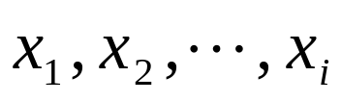
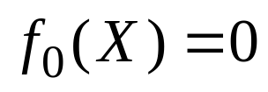
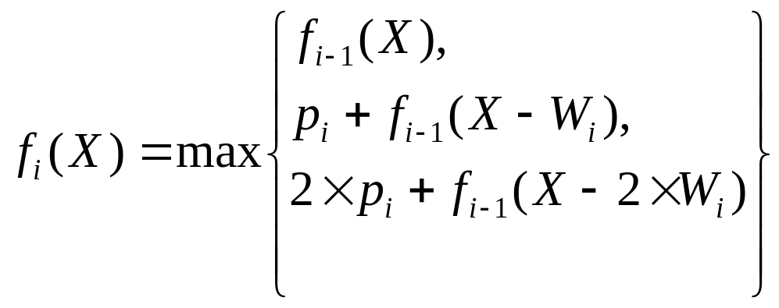
Q.3 0/1/2 Knapsack Problem
Define notation:
= max profit generated after considering
(can have 0 or 1 or 2 of each), subject to capacity X
Q.3(a) Obtain the dynamic programming functional equation
to solve the Integer Knapsack Problem.
Young CS 3310
HW#4 Solution

Slide 4
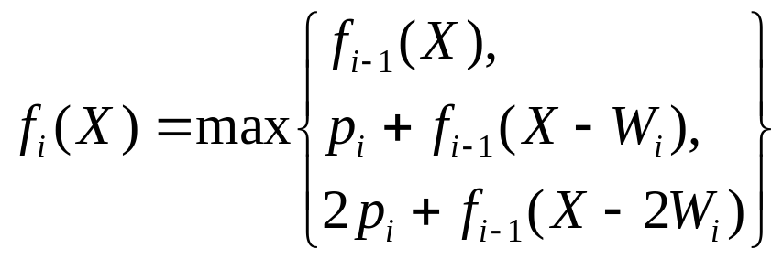
Algorithm:
procedure Zero-One-Two-Knapsack (n, M, f)
// n, M are input, f is output
begin
for X ← 1 to M do
f₀(X) = 0
for i ← 1 to n do
for X ← 1 to M do
return f_{n}(M) // optimal profit
end;
Q.3(b) Give an algorithm to implement your functional equation.
Young CS 3310
HW#4 Solution

Slide 5
Q.3(c) What is the complexity of your algorithm?
f_{i-1}(j-2w_{i})
M+1
 | … |  | … | j-w_{i} | … | j | … | M
0 | 0 | 0 | 0 | 0 | 0 | 0 | 0 | 0
1
…
i-1 | … |  |  | f_{i-1}(j-w_{i}) |  | f_{i-1}(j)
i |  |  |  |  |  | f_{i}(j)
…
n
n+1
+ 2p_{i}
+p_{i}
(M+1)(n+1) entries and O(1) time each ⇒ O(Mn)
Young CS 3310
HW#4 Solution

Slide 6
HW#4 Q.4 NP-completeness
If P ≠ NP, then all problems in NP can be solved in polynomial time deterministically.
False. Note that P ≠ NP implies that there exists at least one problem in NP which is not in P.
(b) It is known that 5SAT is NP-complete. Assume that an O(n²⁰²¹) deterministic algorithm has been found for the 5SAT problem, then P = NP.
True. Note that all other NP-complete problems are reducible to 5SAT in polynomial time.
(c) If a decision problem X is NP-complete, proving that X is reducible to Y, in polynomial time, is sufficient to show that Y is NP-complete.
False. Note that we also need to show Y is in NP in order to show Y is NP-complete.
Young CS 3310
HW#4 Solution

