Slide 1
CS3560: Practice Midterm Review

Slide 2
Question 1:
What are the big ideas in object oriented programming?

Slide 3
Question 1:
What are the big ideas in object oriented programming?
Identity and Objects
Abstraction
Encapsulation
Combining Data and Behavior
Classification
Hierarchy
Inheritance
Polymorphism

Slide 4
Question 2:
Design a class diagram for the following problem statement. Include the relationships between the classes, and the appropriate multiplicity. Include any attributes or methods that are mentioned in the following description, but do not add any attributes or methods that are not mentioned.

Slide 5
Question 2:
A simple diagram editor is used to design a diagram on a sheet. A sheet is a collection of links and boxes. A box has a size, position on the page, color, and may optionally contain some text. A link is a sequence of line segments that connects two boxes. Each line segment is either horizontal or vertical, and connects two points. A point may be shared by a vertical and horizontal segment in the same link. A buffer is a collection of links and boxes that have been cut or copied from the sheet. Note that a link or a box belongs to one buffer or to one sheet. The user can add, move, or delete links or boxes. Elements can be cut, copied, or pasted to the buffer, and the sheet can be read from a file, written to a file, or printed.

Slide 6
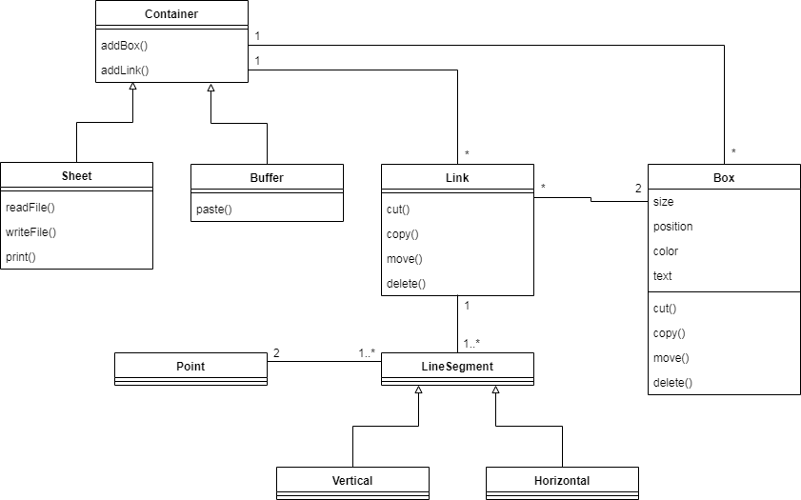
Question 2:

Slide 7
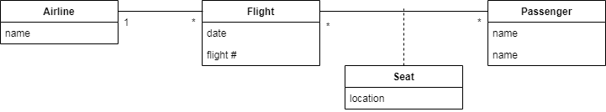
Question 3:
Given the following class diagram, provide an object diagram for the following scenario:
Flight B1234 of American Airlines is scheduled on 3/15/20. Three of the passengers on that flight have reserved the following seats: Tom, for seat 12C, John for seat 11B, and Janet for seat 10A. American Airlines has also scheduled flight B1548 on 3/17/20. Both Tom and John have reserved seats 23A and 17B, respectively, for this return flight.

Slide 8
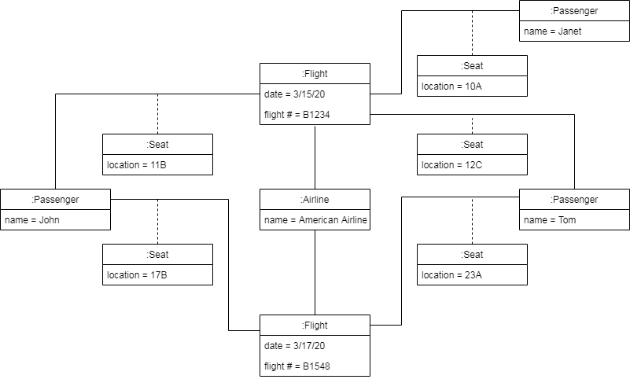
Question 3:

Slide 9
Question 4:
The Adventure game, or the Colossal Cave Adventure, was the first interactive fiction game, and was a trend-setting computer game. The following state diagram shows an approximation of the twisty little maze puzzle. The question? If you start in the west end of the Hall of Mists, what is the shortest sequence of moves to get to the Brink of Pit?

Slide 10
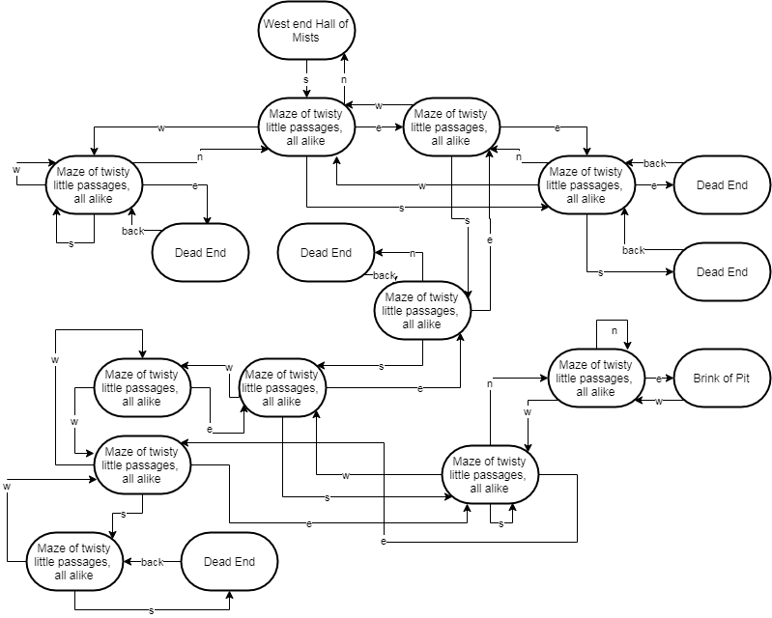
Question 4:

Slide 11
Question 4:
1

Slide 12
Question 4:
1
2
2
2

Slide 13












Question 4:
1
2
So the shortest path is s, e, s, s, s, n, e
2
2
3
5
4
6
7
6
5
7

Slide 14
Question 4 Bonus:
You have until next Tuesday to earn the bonus points.
You can have one sequence of moves that will work from any room.
You can have a flowchart where each step gives one or more moves, but the chart includes decisions and branches depending upon whether the previous move led to a dead end, was an unavailable move, and so on.

Slide 15
Question 5:
Prepare an activity diagram for computing a restaurant bill. There should be a charge for each item delivered. The total should be subject to tax. A service charge of 18% is applied for groups of six or more, but for smaller groups there should be a blank entry for a gratuity. Any coupons or gift certificates should be subtracted.

Slide 16
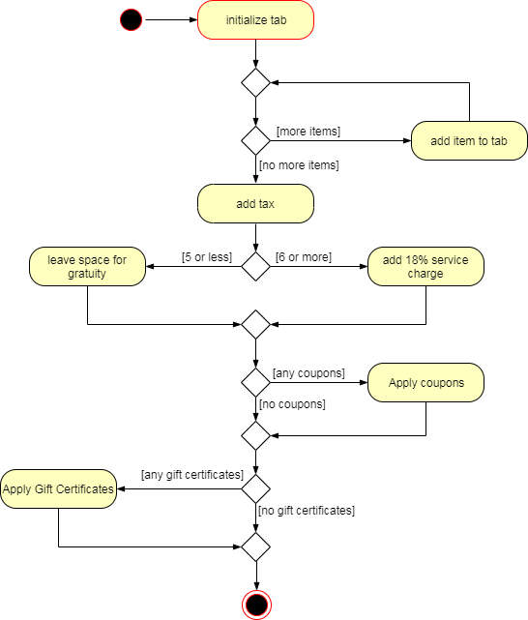
Question 5:

