Slide 1
Research Report
01/13/2024
Yu Li

Slide 2
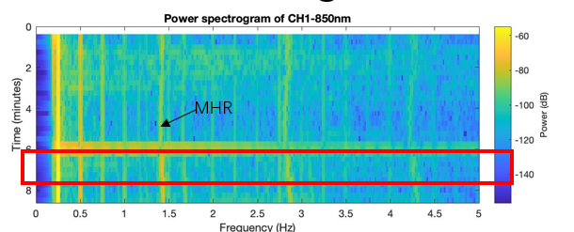
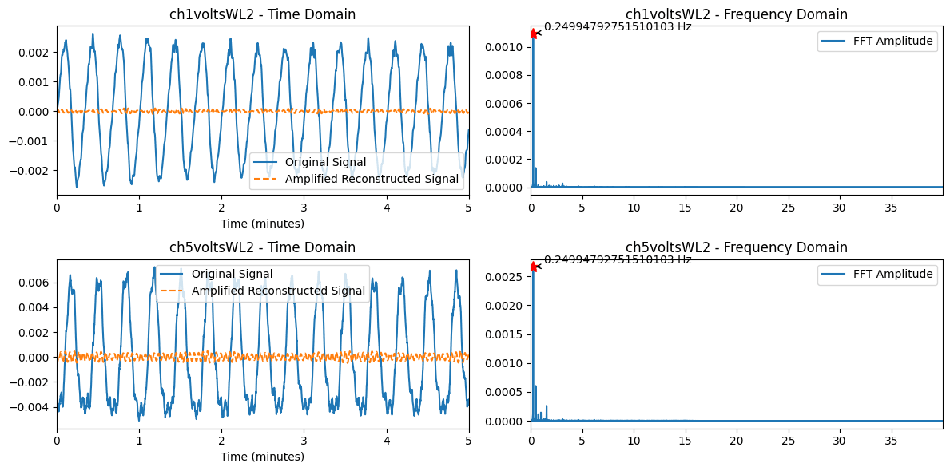
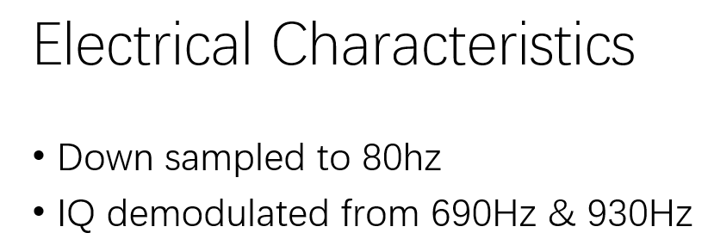
FFT and central frequency correction
1) Perform FFT analysis and find the central frequency corresponding to the peak.
2) There is an error between the center frequency analyzed here and the recorded MHR.
3) Therefore, if the frequency corresponding to the peak value analyzed by FFT is used for filtering, the final result will be different.

Slide 3
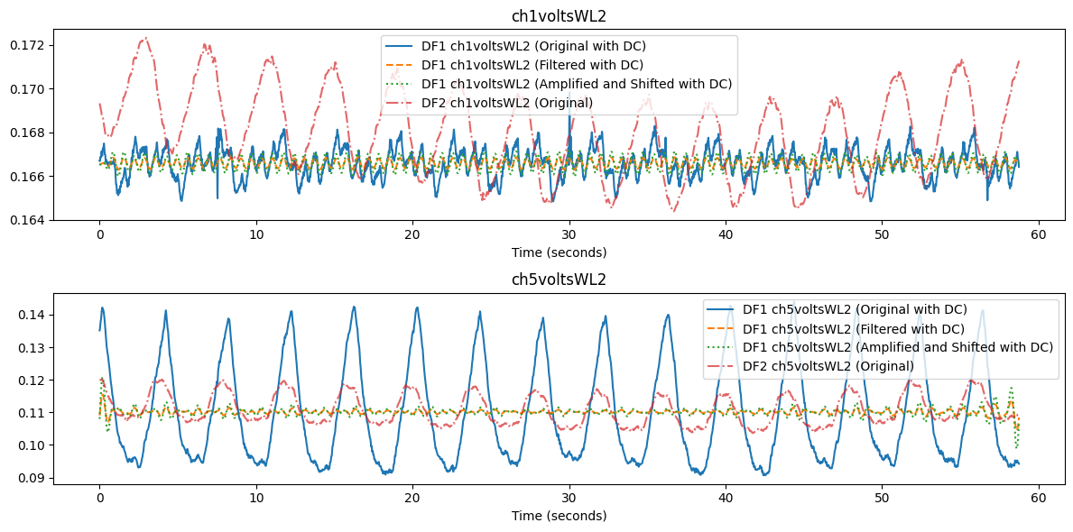
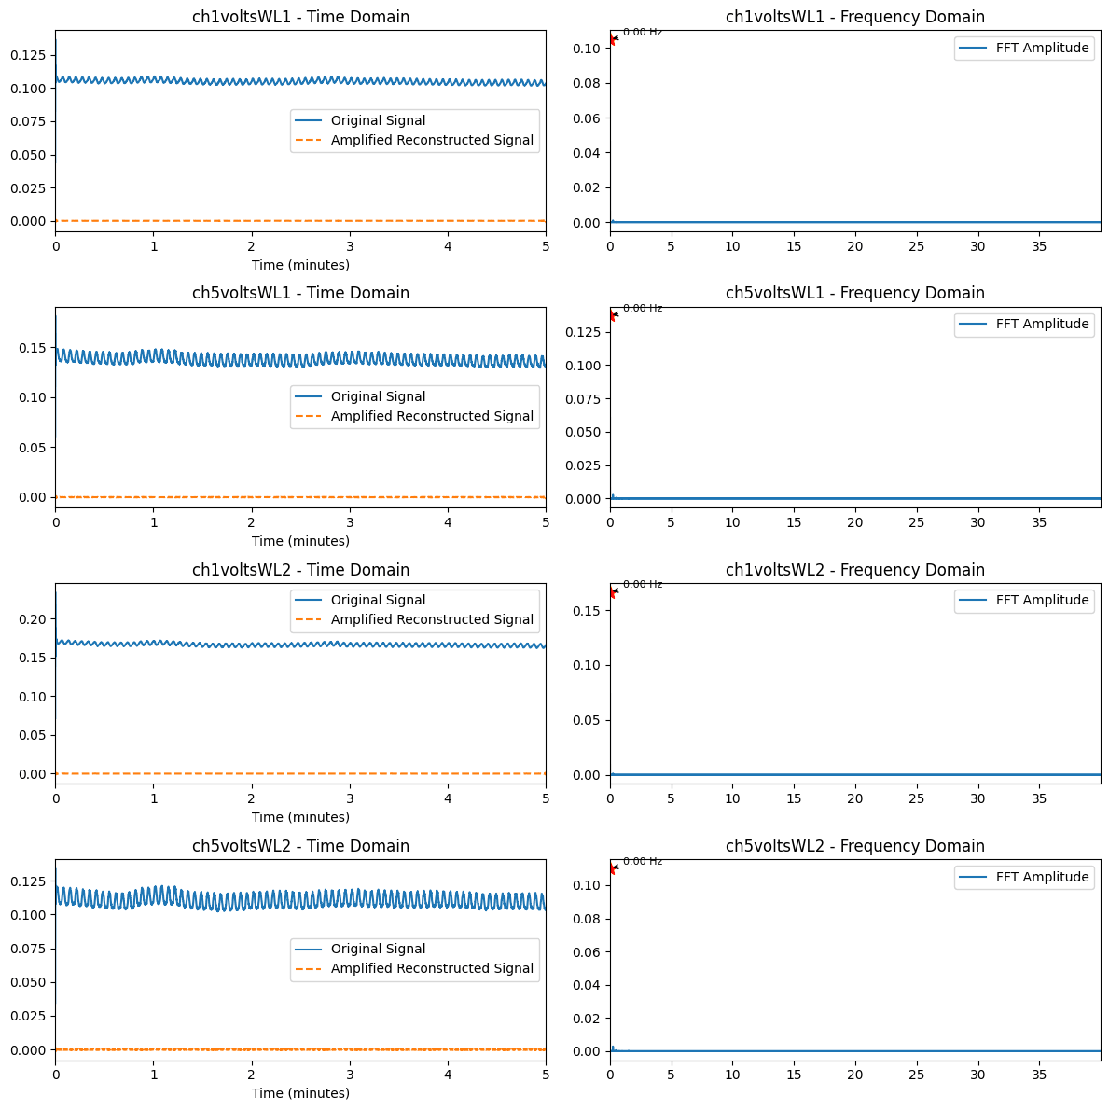
Results of filtering using original data (DF2)
1) DF1 and DF2 are actually signals collected at different times so their AC amplitude parts are different.
2) The AC raw signal with DC is used for filtering. The sampling frequency is set for multiple searches, and the signals after filtering are 0.

Slide 4
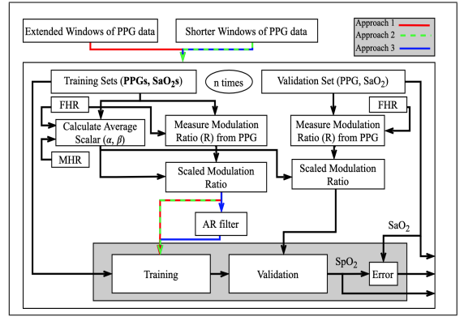

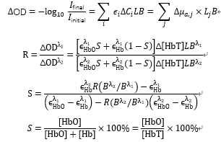

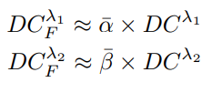
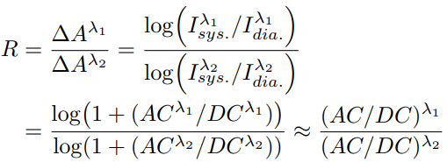

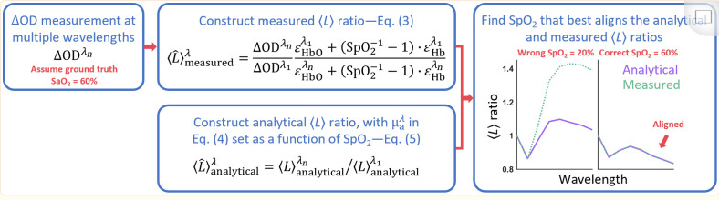

Calculation and correction of R and SpO2
Ref2:
Ref1:
1) Establish a training model and a process of fitting curve to continuously update parameters.
2) For the DC part of the baby signal, it can be approximated by the mom signal.
Reference: 1.Estimation of Fetal Blood Oxygen Saturation from Transabdominally Acquired Photoplethysmogram Waveforms.
2. Self-calibrated pulse oximetry algorithm based on photon pathlength change and the application in human freedivers.

