Slide 1
Sheep 7 Round 3
Lock-in frequencies:
850nm – 690Hz
Duty-cycle: 50%
Drive current:
850nm LED @ 500mA current
700mW peak optical power
High Passed data at 0.2Hz
Down sampled to 80hz
IQ demodulated from 690Hz
 | CH1 | CH2 | CH3 | CH4 | CH5
ADC PGA Gain | 1x | 8x | 8x | 2x | 2x

Slide 2
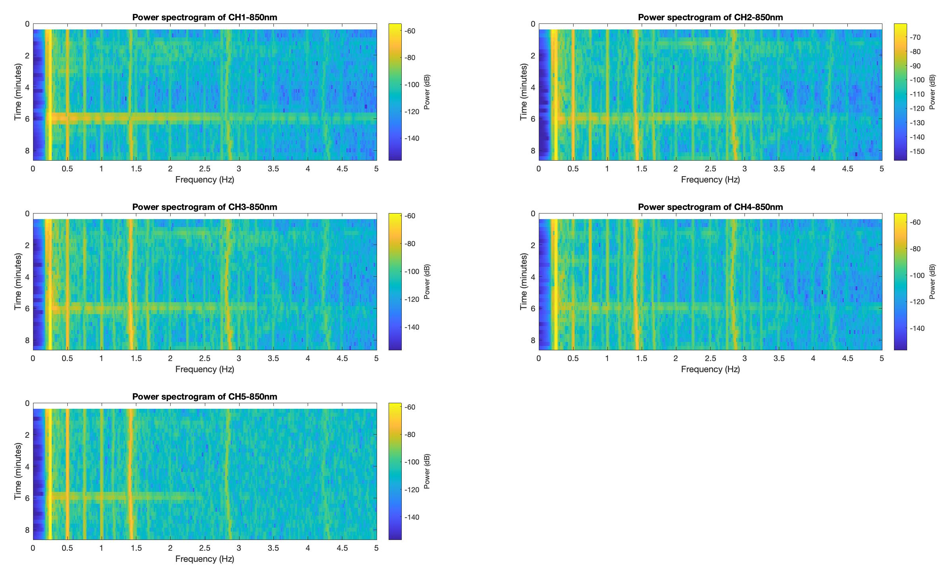
Round 3 starting 16:06:06 extracted 7-8 minutes Det 1&4
FHR
MHR
MHR
MHR
MHR
FHR
FHR

Slide 3
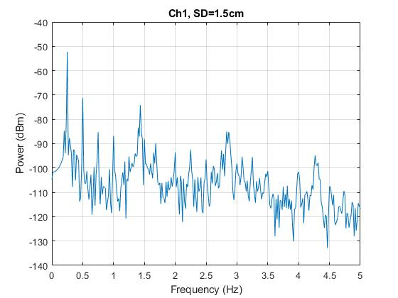
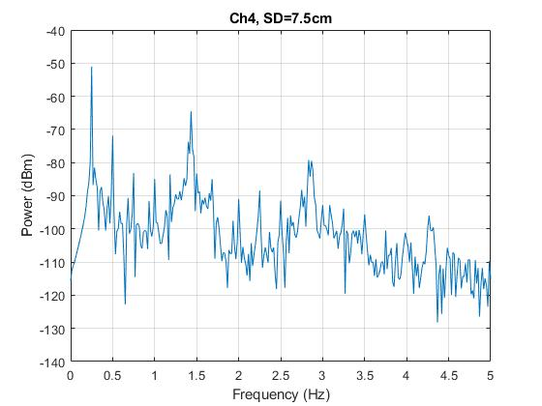
*: Mom signal
1.43
*
2.86
*
~2.86
*
Kourosh told me the fetal signal is mix with the harmonic terms of the respiration signal

