Slide 1
Sheep 8 Part 1
05/11/2023
RR | MHR (bpm) | MSpO2 (proximal) (%) | FHR (bpm) | FSaO2 (%)
15 | 121 | 97 | 130 | 28.4

Slide 2
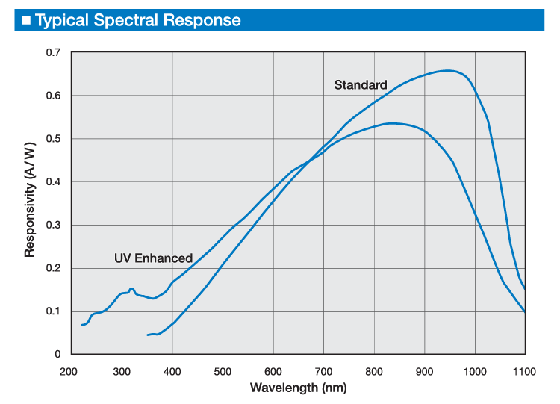
Optical Characteristics
Optical Characteristics:
Lock-in frequencies For LEDs:
740nm – 930Hz​ (50%)
850nm – 690Hz (50%)
Drive current for LEDs:
740nm – 500mA ​(266.67mW peak & 133.33mW average optical power)
850nm – 400mA​ (560mW peak & 280mW average optical power)
Detector Responsivity
 | CH1 | CH2 | CH3 | CH4 | CH5
Detector distance | 1.5 cm | 3 cm | 4.5 cm | 7 cm | 10 cm
Detector Area | 0.051 cm² | 0.051 cm² | 0.051 cm² | 1 cm² | 1 cm²

Slide 3
Electrical Characteristics
Down sampled to 80hz
IQ demodulated from 690Hz & 930Hz
 | CH1 | CH2 | CH3 | CH4 | CH5
TIA Gain | 10k | 100k | 1M | 10M | 100M
PGA Gain | 4x | 8x | 8x | 4x | 4x

Slide 4
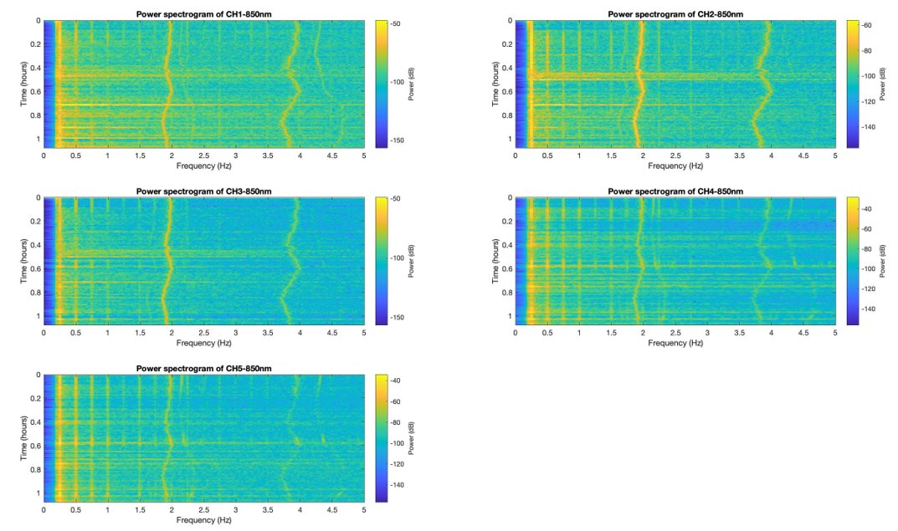
Part 1 - 1:06:57PM extracted 0-5 minutes Det 1&5
MHR
MHR
MHR
MHR
FHR
MHR
Fetal signal in Ch5(850nm)

