Slide 1
Sheep 8 part 3
Lock-in frequencies:
850nm – 690Hz
Duty-cycle: 50%
Drive current:
850nm – 300mA
420mW peak optical power
FSaO2 started at ~14% and dropped to ~10%.
No contractions observed.
High Passed data at 0.2Hz
Down sampled to 80hz
IQ demodulated from 690Hz
 | CH1 | CH2 | CH3 | CH4 | CH5
PGA Gain | 2x | 4x | 8x | 4x | 4x

Slide 2
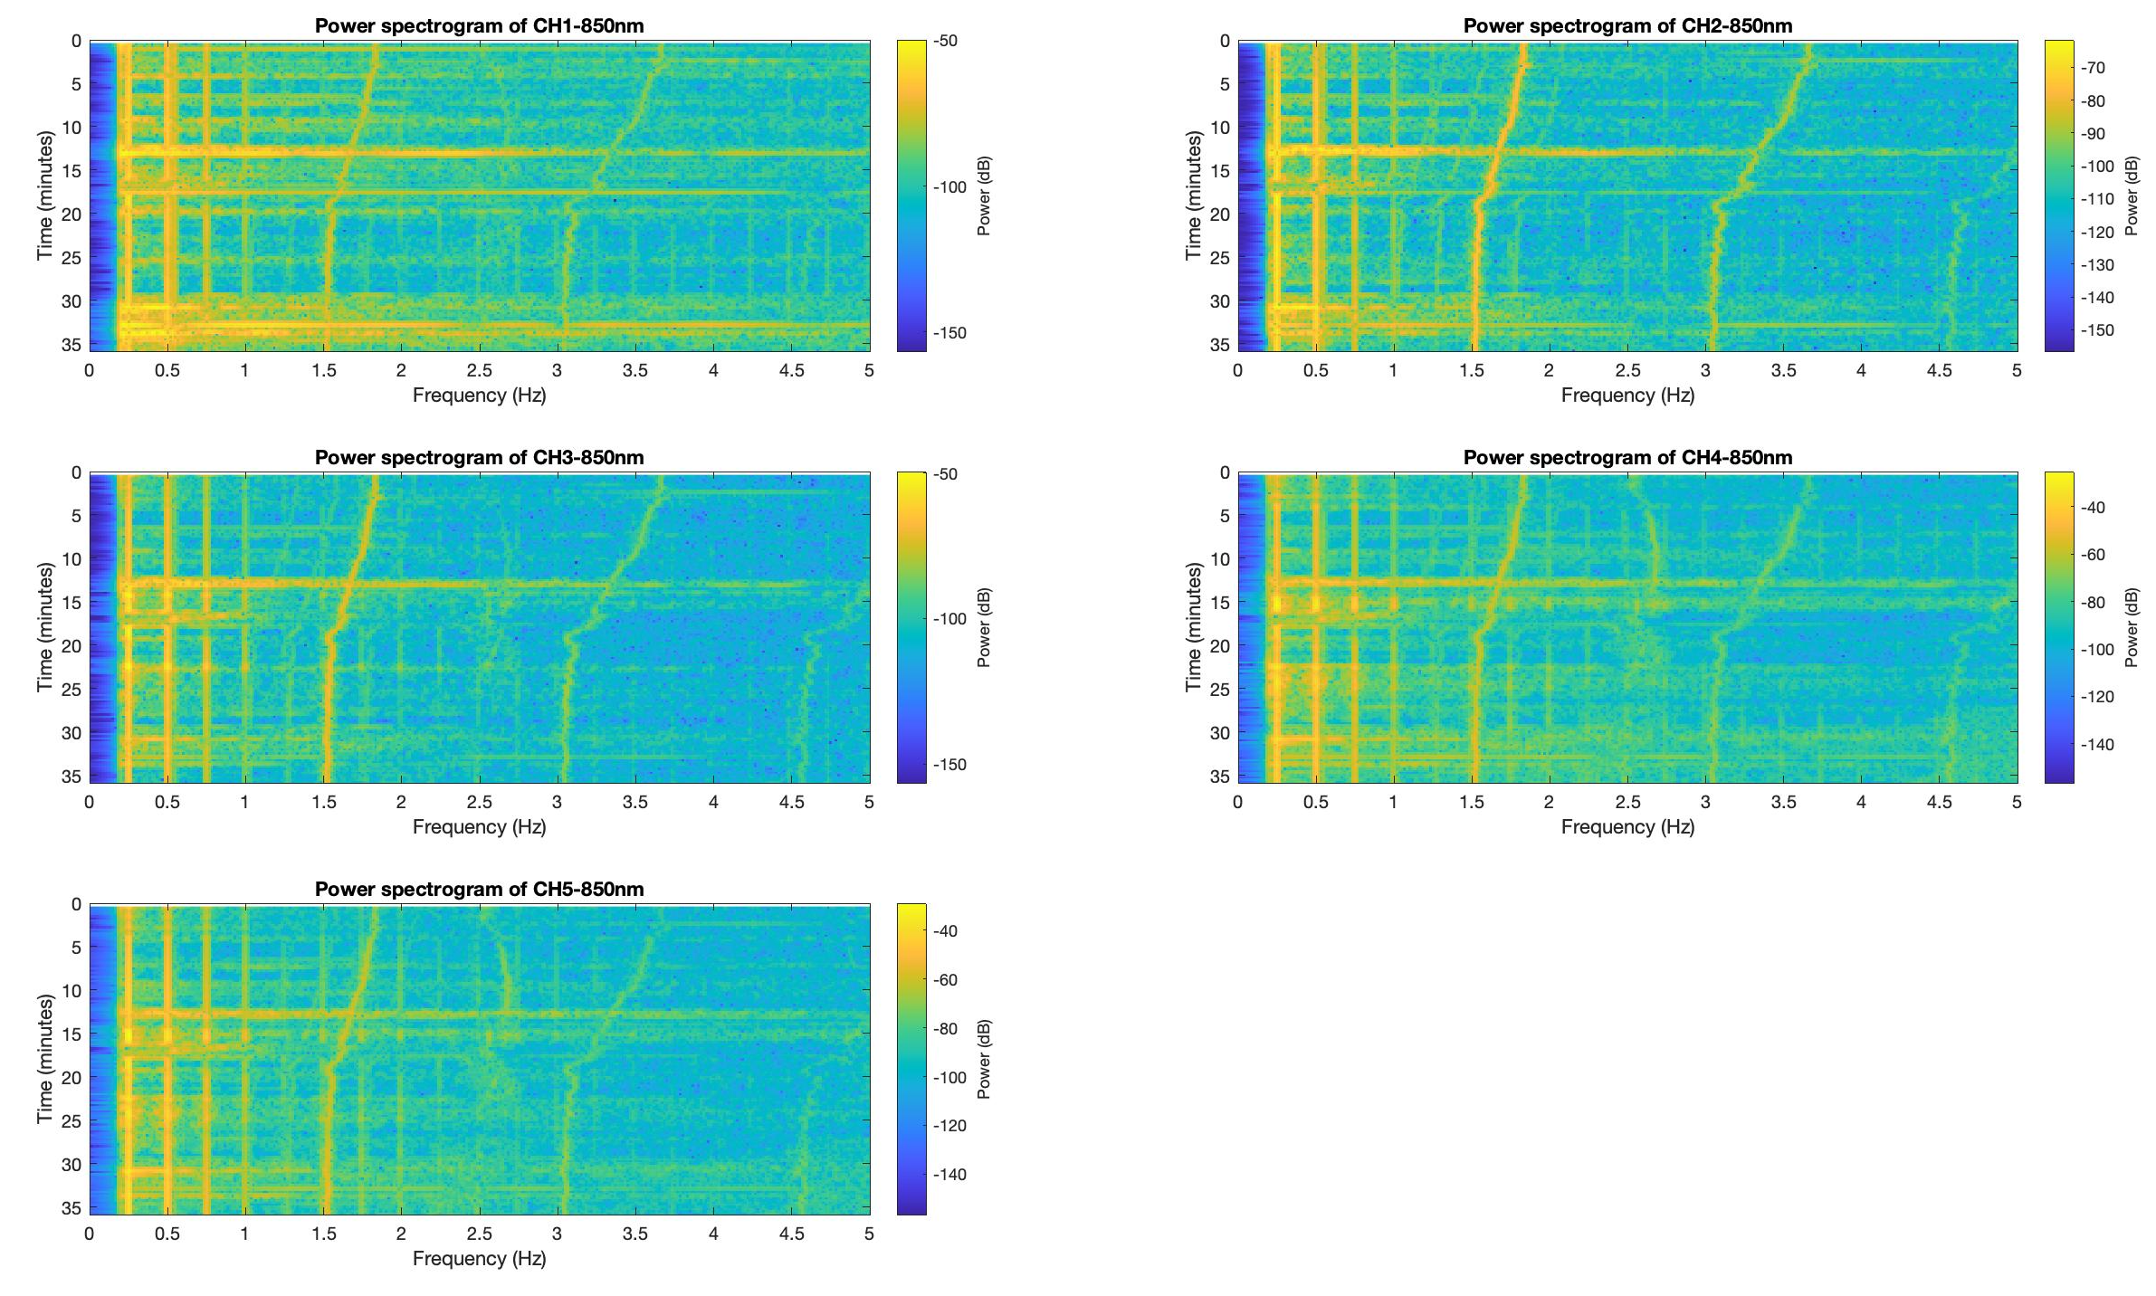
Part 3 starting 3:17:36PM extracted 6-7 minutes Det 1&4
MHR
MHR
MHR
FHR
MHR
FHR
MHR
FHR

Slide 3
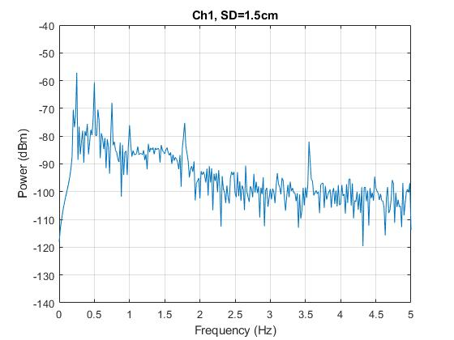
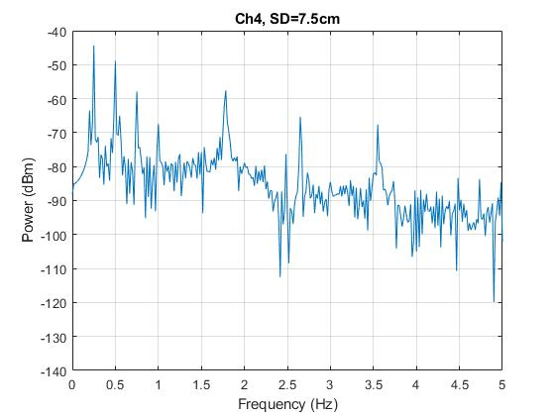
*: Mom signal
1.78
*
2.65
3.56
1.78
*
*
*

