Slide 1
Sheep 11 Round 2
Lock-in frequencies:
850nm – 690Hz
Duty-cycle: 50%
Drive current:
850nm – 400mA
560mW peak optical power
High Passed data at 0.2Hz
Down sampled to 80hz
IQ demodulated from 690Hz
 | CH1 | CH2 | CH3 | CH4 | CH5
PGA Gain | 1x | 2x | 2x | 1x | 2x

Slide 2
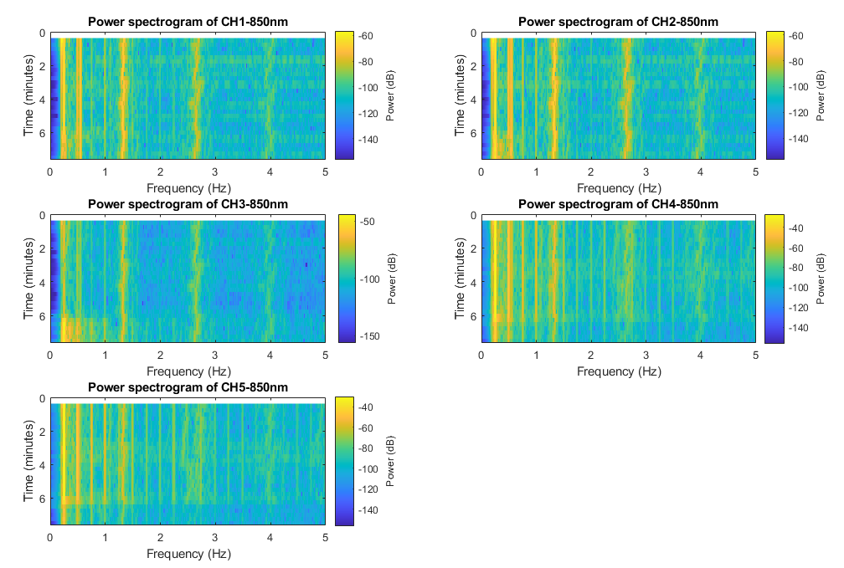
Round 1 starting 02:54:52 PM extracted 3-4 minutes Det 1&5
MHR
MHR
MHR
MHR
MHR
FHR

Slide 3
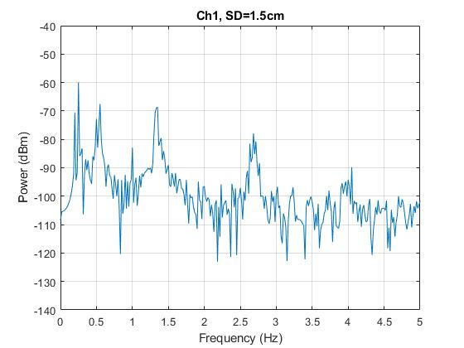
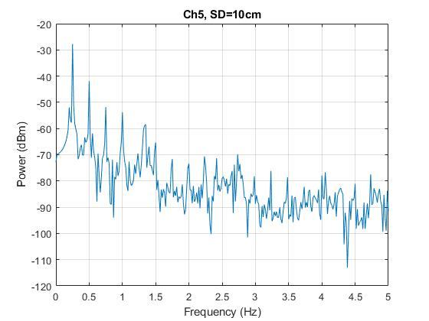
*: Mom signal
1.35
*
2.7
1.35
*
*
2.4
*

