Slide 1
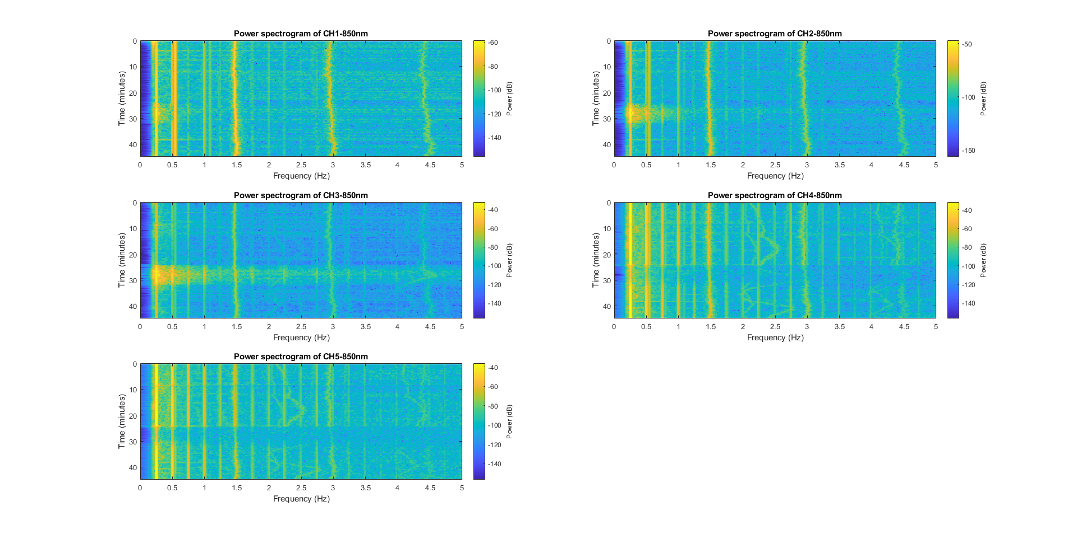
Round 1 starting 01:05:16 PM – 1:47:46 PM (42 minutes)
MHR
MHR
MHR
FHR
MHR
FHR
MHR
FHR

Slide 2
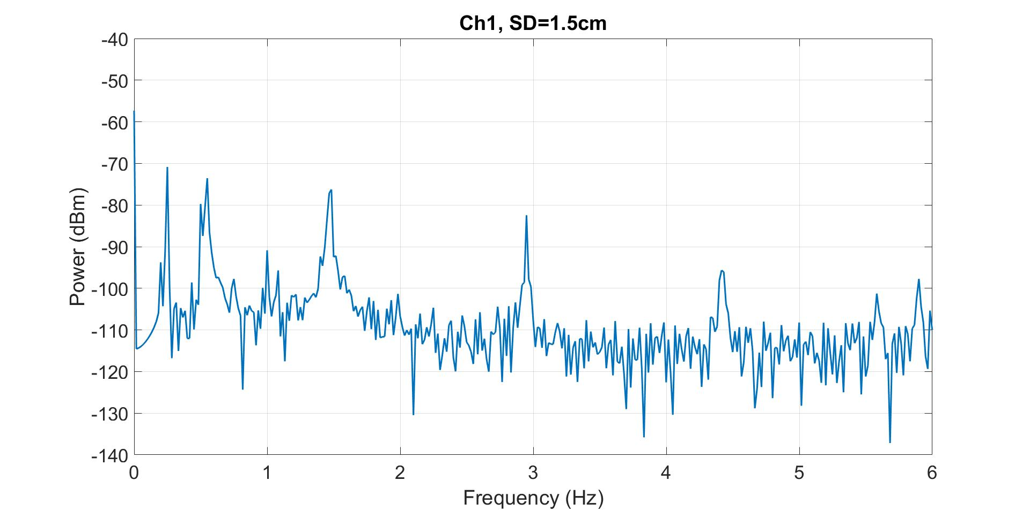
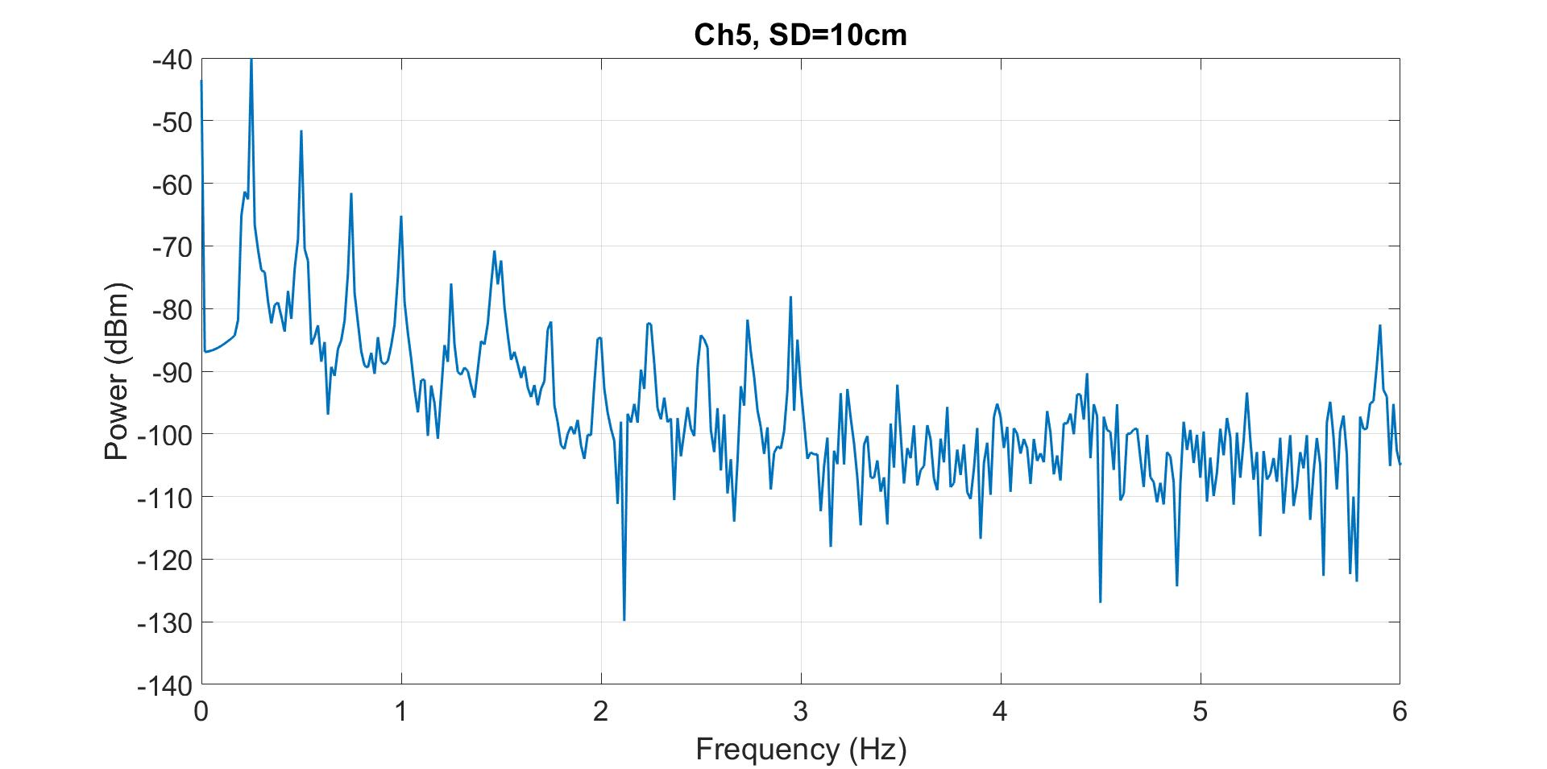
1.48
1.48
2.96
2.96
*
2.24
*
*
2.5
*
*
*
Here there seems to be two fetus signal present on channel 5 (furthest detector). I extracted 17-18 minute from the spectrogram plot.

