Slide 1

High-performance queues / with beanstalkd
By Skylar Kelty
Notes:
V1.0
To change the footer on every slide:
1. On the menu go to Insert > Header and Footer…
2. Select the Footer checkbox and enter the footer text in the accompanying text box
3. Click “Apply to All”

Slide 2
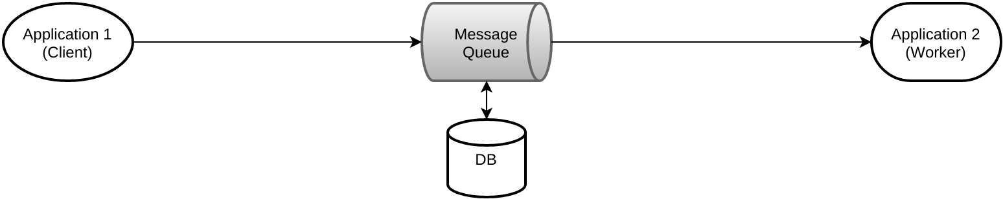
What is a message queue?
A message queue is a FIFO list of strings sent between applications.

Slide 3
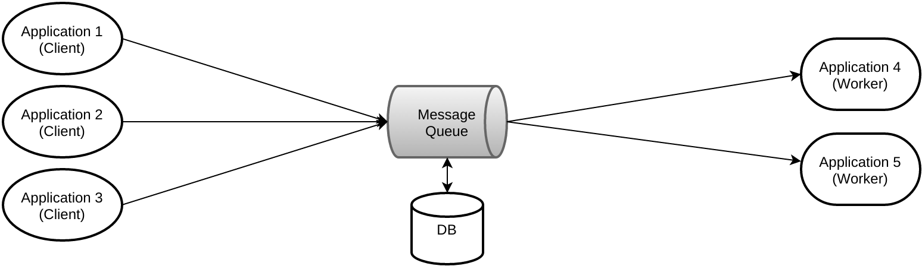
Why message queues?
Decoupling: Cleaner code, fewer bugs
Redundancy/Elasticity: scale workers!
Resilience: Worker bugs don't affect the user

Slide 4
Why beanstalkd?
Simple & lightweight
Fast – 5ms trip from client to worker
Simple REST API
Great PHP library (Pheanstalk)

Slide 5
Use case: Moodle and Turnitin
Problem – Turnitin submissions causing significant load due to lengthy thread lockups
Solution – Move submissions to backend queue, freeing up frontend workers
How – Pheanstalk/Daemons/Adhoc queue

Slide 6
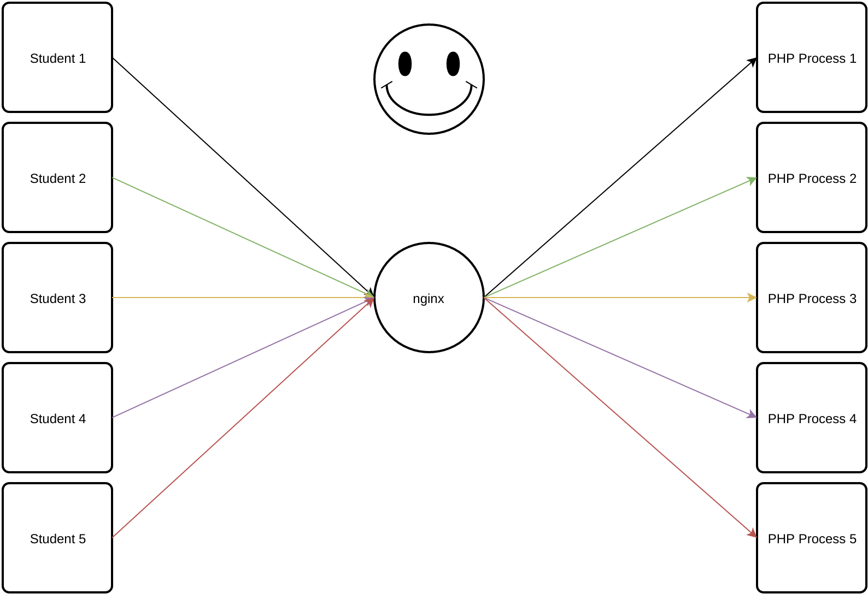
We have more requests than PHP processes

Slide 7
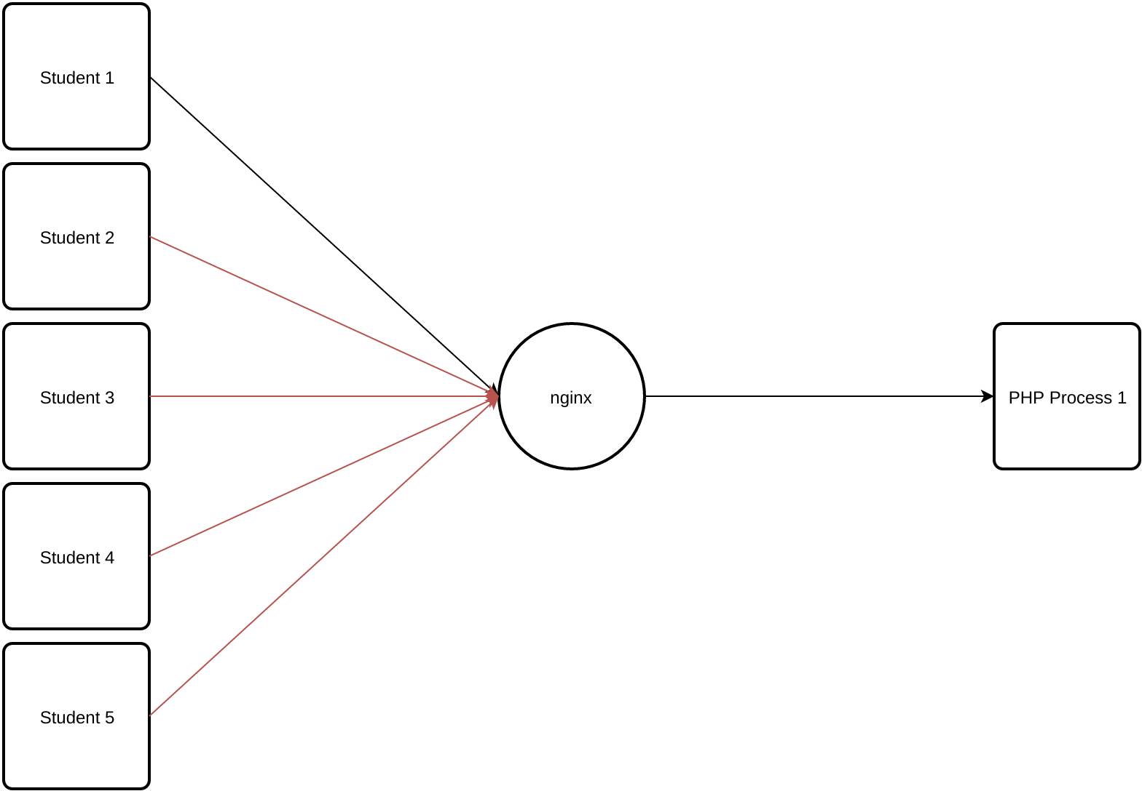
We have more requests than PHP processes

Slide 8
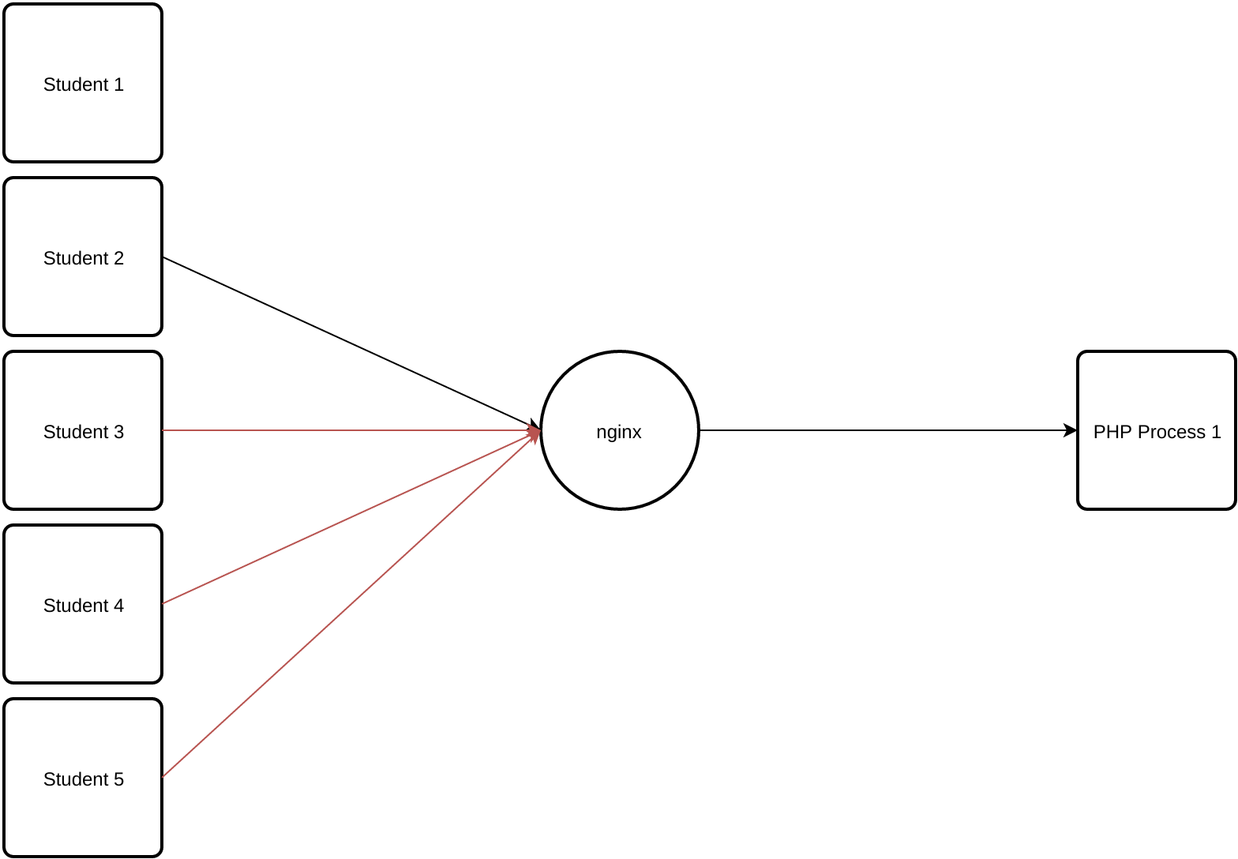
We have more requests than PHP processes

Slide 9
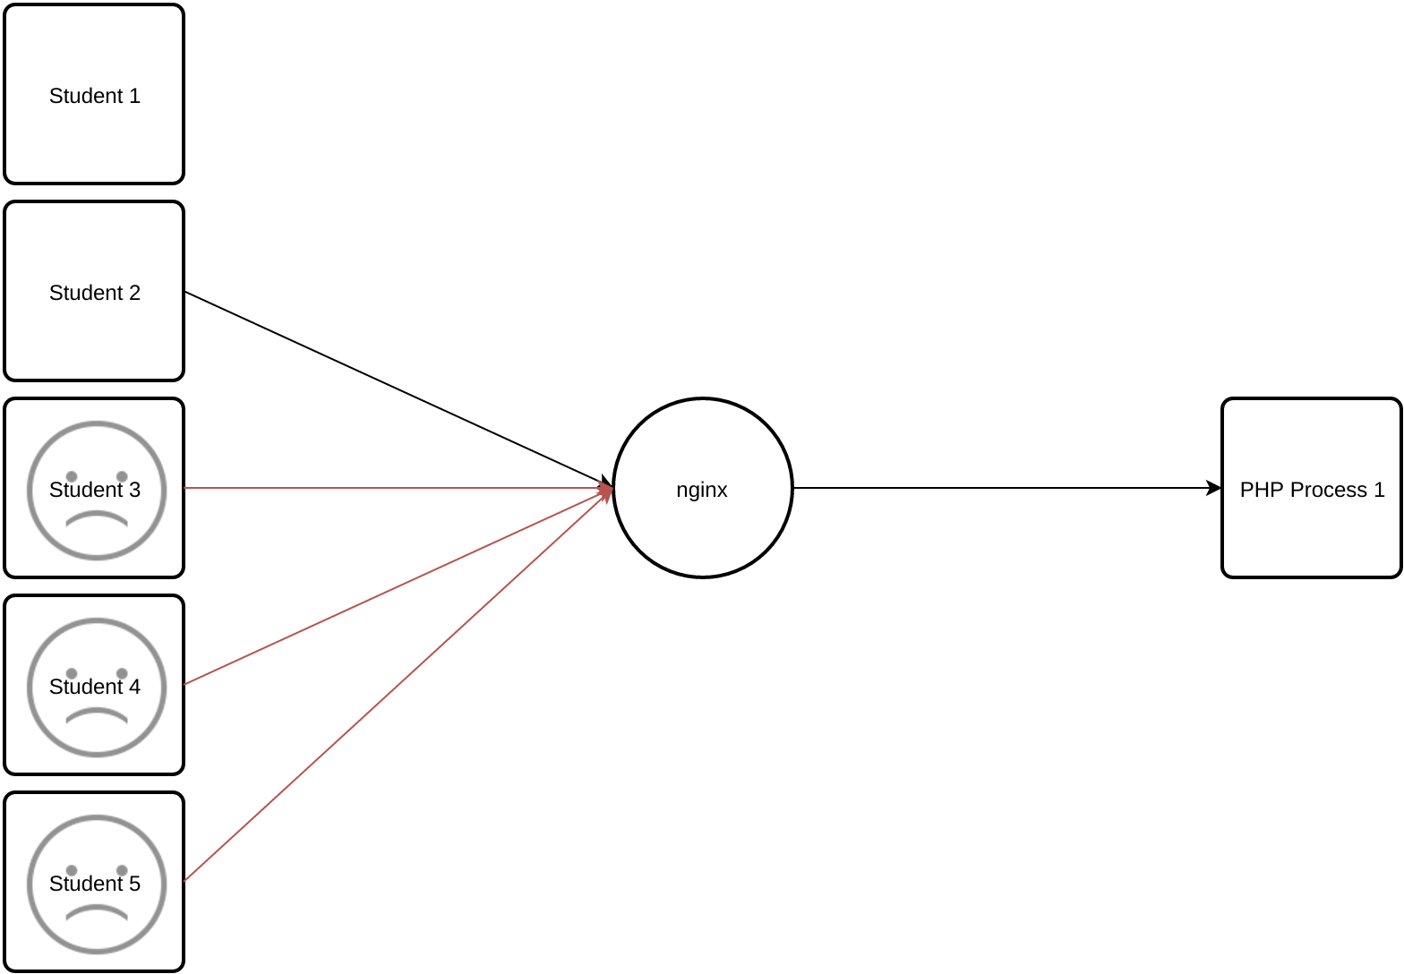
What happens if one request hangs?

Slide 10
Student 2 doesn't care about the result anyway
Why not work on it later?
Just add a note to do what they asked for, then return
Leaving the thread free again!
Message queues.

Slide 11
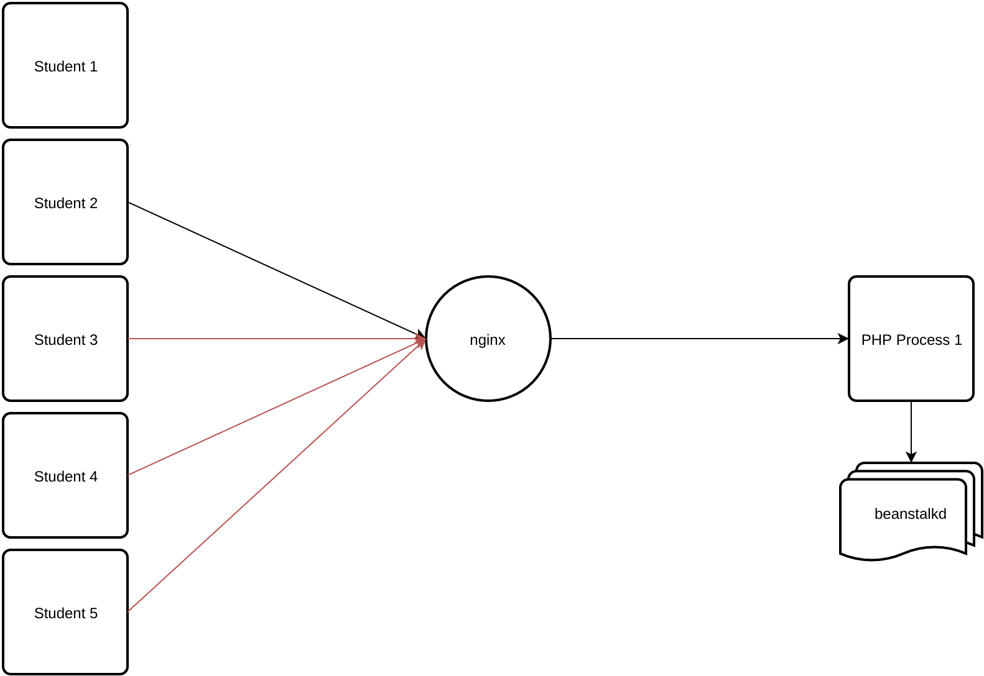
Send it to the queue!

Slide 12
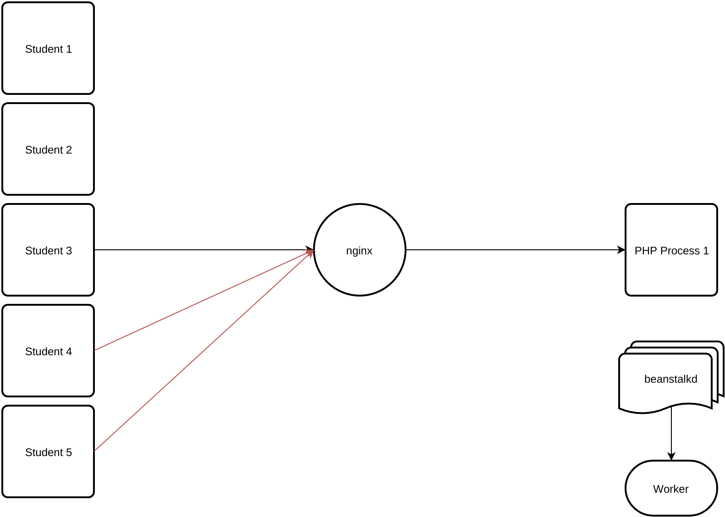
Send it to the queue!

Slide 13
Notes:
This

