Slide 1
Robot Stacking
Skyler Gentner

Slide 2
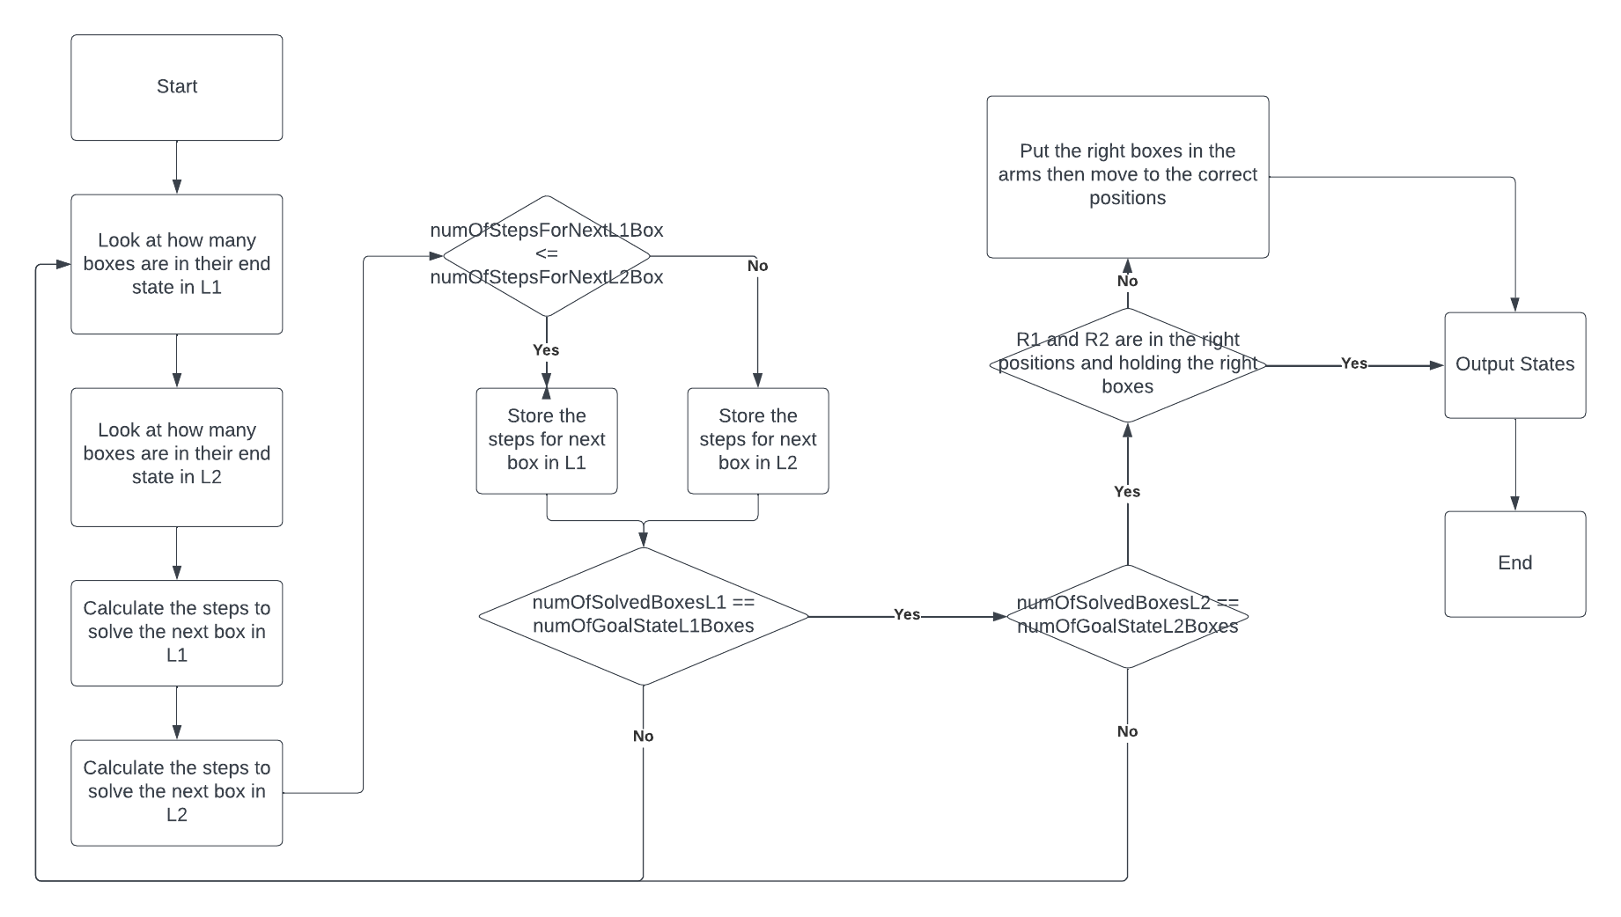
AI Flowchart

