Slide 1
Relational Algebra

Slide 2
Relational Algebra
Relational Algebra is a procedural data manipulation language (DML).
It specifies operations on relations to define new relations:
Unary Relational Operations: Select, Project
Operations from Set Theory: Union, Intersection, Difference,
Cartesian Product
Binary Relational Operations: Join, Divide.

Slide 3
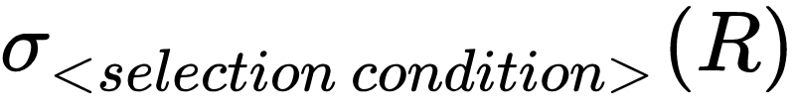
SELECT
The SELECT operation is used to choose a subset of the tuples (rows) from a relation that satisfies a selection condition, denoted by:
The Boolean expression specified in <selection condition> is made up of a number of selection clauses of the form
<attribute name> <comparison op> <constant value>
or
<attribute name> <comparison op> <attribute name>
<comparison op> is normally one of the comparison operators {=, <, ≤, >, ≥, ≠}
Selection clauses can be connected by the standard Boolean operators and, or, and not to form a general selection condition.

Slide 4
STUDENT:
RESEARCHER:
Person# | Name​
1​ | Dr C.C.Chen​
3 | Ms K.Juliff
4 | Ms J.Gledill
5 | Ms B.K.Lee
Person# | Name
1 | Dr C.C.Chen
2 | Dr R.G.Wilkinson
COURSE:
Department | Degree
Psychology | Ph.D.​​
Comp.Sci. | Ph.D.
Comp.Sci. | M.Sc.
Psychology | M.Sc.
ENROLMENT:
Enrolment# | Supervisee | Supervisor | Department | Degree
1 | 1 | 2 | Psychology | Ph.D.
2 | 3 | 1 | Comp.Sci. | Ph.D.
3 | 4 | 1 | Comp.Sci. | M.Sc.
4 | 5 | 1 | Comp.Sci. | M.Sc.

Slide 5
ENROLMENT:
Enrolment# | Supervisee | Supervisor | Department | Degree
1 | 1 | 2 | Psychology | Ph.D.
2 | 3 | 1 | Comp.Sci. | Ph.D.
3 | 4 | 1 | Comp.Sci. | M.Sc.
4 | 5 | 1 | Comp.Sci. | M.Sc.
Q: Select the enrolment records for the students whose supervisor is Person 1
Enrolment# | Supervisee | Supervisor | Department | Degree
2 | 3 | 1 | Comp.Sci | Ph.D.
3 | 4 | 1 | Comp.Sci | M.Sc.
4 | 5 | 1 | Comp.Sci | M.Sc.

Slide 6
ENROLMENT:
Enrolment# | Supervisee | Supervisor | Department | Degree
1 | 1 | 2 | Psychology | Ph.D.
2 | 3 | 1 | Comp.Sci. | Ph.D.
3 | 4 | 1 | Comp.Sci. | M.Sc.
4 | 5 | 1 | Comp.Sci. | M.Sc.
Q: Select the enrolment records for Person 1's non-Ph.D. students
Enrolment# | Supervisee | Supervisor | Department | Degree
3 | 4 | 1 | Comp.Sci | M.Sc.
4 | 5 | 1 | Comp.Sci | M.Sc.

Slide 7
Properties of SELECT
• Commutative:
σ _{<cond1>} (σ _{<cond2>} (R)) = σ _{<cond2>} (σ _{<cond1>} (R))
• Consecutive selects can be combined:
σ _{<cond1>} (σ _{<cond2>} (R)) = σ _{<cond1> AND <cond2>} (R))

Slide 8
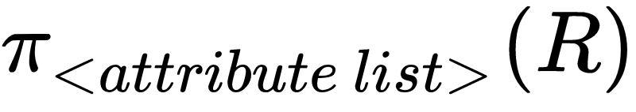
PROJECT
The PROJECT operation is used to project a subset of the attributes (column) of a relation, denoted by:
The result of the PROJECT operation has only the attributes specified in <attribute list> in the same order as they appear in the list. Hence, it's degree is equal to the number of attributes in <attribute list>.
The PROJECT operation removes any duplicate tuples, so the result of the PORJECT operation is a set of distinct tuples, and this is known as duplicate elimination.

Slide 9
ENROLMENT:
Enrolment# | Supervisee | Supervisor | Department | Degree
1 | 1 | 2 | Psychology | Ph.D.
2 | 3 | 1 | Comp.Sci. | Ph.D.
3 | 4 | 1 | Comp.Sci. | M.Sc.
4 | 5 | 1 | Comp.Sci. | M.Sc.
Q: Find departments and degree requirements for the courses that students enroll.
Department | Degree
Psychology | Ph.D.
Comp.Sci | Ph.D.
Comp.Sci | M.Sc.

Slide 10
Properties of PROJECT
• if <list2> contains all the attributes in <list1> then
π _{<list1>} (π _{<list2>} (R)) = π _{<list1>} (R)
else
The operation is not well defined.
• commutes with selection:
π_{X} (σ_{B}(R)) = σ_{B} (π_{X}(R)) (?)
Check the example below:
Commutes follows if and only if the attribute names used in SELECT is a subset of the attribute list in PROJECT
Degree
Ph.D.
=
Error as SELECT cannot find Degree
=

Slide 11
Questions:
1) π (R U S)) = π (R) U π (S)?
2) π (R ∩ S)) = π (R) ∩ π (S)?
Answer:
2) π (R ∩ S)) ≠ π (R) ∩ π (S)
Example:
R = (Animal, Cat), S = (Animal, Dog)
π: project on the first column
π (R ∩ S)) = {}
π (R) ∩ π (S) = {Animal}

Slide 12

UNION
UNION is a relation that includes all tuples that are either in the left relation or in the right relation or in both relations, denoted by
Note: Union requires R and S to be union compatible:
that there is a 1-1 correspondence between their attributes,
in which corresponding attributes are over the same domain

Slide 13
Example:
R1 ← σ _{(Supervisor=2)} (ENROLMENT)
R2 ← σ _{(Name='M.Sc')} (ENROLMENT)
R1 ∪ R2 =
Example: STUDENT ∪ RESEARCHER =
Enrolment# | Supervisee | Supervisor | Department | Name
1 | 1 | 2 | Psych. | Ph.D.
3 | 4 | 1 | Comp.Sci | M.Sc
4 | 5 | 1 | Comp.Sci | M.Sc
Person# | Name
1 | Dr C.C.Chen
3 | Ms K.Juliff
4 | Ms J.Gledhill
5 | Ms B.K.Lee
2 | Dr R.G.Wilkinson

Slide 14
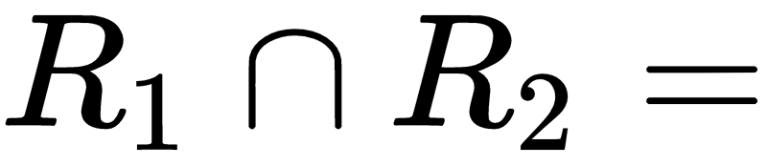
INTERSECTION
INTERSECTION is a relation that includes all tuples that are in both relations, denoted by
Example:
Enrolment# | Supervisee | Supervisor | Department | Name
2 | 3 | 1 | Comp.Sci. | Ph.D.

Slide 15
STUDENT:
RESEARCHER:
Person# | Name​
1​ | Dr C.C.Chen​
3 | Ms K.Juliff
4 | Ms J.Gledill
5 | Ms B.K.Lee
Person# | Name
1 | Dr C.C.Chen
2 | Dr R.G.Wilkinson
Example: STUDENT ∩ RESEARCHER =
Person# | Name
1 | Dr C.C. Chen

Slide 16
DIFFERENCE
SET DIFFERENCE is a relation that includes all tuples that are in the left relation but not in the right relation, denoted by
Example: STUDENT – RESEARCHRER =
Person# | Name
3 | Ms K. Juliff
4 | Ms J. Gledhill
5 | Ms B.K. Lee

Slide 17

CARTESIAN PRODUCT
Where indicates the concatenation of tuples.
Example: STUDENT X RESEARCHRER =
E’ment# | S’ee | S’or | D’ment | Degree | Person# | Name
1 | 1 | 2 | Psych. | Ph.D. | 1 | Dr C.C. Chen
1 | 1 | 2 | Psych. | Ph.D. | 2 | Dr R.G.Wilkinson
2 | 3 | 1 | Comp.Sci | Ph.D. | 1 | Dr C.C. Chen
2 | 3 | 1 | Comp.Sci | Ph.D. | 2 | Dr R.G.Wilkinson
3 | 4 | 1 | Comp.Sci | M.Sc. | 1 | Dr C.C. Chen
3 | 4 | 1 | Comp.Sci | M.Sc. | 2 | Dr R.G.Wilkinson
4 | 5 | 1 | Comp.Sci | M.Sc. | 1 | Dr C.C. Chen
4 | 5 | 1 | Comp.Sci | M.Sc. | 2 | Dr R.G.Wilkinson

Slide 18
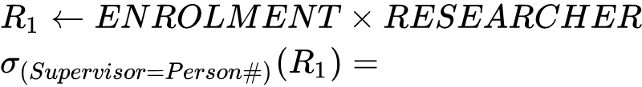
More useful is:
E’ment# | S’ee | S’or | D’ment | E’ment. Name | Person# | R’cher. Name
1 | 1 | 2 | Psych. | Ph.D. | 2 | Dr R.G.Wilkinson
2 | 3 | 1 | Comp.Sci. | Ph.D. | 1 | Dr C.C. Chen
3 | 4 | 1 | Comp.Sci. | M.Sc. | 1 | Dr C.C. Chen
4 | 5 | 1 | Comp.Sci. | M.Sc. | 1 | Dr C.C. Chen

Slide 19
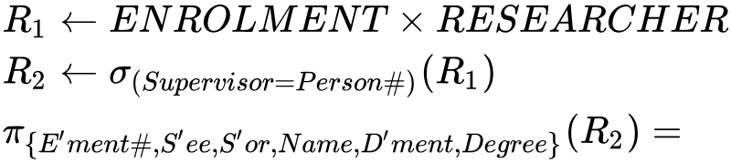
Or even better:
E’ment# | S’ee | S’or | Name | D’ment | Degree
1 | 1 | 2 | Dr R.G.Wilkinson | Psych. | Ph.D.
2 | 3 | 1 | Dr C.C. Chen | Comp.Sci. | Ph.D.
3 | 4 | 1 | Dr C.C. Chen | Comp.Sci. | M.Sc.
4 | 5 | 1 | Dr C.C. Chen | Comp.Sci. | M.Sc.
The last of these is also known as natural join, the next to last is equi-join.

Slide 20
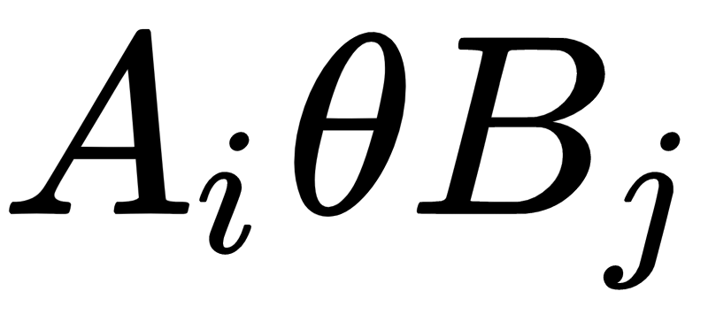



JOIN
JOIN is used to combine related tuples from two relations into single "longer" tuples.
Theta-join
A general join condition is of the form:
<condition> AND <condition> AND … AND <condition>
where each condition is of the form , in which is an attribute of R, is an attribute of S, and have the same domain, and is a comparison operator. A JOIN operation with such a general join condition is called a THETA JOIN.

Slide 21
JOIN: Equi-join
EQUI-JOIN is a theta-join where the only comparison operator used is “=”.
Example:
$$ENROLMENT⋈_{(Supervisor=Person\#)}RESEARCHER$$

Slide 22
JOIN: Natural join
NATURAL JOIN is an equi-join which requires that the two join attributes (or each pair of join attributes) have the same name in both relations.
Example:
Question: If two relations have no join attributes, how do you define the join result? Why?
$$ENROLMENT⋈_{\left(Supervisor\right),(Person\#)}RESEARCHER$$
R (A, B) ⋈ S (B, C) ⋈ T (C, D)

Slide 23

Notes:
1. In a natural join, there may be several pairs of
join attributes.
Example:
Calculate
$$ENROLMENT⋈_{\left(Department,Name\right),(Department,Name)}COURSE$$
2. If the pairs of joining attributes are exactly those that are identically named, we can write
ENROLMENT⋈COURSE
COURSE
Department | Name | By
Comp.Sci | Ph.D. | Research
Comp.Sci. | M.Sc. | Research
Psychology | M.Sc. | Coursework

Slide 24
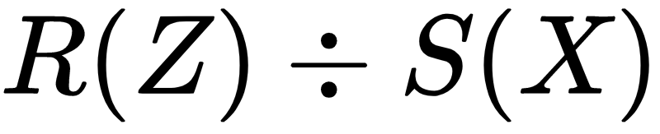

DIVIDE
The DIVISION operation is applied to two Relations
Where the attributes of R are a subset of the attributes of S.
Let Y be the set of attributes of R that are not attributes of S
Example:
X = {B}, Z = {A, B}
and Y = Z - X = {A}
R
A | B
a₁ | b₁
a₁ | b₂
a₂ | b₁
a₃ | b₂
a₄ | b₁
a₅ | b₁
a₅ | b₂
S
B
b₁
b₂

Slide 25
DIVIDE
DIVISION is a relation T(Y) that includes a tuple t if tuples tR appear in R with tR[Y] = t, and with tR[X] = tS for every tuple tS in S.
R ÷ S = {t : t × S ⊆ R }
Example:
X = {B}, Z = {A, B}, Y = {A}
tR[X] = tS = {b1, b2}
In R, there are two satisfied tR pairs:
{a1b1, a1b2} and {a5b1, a5b2}
So t = tR[Y] = {a1, a5}
R
A | B
a₁ | b₁
a₁ | b₂
a₂ | b₁
a₃ | b₂
a₄ | b₁
a₅ | b₁
a₅ | b₂
S
B
b₁
b₂
T
A
a₁
a₅

Slide 26
DIVIDE
R
A | B
a₁ | b₁
a₁ | b₂
a₂ | b₁
a₃ | b₂
a₄ | b₁
a₅ | b₁
a₅ | b₂
S
B
b₁
b₂
T
A
a₁
a₅
=

Slide 27

DIVIDE
Typical use: which courses are offered by all departments?
Note: are sufficient to define all these operations: this is a relationally complete set of operators.

Slide 28
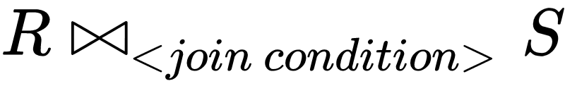



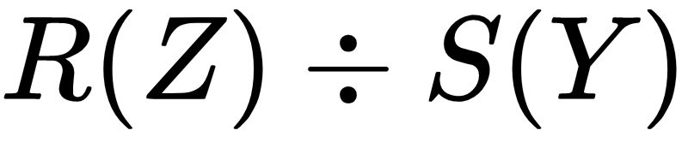
OPERATION | PURPOSE | NOTATION
SELECT | Selects all tuples that satisfy the selection condition from a relation R
PROJECT | Produces a new relation with only some of the attributes of R, and removes duplicate tuples.
THETA-JOIN | Produces all combinations of tuples from R and S that satisfy the join condition.
EQUI-JOIN | Produces all the combinations of tuples from R and S that satisfy a join condition with only equality comparisons.
NATURAL-JOIN | Same as EQUIJOIN except that the join attributes of S are not included in the resulting relation; if the join attributes have the same names, they do not have to be specified at all.
UNION | Produces a relation that includes all the tuples in R or S or both R and S; R and S must be union compatible.
INTERAECTION | Produces a relation that includes all the tuples in both R and S; R and S must be union compatible.
DIFFERENCE | Produces a relation that includes all the tuples in R that are not in S; R and S must be union compatible. | R - S
CARTESIAN PRODUCT | Produces a relation that has the attributes of R and S and includes as tuples all possible combinations of tuples from R and S.
DIVISION | Produces a relation T(X) that includes all tuples t[X] in R(Z) that appear in R in combination with every tuple from S(Y), where Z = X ∪ Y.

