Slide 1
Lecture 15: Cloud Computing
Modified from Mark Baker

Slide 2
What is Cloud Computing?
Cloud Computing is a general term used to describe a new class of network based computing that takes place over the Internet,
basically a step on from Utility Computing
a collection/group of integrated and networked hardware, software and Internet infrastructure (called a platform).
Using the Internet for communication and transport provides hardware, software and networking services to clients
These platforms hide the complexity and details of the underlying infrastructure from users and applications by providing very simple graphical interface or API (Applications Programming Interface).
2

Slide 3
What is Cloud Computing?
In addition, the platform provides on demand services, that are always on, anywhere, anytime and any place.
Pay for use and as needed, elastic
scale up and down in capacity and functionalities
The hardware and software services are available to
general public, enterprises, corporations and businesses markets
3

Slide 4
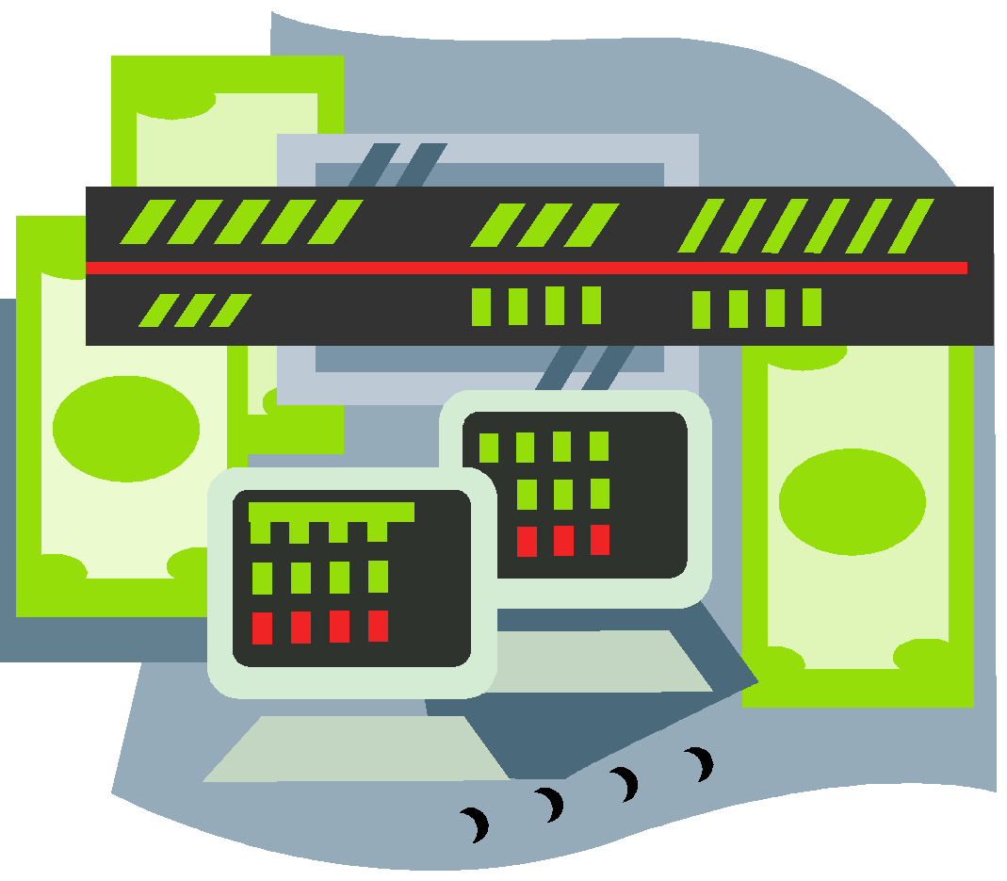
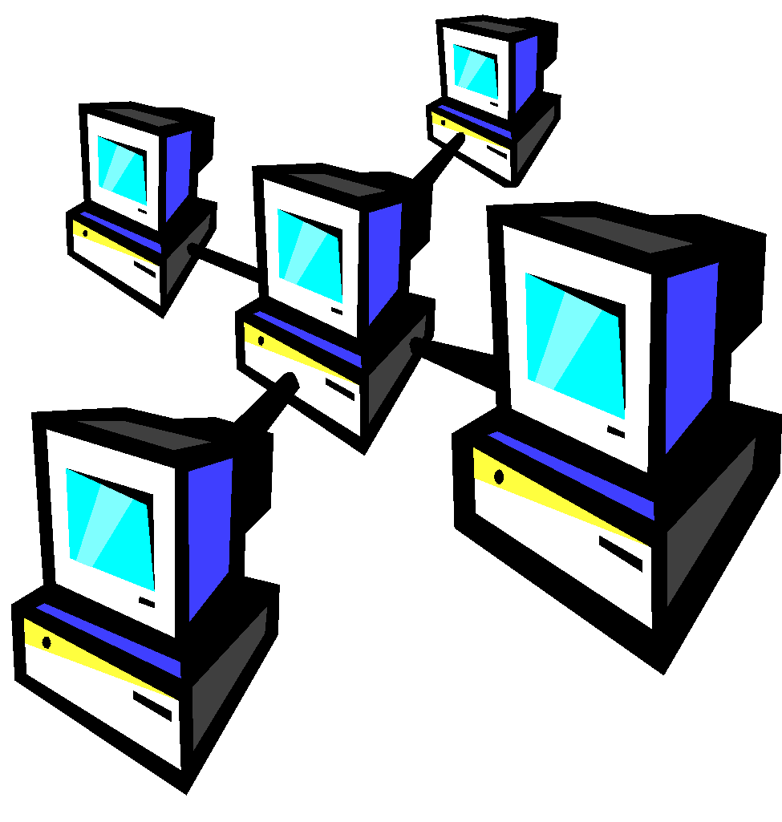
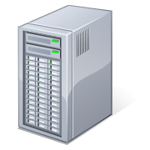
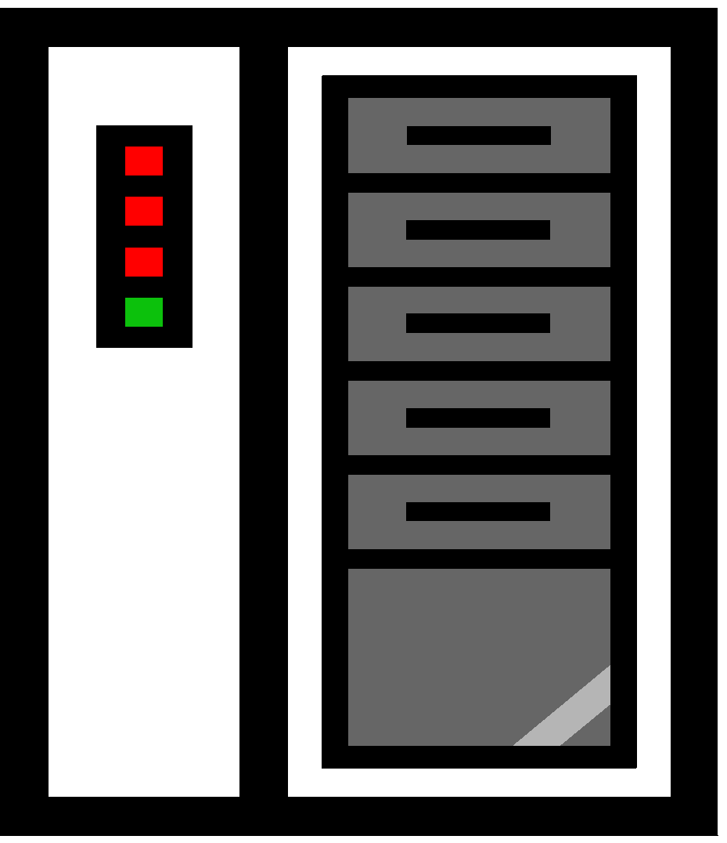
What is Cloud Computing
Shared pool of configurable computing resources
On-demand network access
Provisioned by the Service Provider
APPLICATIONS
SERVICES
COMPUTER NETWORK
STORAGE (DATABASE)
SERVERS
Adopted from: Effectively and Securely Using the Cloud Computing Paradigm by peter Mell, Tim Grance
4

Slide 5
Cloud Definition By NIST
The U.S. National Institute of Standards and Technology (NIST) deﬁnes cloud computing as:
Cloud computing is a model for enabling ubiquitous, convenient, on-demand network access to a shared pool of conﬁgurable computing resources (e.g., networks, servers, storage, applications, and services) that can be rapidly provisioned and released with minimal management effort or service provider interaction.

Slide 6
Cloud characteristics
Rapid elasticity
You can go from 5 servers to 50 or from 50 servers to 5
Measured service
You pay for what you use
On-demand self-service
You get elasticity automatically
Ubiquitous network access
You can access the cloud from anywhere
Location-independent resource pooling
You work with virtual machines that could be hosted anywhere
6

Slide 7
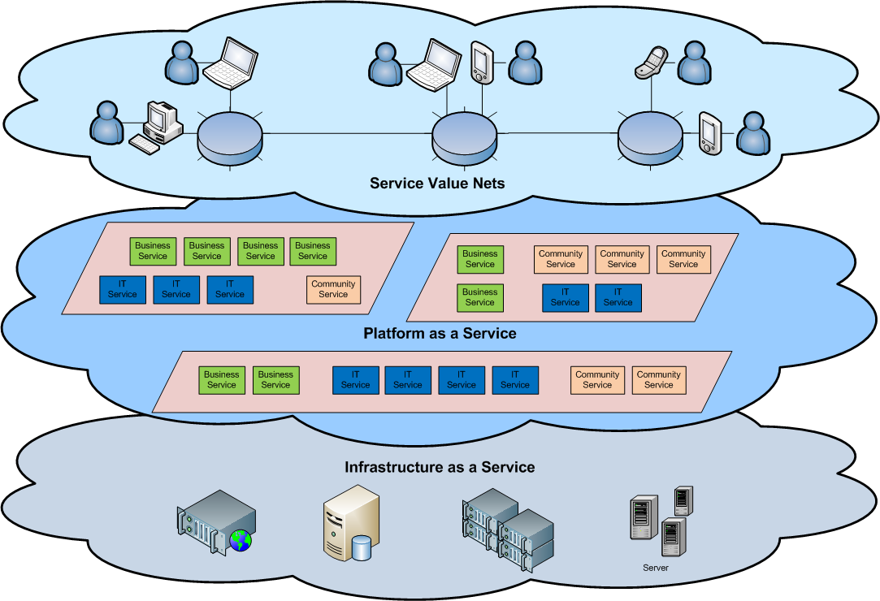
Cloud Architecture
7

Slide 8
CLOUD COMPONENTS
3 components
Clients
Datacenter
Distributed servers

Slide 9
CLOUD COMPONENTS
Clients
Mobile
SmartPhones, Tablets, Service Hubs
Thin
no internal hard drives, lets servers do all work, displays info
Thick
Laptops, desktop computers
Which is the best?
Thin - lower costs, security, power consumption, easy to replace, less noise

Slide 10
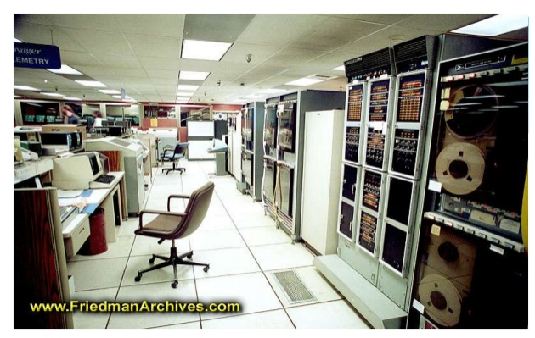
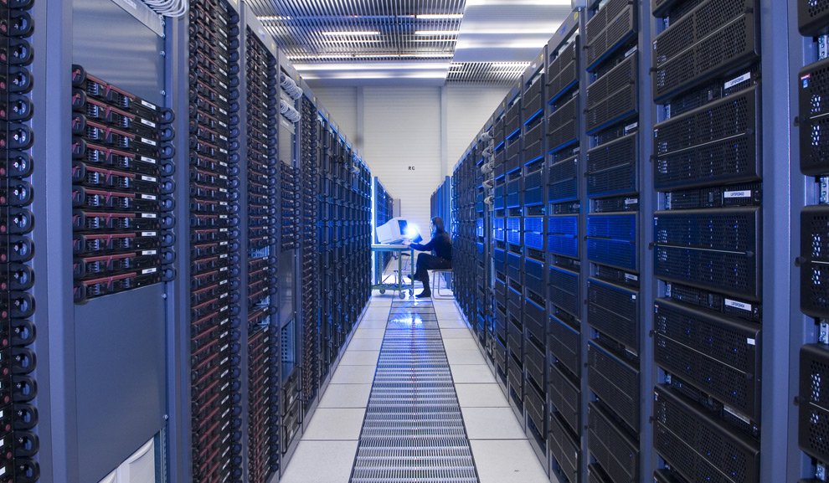
DATA CENTER
Data Center – facility used to house computer systems and associated components

Slide 11
DISTRIBUTED SERVERS
Servers host the resources needed by cloud users
Compute nodes
Provides CPU, Memory, Scratch Storage, and Networking resources through virtualized interfaces.
Hosts guest operating systems (Virtual Machines) using one or more VM hypervisors
Resource interface depends on the type of cloud (horizontal/vertical cloud)
Storage nodes
Compute nodes only provide temporary storage space for users/applications
Storage nodes provide long term data storage solutions
Can be mapped to specific processes running on compute nodes, users, interface applications, etc.
Administrative nodes
Provides “hidden” back-end services such as resource load balancing, administrative/resource databases, security/firewalls, cloud macromanagement

Slide 12
TYPES OF CLOUDS
Public Cloud
Marketed based on
Resources offered, availability, security, price
Local/Private Cloud
Cloud architectures tailored to an organization’s needs.
Hybrid Cloud
Combination of public and local cloud resources.

Slide 13
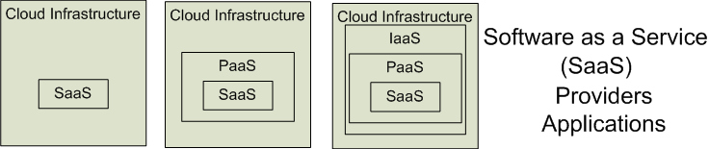

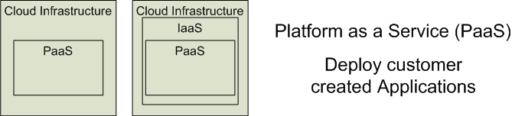

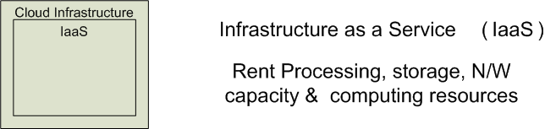


Cloud Service Models
Software as a Service (SaaS)
Platform as a Service (PaaS)
Infrastructure as a Service (IaaS)
SalesForce CRM
LotusLive
Google App Engine
Adopted from: Effectively and Securely Using the Cloud Computing Paradigm by peter Mell, Tim Grance
13

Slide 14
Different Cloud Computing Layers‏
MS Live/ExchangeLabs, IBM,
Google Apps; Salesforce.com
Quicken Online, Zoho, Cisco
Application Service
(SaaS)‏
Google App Engine, Mosso,
Force.com, Engine Yard,
Facebook, Heroku, AWS
Application Platform
Server Platform
3Tera, EC2, SliceHost,
GoGrid, RightScale, Linode
Storage Platform
Amazon S3, Dell, Apple, ...
14

Slide 15
Cloud services
Machines in the cloud
Can I move my VM elsewhere?
Storage in the cloud
Can I move my data elsewhere?
Databases in the cloud
Can I move my data elsewhere?
Applications in the cloud
Can I run my application elsewhere?

Slide 16
Cloud services
There are four basic things people are doing in the cloud:
Machines in the cloud
Storage in the cloud
Databases in the cloud
Applications in the cloud
In addition to these four basics, cloud providers offer other services such as message queues and data mining All of these things are lumped into the generic term “cloud computing”

Slide 17
Machines in the cloud
Many cloud providers allow you to create a Virtual Machine (VM) and deploy it in the cloud:
Your VM images are stored in cloud storage
You can create as many images as you need
You can automatically start and stop running instances of those images as needed
This is the simplest way to get started in the cloud, particularly if you’ve been using virtualization already

Slide 18
Storage in the cloud
Most cloud storage systems are designed as distributed, redundant systems
Your data are stored on more than one disk in more than one place
If one part of the system goes down, the rest of the system keeps going
“There should never be a single point of failure” is a stated design goal
But you can’t think of cloud storage as just another hard drive

Slide 19
Databases in the cloud
Cloud databases have similar design points Datasets are distributed for reliability
Some cloud databases support schemas, some don’t
Some cloud databases support joins, most don’t Some cloud databases are relational, almost all aren’t
Some cloud databases are transactional, some aren’t

Slide 20
Software as a Service (SaaS)
SaaS is a model of software deployment where an application is hosted as a service provided to customers across the Internet.
Saas soothes the load of software maintenance/support
but users quit control over software versions and requirements.
Terms that are used in this field include
Platform as a Service (PaaS) and
Infrastructure as a Service (IaaS)
20

Slide 21
Virtualization
Virtual workspaces:
An abstraction of an execution environment that can be made dynamically available to authorized clients by using well-defined protocols,
Resource quota (e.g. CPU, memory share),
Software configuration (e.g. O/S, provided services).
Implement on Virtual Machines (VMs):
Abstraction of a physical host machine,
Hypervisor intercepts and emulates instructions from VMs, and allows management of VMs,
VMWare, Xen, etc.
Provide infrastructure API:
Plug-ins to hardware/support structures
App
App
App
OS
OS
OS
Hypervisor
Hardware
Virtualized Stack

Slide 22
Virtual Machines
App
App
App
App
App
App
OS
OS
OS
Operating System
Hypervisor
Hardware
Hardware
Traditional Stack
Virtualized Stack

Slide 23
Virtualization in General
Advantages of virtual machines:
Run operating systems where the physical hardware is unavailable,
Easier to create new machines, backup machines, etc.,
Software testing using “clean” installs of operating systems and software,
Emulate more machines than are physically available,
Timeshare lightly loaded systems on one host,
Debug problems (suspend and resume the problem machine),
Easy migration of virtual machines (shutdown needed or not).
Run legacy systems!
23

Slide 24
What is the purpose and benefits?
Cloud computing enables companies and applications, which are system infrastructure dependent, to be infrastructure-less.
By using the Cloud infrastructure on “pay as used and on demand”, all of us can save in capital and operational investment!
Clients can:
Put their data on the platform instead of on their own desktop PCs and/or on their own servers.
They can put their applications on the cloud and use the servers within the cloud to do processing and data manipulations etc.
24

Slide 25



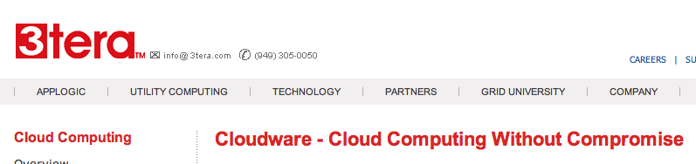

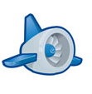

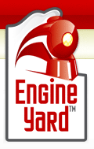


Some Commercial Cloud Offerings
25

Slide 26
Cloud Storage
Several large Web companies are now exploiting the fact that they have data storage capacity that can be hired out to others.
allows data stored remotely to be temporarily cached on desktop computers, mobile phones or other Internet-linked devices.
Amazon’s Elastic Compute Cloud (EC2) and Simple Storage Solution (S3) are well known examples
Mechanical Turk
26

Slide 27
Opportunities and Challenges
The use of the cloud provides a number of opportunities:
It enables services to be used without any understanding of their infrastructure.
Cloud computing works using economies of scale:
It potentially lowers the outlay expense for start up companies, as they would no longer need to buy their own software or servers.
Cost would be by on-demand pricing.
Vendors and Service providers claim costs by establishing an ongoing revenue stream.
Data and services are stored remotely but accessible from “anywhere”.
27

Slide 28
Opportunities and Challenges
In parallel there has been backlash against cloud computing:
Use of cloud computing means dependence on others and that could possibly limit flexibility and innovation:
The others are likely become the bigger Internet companies like Google and IBM, who may monopolise the market.
Security could prove to be a big issue:
It is still unclear how safe out-sourced data is and when using these services ownership of data is not always clear.
There are also issues relating to policy and access:
If your data is stored abroad whose policy do you adhere to?
What happens if the remote server goes down?
How will you then access files?
There have been cases of users being locked out of accounts and losing access to data.
28

Slide 29
Advantages of Cloud Computing
Lower computer costs:
You do not need a high-powered and high-priced computer to run cloud computing's web-based applications.
Since applications run in the cloud, not on the desktop PC, your desktop PC does not need the processing power or hard disk space demanded by traditional desktop software.
When you are using web-based applications, your PC can be less expensive, with a smaller hard disk, less memory, more efficient processor...
In fact, your PC in this scenario does not even need a CD or DVD drive, as no software programs have to be loaded and no document files need to be saved.
29

Slide 30
Advantages of Cloud Computing
Improved performance:
With few large programs hogging your computer's memory, you will see better performance from your PC.
Computers in a cloud computing system boot and run faster because they have fewer programs and processes loaded into memory…
Reduced software costs:
Instead of purchasing expensive software applications, you can get most of what you need for free-ish!
most cloud computing applications today, such as the Google Docs suite.
better than paying for similar commercial software
which alone may be justification for switching to cloud applications.
30

Slide 31
Advantages of Cloud Computing
Instant software updates:
Another advantage to cloud computing is that you are no longer faced with choosing between obsolete software and high upgrade costs.
When the application is web-based, updates happen automatically
available the next time you log into the cloud.
When you access a web-based application, you get the latest version
without needing to pay for or download an upgrade.
Improved document format compatibility.
You do not have to worry about the documents you create on your machine being compatible with other users' applications or OSes
There are potentially no format incompatibilities when everyone is sharing documents and applications in the cloud.
31

Slide 32
Advantages of Cloud Computing
Unlimited storage capacity:
Cloud computing offers virtually limitless storage.
Your computer's current 1 Tbyte hard drive is small compared to the hundreds of Pbytes available in the cloud.
Increased data reliability:
Unlike desktop computing, in which if a hard disk crashes and destroy all your valuable data, a computer crashing in the cloud should not affect the storage of your data.
if your personal computer crashes, all your data is still out there in the cloud, still accessible
In a world where few individual desktop PC users back up their data on a regular basis, cloud computing is a data-safe computing platform!
32

Slide 33
Advantages of Cloud Computing
Universal document access:
That is not a problem with cloud computing, because you do not take your documents with you.
Instead, they stay in the cloud, and you can access them whenever you have a computer and an Internet connection
Documents are instantly available from wherever you are
Latest version availability:
When you edit a document at home, that edited version is what you see when you access the document at work.
The cloud always hosts the latest version of your documents
as long as you are connected, you are not in danger of having an outdated version
33

Slide 34
Advantages of Cloud Computing
Easier group collaboration:
Sharing documents leads directly to better collaboration.
Many users do this as it is an important advantages of cloud computing
multiple users can collaborate easily on documents and projects
Device independence.
You are no longer tethered to a single computer or network.
Changes to computers, applications and documents follow you through the cloud.
Move to a portable device, and your applications and documents are still available.
34

Slide 35
Disadvantages of Cloud Computing
Requires a constant Internet connection:
Cloud computing is impossible if you cannot connect to the Internet.
Since you use the Internet to connect to both your applications and documents, if you do not have an Internet connection you cannot access anything, even your own documents.
A dead Internet connection means no work and in areas where Internet connections are few or inherently unreliable, this could be a deal-breaker.
35

Slide 36
Disadvantages of Cloud Computing
Does not work well with low-speed connections:
Similarly, a low-speed Internet connection, such as that found with dial-up services, makes cloud computing painful at best and often impossible.
Web-based applications require a lot of bandwidth to download, as do large documents.
Features might be limited:
This situation is bound to change, but today many web-based applications simply are not as full-featured as their desktop-based applications.
For example, you can do a lot more with Microsoft PowerPoint than with Google Presentation's web-based offering
36

Slide 37
Disadvantages of Cloud Computing
Can be slow:
Even with a fast connection, web-based applications can sometimes be slower than accessing a similar software program on your desktop PC.
Everything about the program, from the interface to the current document, has to be sent back and forth from your computer to the computers in the cloud.
If the cloud servers happen to be backed up at that moment, or if the Internet is having a slow day, you would not get the instantaneous access you might expect from desktop applications.
37

Slide 38
Disadvantages of Cloud Computing
Stored data might not be secure:
With cloud computing, all your data is stored on the cloud.
The questions is How secure is the cloud?
Can unauthorised users gain access to your confidential data?
Stored data can be lost:
Theoretically, data stored in the cloud is safe, replicated across multiple machines.
But on the off chance that your data goes missing, you have no physical or local backup.
Put simply, relying on the cloud puts you at risk if the cloud lets you down.
38

Slide 39
Disadvantages of Cloud Computing
General Concerns:
Each cloud systems uses different protocols and different APIs
may not be possible to run applications between cloud based systems
Amazon has created its own DB system (not SQL 92), and workflow system (many popular workflow systems out there)
so your normal applications will have to be adapted to execute on these platforms.
39

Slide 40
The Future
Many of the activities loosely grouped together under cloud computing have already been happening and centralised computing activity is not a new phenomena
Grid Computing was the last research-led centralised approach
However there are concerns that the mainstream adoption of cloud computing could cause many problems for users
Many new open source systems appearing that you can install and run on your local cluster
should be able to run a variety of applications on these systems
40

