Slide 1
Kaggle Competition: Santander Customer Satisfaction
GA SEA DAT02
(THIS PERSON IS NAMED RACHEL CHEN)

Slide 2
Santander Bank
Santander Group is a Spanish banking group.
It’s pretty huge.
Uuuuh.
Santander Bank, N. A. is the North American subsidiary but this is irrelevant.

Slide 3
Which customers are happy customers?
From frontline support teams to C-suites, customer satisfaction is a key measure of success. Unhappy customers don't stick around. What's more, unhappy customers rarely voice their dissatisfaction before leaving.
Santander Bank is asking Kagglers to help them identify dissatisfied customers early in their relationship. Doing so would allow Santander to take proactive steps to improve a customer's happiness before it's too late.
In this competition, you'll work with hundreds of anonymized features to predict if a customer is satisfied or dissatisfied with their banking experience.

Slide 4
Tl;dr:
Determine which customers are likely to leave Santander bank (binary response: 0 for happy, 1 for unhappy) based on given data containing demographic features and an account of each customer’s finances and bank services usage over a period of three months.

Slide 5
The data at a glance
It’s at least been provided by Santander Bank.
Training and testing data already split into train.csv and test.csv.
There’s no data dictionary provided.
The features are also all in Spanish.
Features include:
Nationality, age, use of various bank products, mortgages, balances, wages, fees, stocks(?), duration of implementation or use of product, etc.
Different types of features, different variables for each
e.g.: imp_ent_varX, delta_imp_amort_varX_1y3, num_meses_varX, where X is a positive integer

Slide 6
The data at another glance
train.csv original shape = (76020, 371)
test.csv original shape = (75818, 370)
According to train.csv, 4% of customers are discontent.
“Delta” features have errors coded as 9999999999.
But mostly 0’s, occasional -1 and 9999999999.
Nationality feature has errors coded as -999999.
A few seemingly all-zero columns.
importe amortización, importe reembolso, número reembolso, saldo medio
Some columns are the sums of other columns.

Slide 7
The data itself
'ID | var3 | var15 | imp_ent_var16_ult1 | imp_op_var39_comer_ult1 | imp_op_var39_comer_ult3 | imp_op_var40_comer_ult1 | imp_op_var40_comer_ult3 | imp_op_var40_efect_ult1 | imp_op_var40_efect_ult3 | imp_op_var40_ult1 | imp_op_var41_comer_ult1 | imp_op_var41_comer_ult3 | imp_op_var41_efect_ult1 | imp_op_var41_efect_ult3 | imp_op_var41_ult1 | imp_op_var39_efect_ult1 | imp_op_var39_efect_ult3 | imp_op_var39_ult1 | imp_sal_var16_ult1 | ind_var1_0
1 | 2 | 23 | 0 | 0 | 0 | 0 | 0 | 0 | 0 | 0 | 0 | 0 | 0 | 0 | 0 | 0 | 0 | 0 | 0 | 0
3 | 2 | 34 | 0 | 0 | 0 | 0 | 0 | 0 | 0 | 0 | 0 | 0 | 0 | 0 | 0 | 0 | 0 | 0 | 0 | 0
4 | 2 | 23 | 0 | 0 | 0 | 0 | 0 | 0 | 0 | 0 | 0 | 0 | 0 | 0 | 0 | 0 | 0 | 0 | 0 | 0
8 | 2 | 37 | 0 | 195 | 195 | 0 | 0 | 0 | 0 | 0 | 195 | 195 | 0 | 0 | 195 | 0 | 0 | 195 | 0 | 0
10 | 2 | 39 | 0 | 0 | 0 | 0 | 0 | 0 | 0 | 0 | 0 | 0 | 0 | 0 | 0 | 0 | 0 | 0 | 0 | 0
13 | 2 | 23 | 0 | 0 | 0 | 0 | 0 | 0 | 0 | 0 | 0 | 0 | 0 | 0 | 0 | 0 | 0 | 0 | 0 | 0
14 | 2 | 27 | 0 | 0 | 0 | 0 | 0 | 0 | 0 | 0 | 0 | 0 | 0 | 0 | 0 | 0 | 0 | 0 | 0 | 0
18 | 2 | 26 | 0 | 0 | 0 | 0 | 0 | 0 | 0 | 0 | 0 | 0 | 0 | 0 | 0 | 0 | 0 | 0 | 0 | 0
20 | 2 | 45 | 0 | 0 | 0 | 0 | 0 | 0 | 0 | 0 | 0 | 0 | 0 | 0 | 0 | 0 | 0 | 0 | 0 | 0
23 | 2 | 25 | 0 | 0 | 0 | 0 | 0 | 0 | 0 | 0 | 0 | 0 | 0 | 0 | 0 | 0 | 0 | 0 | 0 | 0
25 | 2 | 42 | 0 | 0 | 0 | 0 | 0 | 0 | 0 | 0 | 0 | 0 | 0 | 0 | 0 | 0 | 0 | 0 | 0 | 0
26 | 2 | 26 | 0 | 0 | 0 | 0 | 0 | 0 | 0 | 0 | 0 | 0 | 0 | 0 | 0 | 0 | 0 | 0 | 0 | 0
29 | 2 | 51 | 0 | 0 | 0 | 0 | 0 | 0 | 0 | 0 | 0 | 0 | 0 | 0 | 0 | 0 | 0 | 0 | 0 | 0
31 | 2 | 43 | 0 | 0 | 0 | 0 | 0 | 0 | 0 | 0 | 0 | 0 | 0 | 0 | 0 | 0 | 0 | 0 | 0 | 0
32 | 2 | 33 | 600 | 1086.48 | 1952.91 | 0 | 0 | 0 | 0 | 0 | 1086.48 | 1952.91 | 360 | 750 | 1446.48 | 360 | 750 | 1446.48 | 0 | 0
34 | 2 | 30 | 0 | 0 | 0 | 0 | 0 | 0 | 0 | 0 | 0 | 0 | 0 | 0 | 0 | 0 | 0 | 0 | 0 | 0
36 | 2 | 44 | 0 | 0 | 0 | 0 | 0 | 0 | 0 | 0 | 0 | 0 | 0 | 0 | 0 | 0 | 0 | 0 | 0 | 0
39 | 2 | 36 | 0 | 55.2 | 70.95 | 0 | 0 | 0 | 0 | 0 | 55.2 | 70.95 | 0 | 0 | 55.2 | 0 | 0 | 55.2 | 0 | 0
42 | 229 | 55 | 0 | 0 | 0 | 0 | 0 | 0 | 0 | 0 | 0 | 0 | 0 | 0 | 0 | 0 | 0 | 0 | 0 | 0
43 | 2 | 28 | 0 | 0 | 0 | 0 | 0 | 0 | 0 | 0 | 0 | 0 | 0 | 0 | 0 | 0 | 0 | 0 | 0 | 0
45 | 2 | 23 | 0 | 0 | 0 | 0 | 0 | 0 | 0 | 0 | 0 | 0 | 0 | 0 | 0 | 0 | 0 | 0 | 0 | 0
49 | 2 | 27 | 0 | 0 | 0 | 0 | 0 | 0 | 0 | 0 | 0 | 0 | 0 | 0 | 0 | 0 | 0 | 0 | 0 | 0
51 | 2 | 35 | 0 | 0 | 0 | 0 | 0 | 0 | 0 | 0 | 0 | 0 | 0 | 0 | 0 | 0 | 0 | 0 | 0 | 0
54 | 2 | 54 | 0 | 117.75 | 122.25 | 0 | 0 | 0 | 0 | 0 | 117.75 | 122.25 | 0 | 0 | 117.75 | 0 | 0 | 117.75 | 0 | 0
56 | 2 | 42 | 0 | 0 | 0 | 0 | 0 | 0 | 0 | 0 | 0 | 0 | 0 | 0 | 0 | 0 | 0 | 0 | 0 | 0
60 | 2 | 40 | 0 | 1658.37 | 5722.77 | 247.56 | 835.86 | 0 | 960 | 1585.86 | 1410.81 | 4886.91 | 300 | 1320 | 1710.81 | 300 | 2280 | 3296.67 | 0 | 1
61 | 2 | 23 | 0 | 0 | 0 | 0 | 0 | 0 | 0 | 0 | 0 | 0 | 0 | 0 | 0 | 0 | 0 | 0 | 0 | 0
66 | 2 | 25 | 0 | 0 | 0 | 0 | 0 | 0 | 0 | 0 | 0 | 0 | 0 | 0 | 0 | 0 | 0 | 0 | 0 | 0
68 | 2 | 24 | 0 | 0 | 0 | 0 | 0 | 0 | 0 | 0 | 0 | 0 | 0 | 0 | 0 | 0 | 0 | 0 | 0 | 0
74 | 2 | 23 | 0 | 55.05 | 127.44 | 0 | 0 | 0 | 0 | 0 | 55.05 | 127.44 | 60 | 60 | 115.05 | 60 | 60 | 115.05 | 0 | 0
75 | 2 | 14 | 0 | 0 | 0 | 0 | 0 | 0 | 0 | 0 | 0 | 0 | 0 | 0 | 0 | 0 | 0 | 0 | 0 | 0
77 | 2 | 66 | 0 | 0 | 0 | 0 | 0 | 0 | 0 | 0 | 0 | 0 | 0 | 0 | 0 | 0 | 0 | 0 | 0 | 0
80 | 2 | 26 | 0 | 0 | 0 | 0 | 0 | 0 | 0 | 0 | 0 | 0 | 0 | 0 | 0 | 0 | 0 | 0 | 0 | 0
82 | 2 | 25 | 0 | 59.7 | 59.7 | 0 | 0 | 0 | 0 | 0 | 59.7 | 59.7 | 0 | 0 | 59.7 | 0 | 0 | 59.7 | 0 | 0
83 | 2 | 42 | 0 | 0 | 0 | 0 | 0 | 0 | 0 | 0 | 0 | 0 | 0 | 0 | 0 | 0 | 0 | 0 | 0 | 0
84 | 2 | 23 | 0 | 0 | 0 | 0 | 0 | 0 | 0 | 0 | 0 | 0 | 0 | 0 | 0 | 0 | 0 | 0 | 0 | 0
87 | 2 | 39 | 0 | 0 | 0 | 0 | 0 | 0 | 0 | 0 | 0 | 0 | 0 | 0 | 0 | 0 | 0 | 0 | 0 | 0
88 | 2 | 39 | 0 | 0 | 0 | 0 | 0 | 0 | 0 | 0 | 0 | 0 | 0 | 0 | 0 | 0 | 0 | 0 | 0 | 0
90 | 2 | 23 | 0 | 0 | 0 | 0 | 0 | 0 | 0 | 0 | 0 | 0 | 0 | 0 | 0 | 0 | 0 | 0 | 0 | 0

Slide 8
The data at a slightly deeper glance
 | count | mean | std | min | 25% | 50% | 75% | max
'ID | 76020 | 75964.05 | 43781.95 | 1 | 38104.75 | 76043 | 113748.8 | 151838
var3 | 76020 | -1523.2 | 39033.46 | -999999 | 2 | 2 | 2 | 238
var15 | 76020 | 33.21287 | 12.95649 | 5 | 23 | 28 | 40 | 105
imp_ent_var16_ult1 | 76020 | 86.20827 | 1614.757 | 0 | 0 | 0 | 0 | 210000
imp_op_var39_comer_ult1 | 76020 | 72.36307 | 339.3158 | 0 | 0 | 0 | 0 | 12888.03
imp_op_var39_comer_ult3 | 76020 | 119.5296 | 546.2663 | 0 | 0 | 0 | 0 | 21024.81
imp_op_var40_comer_ult1 | 76020 | 3.55913 | 93.15575 | 0 | 0 | 0 | 0 | 8237.82
imp_op_var40_comer_ult3 | 76020 | 6.472698 | 153.7371 | 0 | 0 | 0 | 0 | 11073.57
imp_op_var40_efect_ult1 | 76020 | 0.412946 | 30.60486 | 0 | 0 | 0 | 0 | 6600
imp_op_var40_efect_ult3 | 76020 | 0.567352 | 36.51351 | 0 | 0 | 0 | 0 | 6600
imp_op_var40_ult1 | 76020 | 3.160715 | 95.2682 | 0 | 0 | 0 | 0 | 8237.82
imp_op_var41_comer_ult1 | 76020 | 68.80394 | 319.6055 | 0 | 0 | 0 | 0 | 12888.03
imp_op_var41_comer_ult3 | 76020 | 113.0569 | 512.1548 | 0 | 0 | 0 | 0 | 16566.81
imp_op_var41_efect_ult1 | 76020 | 68.20514 | 531.8979 | 0 | 0 | 0 | 0 | 45990
imp_op_var41_efect_ult3 | 76020 | 113.2251 | 950.0864 | 0 | 0 | 0 | 0 | 131100
imp_op_var41_ult1 | 76020 | 137.2428 | 697.7126 | 0 | 0 | 0 | 0 | 47598.09
imp_op_var39_efect_ult1 | 76020 | 68.61809 | 535.4737 | 0 | 0 | 0 | 0 | 45990
imp_op_var39_efect_ult3 | 76020 | 113.7924 | 953.5786 | 0 | 0 | 0 | 0 | 131100
imp_op_var39_ult1 | 76020 | 140.4035 | 712.7672 | 0 | 0 | 0 | 0 | 47598.09
imp_sal_var16_ult1 | 76020 | 5.477676 | 465.3911 | 0 | 0 | 0 | 0 | 105000
ind_var1_0 | 76020 | 0.011458 | 0.106425 | 0 | 0 | 0 | 0 | 1
ind_var1 | 76020 | 0.003762 | 0.061221 | 0 | 0 | 0 | 0 | 1
ind_var2_0 | 76020 | 0 | 0 | 0 | 0 | 0 | 0 | 0
ind_var2 | 76020 | 0 | 0 | 0 | 0 | 0 | 0 | 0
ind_var5_0 | 76020 | 0.958024 | 0.200535 | 0 | 1 | 1 | 1 | 1
ind_var5 | 76020 | 0.66376 | 0.472425 | 0 | 0 | 1 | 1 | 1
ind_var6_0 | 76020 | 0.000105 | 0.010258 | 0 | 0 | 0 | 0 | 1
ind_var6 | 76020 | 2.63E-05 | 0.005129 | 0 | 0 | 0 | 0 | 1
ind_var8_0 | 76020 | 0.032833 | 0.178202 | 0 | 0 | 0 | 0 | 1
ind_var8 | 76020 | 0.028598 | 0.166674 | 0 | 0 | 0 | 0 | 1
ind_var12_0 | 76020 | 0.067522 | 0.250925 | 0 | 0 | 0 | 0 | 1
ind_var12 | 76020 | 0.045462 | 0.208316 | 0 | 0 | 0 | 0 | 1
ind_var13_0 | 76020 | 0.052249 | 0.222531 | 0 | 0 | 0 | 0 | 1
ind_var13_corto_0 | 76020 | 0.042936 | 0.202714 | 0 | 0 | 0 | 0 | 1
ind_var13_corto | 76020 | 0.041476 | 0.19939 | 0 | 0 | 0 | 0 | 1
ind_var13_largo_0 | 76020 | 0.010168 | 0.100325 | 0 | 0 | 0 | 0 | 1
ind_var13_largo | 76020 | 0.009997 | 0.099486 | 0 | 0 | 0 | 0 | 1
ind_var13_medio_0 | 76020 | 2.63E-05 | 0.005129 | 0 | 0 | 0 | 0 | 1
ind_var13_medio | 76020 | 2.63E-05 | 0.005129 | 0 | 0 | 0 | 0 | 1
ind_var13 | 76020 | 0.050855 | 0.219703 | 0 | 0 | 0 | 0 | 1
ind_var14_0 | 76020 | 0.023652 | 0.151962 | 0 | 0 | 0 | 0 | 1
ind_var14 | 76020 | 0.005301 | 0.072617 | 0 | 0 | 0 | 0 | 1
ind_var17_0 | 76020 | 0.001802 | 0.042414 | 0 | 0 | 0 | 0 | 1
ind_var17 | 76020 | 0.001447 | 0.038012 | 0 | 0 | 0 | 0 | 1
ind_var18_0 | 76020 | 2.63E-05 | 0.005129 | 0 | 0 | 0 | 0 | 1
ind_var18 | 76020 | 2.63E-05 | 0.005129 | 0 | 0 | 0 | 0 | 1
ind_var19 | 76020 | 0.004196 | 0.064643 | 0 | 0 | 0 | 0 | 1
ind_var20_0 | 76020 | 0.003631 | 0.060146 | 0 | 0 | 0 | 0 | 1
ind_var20 | 76020 | 0.002697 | 0.05186 | 0 | 0 | 0 | 0 | 1
ind_var24_0 | 76020 | 0.04237 | 0.201434 | 0 | 0 | 0 | 0 | 1
ind_var24 | 76020 | 0.037885 | 0.190919 | 0 | 0 | 0 | 0 | 1
ind_var25_cte | 76020 | 0.026427 | 0.160403 | 0 | 0 | 0 | 0 | 1
ind_var26_0 | 76020 | 0.024638 | 0.155021 | 0 | 0 | 0 | 0 | 1
ind_var26_cte | 76020 | 0.027559 | 0.163705 | 0 | 0 | 0 | 0 | 1
ind_var26 | 76020 | 0.024638 | 0.155021 | 0 | 0 | 0 | 0 | 1
ind_var25_0 | 76020 | 0.023639 | 0.151921 | 0 | 0 | 0 | 0 | 1
ind_var25 | 76020 | 0.023639 | 0.151921 | 0 | 0 | 0 | 0 | 1
ind_var27_0 | 76020 | 0 | 0 | 0 | 0 | 0 | 0 | 0
ind_var28_0 | 76020 | 0 | 0 | 0 | 0 | 0 | 0 | 0
ind_var28 | 76020 | 0 | 0 | 0 | 0 | 0 | 0 | 0
ind_var27 | 76020 | 0 | 0 | 0 | 0 | 0 | 0 | 0
ind_var29_0 | 76020 | 0.000105 | 0.010258 | 0 | 0 | 0 | 0 | 1
ind_var29 | 76020 | 2.63E-05 | 0.005129 | 0 | 0 | 0 | 0 | 1
ind_var30_0 | 76020 | 0.995488 | 0.06702 | 0 | 1 | 1 | 1 | 1
ind_var30 | 76020 | 0.732833 | 0.442483 | 0 | 0 | 1 | 1 | 1
ind_var31_0 | 76020 | 0.004275 | 0.065245 | 0 | 0 | 0 | 0 | 1
ind_var31 | 76020 | 0.00367 | 0.06047 | 0 | 0 | 0 | 0 | 1
ind_var32_cte | 76020 | 0.00121 | 0.034767 | 0 | 0 | 0 | 0 | 1
ind_var32_0 | 76020 | 0.001079 | 0.032826 | 0 | 0 | 0 | 0 | 1
ind_var32 | 76020 | 0.001079 | 0.032826 | 0 | 0 | 0 | 0 | 1
ind_var33_0 | 76020 | 0.00075 | 0.027372 | 0 | 0 | 0 | 0 | 1
ind_var33 | 76020 | 0.000631 | 0.02512 | 0 | 0 | 0 | 0 | 1
ind_var34_0 | 76020 | 2.63E-05 | 0.005129 | 0 | 0 | 0 | 0 | 1
ind_var34 | 76020 | 2.63E-05 | 0.005129 | 0 | 0 | 0 | 0 | 1
ind_var37_cte | 76020 | 0.072297 | 0.25898 | 0 | 0 | 0 | 0 | 1
ind_var37_0 | 76020 | 0.065259 | 0.246984 | 0 | 0 | 0 | 0 | 1
ind_var37 | 76020 | 0.065259 | 0.246984 | 0 | 0 | 0 | 0 | 1
ind_var39_0 | 76020 | 0.880755 | 0.324079 | 0 | 1 | 1 | 1 | 1
ind_var40_0 | 76020 | 0.011418 | 0.106244 | 0 | 0 | 0 | 0 | 1
ind_var40 | 76020 | 0.003723 | 0.060901 | 0 | 0 | 0 | 0 | 1

Slide 9
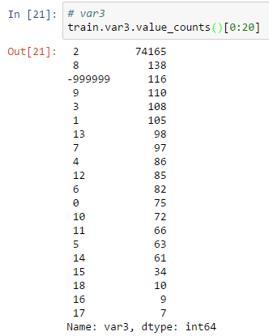
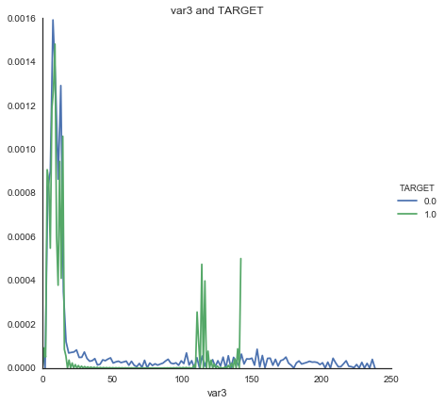
The data at another slightly deeper glance

Slide 10
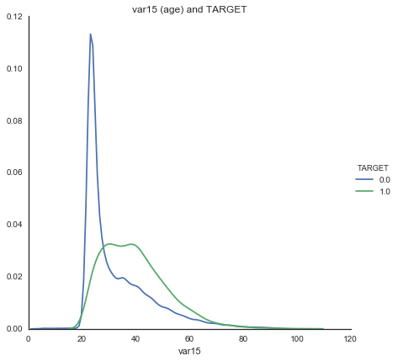
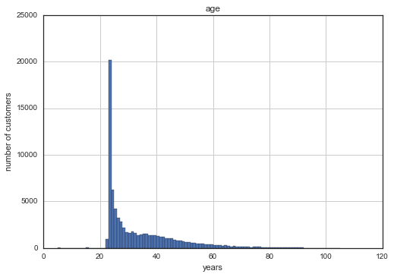
The data at some more slightly deeper glances

Slide 11
What now
Do everything else.
Determine how other features relate to one another if there are more relationships I haven’t figured out yet.
Narrow down potential features as much as possible.
Cross validate within train.csv before attempting to predict test.csv.

