Slide 1
KAGGLE COMPETITION
Look at how postmodernist this layout is

Slide 2
Once more, with feeling
Took a stab at a Kaggle Competition.
Santander Bank
Figure out which customers are unhappy.
While going in blind.
In Spanish.

Slide 3
So since the last time we spoke, I
Translated the feature names, sorta (but it didn’t really help a whole lot),
Cleaned up the data, looking for duplicate columns, no-variance columns, and errors, and reduced my range of features from 370 to 308,
Looked at a number of feature “types” in more detail, finding a few relationships here and there, chucked graphs at others,
Actually tossed a rough submission at the competition and got a score of 0.499770,
Created a couple of features, bumping the 308 to 310,
Managed to improve my model slightly but not well enough,
Tried asking the computer to select features for me,
Played around with my models some more.

Slide 4
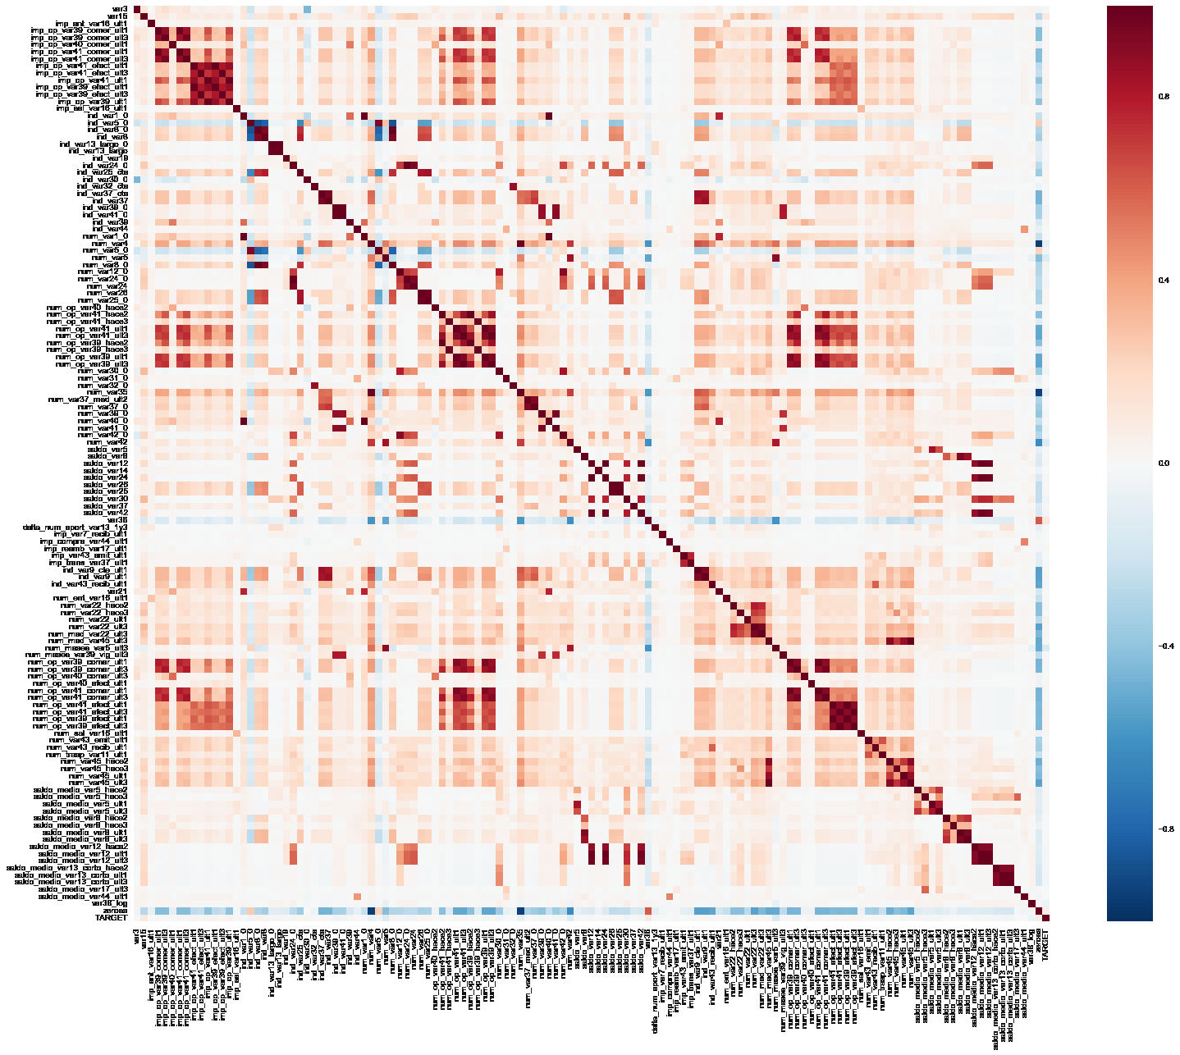
HERE IS A THING I TOLD MY COMPUTER TO DO:

Slide 5
HERE ARE OTHER THINGS I TRIED
Mostly played around with KNN and Logistic Regression, using cross validation to determine accuracy. Tossed in a LinearSVC for the heck of it but wow it did not perform well. Also tried scaling, which made models worse.
First submission used logreg and five features based on some histograms, kernel density estimations, and generic plots.
Score: 0.499770
Added a couple more features based on their relationship with other features (e.g. balances that were sums (or looked like sums) of other features, features with more dense data). Found that KNN worked better than logreg.
cross_val accuracy: 96.0418%. Score: 0.500000
Got stuck for a long time. Threw treeclf.feature_importance_ at the feature selection problem to see what stuck.
cross_val accuracy: 96.0457%. Score: 0.500000

Slide 6
THIS IS THE LAST THING I TRIED BEFORE TODAY
I separated my data by country and used cross validation on each to see how accuracy changed.
Trained discrete models for different countries’ observations and mashed the response vector together so I can check the score.
Score: 0.499298
To be fair I didn’t tune KNN specifically for each country, and there are many different quantities of observations per country.

Slide 7
Welp. Anyway, I would like to try
Playing with the “per-country modeling” code to tune KNN according to number of samples to see if it makes a difference at all,
Exploring the relationships that the heatmap suggests exist,
Studying what other competitors have done (if they shared anything in the competition forums), because they’re prooobably much more experienced and/or worked in teams,
Pick up other competitions or personal projects with a gentler learning curve.

