Slide 1
EXPERIENTIAL LEARNING | GROUP 4
“Rising sea levels threaten millions of people living in coastal cities.”
Semantic Similarity and Plagiarism Detection
meaning match 0.83
Finding passages that mean the same thing, and showing why that is not the same as copying.
“Coastal cities with millions of residents are at risk as the oceans keep rising.”
Oishani Majumder 2330316
Shubhradeep Paul 2330337
Almost no shared words. Same idea.
Notes:
Hello everyone. We are Group 4: Oishani Majumder and Shubhradeep Paul. Our project is about finding text that says the same thing, and being careful about what that does and does not prove. On the right are two sentences that share almost no words, yet any reader sees they mean the same. Our system gives them a meaning match of 0.83.

Slide 2
A copied idea does not need copied words
“Rising sea levels threaten millions of people living in coastal cities.”
0.16
0.83
word overlap
(looks different)
meaning similarity
(looks the same)
same idea
“Coastal cities with millions of residents are at risk as the oceans keep rising.”
And the catch: two students can independently write the same fact. Similar meaning is a reason to look closer, not proof of copying.
Humans see it instantly. A checker that only looks for matching words does not.
Semantic Similarity and Plagiarism Detection | Group 4
2
Notes:
Word-matching checkers look for the same words in the same order. If someone rewrites a sentence, they find nothing. These two sentences have almost no wording in common, so a word checker gives 0.16, but the meaning score is 0.83. There is also a second problem, which is the theme of our project: finding similar meaning is not the same as proving someone copied.

Slide 3
What we set out to do
1
2
3
Find similar passages
Tell copying from rewording
Be honest about the result
Turn every sentence into numbers that capture its meaning, then compare two documents sentence by sentence.
Add a word-overlap check so the report says “likely copied” or “paraphrase”, not just “similar”.
Test the method on public benchmarks and show clearly why a high score is not proof of plagiarism.
Task 4 from the assignment list. Pretrained model, no training needed, runs on a free Colab CPU.
Semantic Similarity and Plagiarism Detection | Group 4
3
Notes:
We had three goals. One: find passages with similar meaning between two documents. Two: tell apart sentences copied word for word from sentences that were reworded. Three: be honest about what the result proves. Importantly, we train nothing. We use a free pretrained model, so anyone can re-run the notebook.

Slide 4
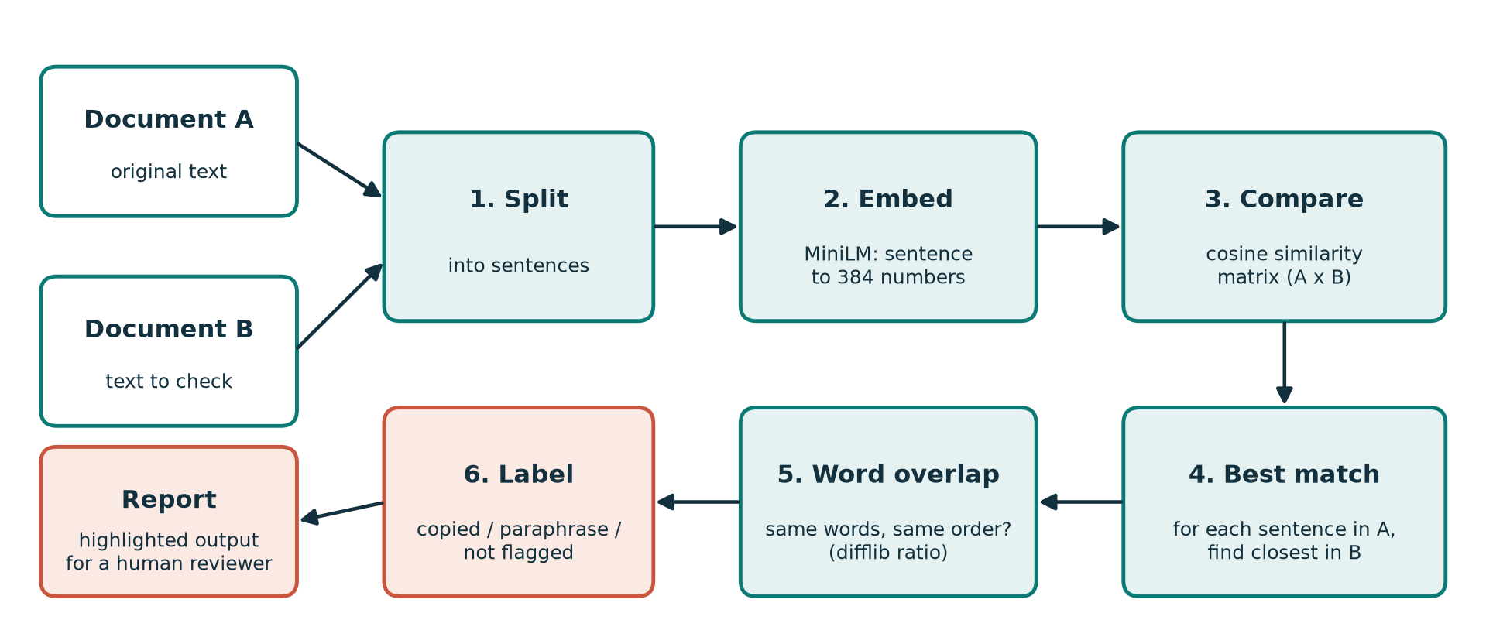
How it works in six steps
Nothing is trained. The model is pretrained; our own work is the comparison logic around it.
Semantic Similarity and Plagiarism Detection | Group 4
4
Notes:
Walk through the diagram. Two documents go in. Step 1 splits them into sentences. Step 2 turns each sentence into 384 numbers using the MiniLM model. Step 3 compares every sentence of A with every sentence of B using cosine similarity. Step 4 keeps the best match for each sentence of A. Step 5 checks how many words are shared. Step 6 labels the result and produces a highlighted report for a human reviewer.

Slide 5
Sentences become numbers, meaning becomes closeness
384
numbers describe each sentence
Angle
between two lists = cosine similarity
1.0
same meaning
~0
unrelated
Model: all-MiniLM-L6-v2 (Sentence Transformers)
Compared with: “The cat sat on the mat.”
Semantic Similarity and Plagiarism Detection | Group 4
5
Notes:
Each sentence becomes a list of 384 numbers. Sentences with similar meaning get lists that point the same way. Cosine similarity measures that angle: 1 means identical direction, near 0 means unrelated. The chart is real output from our notebook. The exact copy is 1.00. The paraphrase, with almost no shared words, is 0.56. A same-topic but different sentence is 0.16 and an unrelated one is 0.08. Note the paraphrase falls below our 0.65 threshold. That is an honest limitation we discuss later.

Slide 6
Models, data and tools
Model
Datasets
Tools
all-MiniLM-L6-v2
About 22M parameters, ~90 MB
Output: 384 numbers per sentence
huggingface.co/sentence-transformers/all-MiniLM-L6-v2
STS-B: 1,379 pairs with human similarity scores
MRPC: 408 pairs labelled paraphrase or not
Used for testing only, no training
Hugging Face: stsb, glue (mrpc)
Python in Google Colab, CPU is enough
sentence-transformers, datasets
scikit-learn: TF-IDF baseline, accuracy, F1
SciPy, pandas, matplotlib, difflib
Semantic Similarity and Plagiarism Detection | Group 4
6
Notes:
The model is all-MiniLM-L6-v2 from Hugging Face. It is small, about 22 million parameters, runs on a normal CPU, and was trained on over a billion sentence pairs. We use two public datasets for testing, not training: STS-B, where humans scored how similar sentence pairs are, and MRPC, where pairs are labelled paraphrase or not. We compare against a TF-IDF baseline, which only counts shared words.

Slide 7
Two signals: meaning and wording
Every sentence in A is matched to its closest sentence in B, then labelled:
Meaning ≥ 0.65 and words ≥ 0.75
Same idea in nearly the same words. Could still be a quotation.
Likely copied
Meaning ≥ 0.65 and words < 0.75
Same idea, new words. Could be copying or independent writing.
Paraphrase / same idea
Meaning < 0.65
No close match in the other document.
Not flagged
Thresholds are settings, not laws: tuned on our samples and easy to change.
Semantic Similarity and Plagiarism Detection | Group 4
7
Notes:
Meaning alone cannot tell copying from rewording, so we use two scores. The meaning score is the cosine similarity. The wording score is how many of the words appear in the same order. If both are high, we say likely copied. If only meaning is high, we say paraphrase or same idea. Otherwise we do not flag it. The thresholds 0.65 and 0.75 are settings and can be changed in one line.

Slide 8
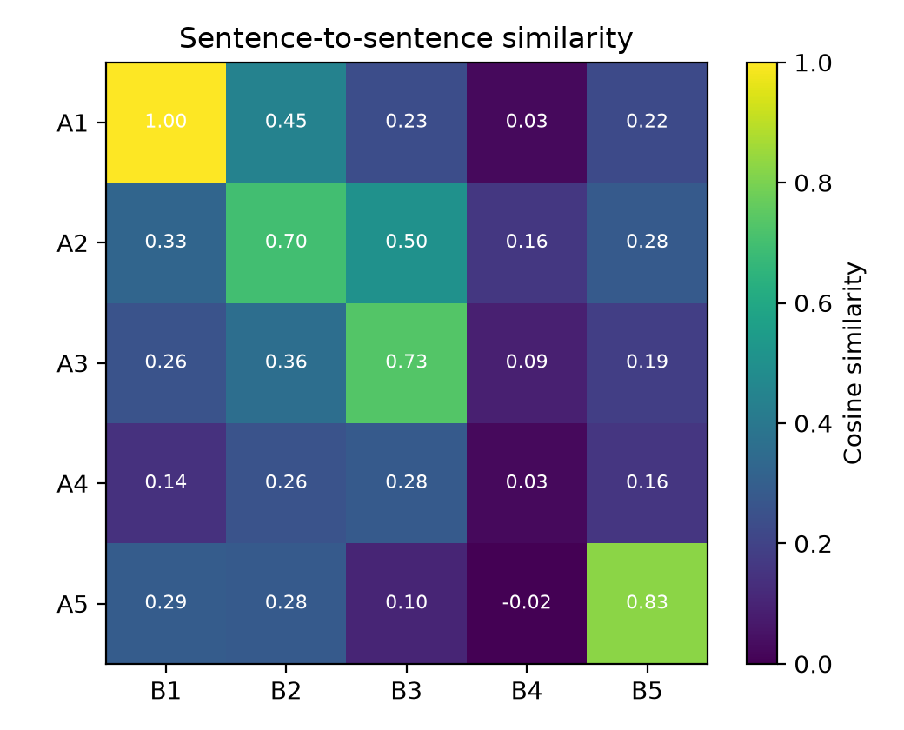
Demo: what the report looks like
Likely copied
A1: Climate change refers to long-term shifts…
meaning 1.00 | words 1.00
Paraphrase / same idea
A2: Burning fossil fuels such as coal, oil and gas…
meaning 0.70 | words 0.18
Paraphrase / same idea
A3: Renewable energy sources like solar and wind…
meaning 0.73 | words 0.08
Not flagged
A4: Many countries have pledged to reach net-zero…
meaning 0.28 | words 0.23
Rows: sentences of A. Columns: sentences of B. Bright = close in meaning.
Paraphrase / same idea
A5: Rising sea levels threaten millions of people…
meaning 0.83 | words 0.16
Semantic Similarity and Plagiarism Detection | Group 4
8
Notes:
This is the real output on our sample texts. Text B was designed to cover every case. Sentence A1 was copied word for word and is labelled Likely copied. A2, A3 and A5 were rewritten and are labelled Paraphrase, even though their word overlap is only 0.08 to 0.18. A4 has no counterpart and is not flagged. The heatmap shows the same thing: the bright cells are the matches. In the live demo we also paste our own two sentences into the notebook. Be fair: this is a small hand-made example, not a benchmark.

Slide 9
Does the model agree with humans?
0.82
Spearman correlation with human scores
TF-IDF, which only counts shared words, reaches 0.69.
In plain words: when people say one pair is more similar than another, the model usually agrees, and more often than word matching does.
STS-B test set, 1,379 sentence pairs
Semantic Similarity and Plagiarism Detection | Group 4
9
Notes:
STS-B has 1,379 sentence pairs that humans scored for similarity. We measure Spearman correlation, which asks: when people rank one pair as more similar than another, does the model rank them the same way? The embedding model scores 0.82; the word-counting TF-IDF baseline scores 0.69. So the model agrees with humans clearly better than word matching does.

Slide 10
Spotting paraphrases: better, but only modestly
Accuracy 74.0% vs 70.8% for TF-IDF. Better, but the gap is small.
68% of pairs are paraphrases, so even “always yes” scores well.
Threshold tuned on the same pairs, so figures are a little optimistic.
Lesson: a threshold is a trade-off, so we show scores, not just a verdict.
Semantic Similarity and Plagiarism Detection | Group 4
10
Notes:
MRPC pairs are labelled paraphrase or not. We pick the cosine threshold that gives the best F1. The embedding model gets accuracy 0.740 and F1 0.835. TF-IDF gets 0.708 and 0.824. A lazy system that always says paraphrase gets F1 0.812, because 68 percent of pairs are paraphrases. So our gain is real but small. Also, we tuned the threshold on the same 408 pairs, so the numbers are slightly optimistic. We think it is better to say that clearly.

Slide 11
Accuracy at a glance
0.82
74.0%
94.4%
STS-B agreement with humans
MRPC accuracy
Labeller accuracy (17 of 18)
TF-IDF: 0.69
TF-IDF: 70.8%
Chance level: 33.3%
Labeller results (rows: true label, columns: predicted)
 | Likely copied | Paraphrase / same idea | Not flagged
Likely copied | 6 | 0 | 0
Paraphrase / same idea | 0 | 5 | 1
Not flagged | 0 | 0 | 6
The one miss: a real paraphrase scored under the 0.65 threshold, so it was not flagged.
Semantic Similarity and Plagiarism Detection | Group 4
11
Notes:
Here are the accuracy numbers in one place. On MRPC, the embedding model is 74.0 percent accurate at the best threshold, against 70.8 for TF-IDF. Then we tested our full three-way label on 18 sentence pairs that we wrote and labelled by hand. It got 17 right, which is 94.4 percent. The table shows where it went right: every copied pair and every unrelated pair was correct. The single mistake was a real paraphrase whose meaning score fell just under the 0.65 threshold, so it was not flagged. Be fair about the limits: 18 pairs we wrote ourselves is a sanity check, not a benchmark.

Slide 12
Similar is not the same as plagiarised
A human must still check
0.92
1
Was the source cited?
A properly credited passage is not plagiarism.
cosine similarity, and nobody copied
2
Is it a quotation?
“Water boils at 100 degrees Celsius at sea level.”
“At sea level, water reaches its boiling point at 100 degrees Celsius.”
Quoted text will always match.
3
Is it common knowledge?
Facts and definitions get stated alike.
4
Was it written independently?
Two people can reach the same sentence.
Semantic Similarity and Plagiarism Detection | Group 4
12
Notes:
This is the key message of the project. These two sentences were written independently: water boils at 100 degrees at sea level, said in two ways. The model gives them 0.92, a very high score, and nobody copied anything. So the score cannot be the final verdict. A human has to check four things: was the source cited, is it a quotation, is it common knowledge, and was it written independently. That is why our tool says 'likely copied' or 'paraphrase' as a pointer for review and never as an accusation.

Slide 13
Limits, and where we would take it next
Limitations
Next steps
Thresholds depend on the kind of text
Short paraphrases can slip under the threshold (cat and mat: 0.56)
Only the closest sentence is compared
English only; two documents at a time, no web search
Our own test set is small
Multilingual model for Hindi and Odia
Compare windows of several sentences
Re-rank borderline cases with a cross-encoder
Test on a real plagiarism corpus (PAN)
Upload page for PDF and Word files
Semantic Similarity and Plagiarism Detection | Group 4
13
Notes:
Limitations first. Thresholds depend on the text. A short paraphrase, like our cat and mat example at 0.56, can slip under a strict threshold. We compare each sentence with only its best match, so plagiarism spread across several sentences can be under-reported. The model is English only, it compares two documents and does not search the web, and our own test is small. For next steps: a multilingual model for Hindi and Odia, windows of several sentences, a re-ranking step, testing on a real plagiarism corpus, and a simple upload page.

Slide 14
What we learned
0.82
agreement with humans on STS-B, vs 0.69 for word matching
TEAM
Oishani Majumder 2330316
Models, datasets, evaluation, results
Shubhradeep Paul 2330337
Comparison pipeline, GitHub, slides
2 signals
meaning plus wording separate “copied” from “paraphrased”
CODE, REPORT AND VIDEO
Human first
a high score is a pointer for review, never a verdict
github.com/<your-username>/<your-repo-name>
Thank you. Questions?
Semantic Similarity and Plagiarism Detection | Group 4
14
Notes:
To wrap up. We built a working pipeline with a free pretrained model. It agrees with human similarity ratings clearly better than word matching. It can separate copied from reworded text using two signals. Most importantly, a similarity score is evidence for a human to review, not proof of plagiarism. Everything is in our GitHub repository with the notebook, report, slides and this video. Thank you, we are happy to take questions.

