Slide 1
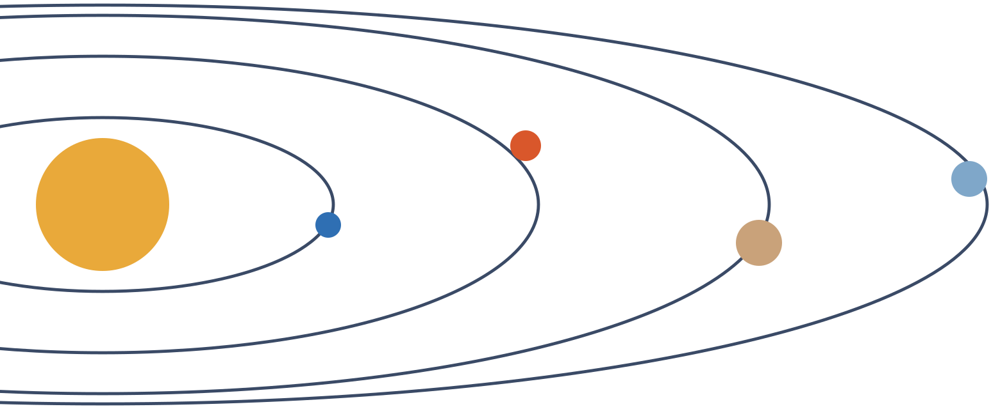
Solar Exploration
From a Raptor-class engine model to a Mars-first, solar-system-wide programme: scientific research, master planning, commercial implementation and cutting-edge concepts
Project summary | Version 1, 31 October 2026 | Sections marked PLACEHOLDER update as the remaining studies finish
Notes:
Version 1 of the project summary. Engine, component, vehicle and business results are complete. Mission and base studies are still running; their slides are marked PLACEHOLDER.

Slide 2
Engine and Mars mission close; the business pays back in 2037
Headline results from the four completed workstreams (all figures from this project's models unless tagged CITED)
MODEL
MODEL
MODEL
ESTIMATE
295 bar
1,935 kg
4 tankers
IRR 25%
Highest chamber pressure where all 53 component checks pass
Engine dry mass, sea-level T/W 119 (Raptor 2 public: ~1,630 kg)
Refilling flights in LEO to land 100 t of cargo on Mars
Base case, $7.1B equity, cumulative payback in 2037
Scientific research
Engine model within 0.3% of Raptor 2 Isp; AI optimizer ran 300 designs; component design, drawings and BOM verified against 53 checks
Master planning
Starship-class vehicle, 155 t to LEO in the model; Mars cargo with ISRU return; full mission roadmap in progress
Commercial
Engine $2.46M first unit falling to $0.85M; reusable flight $7.6M; NPV $8.8B at 12% (bear case does not pay back)
Cutting-edge
Closed AI design loop, additive copper liners, ISRU propellant, and nuclear and detonation propulsion for the outer system
Notes:
One-line summary per section. Key caveat: the business case and the vehicle still carry known gaps (155 t vs 100 t to LEO; thin cooling margin).

Slide 3
Twelve workstreams feed one programme
Status on 31 October 2026. Completed work is in the repository; studies in progress appear here as placeholders
Design and verification procedure
Gates G0 to G7, fidelity ladder
Crewed missions and return
Placeholder
Engine model and AI optimizer
PR #1: thermochemistry, cycle, 300-design search
Crewed lunar missions
Placeholder
Engine components, drawings, BOM
PR #2: 53 of 53 checks at 295 bar
Lunar transit base and spaceport
Placeholder
Business viability
PR #3: cost, 15-year plan, financing
Transit bases across the solar system
Placeholder
Mars launch campaign
Placeholder
Human settlement on other planets
Placeholder
Planetary sample return
Placeholder
Master solar exploration roadmap
Placeholder
Notes:
Green dot: delivered. Amber dot: study running; its results will replace the placeholder slides in the next version of this deck.

Slide 4
Scientific research
01
Engine design and digital verification: a Raptor-class full-flow staged combustion engine, modelled, optimized, designed to component level and checked against public data

Slide 5
Eight gates take a design from requirements to benchmark
Design and verification procedure: every design, human or AI-proposed, must pass the same gates
G0
G1
G2
G3
G4
G5
G6
G7
Requirements
Thermo-chemistry
Cycle balance
Performance
Cooling
Turbopumps
Engine system
Benchmark
Mission sets thrust, Isp, mass
CEA vs Cantera cross-check
Both turbopump shafts close
Isp, nozzle, separation
Wall temp, stress, pressure drop
Pump and turbine sizing, stress
Mass, thrust-to-weight
Error vs public Raptor 2
Status in the repository
Fidelity ladder
PR #1: G0, G1, G2, G3 and G7 pass for the reference engine
PR #2: component models add G4, G5 and G6; all eight gates pass at 295 bar
This project works on the analytic and 1-D rungs (L0 to L1)
CFD, finite-element analysis and hot-fire testing are the next rungs (L2 to L3)
Source: Rocket Engine Design and Verification Procedure (project document)

Slide 6
The engine model reproduces Raptor 2 within 0.3% on Isp
Reference design: full-flow staged combustion, CH4/LOX, 300 bar, mixture ratio 3.6
Quantity | Model | Raptor 2 public | Error
Sea-level Isp | 326.7 s | 327 s | 0.10%
Vacuum Isp (sea-level nozzle) | 348.0 s | 347 s | 0.29%
Chamber temperature, CEA vs Cantera | 3,762 K | 3,766 K (Cantera) | 0.10%
Nozzle exit diameter | 1.36 m | about 1.3 m | ~5%
Propellant flow | 704 kg/s | 650 kg/s (low confidence) | 8%
Raptor Vacuum Isp | 362.7 s | 380 s | 4.6% low
MODEL
5 of 8
Gates passed by the reference engine in PR #1 (G0 to G3, G7). G4 to G6 added in PR #2
What is calibrated
c* efficiency 0.975 and thrust-coefficient efficiency 0.970 are fitted to Raptor's Isp, not predicted
Thrust and Pc are inputs, so G7 mainly tests Isp
Vacuum variant is 4.6% low: efficiencies were fitted on the sea-level engine
MODEL
CITED
Public figures: Wikipedia 'SpaceX Raptor', Everyday Astronaut Raptor comparison (as cited in raptor_sim/benchmarks.py)

Slide 7
An AI optimizer found Raptor 2 already sits near the best design
Bayesian search (Optuna TPE) over chamber pressure, mixture ratio, area ratio and preburner temperatures: 300 designs, 187 passed every gate
 | Reference | Best found
Chamber pressure | 300 bar | 314 bar
Mixture ratio | 3.60 | 3.46
Area ratio | 34.3 | 37.2
Sea-level Isp | 326.7 s | 327.5 s
Vacuum Isp | 348.0 s | 349.8 s
Gain is only ~1 s at sea level, 2 s in vacuum
Limits: oxygen turbine power above ~315 bar, 1.40 m nozzle packaging
Main failure reasons: ox shaft does not balance (55), nozzle too wide (51)
MODEL

Slide 8
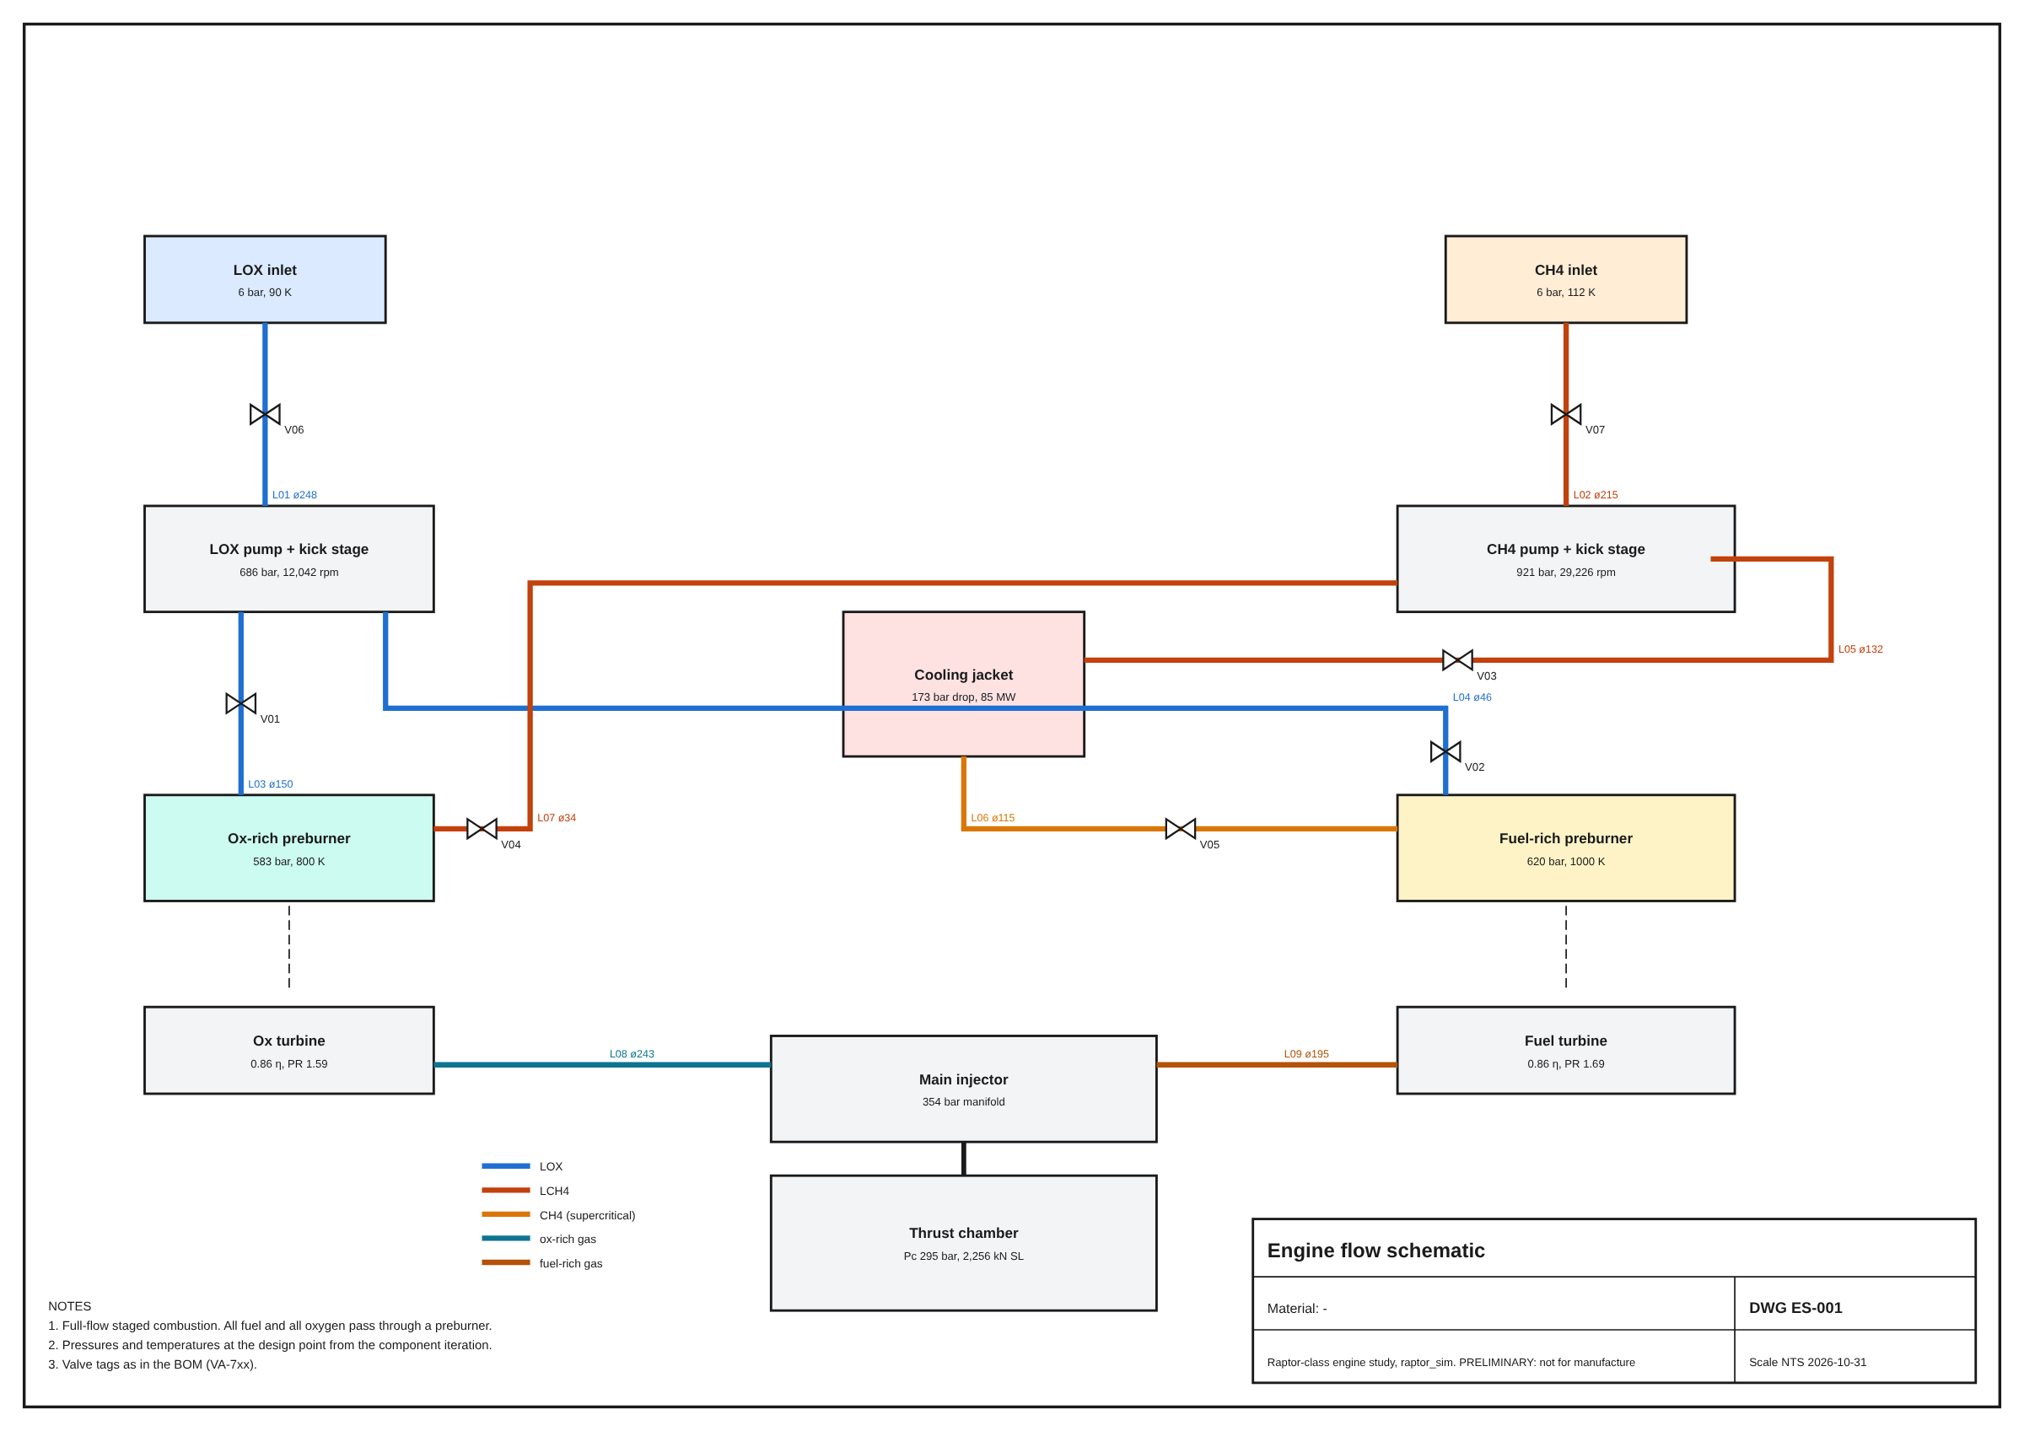
Component design turns the cycle into hardware
Engine flow schematic ES-001 at the 295 bar design point: every pressure and temperature comes from the component iteration
MODEL
921 bar
Fuel pump discharge, 29,226 rpm; oxygen pump 686 bar at 12,042 rpm
MODEL
620 / 583 bar
Fuel-rich and oxygen-rich preburner pressures
MODEL
173 bar
Cooling jacket pressure drop (budget 192 bar), 85 MW absorbed

Slide 9
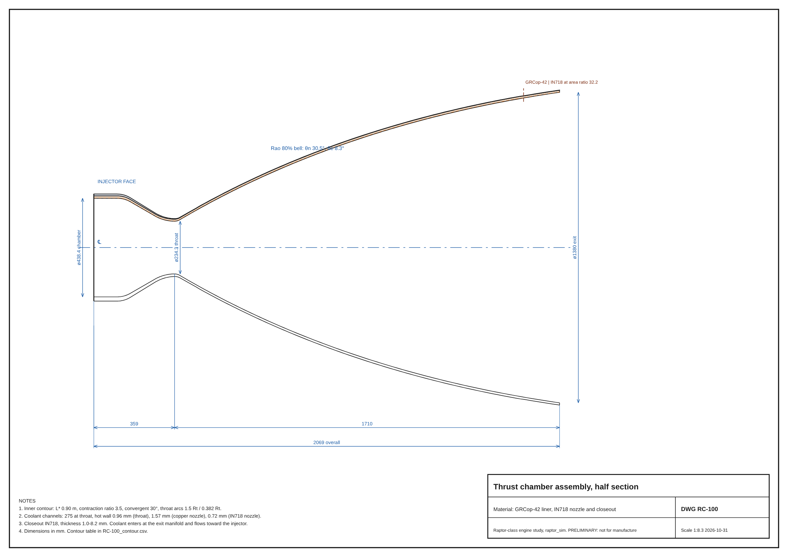
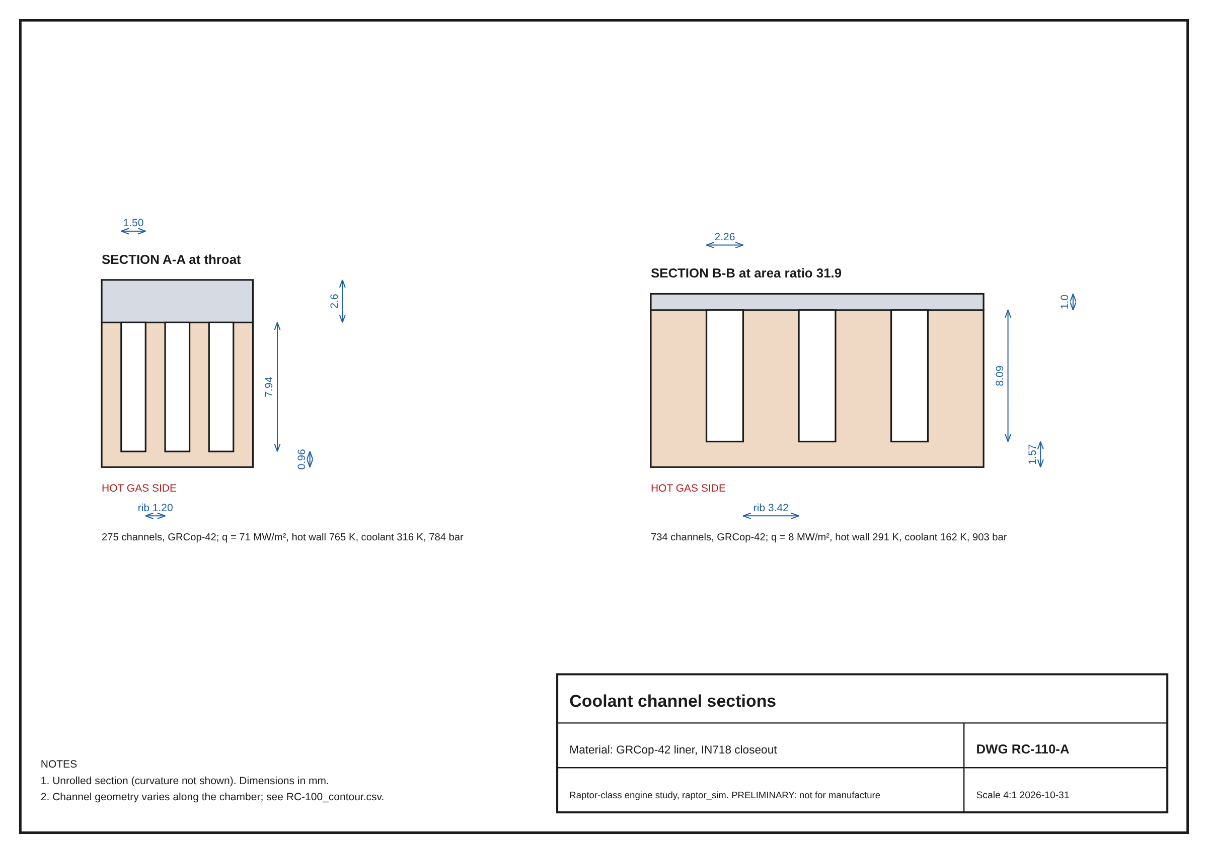
Thrust chamber: milled-channel copper liner, Inconel nozzle
Drawing RC-100 (half section) and RC-110-A (coolant channel sections), generated from the model geometry
MODEL
GRCop-42 liner: peak hot wall 766 K vs 808 K limit
Throat 234 mm, exit 1.38 m, overall length 2.07 m
~6% fuel film cooling costs ~3 s of sea-level Isp

Slide 10
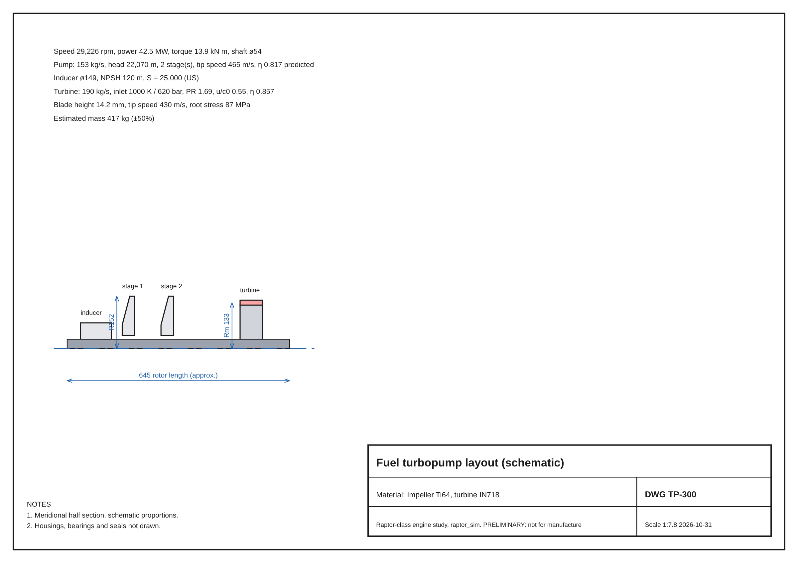
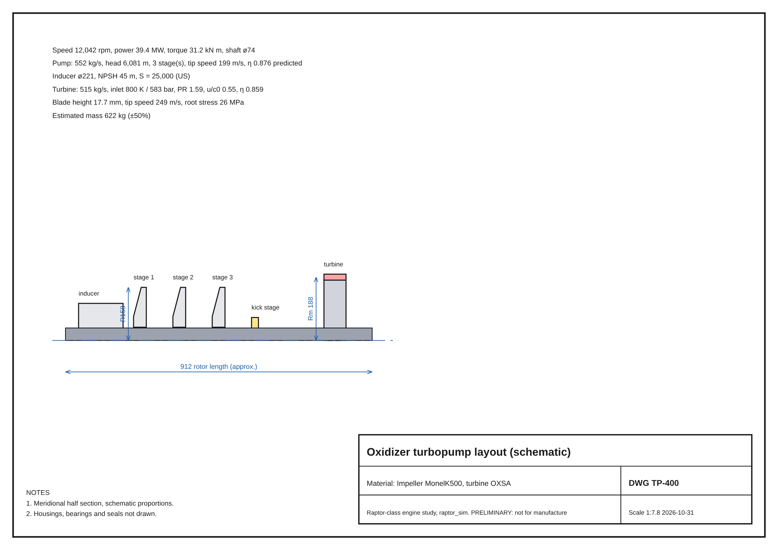
Two turbopumps deliver 82 MW of shaft power
Drawings TP-300 (fuel) and TP-400 (oxygen); impeller, disc, blade and housing sizes from the turbomachinery model
Fuel: 2 stages + kick stage, 42.5 MW, pump efficiency 0.82 predicted
Oxygen: 3 stages + kick stage, 39.4 MW, oxygen-compatible alloys throughout
MODEL

Slide 11
Four design passes cut failing checks from 13 to zero
Each pass sizes every component, runs all checks, then changes the design where a check fails
Design changes the loop found
Kick stages on both pumps to feed the preburners
Propellant-cooled liner in the fuel-rich preburner
Cooling layout re-optimized each pass (200+ trials)
Cycle efficiencies set from component predictions less 0.03
Pump inlet requirement raised to 6 bar
Pass 1: coolant drop 1,510 bar vs 59 bar budget, wall 1,730 K: the first guess was far off
Pass 4: 53 of 53 checks pass, 1,935 kg
MODEL

Slide 12
295 bar is the highest chamber pressure passing all checks
Full iteration re-run from the first guess at each pressure, nozzle exit held at 1.38 m
Why 300 and 298 bar fail
Cooling rib stress over the limit
Cycle no longer closes with component efficiencies
Mass and T/W miss the targets
Thin cooling margin
Gas-side heat flux +20% gives 859 K vs 808 K limit
Channel roughness x2 exceeds the jacket budget
Film cooling half as effective: 1,036 K
Mass varies non-monotonically because each run converges to its own cooling layout; differences of a few hundred kg are within model scatter

Slide 13
Turbopumps make up over half the engine's 1,935 kg
Bill of materials by assembly; 'sized' parts come from model geometry, turbopump masses carry about +/-50% uncertainty
MODEL
+19%
Over the public Raptor 2 mass (~1,630 kg, low confidence); within the 30% G6 allowance
Vehicle effect | Public | Model
Booster dry mass | 275 t | 285 t
Ship dry mass | 100 t | 102 t
Payload to LEO | 155 t | 153 t
Full BOM: 40+ parts with material, quantity and mass, plus DXF drawings for manufacture-style review

Slide 14
Master planning
02
Vehicle and mission architecture, starting with Mars and extending to the Moon, sample return, crewed flight, transit bases and settlement

Slide 15
100 t to Mars takes four tankers and Mars-made propellant
Starship-class two-stage vehicle built around the modelled engine; patched-conic transfer, LEO refilling and ISRU return
1
2
3
4
5
6
Launch
Refill
Transfer
Land
Make propellant
Return
Ship to LEO, 155 t payload capacity in the model
546 t of propellant from 4 tanker launches
3,951 m/s trans-Mars injection, 259 days
100 t of cargo delivered to the surface
642 t of methane and oxygen made on Mars
6,401 m/s back to Earth with 20 t
Known gap
The model gives 155 t to LEO; SpaceX states about 100 t for Block 3. A ship dry mass near 150 t closes the gap and raises the Mars tanker count from 4 to 7.
MODEL
CITED

Slide 16
Draft roadmap: hot fire 2028, first orbit 2031, Mars cargo 2033
Drawn from the business plan milestones; the master roadmap study will replace this slide
PLACEHOLDER
Seed $30M
Preburner and injector test articles
Engine hot fire
Full engine at rated Pc (Series B)
Stack on pad
Anchor government contract
First Mars cargo
Mars window; 14 flights a year
Payback
Cumulative cash turns positive
2026
2028
2030
2032
2034
2036
2038
2040
2041
Turbopump hot fire
Series A $400M
Engine qualified
Booster test article
First orbital flight
LEO launch revenue starts
Lunar cargo
Science missions begin
110 flights a year
$6.9B revenue (base)
Pending from the roadmap study: crewed lunar landing, lunar transit base, sample return, first crewed Mars mission, outer-planet transit bases and settlement phases
ESTIMATE

Slide 17
Seven mission and infrastructure studies extend the programme
Each study reuses the engine, vehicle and cost models; results will be added here as they finish
Mars launch campaign
Planetary sample return
Crewed missions and return
Crewed lunar missions
Window-by-window flight plan, tanker logistics, fleet size
Mars and other bodies; compare with the $8-11B MSR estimate
Crew transit, life support, abort and return trajectories
Landing, refilling and surface operations; shared lunar delta-v table
PLACEHOLDER
PLACEHOLDER
PLACEHOLDER
PLACEHOLDER
Lunar transit base and spaceport
Transit bases across the solar system
Human settlement
Shared models
raptor_sim engine, vehicle sizing, Mars transfer and the cost model are the common base for every study
Propellant depot and staging for deep-space flights
Depots at Mars, asteroids and outer-planet moons
Habitat, power and ISRU scale-up on other planets
PLACEHOLDER
PLACEHOLDER
PLACEHOLDER

Slide 18
Commercial implementation
03
Cost from the bill of materials up, a 15-year business plan with three scenarios, and the equity needed to reach payback

Slide 19
Production learning takes the engine from $2.46M to $0.85M
Engine unit cost from the BOM with a learning curve; mature reusable flight cost from amortisation, refurbishment and operations
Engine cost moves NPV by only +/-$0.3B; demand, schedule and price matter far more
Booster $37.6M and ship $21.9M at vehicle unit 100
ESTIMATE

Slide 20
At maturity, 100 t lands on Mars for about $98M
Per-mission cost including tanker flights; Mars and lunar cargo ships are expended in the model
ESTIMATE
$7.6M
LEO launch of 100 t, one reusable flight ($76/kg)
ESTIMATE
$97.9M
Mars cargo, 100 t landed: 5 flights ($979/kg)
CITED
$74M
Falcon 9 list price today, for comparison

Slide 21
Revenue builds from government contracts to Mars cargo
Base case revenue by segment, $M per year (2026 dollars); Mars revenue arrives every 26-month launch window
ESTIMATE
$6.9B
Base case revenue in 2041, 110 flights
ESTIMATE
45%
Share of 2041 revenue from Mars cargo
CITED
$613B
Global space economy, 2024

Slide 22
Base case pays back in 2037; the bear case never does
Cash balance including the equity rounds, $M, three scenarios 2027-2041; payback year is from free cash flow alone
Scenario | NPV @12% | IRR | Trough | Payback
Bear | -$4.6B | 3% | -$11.9B | none
Base | $8.8B | 25% | -$5.8B | 2037
Bull | $20.4B | 39% | -$4.2B | 2035
Bear: first orbit 2033, development +50%, prices -20%, half Mars demand
Bull: first orbit 2030, development -15%, 1.5x Mars demand
ESTIMATE

Slide 23
Mars demand and schedule drive value, not engine cost
Change in base-case NPV ($B) when one driver moves to its low or high value
What to de-risk first
Lock anchor Mars and lunar customers early
Protect the 2031 first-orbit date: two years late costs $3.0B of NPV
Price discipline: +/-20% on launch prices moves NPV $2.2B
Engine unit cost +/-40% moves NPV only $0.3B
ESTIMATE

Slide 24
$7.1B of equity over six rounds funds the path to payback
Each round is tied to a technical milestone the models in this project prepare for
Round | Year | Raise | Pre-money | Founders after | Milestone
Seed | 2026 | $30M | $90M | 68% | Team, preburner and injector test articles, data package from this repo
Series A | 2027 | $400M | $600M | 40% | Full-scale preburner and turbopump hot fire
Series B | 2028 | $900M | $1.8B | 27% | Full engine hot fire at rated chamber pressure
Series C | 2029 | $1.8B | $4.0B | 19% | Engine qualification; booster structural test article
Series D | 2030 | $2.5B | $7.5B | 14% | Integrated stack on pad; anchor government contract
Series E | 2032 | $1.5B | $14.0B | 13% | Booster and ship recovered and reflown
ESTIMATE
-$5.8B
Comparable: Stoke Space raised a $510M Series D (2025)
CITED
Anchor customers: NASA HLS (~$4.2B), Commercial LEO Destinations ($300M in FY26)
Base case cash trough in 2032

Slide 25
Cutting-edge concepts
04
Where the design method and the propulsion technology go next: AI-driven engineering, new manufacturing, and propulsion for the outer solar system

Slide 26
A closed AI design loop already runs end to end in this project
From optimizer proposal to verified component design, every step is code that can re-run in minutes
Propose
Simulate
Verify
Redesign
Bayesian optimizer (Optuna TPE) picks Pc, MR, area ratio, temperatures
CEA chemistry, FFSC cycle, cooling, turbopump and preburner models
53 checks across gates G0 to G7, with sensitivity cases
Failing checks drive layout and assumption changes automatically
MODEL
MODEL
MODEL
MODEL
Next steps for the loop
Neural surrogates
CONCEPT
Generative geometry
CONCEPT
Engine digital twin
CONCEPT
Train fast models on CFD and FEA runs so the optimizer can search the L2 design space
Topology-optimized manifolds and housings, sized by the same checks
Update the model from test-stand data to flag anomalies and predict life

Slide 27
Six technologies stretch the programme beyond Mars
Tagged by maturity: MODEL means this project has simulated it; CONCEPT means it is a direction for later studies
Additive copper chambers
In-situ propellant
Orbital refilling
GRCop-42 liners with milled or printed channels, as in this design; printing cuts part count and lead time
Methane and oxygen made from Martian CO2 and water: 642 t for one return flight in the model
Cryogenic propellant transfer in LEO; four tanker flights per Mars cargo mission
MODEL
MODEL
MODEL
Transpiration-cooled faces
Rotating detonation engines
Nuclear thermal and electric
Porous injector and wall cooling to restore the thin thermal margin at higher Pc
Pressure-gain combustion promises higher Isp from a shorter chamber; ground-tested, not flown
Roughly double chemical Isp for the outer planets and transit bases; needs reactor development
CONCEPT
CONCEPT
CONCEPT

Slide 28
Close three gaps before the next design cycle
Open issues from the completed work, and what fixes each
Thin cooling margin
+20% heat flux or rougher channels breaks the jacket at 295 bar
Run CFD on the chamber (L2), test transpiration or more film cooling
Vehicle payload gap
Model 155 t to LEO vs about 100 t stated for Block 3
Recalibrate ship dry mass near 150 t; re-run tanker counts and mission costs
Raptor Vacuum Isp
Model 362.7 s vs 380 s quoted
Calibrate vacuum-nozzle efficiencies separately
Then: fold the mission, base and settlement studies into this deck and the master roadmap

Slide 29
Sources and how to read the figures
Every number in this deck carries one of these labels
CITED
From a public source, listed below
Code: github.com/Skymeapple/solar-exploration, PR #1 (engine, optimizer, vehicle, Mars), PR #2 (components, drawings, BOM), PR #3 (business case)
Project documents: Rocket Engine Design and Verification Procedure; Commercial Viability Assessment
Raptor 2: en.wikipedia.org/wiki/SpaceX_Raptor; everydayastronaut.com Raptor engine comparison
Starship Block 3: en.wikipedia.org/wiki/SpaceX_Starship (checked 31 Oct 2026)
Space economy $613B: Space Foundation, The Space Report 2025 Q2
Falcon 9 price, NASA HLS, CLD budget, MSR cost, Stoke round: as cited in raptor_sim/econ/inputs.py
MODEL
Computed by this project's code (raptor_sim)
ESTIMATE
Assumption-driven planning figure
CONCEPT
Direction for later work; not simulated
PLACEHOLDER
Study in progress; will be replaced

Slide 30
From one engine to the solar system
The engine and the business close on paper. The next version of this deck adds the mission, base and settlement studies and the master roadmap.

