Slide 1
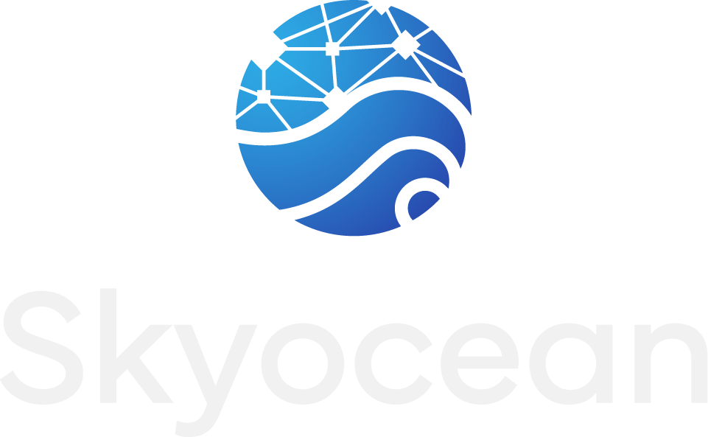
Global Commodity Trading
& Supply Chain Finance
Physical Trading | Verified Supply Chains | Global Payment Connectivity
March 2026 | Confidential

Slide 2


Executive Summary
Skyocean is a global commodity trading platform that buys, ships, and sells physical goods. We connect merchants and retail buyers directly to verified supply chains. Our hybrid platform serves both crypto and non-crypto users through any payment method worldwide.
MVP Live
5–8%+
Hybrid
15 yrs
Platform Status
Margin Per Trade
Platform Model
Founder Experience
Operational & accepting users
Conservative est. (45–60 day cycle)
Crypto & non-crypto users
Commodity trading operations
Platform Highlights
Key Partnerships
MVP live — accepting merchants & investors
Government of Sudan Essential commodity imports
Hybrid platform — crypto and traditional users
Port of Thessaloniki (ThPA) EU logistics gateway
Global payment connectivity — any method, any region
World Trade Center Accra Ghana trade corridor
Direct merchant access — retail & wholesale

Slide 3
How It Works
Skyocean owns the commodity at every stage. Merchants and retail buyers access goods directly through our platform.
1
2
3
4
Buyer Orders
We Procure & Ship
Verified Delivery
Returns Generated
Merchant or retail
buyer places order
directly on platform.
Skyocean buys the
commodity. We retain
title throughout.
Quality inspection.
Digital verification.
Payment on delivery.
Trade margin earned.
Capital recycled to
next trade cycle.
Traditional Trade Finance
Skyocean Model
Bank lends money → charges interest → borrower repays or defaults → bank loses everything. Requires 150%+ collateral. 30–45 day processing.
We buy the commodity → ship to buyer → buyer pays trade price → if buyer defaults, we resell. No lending, no interest, no collateral. Goods are the collateral.

Slide 4

The Problem We Solve
$2.6 trillion trade finance gap | 70% first-time applicants rejected | 40% rejection rate in Africa
Why Banks Can’t Close the Gap
Skyocean’s Approach
No supply chain visibility — betting on strangers
We own the commodity — full supply chain control
Usury caps (8–15%) make risky trades unprofitable
Pricing through trade margin, not interest rates
Credit assessment costs exceed profit on small deals
Self-consignment eliminates buyer credit risk
Binary outcome: borrower pays or total loss
Buyer defaults? We resell to next buyer
Cannot price high-risk markets appropriately
Digitally verified supply chain data for all parties
Seller payment gaps from buyer defaults
Direct merchant access — no intermediaries needed

Slide 5



Verification Technology
Every shipment is digitally verified. Documents are tamper-proof. Payments release automatically when conditions are met.
Document Verification
Why It Matters
Every document (bill of lading, quality inspection, customs clearance) gets a unique digital fingerprint. Cannot be forged, altered, or disputed. Verified in seconds, not weeks.
2 sec
verification vs 5–10 days at banks
$0.02
Decentralized Data Storage
per verification vs $500+ bank fees
Trade data is stored across multiple independent nodes worldwide — not on our servers. No single point of failure. No one can alter records. Enterprise-grade technology used by Walmart, Swiss Railways, and major logistics companies.
0%
document fraud — mathematically impossible
24/7
global operation — no office hours
Automated Settlement
100%
Payments release automatically when verified milestones are confirmed: goods shipped, quality inspected, customs cleared, delivery confirmed. No manual intervention. No disputes.
audit trail — every action recorded
Hybrid Platform
Crypto & non-crypto users
Same verification, same trust

Slide 6
Global Platform & Payments
Merchants and retail buyers access goods directly. We connect to any payment system used in any region worldwide.
Who Uses the Platform
Global Payment Connectivity
Retail Merchants
Bank transfers (SWIFT, SEPA, local rails)
SME buyers place orders directly on the platform for commodities at fair market prices. Full KYC onboarding, order tracking, document access.
Mobile money (M-Pesa, MTN, Airtel, etc.)
Wholesale Buyers
Cash against documents (CAD)
Government agencies, cooperatives, and large importers access bulk commodities with verified quality and full supply chain transparency.
Letter of credit (LC)
Investors & Capital Partners
Digital stablecoin settlement (optional)
Participate in trade financing through the platform. Earn returns from real commodity trade margins on 45–60 day cycles.
Gold-backed payment (select markets)
Multi-currency support (USD, EUR, GHS, etc.)
Hybrid Platform — Built for Everyone
Non-Crypto Users
Crypto-Native Users
Same Platform, Same Trust
Use bank transfers, mobile
money, or cash. No wallets,
no seed phrases needed.
Use digital wallets, stablecoin
settlement, on-chain verification.
Full transparency.
Both paths get identical
verification, same supply
chain data, same protections.

Slide 7
Pilot Program — Trade Corridors
Initial corridors to prove the model. The platform is global — pilot numbers represent launch phase only.
SUDAN — Flagship Pilot Corridor
GHANA — Diversification Corridor
Commodity
Volume
Value
Source
Commodity
Value
Source
Wheat / Flour
10,000 MT
~$4M
Turkey
Dairy / Milk Powder
~$1M
Poland
Sugar
10,000 MT
~$4M
Brazil
Chicken / Poultry
~$1M
Brazil / EU
Milk Powder
20 containers
~$1M
Poland
Sugar
~$4M
Brazil
Sunflower Oil
40 containers
~$1.2M
Turkey
Pilot cycle: ~$7M | 0% tariff under EU–Ghana EPA
Lentils / Pasta
Mixed
~$1.3M
Turkey/Italy
Lower risk — established port (Tema), proven trade route
Pilot cycle: ~$14–16M per cycle
Gov't demand: 30,000 MT wheat/month (~$12M/mo)
EU Gateway
Partnership: Ministry of Investment, Republic of Sudan
Port of Thessaloniki — shortest transit to East Africa.
Sofia Dry Port for rail consolidation to Central Europe.
Status: Government partnership, MOU signed

Slide 8
Business Model & Revenue
Trade Margins
Transaction Fees
Capital Participation
5–8%+
1.5–2.5%
3–4%/cycle
Conservative estimate per trade. We buy commodities at origin and sell at destination. Multiple cycles per year multiply annualized returns significantly.
Platform fee per trade. Covers KYC verification, data integrity, document processing, and settlement infrastructure.
Investors earn returns per trade cycle (45–60 days). Multiple cycles per year. Backed by real commodities, not speculation.
Annualized Returns: 5–8% margin per trade × 6–8 cycles/year = 30–60%+ annualized returns on deployed capital. Pilot program data from Sudan projects 15–25% per trade in high-demand markets.
Pilot Program Revenue Projections (Initial Corridors Only)
Period
Trade Volume
Trades
Revenue Est.
Milestone
Year 1 — Pilot
$40M
4–6
$1–1.6M
First trades, prove margins, build track record
Year 2 — Scale
$120M
12–15
$3.3–5.5M
Multi-corridor, 5–7 countries, expand pipeline
Year 3 — Expand
$175–200M
18–25
$8.8–12.3M
Institutional partners, new regions, full scale

Slide 9
Market Opportunity
$2.6T
$260B
$52–65B
TAM
SAM
SOM
Global SME trade finance gap
ICC Banking Commission 2024
EU ↔ emerging market corridors
addressable from our platform
Africa ↔ EU corridors
initial target regions
Commodity Focus: Agricultural Products | Essential Goods (FMCG) | Industrial Equipment | Construction Materials | Containerised Cargo
Global Platform — Pilot Numbers Represent Launch Phase Only
Pilot corridors (Sudan + Ghana): $21–23M confirmed pipeline, first cycle. Sudan government demand: 30,000 MT wheat/month (~$12M/month). Pipeline is institutional-scale — execution is capital-constrained, not demand-constrained.
Global platform: Pilot success validates expansion to LATAM, Asia, and additional African markets. Capital scales directly into volume.
Sources: ADB 2023, ICC 2024, WTO 2023, World Bank 2023

Slide 10
Competitive Positioning
Capability
Skyocean
Drip Capital
Centrifuge
Banks
Quick SME Financing
Owns the Supply Chain
Earns Trade Margins (not interest)
Digital Verification & Transparency
Lower Collateral Requirements
No Interest Charged to SMEs
Global Payment Connectivity
Direct Merchant Access
Hybrid (Crypto & Non-Crypto)
Key Differentiator: Competitors either lend capital (Drip Capital, banks) or facilitate others’ financing (Centrifuge). Skyocean owns the commodity, controls the supply chain, and earns margin from trading — not interest. Failed platforms (TradeLens, Marco Polo, we.trade) didn’t own the value chain. We do.

Slide 11
Risk Management
Buyer Default
Security (Sudan)
Commodity Price
Self-consignment: Skyocean retains title to goods. Buyer defaults = goods resold to next buyer. No capital loss.
Port Sudan under SAF control. War risk + marine cargo insurance. Egypt backup route verified. First-come-first-serve model.
Short cycles (45–60 days). Essential goods with stable demand (wheat, sugar, dairy). Minimal price exposure window.
Financial / FX
Quality / Dispute
Sanctions
All contracts USD-denominated. No local currency exposure. Gold accepted as alternative in select markets.
Pre-shipment inspection (SGS/Bureau Veritas). Independent surveyor. ICC arbitration clause. Digital verification.
Food/essential goods exempt from most sanctions. Rigorous KYC/KYB on all parties. SDN list screening. Full compliance framework.
Insurance: Marine Cargo ~1.5% + War Risk ~3% + Warehouse ~0.5% = ~5% of cargo value (fully covered)

Slide 12

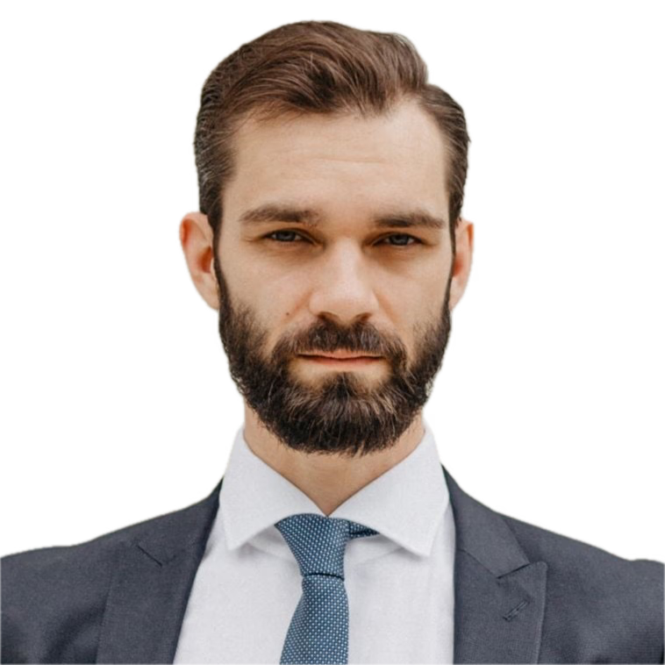
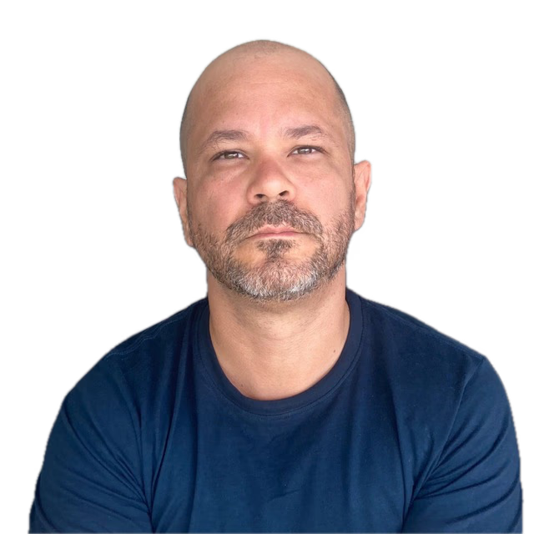
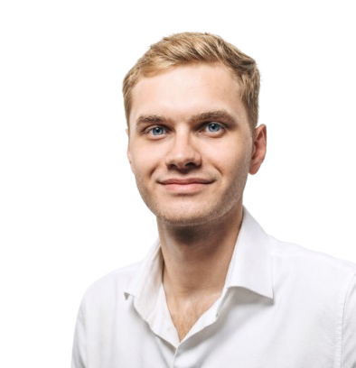
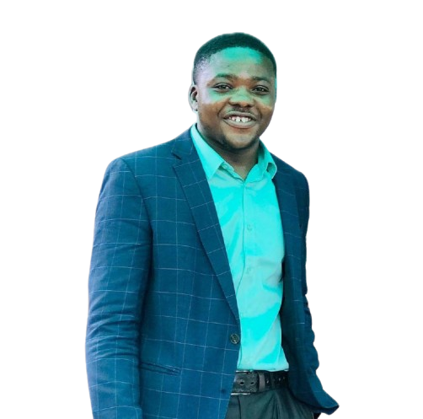
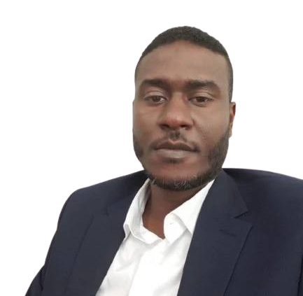
Team
Gaurav Yadav Head of Tech
Andrius Petkevicius Legal Advisory
Sebastian Gonzalez CEO/Co-founder
Alexey Deshin CGO/Advisor
Elias Nartey PR- Ghana
Mustafa Alhamare Manager Sudan

Slide 13
Roadmap
Q2 2026
Q4 2026
Q3 2027
Launch
Scale
Expand
MVP live with first trade cycles
~$40M trade pipeline active
Full pipeline scale ($120M+)
Pilot program — Sudan & Ghana corridors
Multiple corridors operational
Africa + LATAM corridors
First revenue from trading operations
Technology infrastructure scaled
Institutional partnerships
Active fundraising (pre-seed)
EU regulatory compliance
B2B yield platform integration

Slide 14
Use of Funds & Investment
Pre-Seed Round
Equity Tiers at $15M Pre-Money
$3M Target | $15M Pre-Money Valuation
$150K
= 1.0% equity
Bootstrapped to date | Founder-owned
$250K
= 1.6% equity
$500K
= 3.2% equity
$750K
= 4.8% equity
● Working Capital 85% ($2.55M)
$1.0M
= 6.3% equity
● SG&A 15% ($450K)
Why Now
MVP live — platform operational today
Government partnership signed
Pilot pipeline ready — real demand confirmed
Global payment connectivity built
Trading company profitable from Year 1
Pre-seed pricing — Series A won't be at this valuation.
Revenue projections based on analysis and assumptions. Actual results may vary. Consultation with financial experts is advised.

Slide 15
Let’s Talk
Skyocean is bridging the $2.6 trillion trade finance gap by doing what banks can’t: owning the commodity, controlling the supply chain, and sharing the profits with investors. Our global platform connects merchants and retail buyers directly — through any payment method, in any market.
Next Steps
1
Introductory meeting — Discuss corridors, model, pipeline
2
Structure discussion — Equity, trade finance, or hybrid
3
Due diligence — Full data room access, platform demo
4
Term sheet — Commercial terms, governance
5
First trade — Capital deployed, trade cycle begins
Sebastian Gonzalez
Alexey Deshin
Elias Nartey
CEO / Co-founder
CGO / Co-founder
PR & Communications
sebastian@skyocean.io
alexey@skyocean.io
elias@skyocean.io

