Slide 1
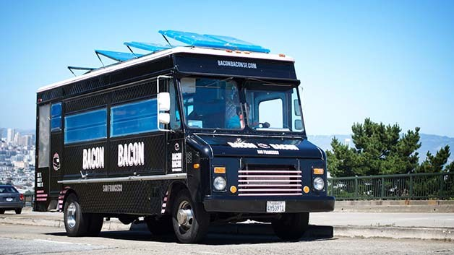

Truck Truck Go Find Your Food Truck
Group 5 Bob Brown Evan Marshall Clinton Paulus Jason Wang
This Photo by Unknown author is licensed under CC BY-NC-ND.

Slide 2



Mission
Connect Customers to Food Trucks using the Power of a Database!
Help Customers Find the Right Food Truck for their Food Mood
Make Food Trucks more Accessible and Organized for Customers and Operators
Provide Tools for Operators to Strategize and Grow their Food Truck Empire
Improve Interaction between Customers and Operators through integrated Feedback and Review

Slide 3


Problem
How does one connect Food Truck Customers and Operators?
Customers have questions about Food Trucks
Which food truck should I eat at?
What is on the menu?
How much will it cost?
Where will it be, and how long will it be there?
Operators have concerns about Connecting to Customers
How will they find out about our truck?
How will they know what to order?
How will they find us?​
Existing Solutions can be Complex or Cumbersome
Operators may not have the Budget or Expertise to maintain a website or Social Media presence

Slide 4



Solution
One Integrated Platform to Connect Customers and Operators
Informative and Enriching App for all Users
Customers have Access to Food Truck Facts at their Fingertips!
Operators can Update their Food Truck Experience Instantly!
Happy Customers Enjoying Delicious Meals on Wheels!
Supported by a Structured Database Backend
Stores Food Truck Menus and Orders
Logically Organizes Locations and Schedules
Catalogs User Reviews and Ratings

Slide 5
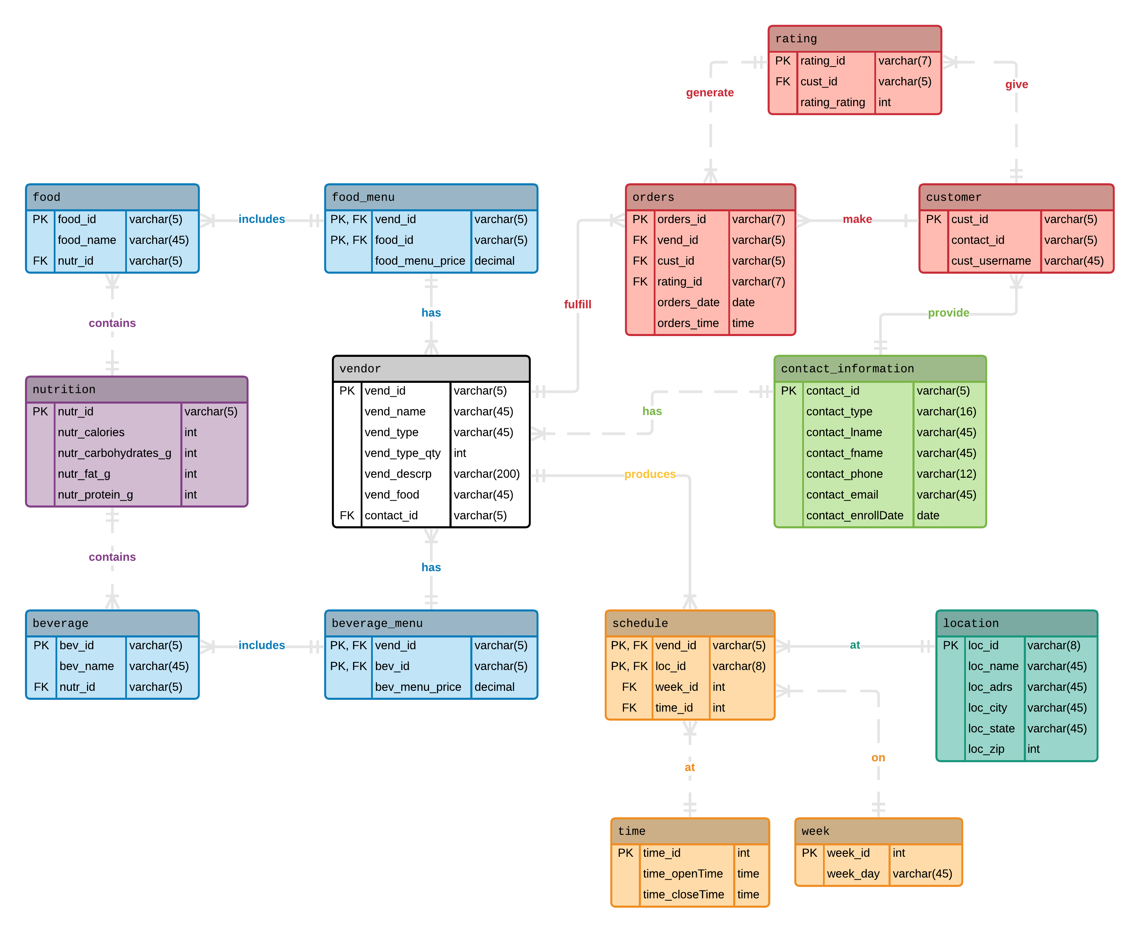
Physical Model

Slide 6
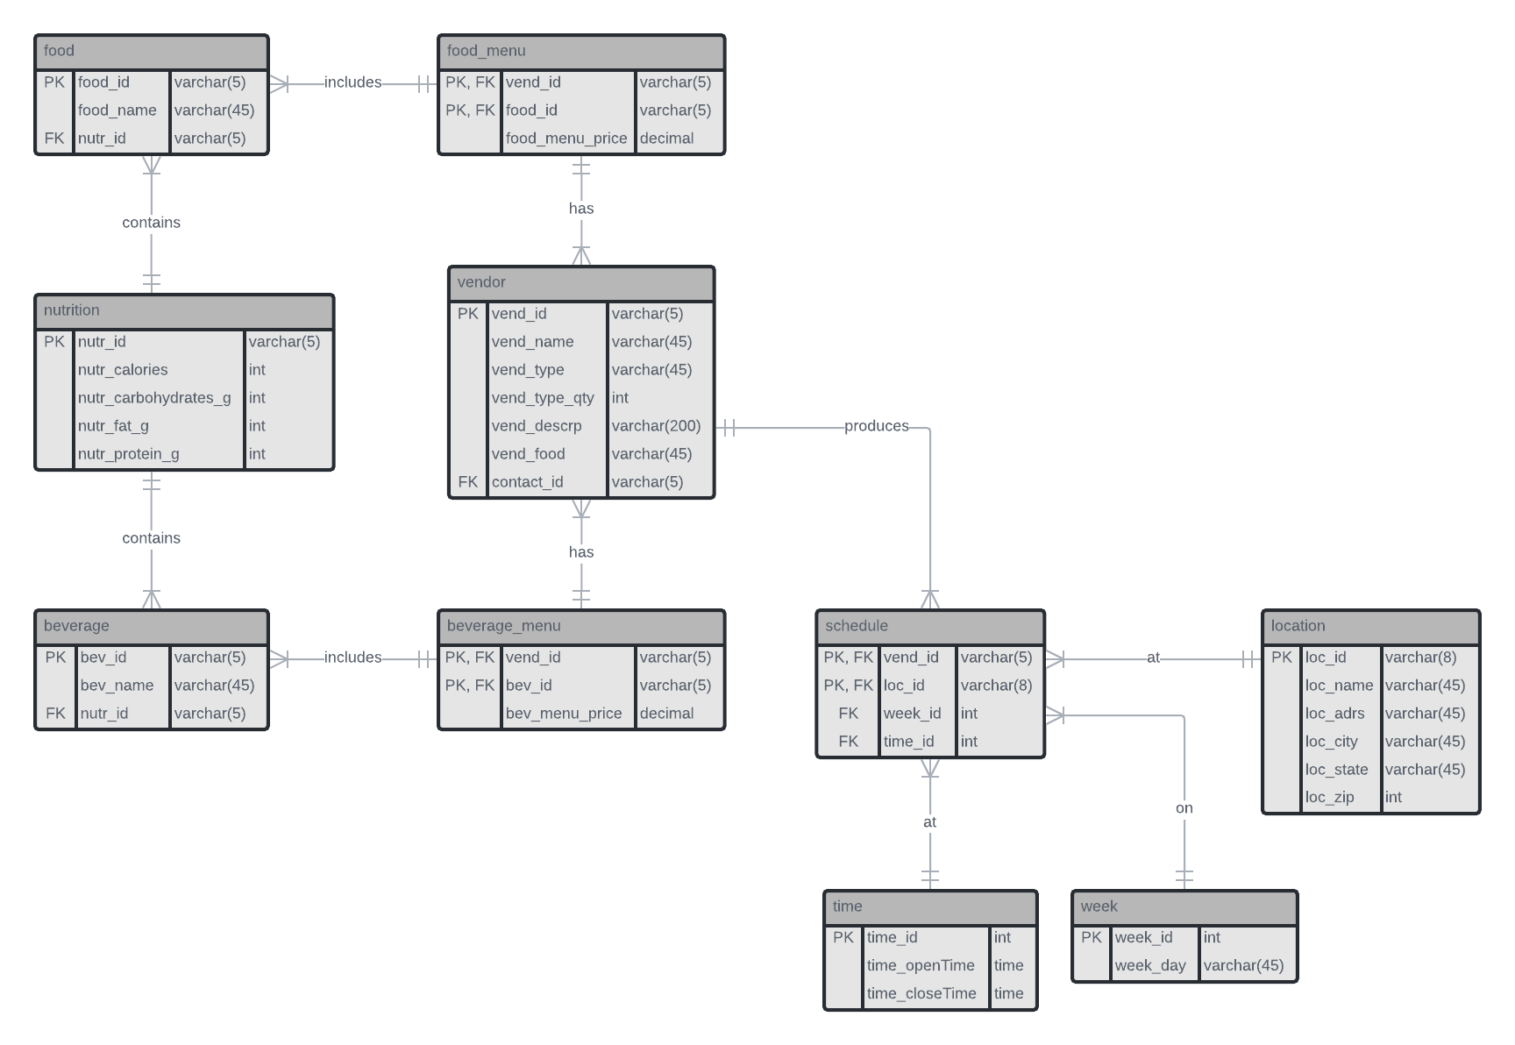
Customer View

Slide 7
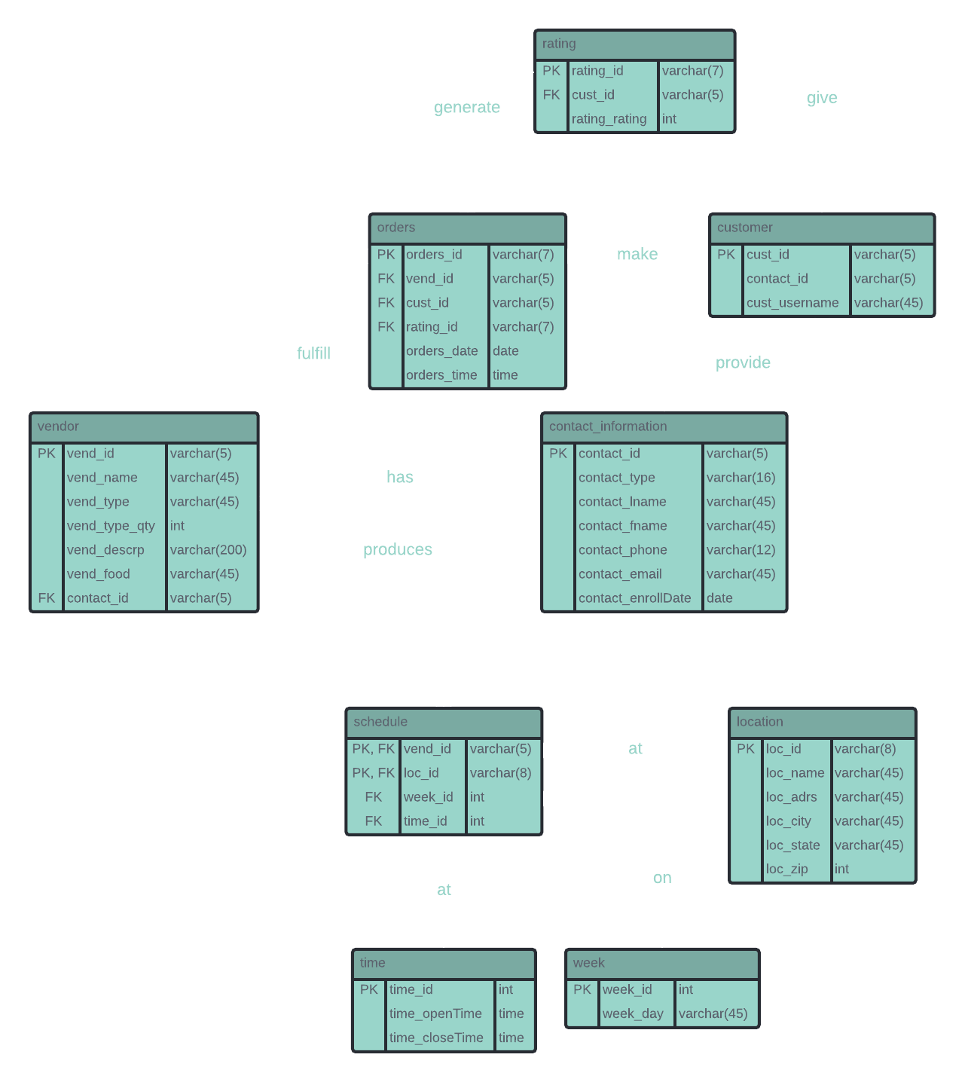
Vendor View

Slide 8
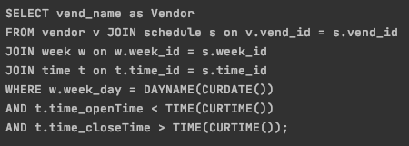

The Application
Automated Connection to Database!
Mode Selection from Console
Utilizes JDBC Protocols
Interesting and Exciting Queries:
What trucks are open RIGHT NOW?
Add an item to a truck menu

Slide 9
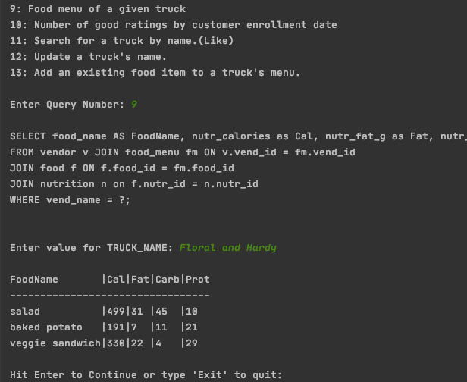
The Application: Console
"Perfectly" Formatted Tables
Exact Column Widths
Table-like Separator Lines
Handles:
Parameters
Action Queries
Like Parameters
Query Menu with Descriptions
Connection and Query Error Messaging
Messages for Try, Catch, Stack Trace

Slide 10
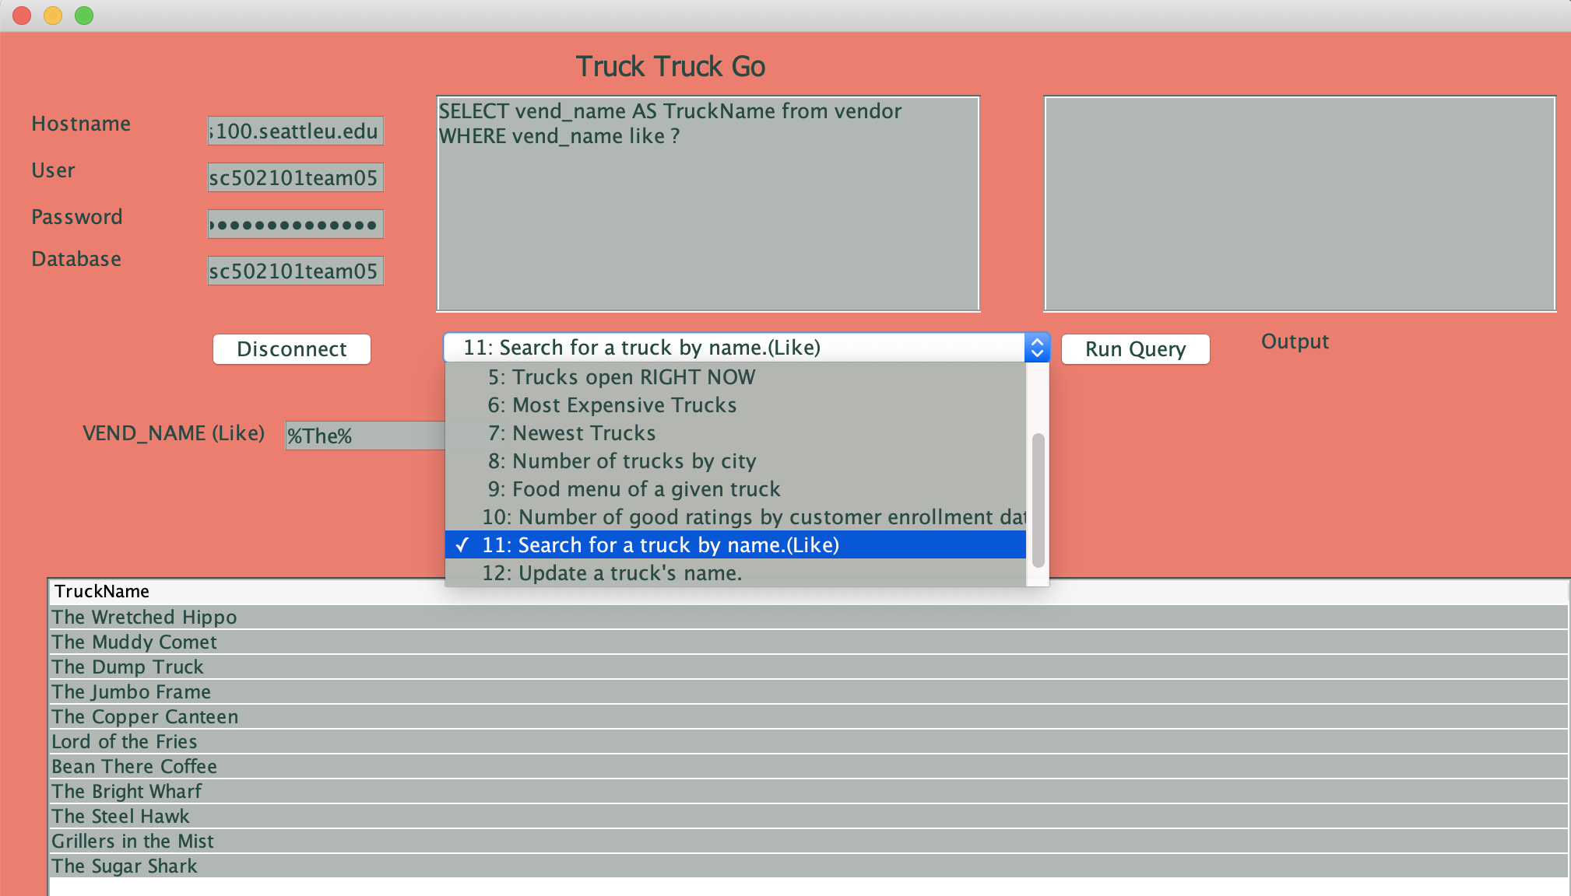
The Application: GUI
Exciting Three Tone Color Scheme!
Automatically Populated Connection Information!
Query Descriptions in Selection Pane
Interface Improvements!
Resize Query Dropdown
Components Placement

Slide 11
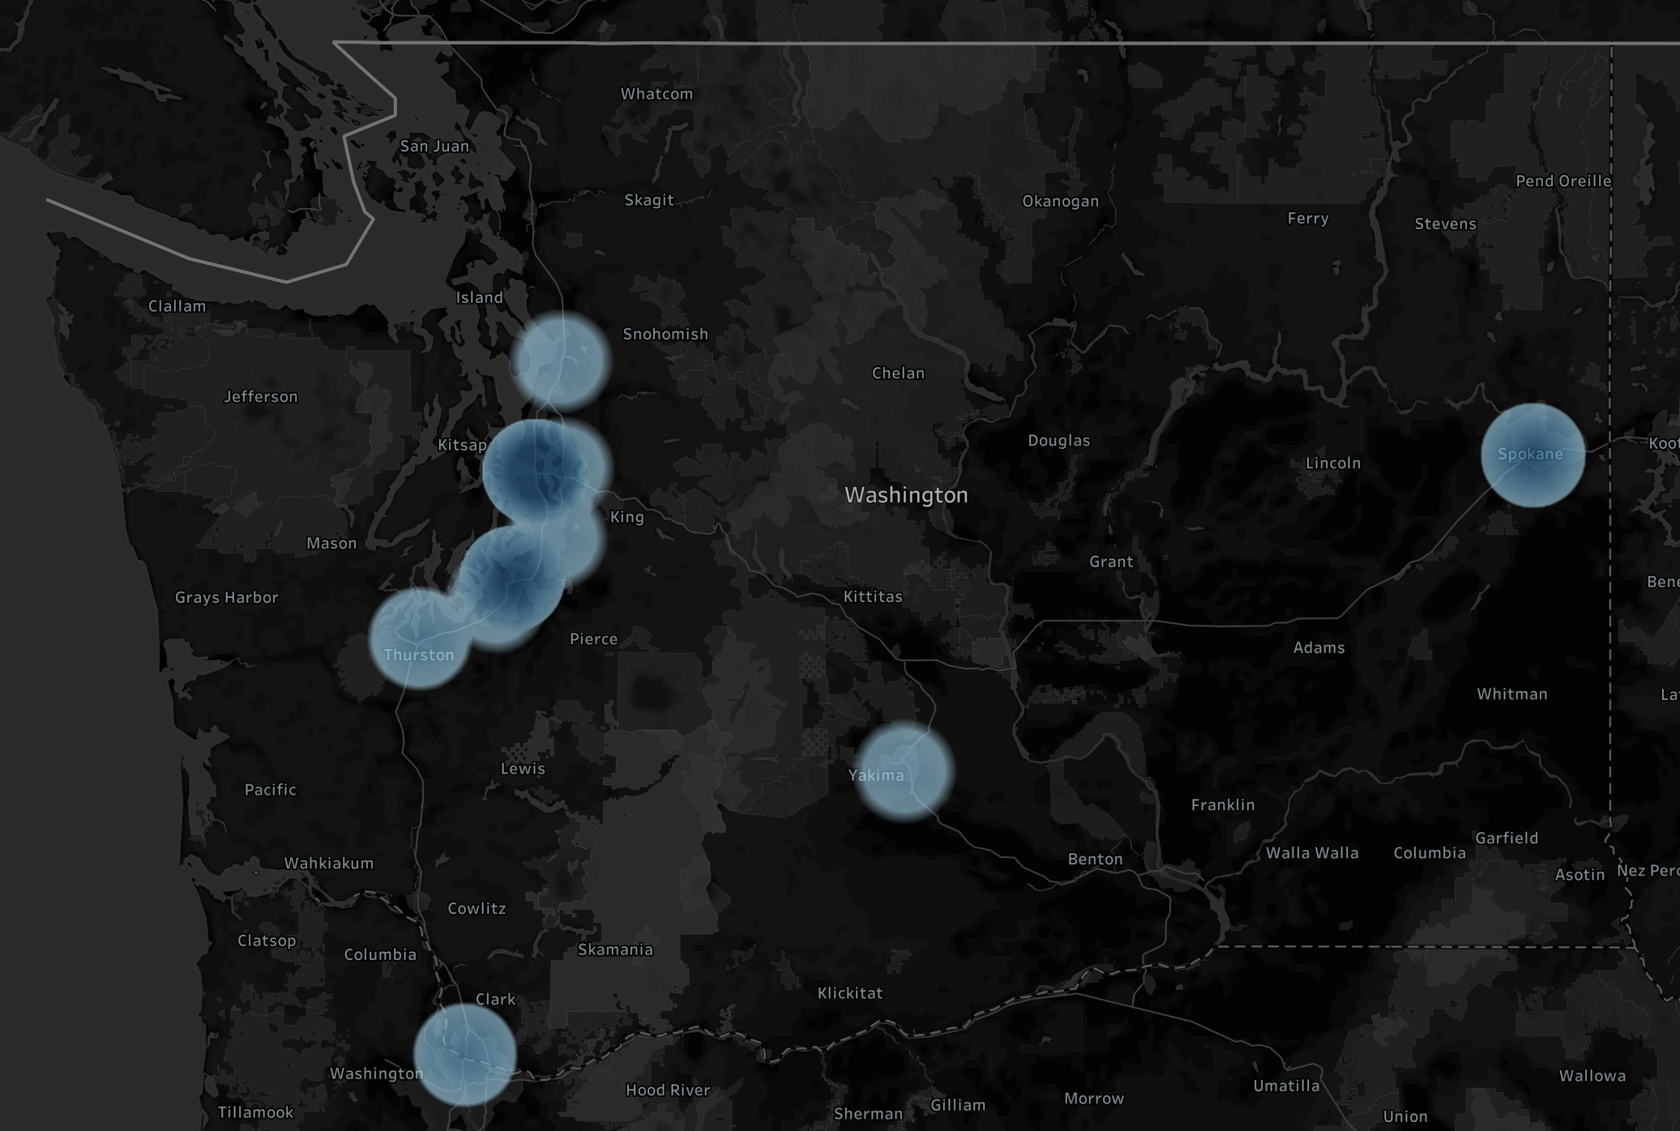
Business Intelligence
Food Truck Heat Map
Lets Users know where Food Trucks Congregate!
Filter by desired Cities or Zip Codes
Future Implementation: Real Time Food Truck Coordinates mean Greater Precision Tools to track down your Next Meal

Slide 12
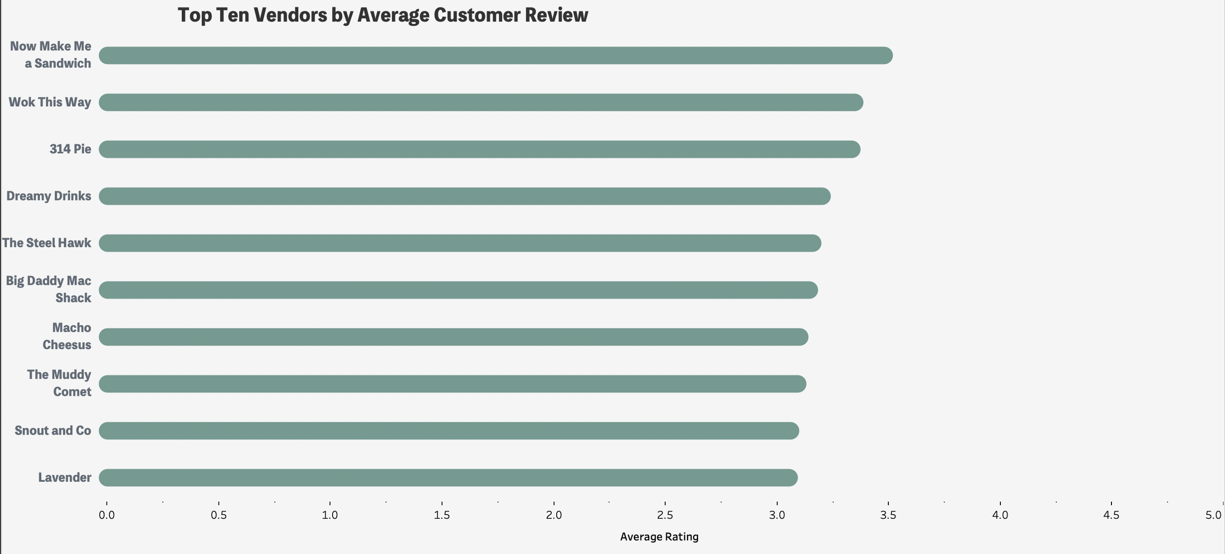
Business Intelligence
Find the Best Quality Food Trucks near you with our Collection of Customer Reviews
Filter Reviews by:
Number of Food Trucks
Default Settings to see all Food Trucks in the System

Slide 13
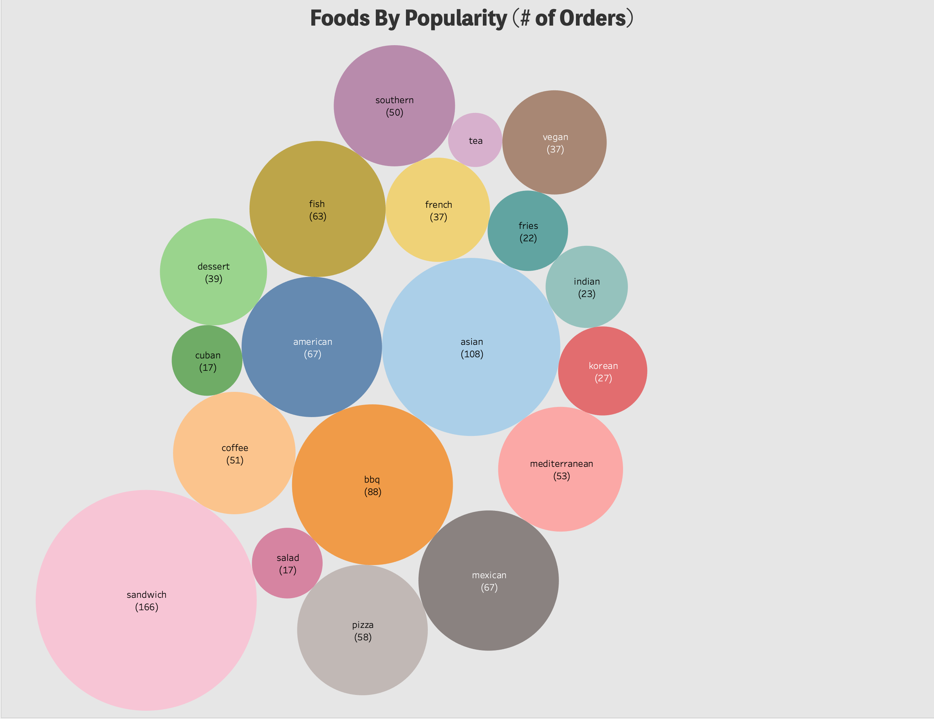
Business Intelligence
Not Sure what you want to order?
Popularity Tool allows Users to know what meals are most popular in their area
Filter to Find what Food Types might be nearby!

Slide 14


Questions?

