Slide 1
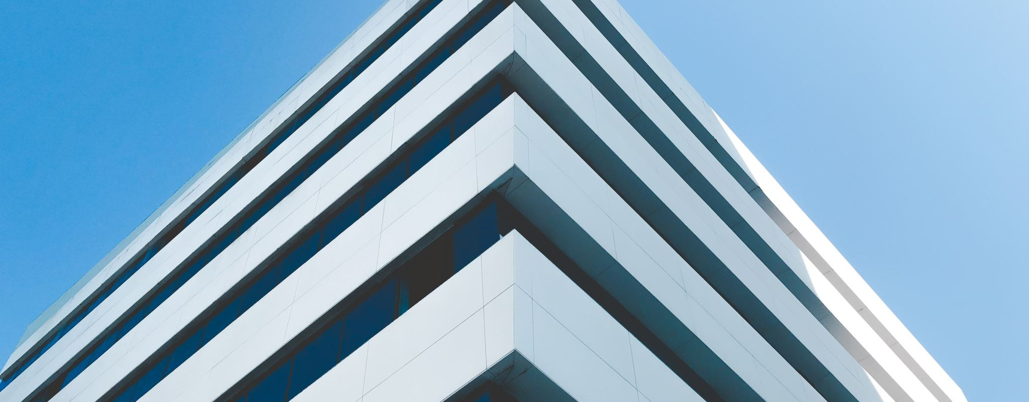
Final Project: Network design proposal for the new building
David Andrés Gómez Rincón
20201020031

Slide 2

Thank you

Slide 3
Problem definition
Dimensions of the building
Cable connections and Wireless connections (Interconnectivity)
Efficiency and low cost
Which network devices should be used?

Slide 4
Objectives
Gather information about the new building
Identify the optimal set of devices that will be used
Propose a topology to be implemented in the new building
Simulate the design of the proposed topology

Slide 5
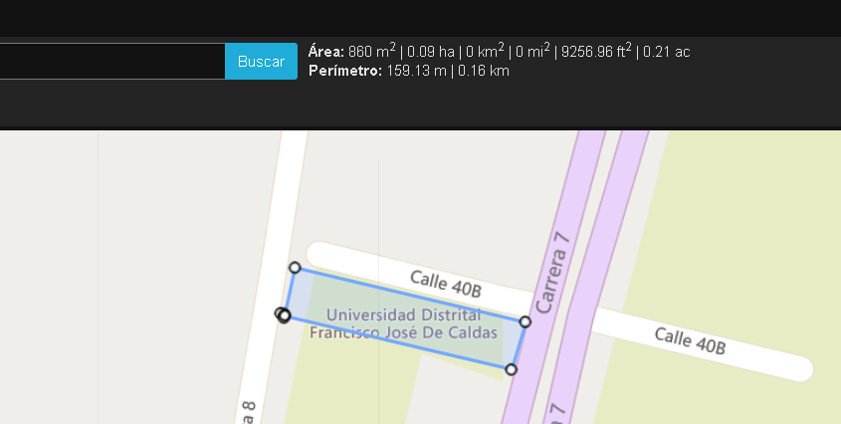
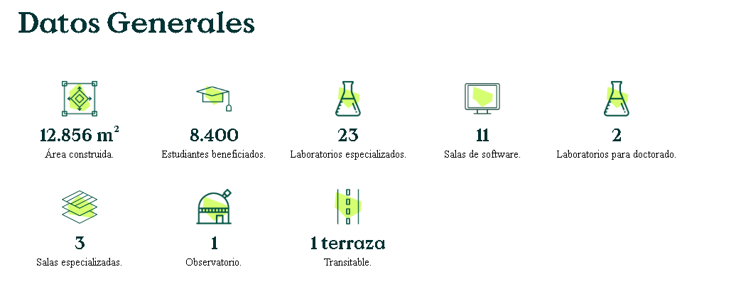
Infomation about the building

Slide 6
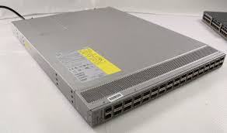
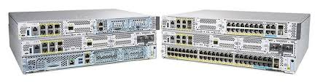
Devices research (4k full hd)
Edge Router: NCS 5011
Internal Router: Catalyst 8300-1N1S-4T2X

Slide 7
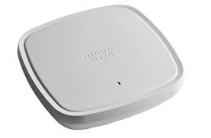
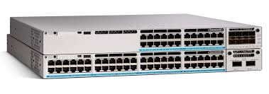
Devices Research
Access Point:Cisco catalyst 9130
Switch:Catalyst 9300 with 24-port 1G copper with modular uplinks

Slide 8
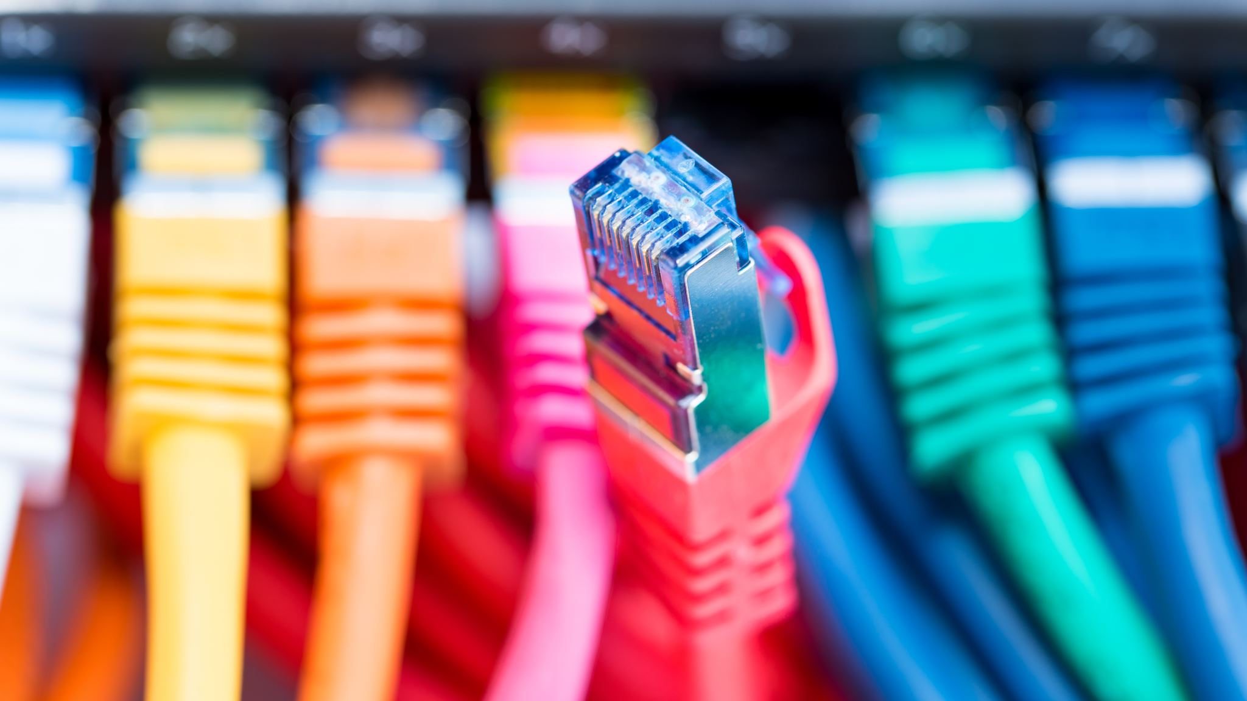
Devices Research
Cables: Ethernet Category 6A

Slide 9
Design proposal: sorted by cable connections and Wireless connections
Cable connections
Wireless connections
11 Software rooms
3 PhD rooms
2 Doctoral laboratories
Multiple classrooms
Astronomical observatory
Multiple classrooms
Study and consultation rooms
Rest and socializing rooms
Terrace
11 Wellness areas
X number of classrooms
Corridors and common areas

Slide 10
Distribution:
Average of 100 meters of cable, a total of 48800 meters
25 devices per informatics room, 18 romos
488 connections
1 switch every 24 end devices, that means 19 switches
An estimate of 4 servers
A Router per floor, only one Edge router
2 Access points per floor, 30 in total

Slide 11
Prices:
Routers: 559’082.120 COP
Access points : 209’610.660 COP
Switches: 389’515,599 COP
Cabling Price: 229’360.000 COP
Total Price: 1,387’568,379 COP

Slide 12
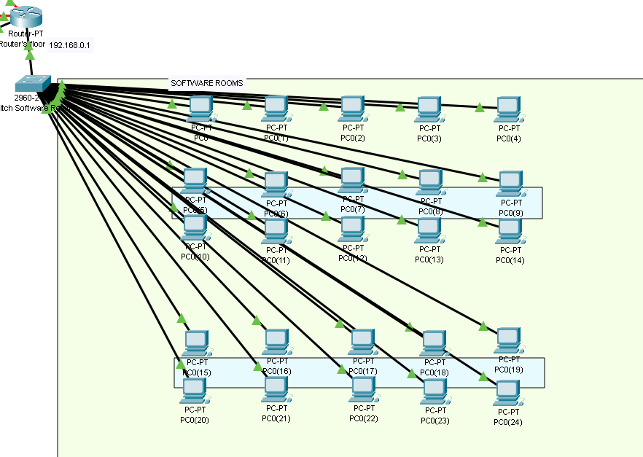
Design and simulation

Slide 13
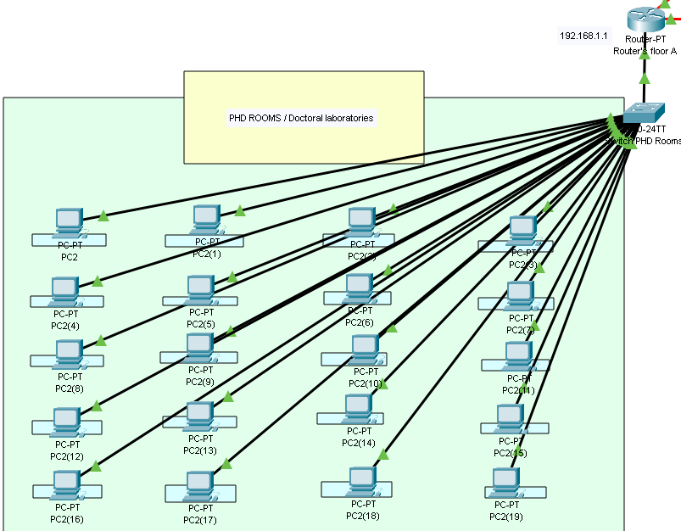

Slide 14
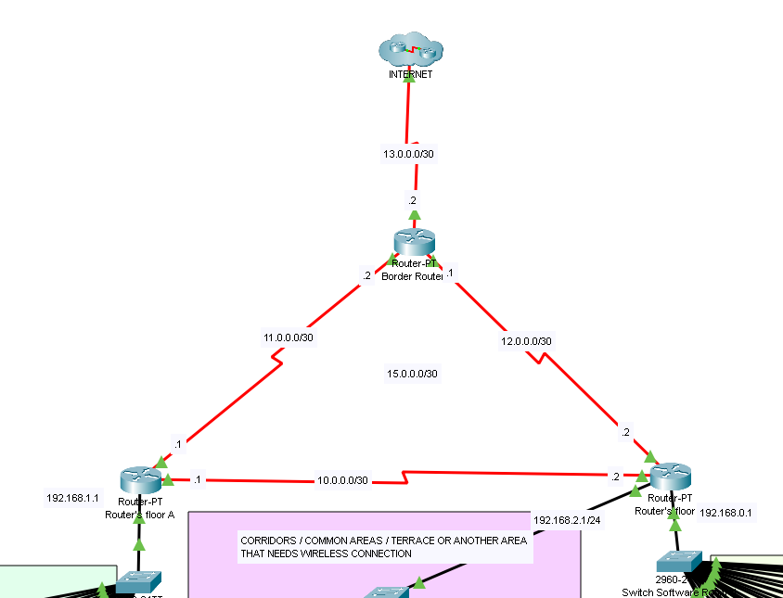
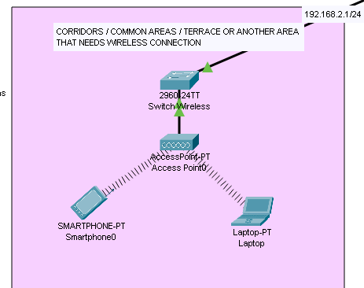

Slide 15

