Slide 1
Week 3 Assignment
Yufeng Zheng

Slide 2
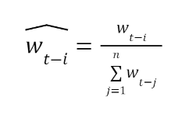
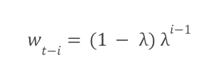
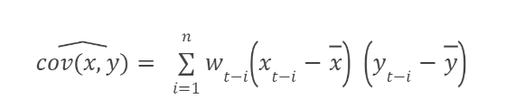
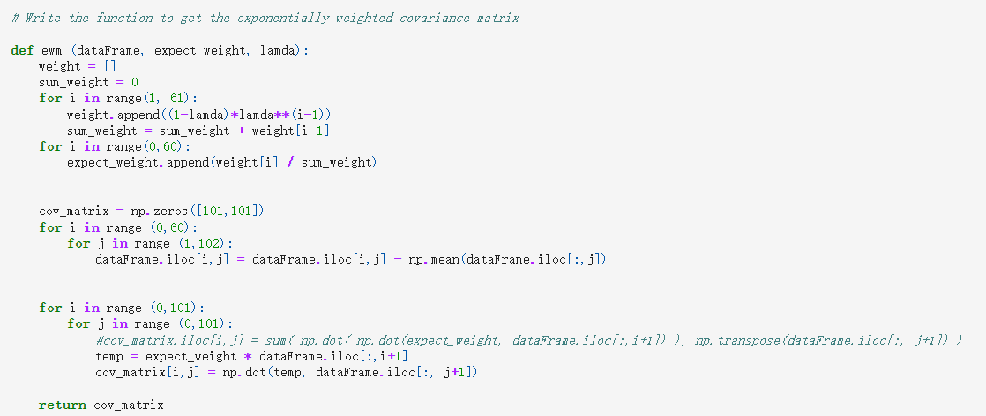
Question 1
I wrote a function named “ewm” to create the exponentially weighted covariance matrix. In this function, I just followed the formula in the note. First, I calculate the weight value. Then, I normalize the weight by using the individual weight value divide the total weight value. After, I subtract the each column’s mean for each element in the matrix. Then, I use the dot product to calculate the covariance matrix.

Slide 3
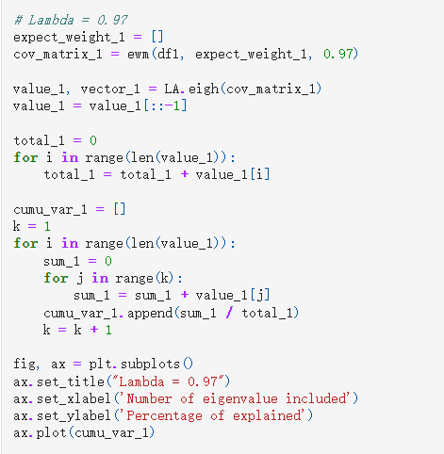
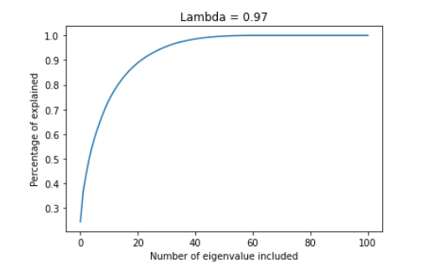
After writing this function, I plug lambda equal to 0.97, 0.7, and 0.85 into the function to see the cumulative variance explained by each eigenvalue for each lambda chosen. The basic math method is very simple. First, I use “eigh” function to calculate the eigenvalue and eigenvector for exponentially weighted covariance matrix. Second, I sort the eigenvalue from large to small. Third, I calculate the total value of the eigenvalue, then using cumulative eigenvalue divide the total value to calculate the percentage explained.
Using lambda = 0.97 as example

Slide 4
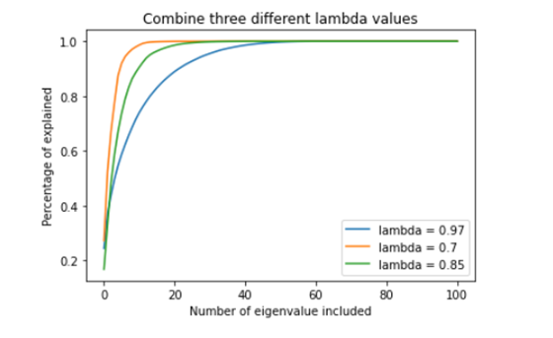
Result
Compare lambda for different values
From the plot, we can see that there needs more eigenvalues involved to explain the data when lambda become larger. Also, we can understand from math equation that W_(t-i) = (1-lambda)*lambda^(i-1). In our question, it means that when lambda increases, we are more care about recent data (give more weight for most recent data).

Slide 5
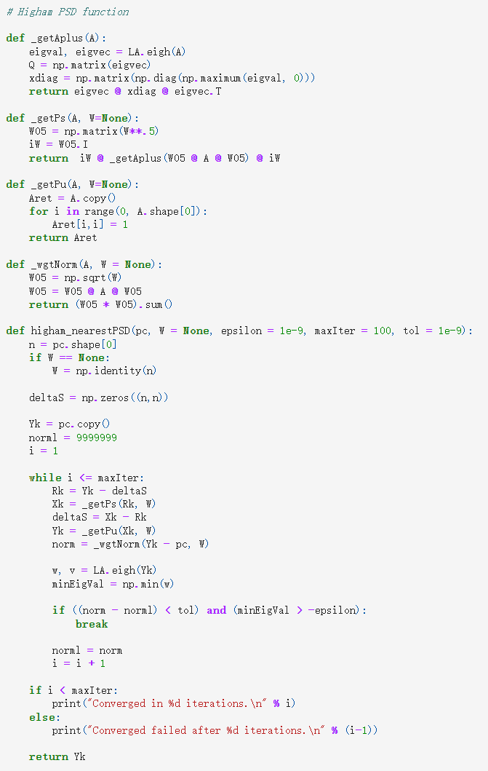
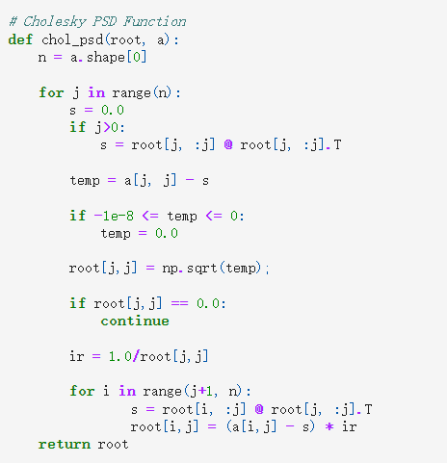
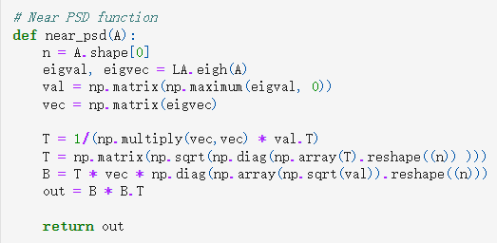
Question 2
Translate chol_psd(), near_psd(), and higham_psd() from Julia into Python

Slide 6
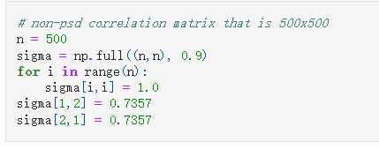
Data frame for this question
I simulate a matrix sigma (500X500) with all 1 on diagonal, and 0.9 for other elements. Also, the first two elements are changed to 0.7357.

Slide 7
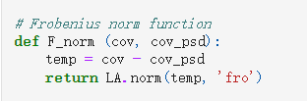
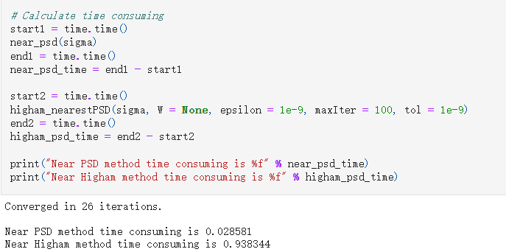
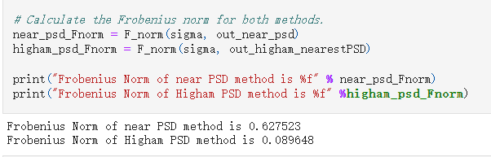
Calculate Norm
Record Time

Slide 8

result
I get the running time for near_psd() is 0.028581 and higham_psd() is 0.938344. The higham method will consume more time than near psd method. However, higham will give a nearer psd than near_psd(). I compare the norm for each method. We can think about the norm as the difference between the original matrix and psd matrix. Higham method gives a smaller Frobenius norm than near_psd method.

Slide 9
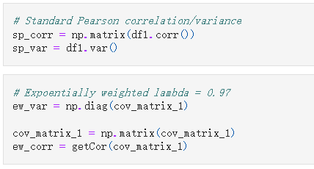
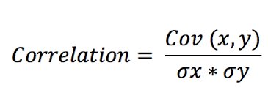
Question 3
First, I just use corr() and var() to find out the standard pearson correlation matrix and variance values for the data frame. Then, I also have the covariance matrix for lambda = 0.97 from question 1. Then, I use the formula that Cov_AB = Corr_AB * Var_A * Var_B to calculate the correlation matrix for exponentially weight matrix. The Var_i is the diagonal values for exponentially weight covariance matrix.

Slide 10
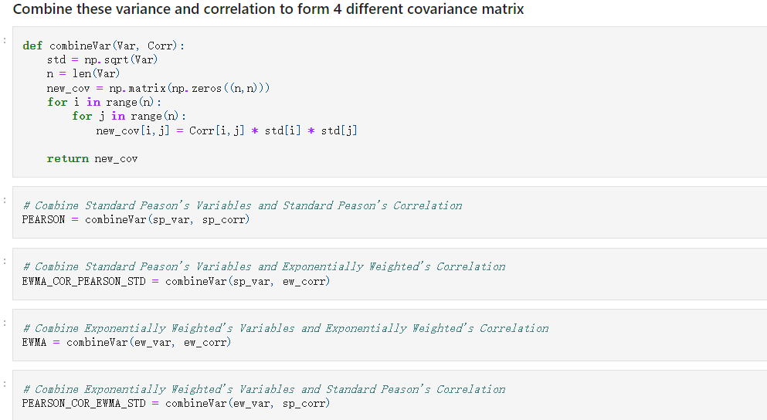
Then, now we have pearson’s variance, pearson’s correlation, ewma’s variance, and ewma’s correlation. Applied formula Cov_AB = Corr_AB * Var_A * Var_B, we can get peason’s covariance matrix, ewma’s covariance matrix, covariance matrix combined by pearson’s variance and ewma’s correlation, and covariance matrix combined by pearson’s correlation and ewma’s variance.

Slide 11
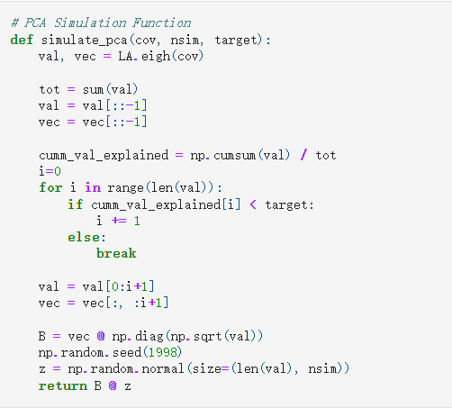
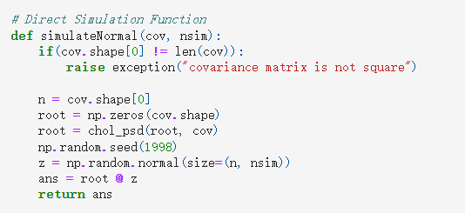
Normal Simulation
PCA Simulation

Slide 12
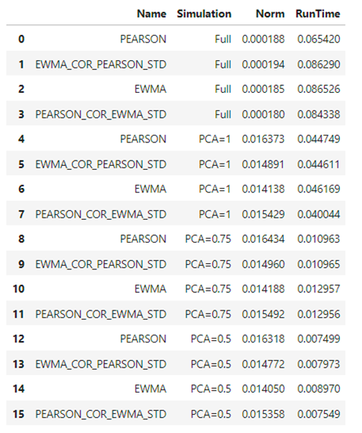
result
We can see from this plot that direct simulation give the most accuracy matrix, but it spend more time. With increasing of PCA explained, the norm become smaller, but we need to spend more time to run the code. This is a trade off between the accuracy and spending time.

