Slide 1
COMPILER DESIGN
String Processing Language
A mini compiler front end in C
Project Based Learning Activity
Presentation and demonstration 23 October 2026
Group and member details to be completed
String Processing Mini Compiler in C
01
Notes:
Introduce the allotted topic. This is a C99 compiler front end with a separate output preview interpreter. Add the actual group number, names and roll numbers before presentation. The topic and date come from the supplied assignment.

Slide 2
COMPILER DESIGN
Language and required features
string name = "World";
string greeting;
greeting = "Hello, " + name + "!";
print(greeting);
One global scope. String is the only type.
Double-quoted literals, parentheses and // comments.
String Processing Mini Compiler in C
02
Notes:
Source: examples/hello.str and docs/grammar.md. Walk through both declaration forms, assignment, concatenation, and print. Every statement ends with a semicolon.

Slide 3
COMPILER DESIGN
Compiler pipeline
01 Source file and lexical analysis
02 Tokens and recursive-descent parsing
03 AST and semantic analysis
04 Accepted program and preview output
Diagnostics identify the phase, line and byte column.
String Processing Mini Compiler in C
03
Notes:
The implementation is src/mini_compiler.c. Explain the distinction between the three compiler-front-end phases and the optional interpreter. A failed phase prevents preview execution.

Slide 4
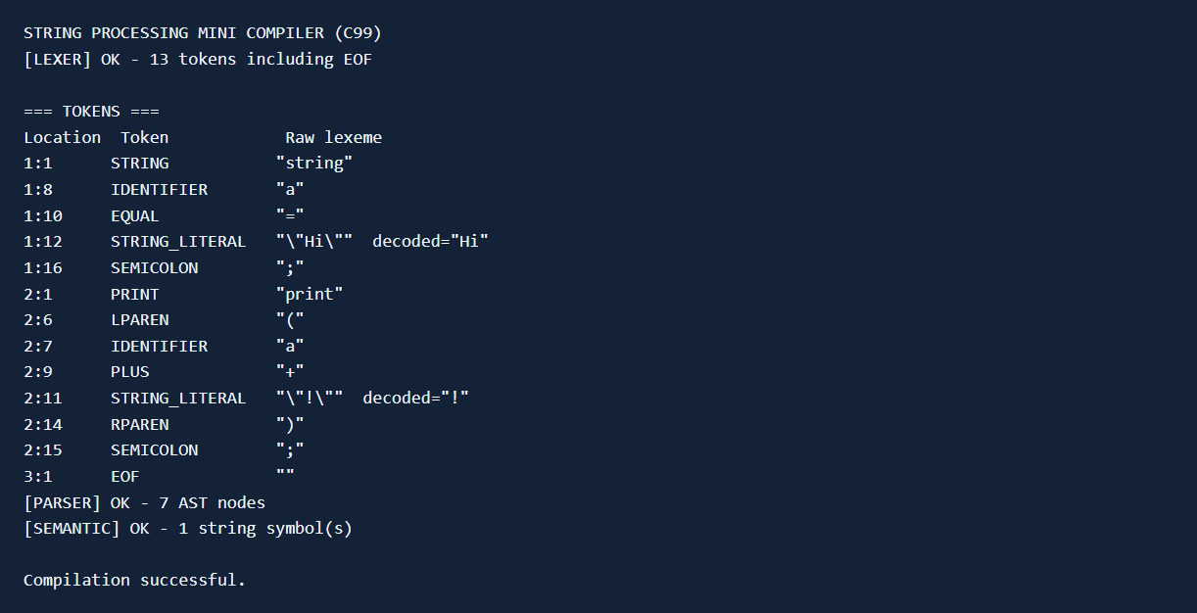
COMPILER DESIGN
Lexical analyzer
Positioned tokens
Decoded literals
Validated escapes
String Processing Mini Compiler in C
04
Notes:
Source: lex() in src/mini_compiler.c and screenshots/transcripts/02_tokens.txt. The raw literal retains its source spelling, while decoded text is stored separately. Identifier matching happens before keyword classification.

Slide 5
COMPILER DESIGN
Grammar transformations
Original expression
After removing left recursion
Expr -> Expr + Term
| Term
Expr -> Term Tail
Tail -> + Term Tail
| epsilon
Left-factored declaration
Decl -> string id Init ;
Init -> = Expr | epsilon
String Processing Mini Compiler in C
05
Notes:
Source: docs/grammar.md. The original CFG has immediate left recursion in Program and Expr. Explain that the loop-based expression parser builds a left-associated AST after removing left recursion. Declarations share a string id prefix.

Slide 6
COMPILER DESIGN
Abstract syntax tree
Program
Declaration a
Literal "Hi"
Print
Concat
Identifier a
Literal "!"
string a = "Hi";
print(a + "!");
The parser uses the transformed LL(1) grammar.
String Processing Mini Compiler in C
06
Notes:
Source: examples/ast_demo.str and the executable AST. AST nodes omit punctuation and helper nonterminals. Show --ast and explain --dot. Existing readable export paths are preserved, so choose a new DOT filename for each export.

Slide 7
COMPILER DESIGN
Semantic analysis
Declaration before use
Initialization before reading
No duplicate declarations
String values within 1023 bytes
string x;
print(x); // semantic error
String Processing Mini Compiler in C
07
Notes:
Source: analyze() and expression_length() in src/mini_compiler.c. Symbols are inserted uninitialized before checking an initializer. Failed assignment does not initialize a previously uninitialized variable. String type follows from the language grammar.

Slide 8
COMPILER DESIGN
String literals and escapes
print("A\nB");
print("She said: \"Hi\"");
print("Path: C:\\project");
Accepted escapes: \n \t \r \\ \"
Empty strings are valid. Invalid escapes stop compilation.
String Processing Mini Compiler in C
08
Notes:
Source: examples/escapes.str. Accepted escapes are newline, tab, carriage return, backslash and double quote. Decode once. Raw newline, invalid escape or missing closing quote produces a lexical error.

Slide 9
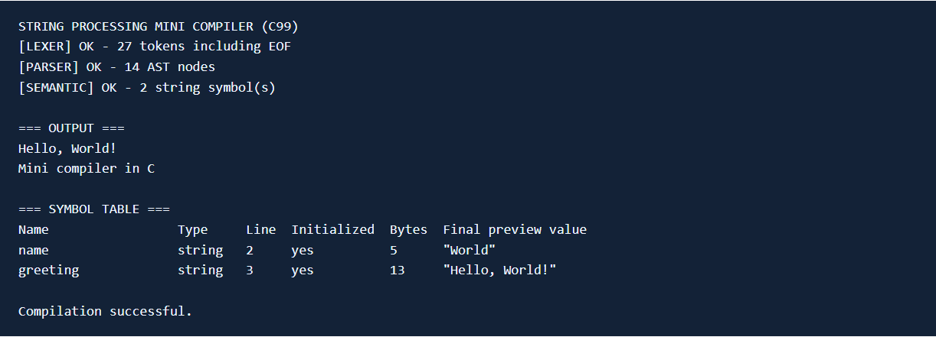
COMPILER DESIGN
Successful program demonstration
String Processing Mini Compiler in C
09
Notes:
Source: screenshots/transcripts/01_success.txt, generated by build/mini_compiler.exe examples/hello.str --run --symbols. Captured on 20 October 2026. The screenshot shows actual executable output, rendered for readability.

Slide 10
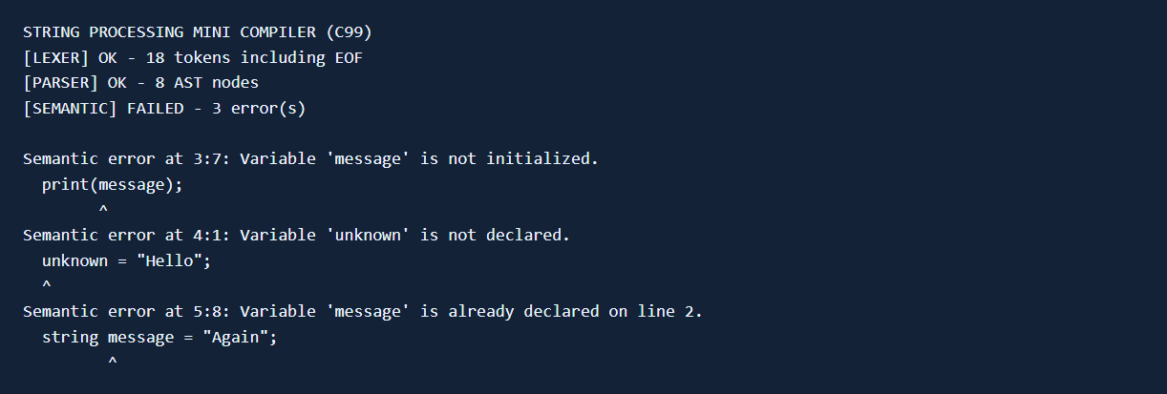
COMPILER DESIGN
Error detection
String Processing Mini Compiler in C
10
Notes:
Source: screenshots/transcripts/07_semantic_errors.txt. The error example deliberately returns 1. Show examples/lexical_error.str and examples/syntax_error.str during the live demonstration as well. No compilation error permits the interpreter to run.

Slide 11
COMPILER DESIGN
Testing and scope
26 automated test methods pass
Valid programs, error phases, source locations,
fixed capacities, file handling and AST export.
Scope: one string type and one global scope.
No input, loops, functions or machine-code generation.
String Processing Mini Compiler in C
11
Notes:
Source: tests/test_compiler.py and local test execution. 26 test methods pass, some with multiple cases. Python is only a development test runner. The implementation uses standard C99. A fresh clone requires a C compiler. No machine-code generation is implemented.

Slide 12
COMPILER DESIGN
Individual contributions
Names and roll numbers to be completed by the group
Member 1 Actual work and evidence to be entered
Member 2 Actual work and evidence to be entered
Member 3 Actual work and evidence to be entered
Member 4 Actual work and evidence to be entered
Adjust the rows to your allotted group size.
String Processing Mini Compiler in C
12
Notes:
Complete this slide with actual names, roll numbers and the work each member performed. Suggested areas are not a claim that any person completed them. Adjust rows to actual group size. Use docs/contributions.md as the evidence log. Review and understand assistant-prepared material and follow institutional disclosure requirements.

