Slide 1


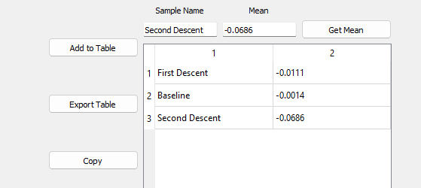
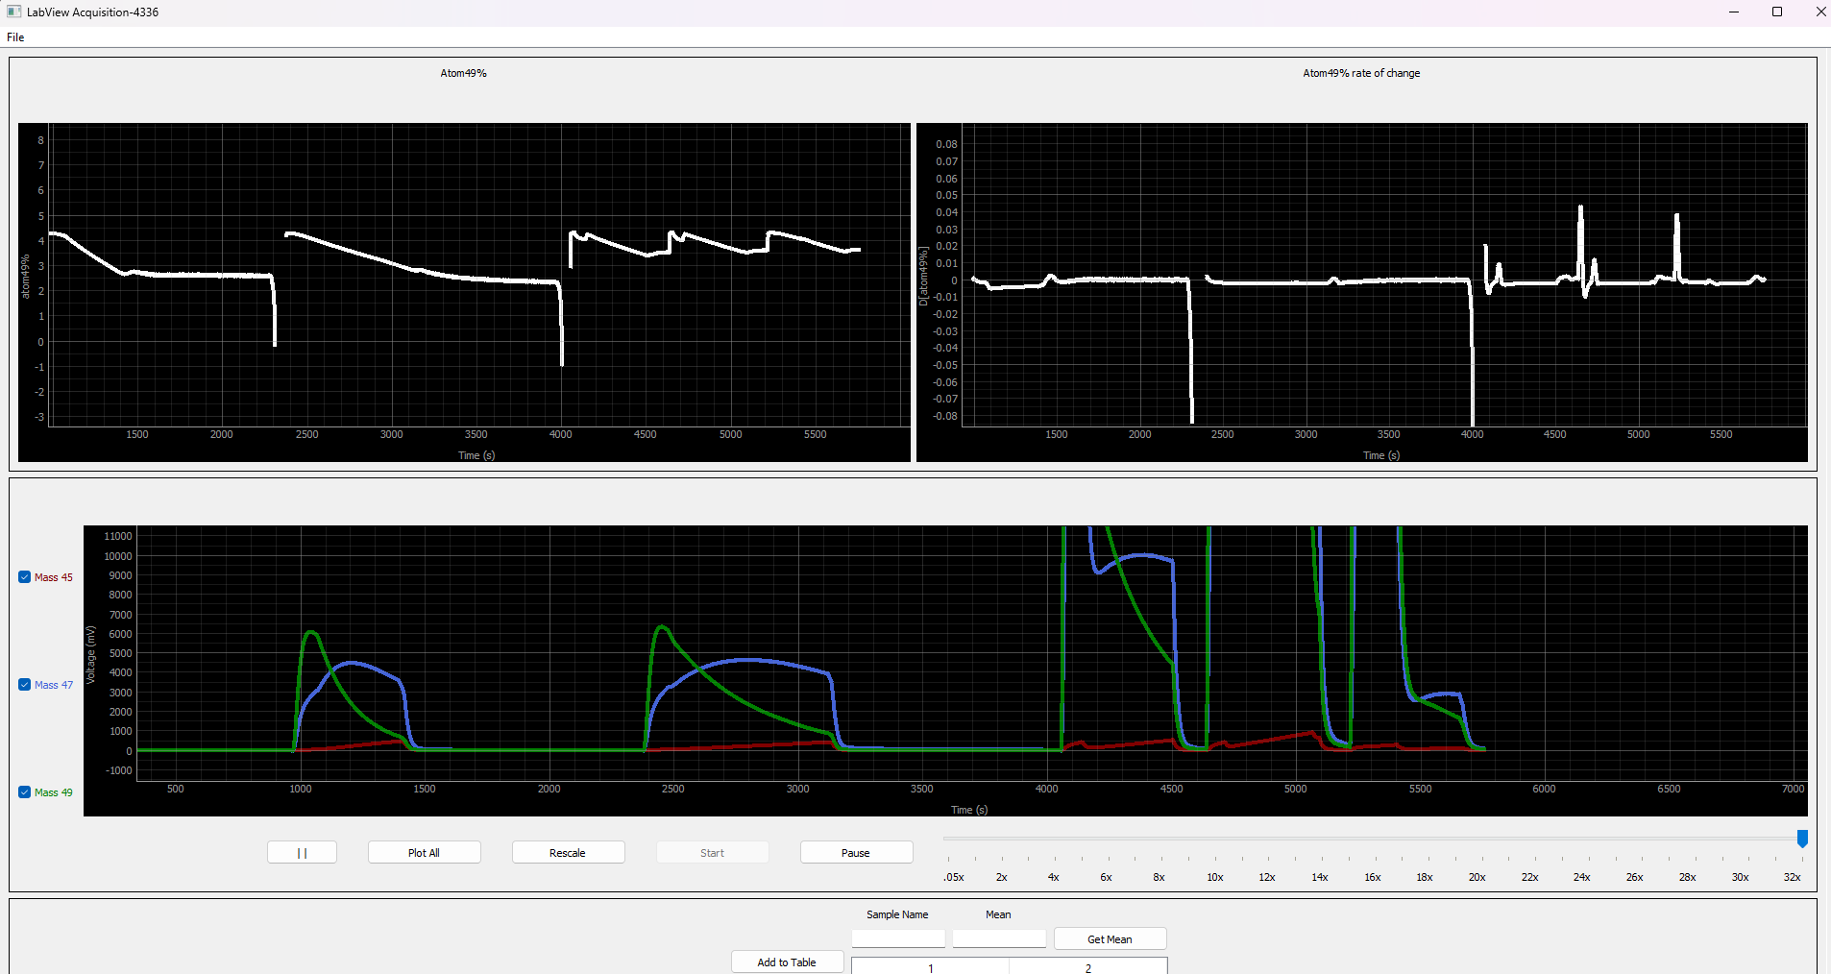
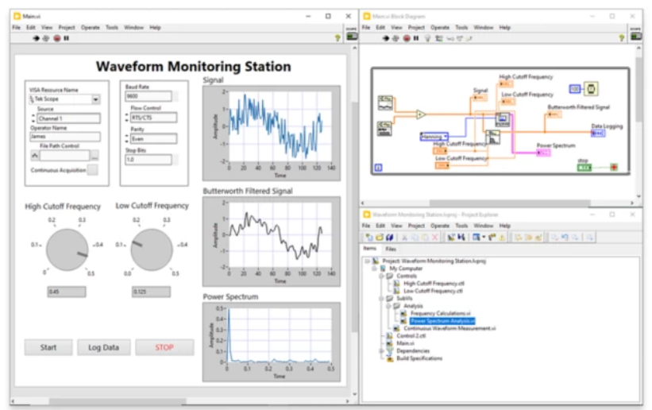
Mass Spectrometer Interface Sponsor: WSU School of Biology Cousins Lab Mentor: Parteek Kumar Erik Holtrop, Kyler Kupp
Abstract
Process and graph mass spectrometer data
Develop a modular system for different data perspectives and transformations.
Efficient data processing, structured storage, and intuitive visualization.
Our Solution: A Powerful Python-based Graph Interface
Process data from CSV’s
Extract relevant datapoints
Calculate derived values
Display data in one or more graphs
Different versions for different situations
Sample or complete exporting
Figure 3: Sampling Feature Screenshot
Future Work
Improve automatic data-intake speed management
Improve performance
Decrease latency
Previous Solution: LabVIEW
Unfamiliar for newer generation of researchers/developers
Incompatible with Git
Poor cross-platform support
Paid licensing
Different version for each instrument
Glossary
Mass Spectrometer – An instrument used to identify the molecular composition of an object, liquid, or gas.
CSV – A universal spreadsheet format; Comma-Separated Values
Figure 2: Interface Project Screenshot
Compatibility Module
Converts data from secondary mass spectrometer to the forma of first mass spectrometer
Integrated directly into interface module
Acknowledgements
Dr. Asaph Cousins, Diego Zamudio Ayala
Team Linnaea Borealis
Figure 1: LabVIEW Screenshot

