Slide 1
UpLift
Update 4

Slide 2
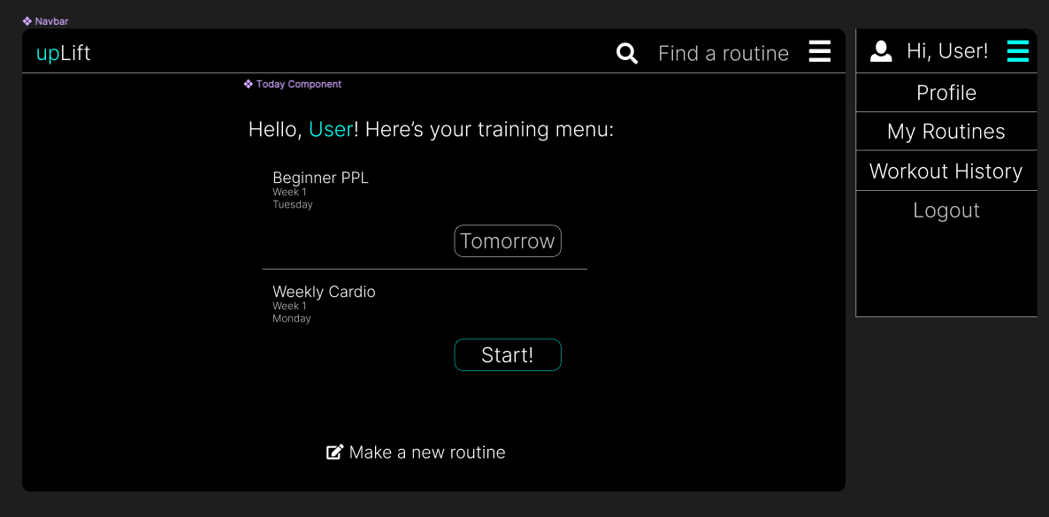
Dashboard

Slide 3
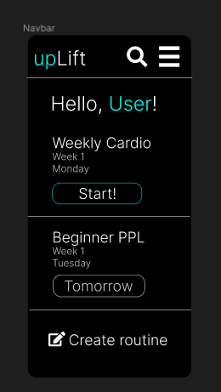
Mobile Dashboard

Slide 4
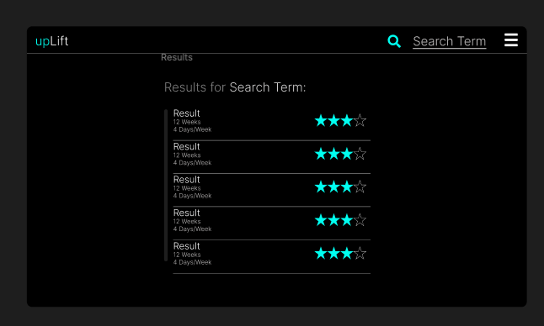
Search Results

Slide 5
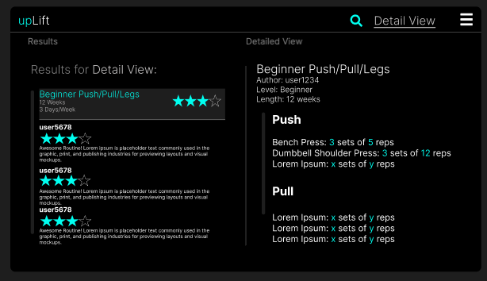
Detail View

Slide 6
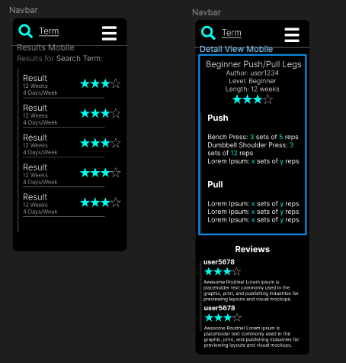
Mobile Search Views

Slide 7
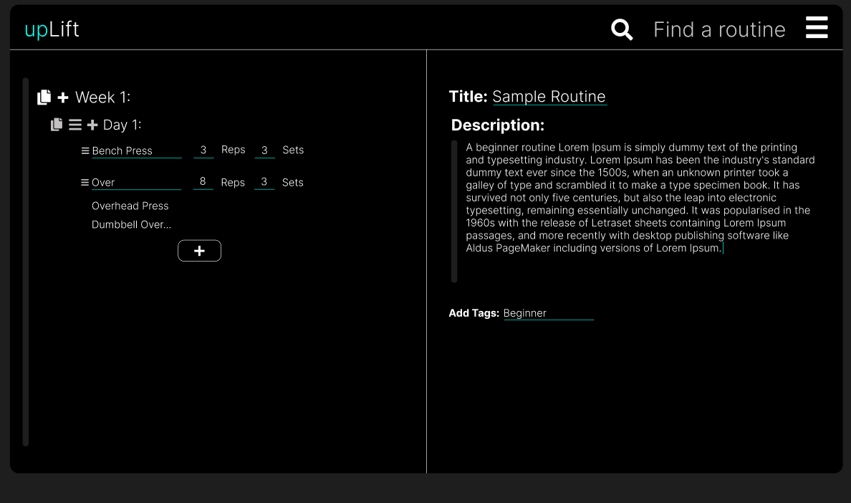
Editor View

Slide 8
Notes
I didn’t do a mobile view for the editor because it’s self explainatory, the columns go below each other and everything gets narrower.
Also I was at the end of my patience with figma.
Design of the workout tracking portions will be handled after the fundamental functionality is figured out.
Next Steps:
Development starts!
We’re on time, everything is great.

Slide 9
Goals
Fit test the tech stack (Firebase, Nuxt, Tailwind, Algolia, Firebase Auth).
What I mean by this is literally just handle the barebones setup of these, linking the projects and all that.
user login and registration( Firebase data models, javascript functions, frontend)
- Start Routine Editor ( Firebase data models, javascript functions)

