Slide 1
uplift!
Presentation 3

Slide 2
Major updates!
Firebase is going to make my life MUCH easier.
No separate API will be needed, all will be handled between frontend and Firebase
As such, here are updated diagrams and timelines

Slide 3
Design Timeline
Use Case diagram (1 day)
System Architecture diagram (1 day)
Data Flow, User Flow, System Sequence Diagrams (2 days)
Database diagram (2 days)
UI Design ( 2 weeks). Each includes computer, tablet, and mobile layouts. Excess time will be used for refinement.
Homepage ( 1 day)
Routine Creator (3 days)
Routine Viewer ( 1 day)
Routine Search ( 1 day)
Workout Editor ( 2 days)
Workout List ( 1 day)
Login/Register ( 1 day)
Profile( 1 day)

Slide 4
Development Timeline
Test cases should be created before starting on each component.
Fit Test: Create ultra-barebones frontend and database, test CRUD of basic data. (1 day)
User Collection: Create the collection for user accounts.( 1/2 day)
User Functions; Create JS functions to handle user data CRUD (2 days)
User Authorization: Add firebase auth to frontend (1 day)
Login frontend: Create frontend page to login a user and send them to dummy homepage.(1 day)
Register frontend: Create registration page to create new users.(1 day)
Navbar: Create site navigation bar. (1 day)
Exercise collection: Create collection for comon exercises, make visible to all users.(1 day)
Exercise functions: Create JS functions to CRUD exercises. ( 2 days)
Routine collection: Create Database collections related to storing routines. Control edit/delete access by user. (1 day)

Slide 5
Development Timeline (2)
Routine functions: Create JS functions to CRUD reviews.( 2 days)
Routine create frontend: Create view to create a new routine. (3 days)
Routine list frontend: Create page for viewing list of public routines created by all users. ( 1 day)
Routine serach integraton: Create JS functions to integrate with Algolia for serach of routines. (1 day)
Routine search frontend: Allow for searching of routines. Should allow for filtering on various database fields.(2 days)
Workout Collection: Create collection to track instances of working out. Must be associated with routines and only visible to user that created it.(1 day)
Workout Tracking functions: Create JS functions to CRUD workout data. ( 2 days)
Workout Editor frontend: Start a workout, then be guided through all exercises in a routine. Prompts for weightsxreps throughout. If first workout of routine, then ask for initial values. Workout controller should be aware of former workouts to dictate weight increases/decreases. These will be based on what is dictated by the routine. ( 3 days)
Workout list frontend: Get a list of each time you've worked out, and be able to open workout objects to see how you did. ( 1 day)
Homepage Frontend: A homepage that informs you of what workout is due for that day, and also provides access to all other features of the site. ( 2 days)
User profile frontend: Change your username, contact info, reported weight, age, and other details. ( 1 day)

Slide 6
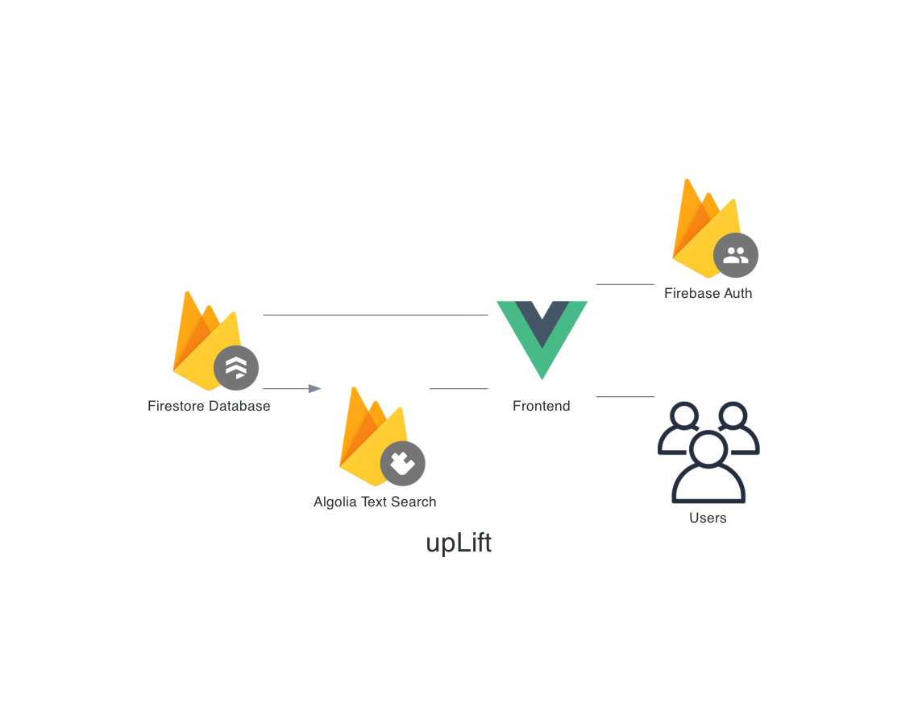
System Architecture

Slide 7
Updated Tech Stack
Nuxt.js/Vue frontend
Algolia (Search)
Firestore (Database)
Firebase Auth (Auth)
neovim (text editor)
TailwindCSS (CSS classes)

Slide 8
Other Notes
- I dropped the System Sequence Diagram because given the amount of time I have, the user flow diagram does enough of the same things for me.

Slide 9
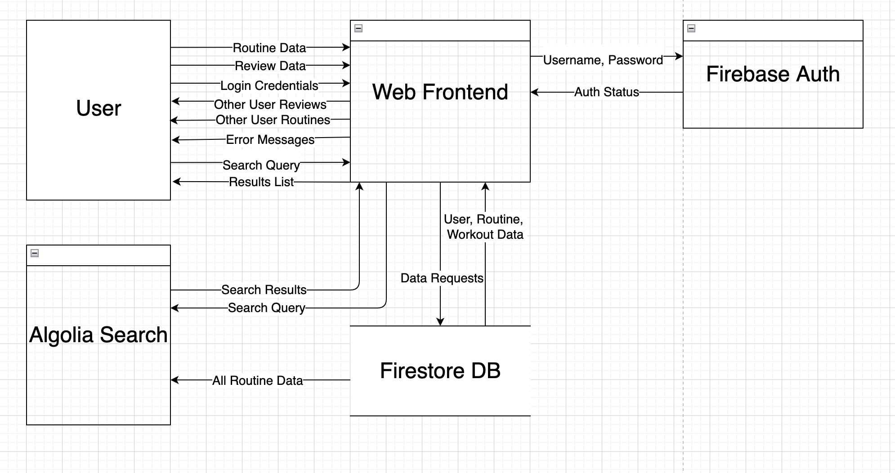
Data Flow Diagram

Slide 10
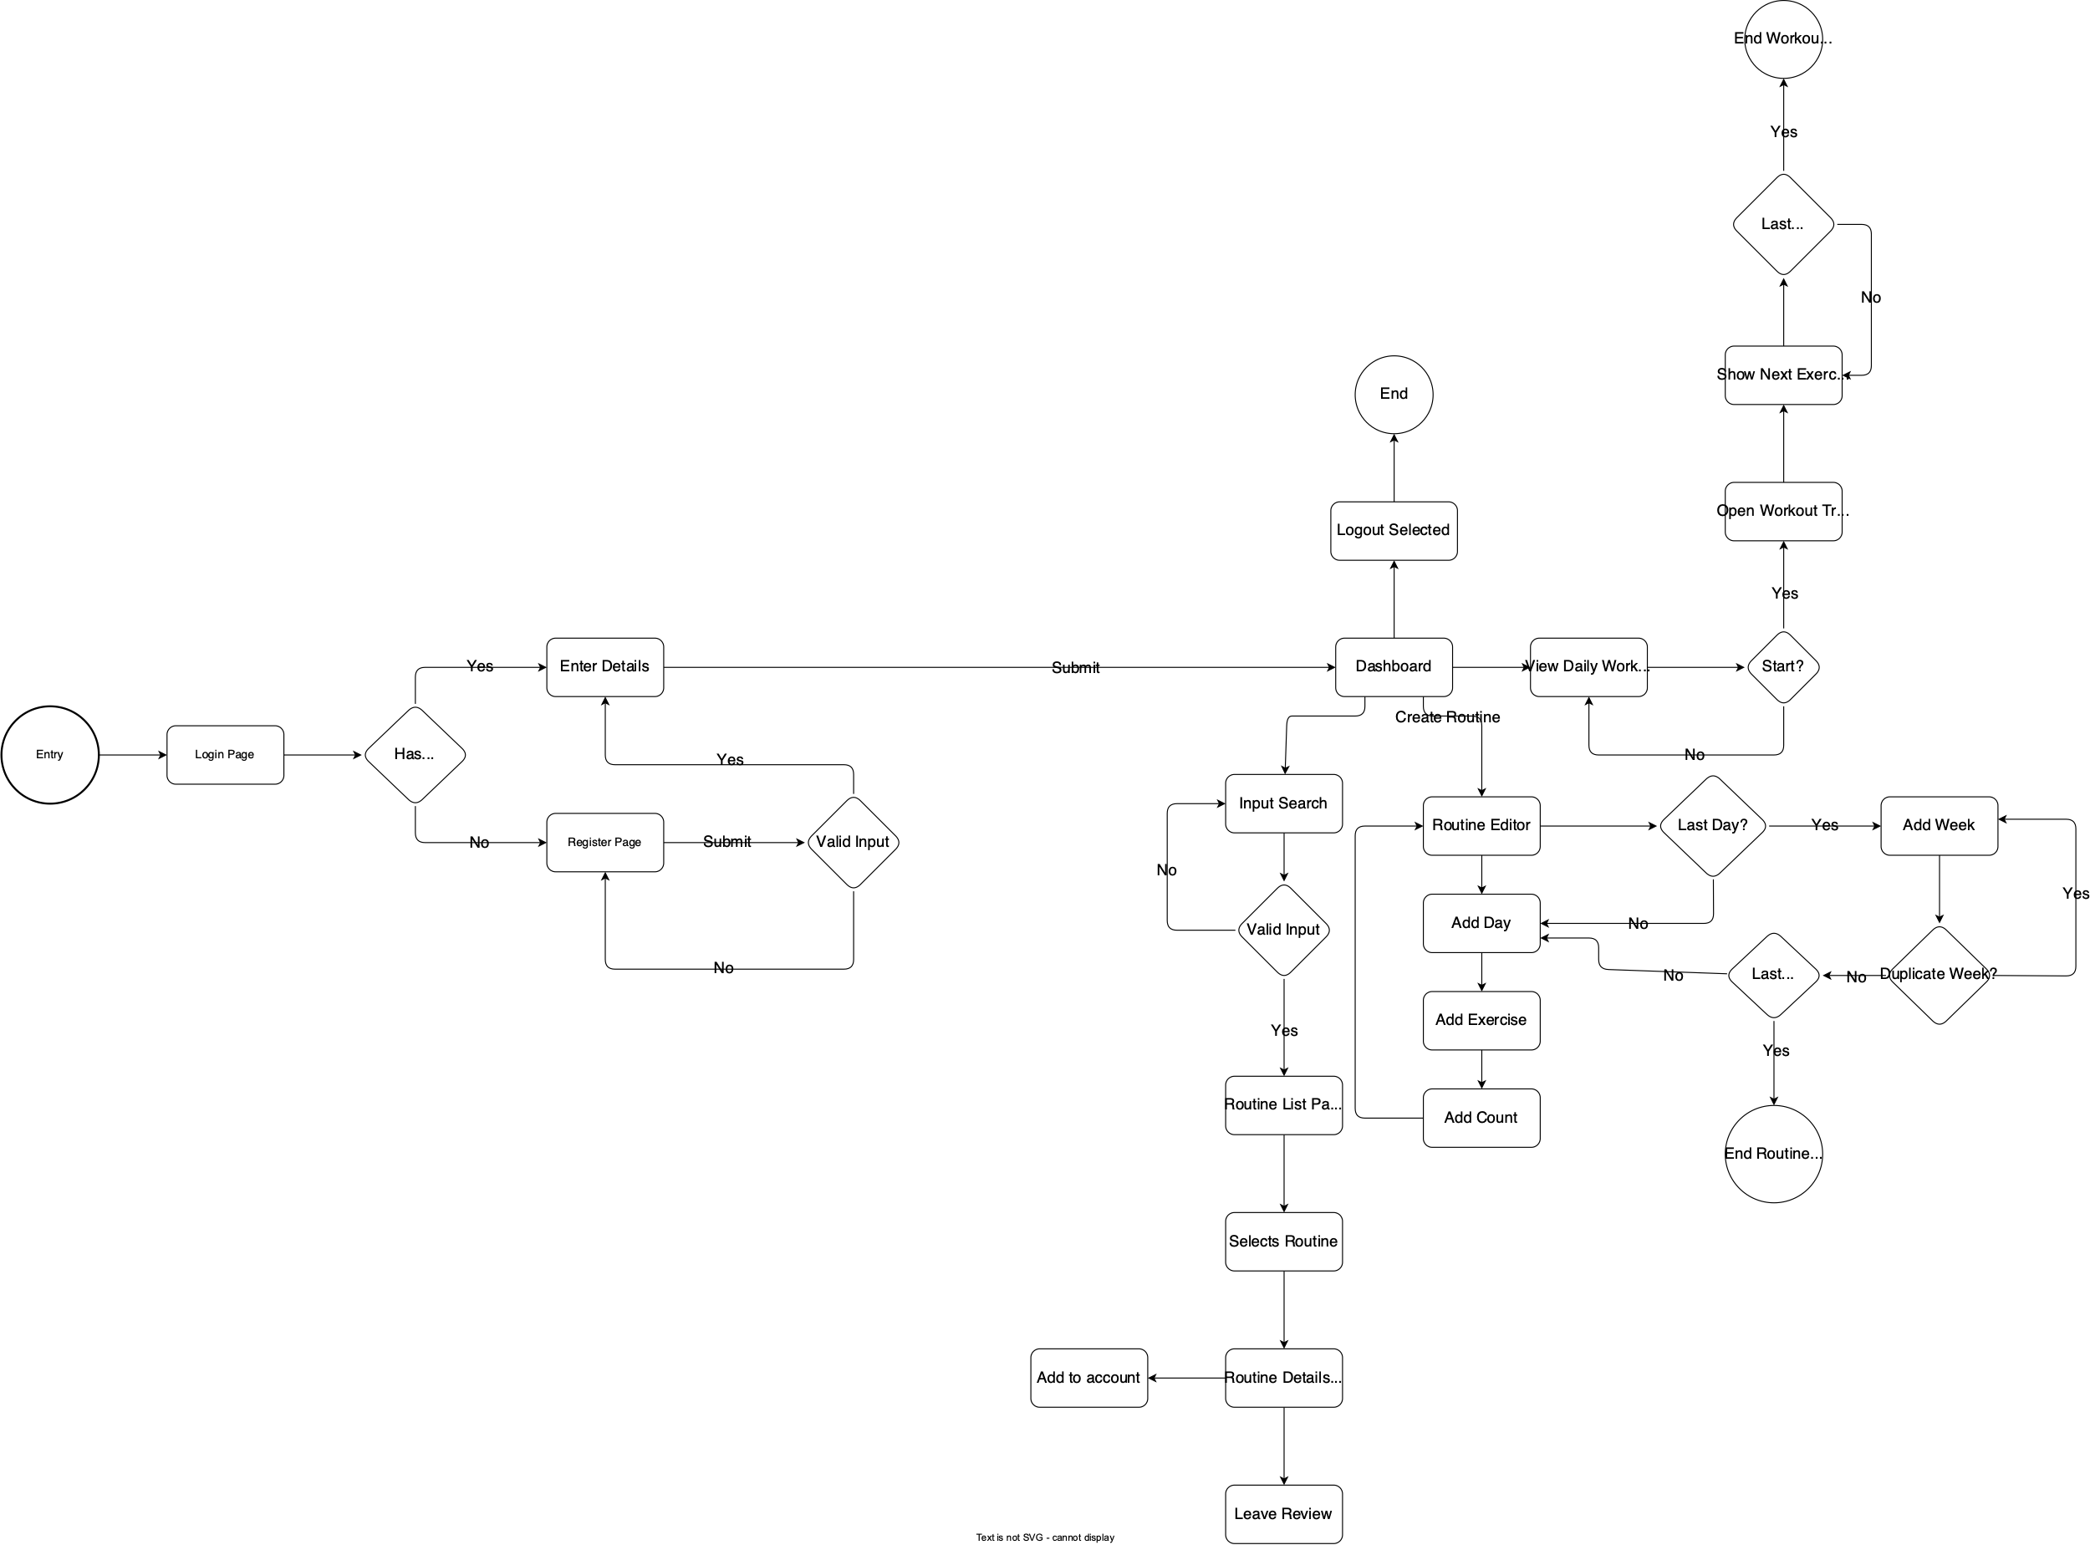
User Flow Diagram

Slide 11
Database Definitions
[ see GitHub ]

