Slide 1
upLift
Deliverable 2

Slide 2
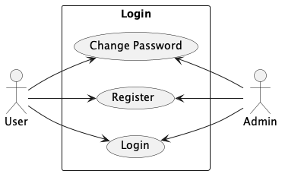
Login Usecases

Slide 3
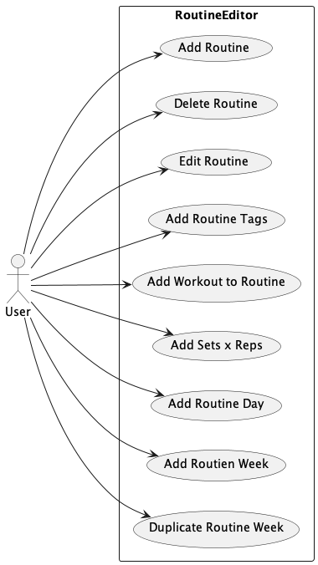
Routine Editor Usecases

Slide 4
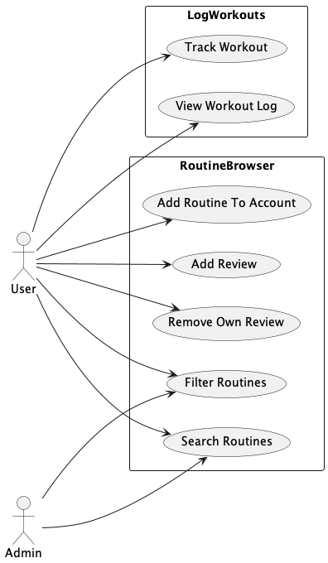
Routine Browsing and Workout Logging Usecases.

Slide 5
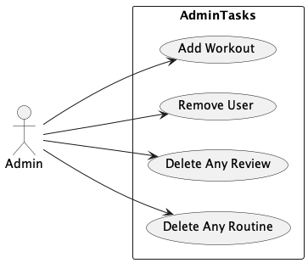
Site Admin Usecases

Slide 6
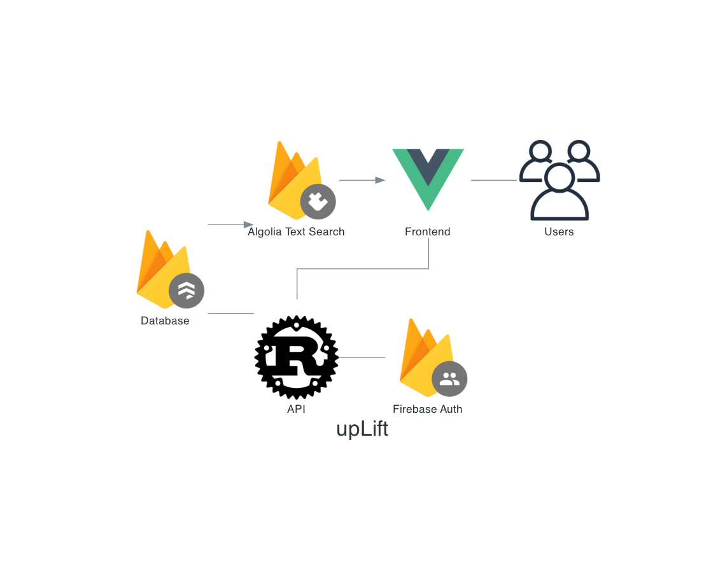
SAD

Slide 7
Other:
Made small Revisions to Project Plan
Cleaned up repository( Added Readme, timeline markdown files)
To answer the question poised last week on the need for a third party search tool: Firestore Cloud databases does not provide full text search built in.
Status: Slightly behind where I intended to be at this point. Want to have all design done in the next 1-2 weeks to start development ASAP. As a result, UI wireframes may be less detailed.
Goals for this week:
Complete Data and User Flow Diagrams.
Complete System Sequence Diagrams
Complete Database Diagram

