Slide 1
BTC and ETH Data analytics
Skylan Recana, Vinuthna Akurati

Slide 2
Business Case Scenario
A buyer is a beginner in cryptocurrency. He has the understanding how cryptocurrency works, however since there are cryptocurrency variations available, he does not know which cryptocurrency to buy. Since he wanted to be on trend, he picked Bitcoin and Ethereum as his two of his best choices and also two of the popular cryptocurrency available out there.
As data scientists, it is our duty to help him guide with his current issue: which cryptocurrency to buy that is optimal for him as a beginner. We will create a model that determines whether Bitcoin or Ethereum is the best for his situation in the long run to help him get started with his cryptocurrency journey.

Slide 3
Dataset
Our source of data will be coming from an API called Cryptocompare API: https://min-api.cryptocompare.com.
Through this API and Web Scraping we can access the Bitcoin and Ethereum data needed for the model.

Slide 4
Modules
JSON (JavaScript Object Notation)
Lightweight data storage and transport format that is frequently used when data is transmitted from a server to a web page; JSON is "self-descriptive”
Keras
Adheres to best practices for lowering cognitive load: it provides consistent and straightforward APIs, reduces the amount of user activities necessary for typical use cases, and delivers clear and actionable error signals
Matplotlib
Python package that allows you to create static, animated, and interactive visualizations
NumPy (Numerical Python)
Python package that is used to work with arrays as well as functions for working with linear algebra, fourier transforms, and matrices

Slide 5
Modules (Cont.)
Pandas
Open-source library designed primarily for dealing with relational or labelled data in an easy and straightforward manner
It offers several data structures and methods for manipulating numerical data and time series
Requests
Python module that allows you to make HTTP requests to a certain URL. Requests, whether REST APIs or Web Scraping, must be learnt before moving forward with these technologies.
Scikit-learn (Sklearn)
It provides a set of efficient tools for machine learning and statistical modelling, such as classification, regression, clustering, and dimensionality reduction, via a Python interface

Slide 6
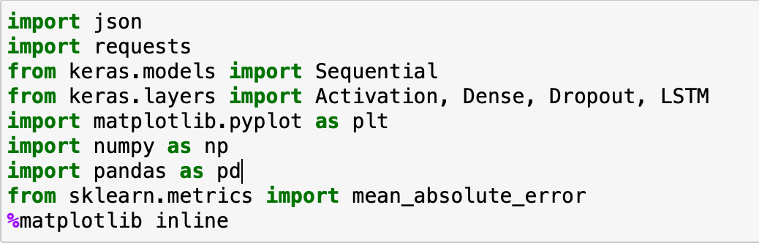
Import Libraries

Slide 7
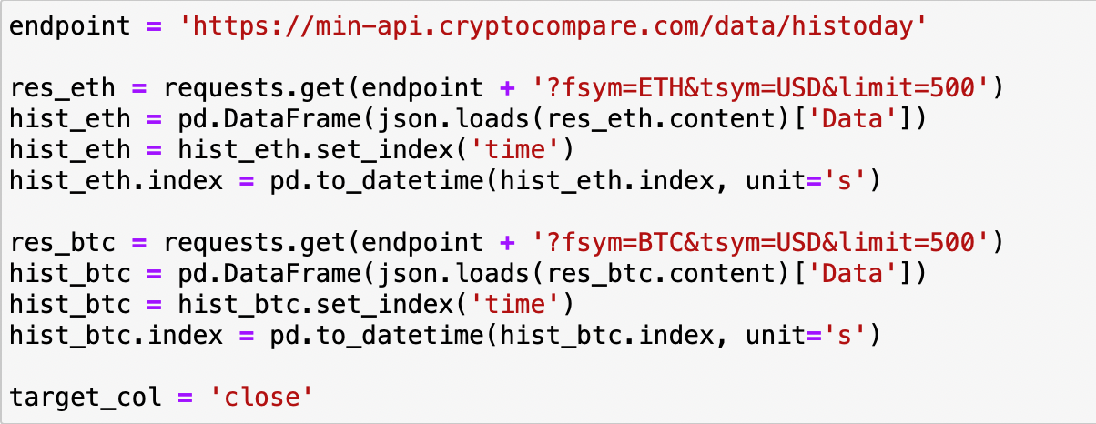
Web Scraping Data

Slide 8
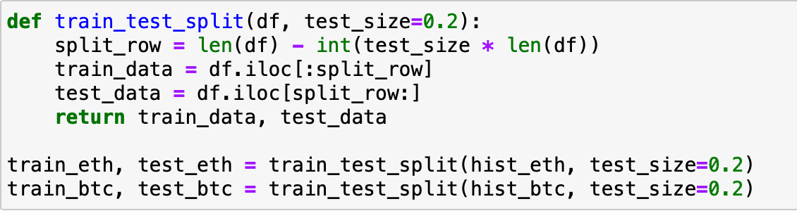
Split Dataset (Training Data and Test Data)

Slide 9
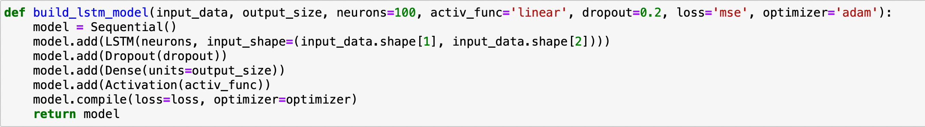
Long Short-Term Memory (LSTM) Model
Long Short-Term Memory Model
Deep learning architecture based on an artificial recurrent neural network (RNN)
Has a chain-like architecture that allows to store data for extended periods of time
Use Cases:
Handwriting recognition, anomaly detection in network traffic, intrusion detection systems
Weather forecasting, stock market forecasting, product recommendation, text/image generation, text translation
Time-series data processing, prediction, classification

Slide 10
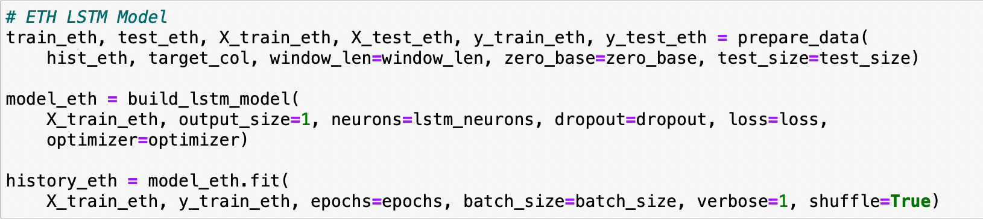
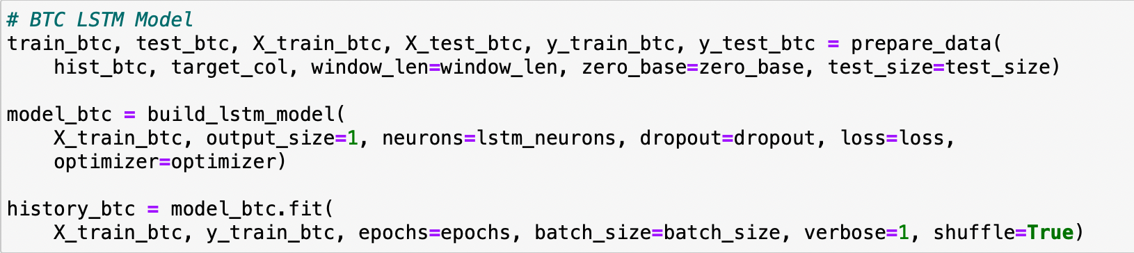
Make LTSM Model using the Split Dataset

Slide 11
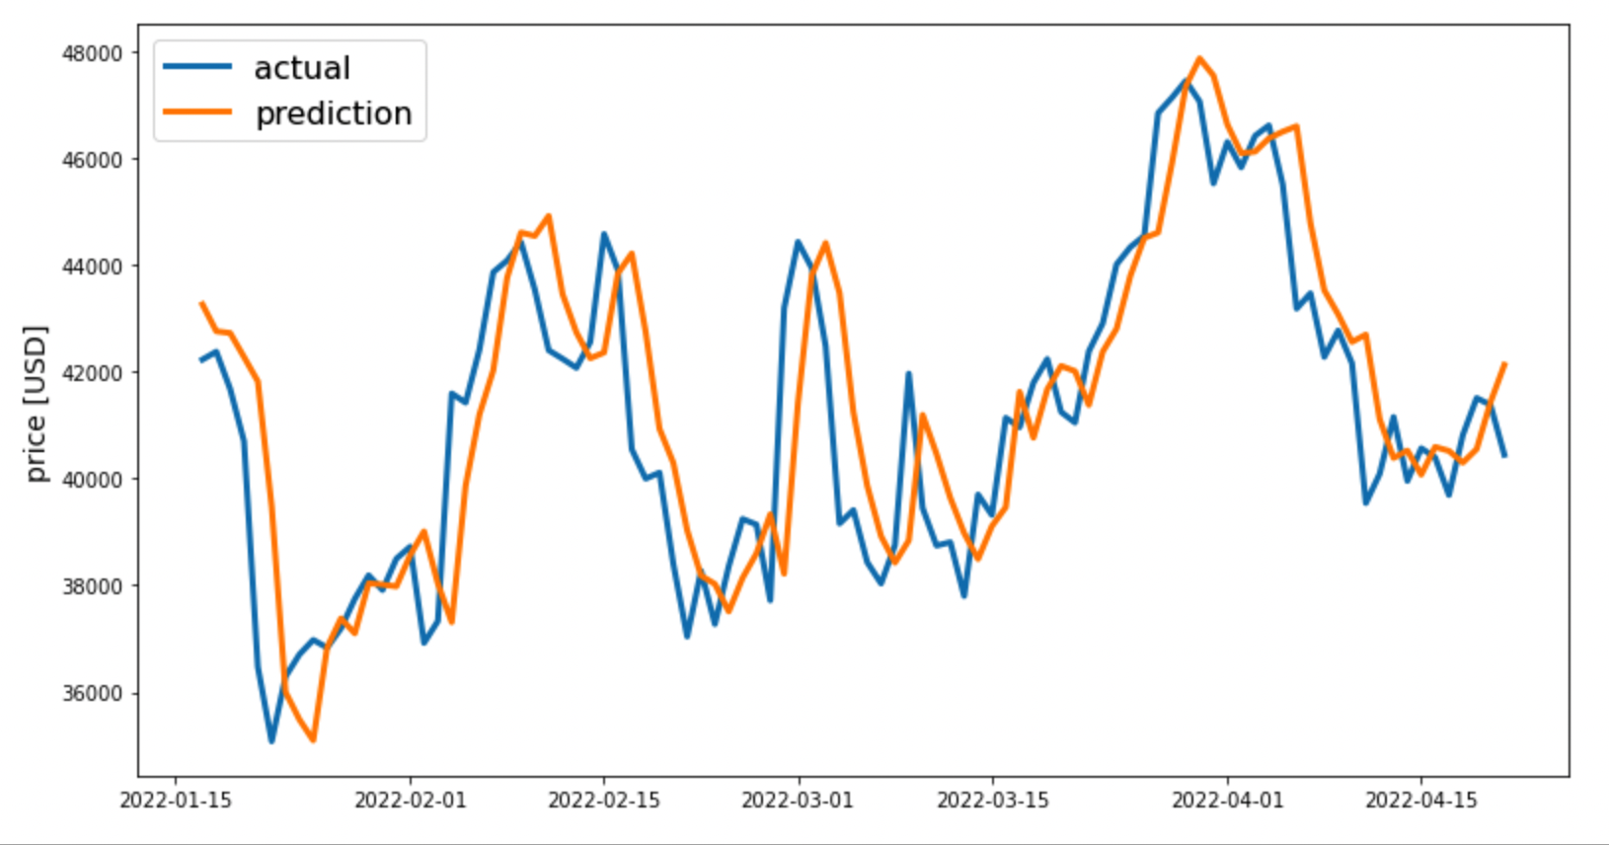
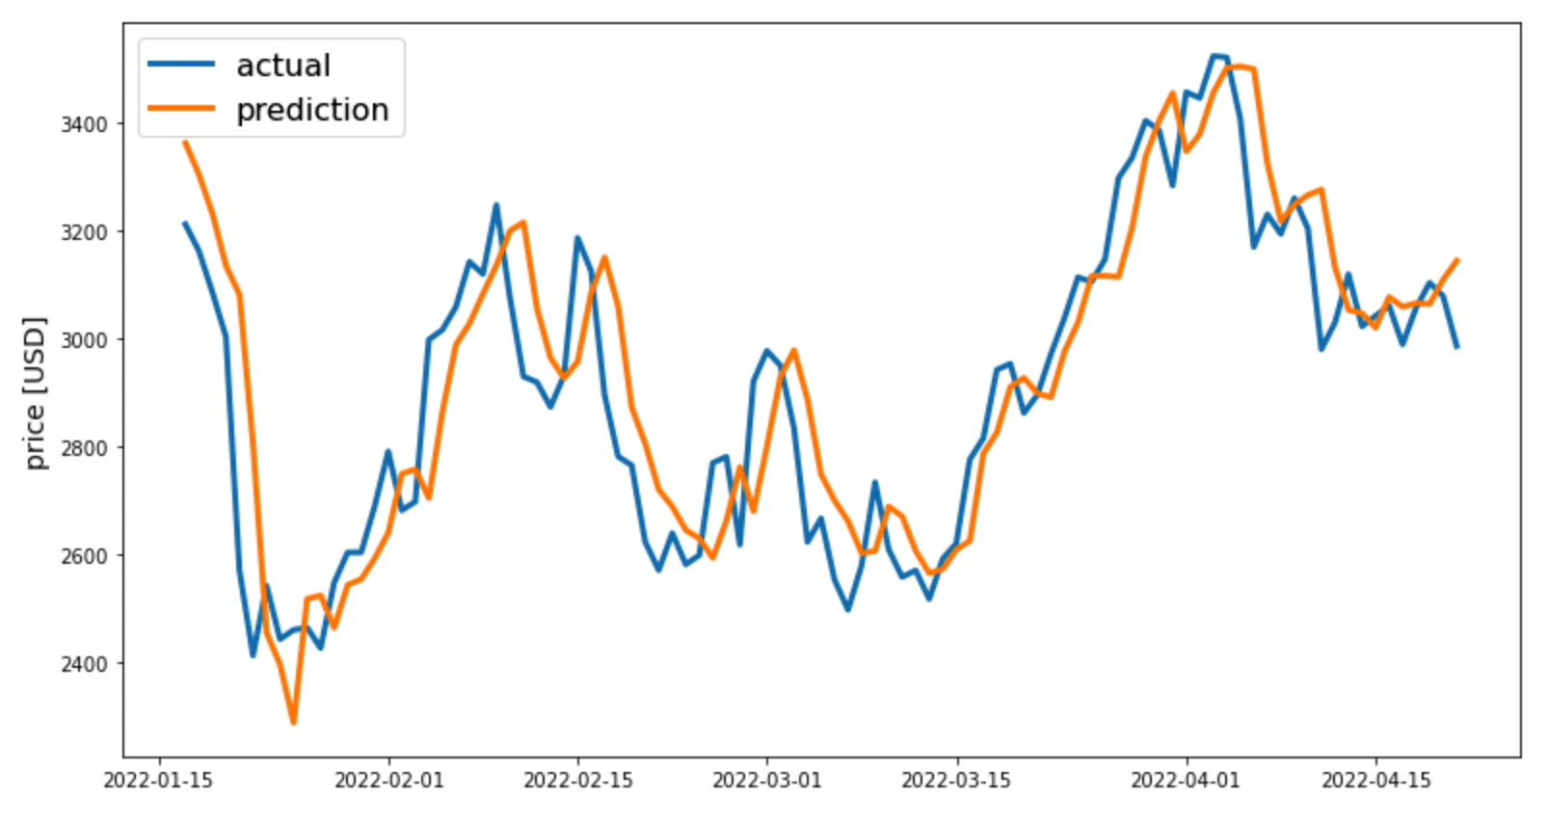
Prediction vs Actual Data Plot
Bitcoin (BTC)
Ethereum (ETH)

Slide 12
Findings
We found that the model that we've created was accurate, at least to say that the prediction of the model is close enough to the actual data. Bitcoin's price has its highest peak on the first week of April 2022 while Ethereum's price has its highest peak on the last week of March 2022. Since the model is close enough to the actual data, we can reuse this model to determine what the future of cryptocurrency would look like to determine whether it is good to buy stock at that given timeframe.

Slide 13
Conclusion
Based on the data plots above, we could assume that both Ethereum and Bitcoin could rise in future, at least for the next few months. According to the plots, we have concluded that the Bitcoin has more loss than Ethereum by price. As data scientists and based on the findings that we discovered, we would suggest that the stock buyer should spend on Ethereum rather than Bitcoin as a beginner.

