Slide 1
Vindinium
„Four legendary heroes were fighting for the land of Vindinium
Making their way in the dangerous woods
Slashing goblins and stealing gold mines
And looking for a tavern where to drink their gold“
http://vindinium.org/lcj09p8j

Slide 2
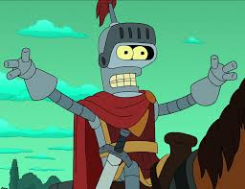
Enter: Bender

Slide 3
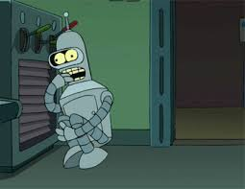
Bender
Wie funktioniert es?
Analyse des Zustands
Entscheidung welche Aktion
Rewards - Belohnungen … oder Bestrafung

Slide 4
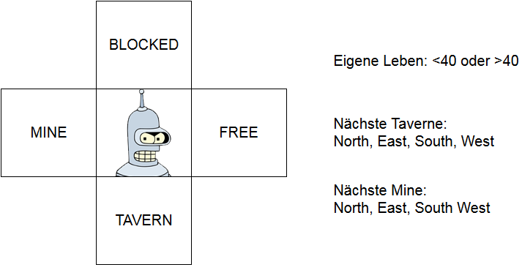
Bender0

Slide 5
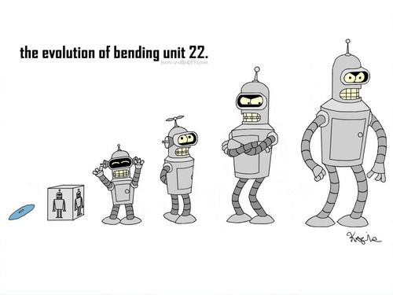
Erfahrener Bender!
http://vindinium.org/e7pb0y2u

Slide 6
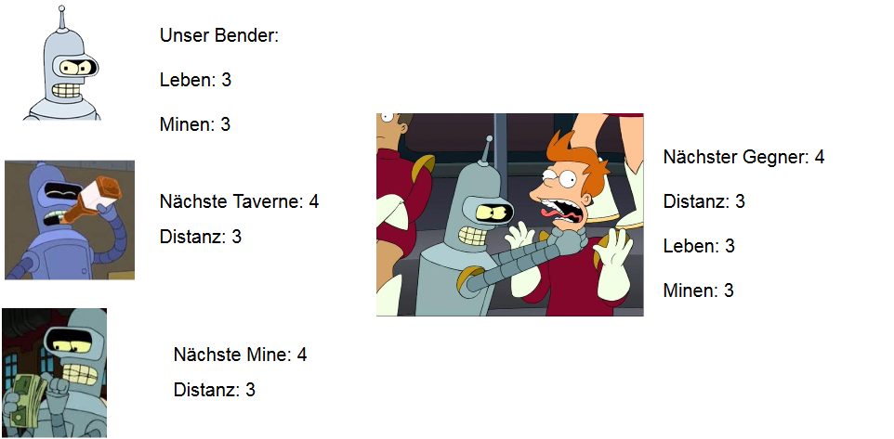
Bender2

Slide 7

Thanks!

