Slide 1

Jetpack Joust
Kyle Brown
Seth Lakstins

Slide 2
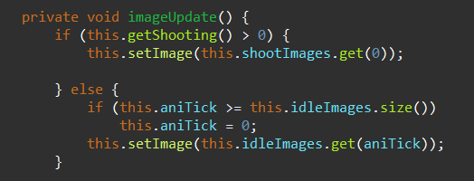


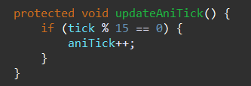
Animations

Slide 3
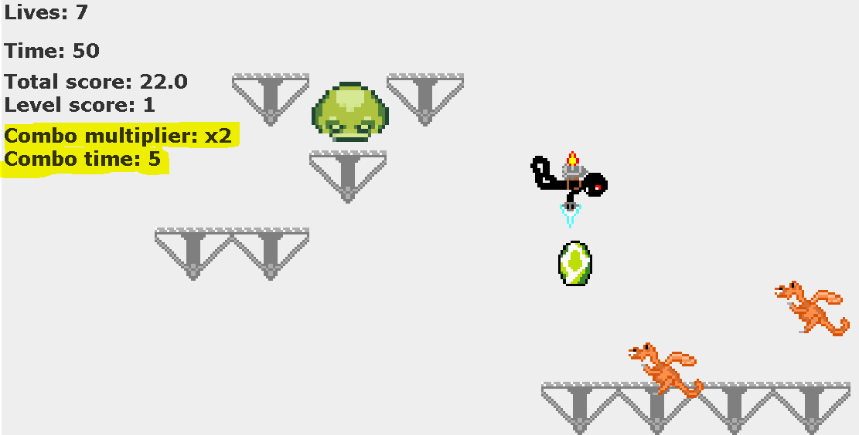
Combo Multiplier

Slide 4
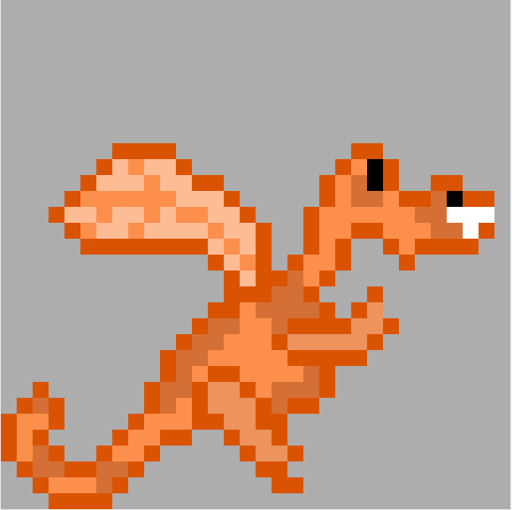
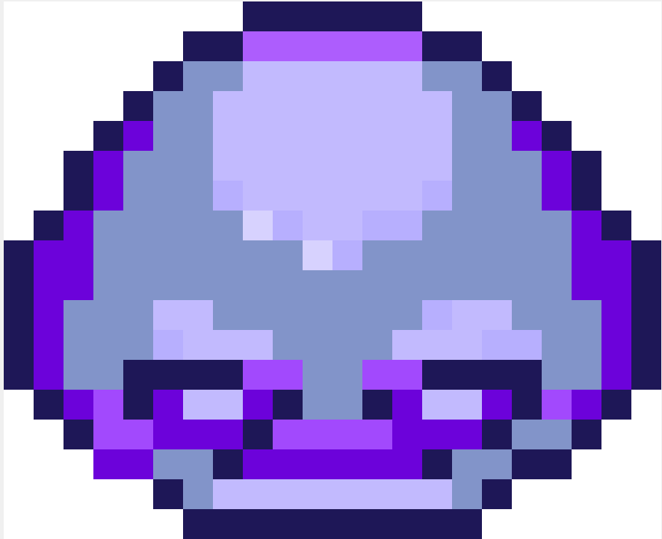



Mobs

Slide 5
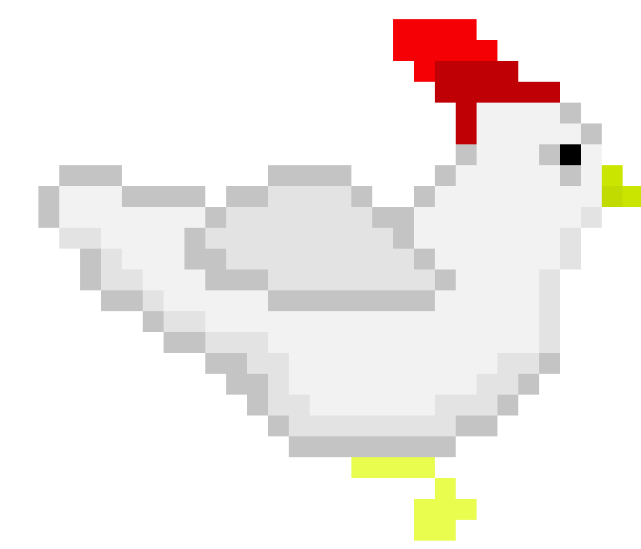
The Chicken

Slide 6
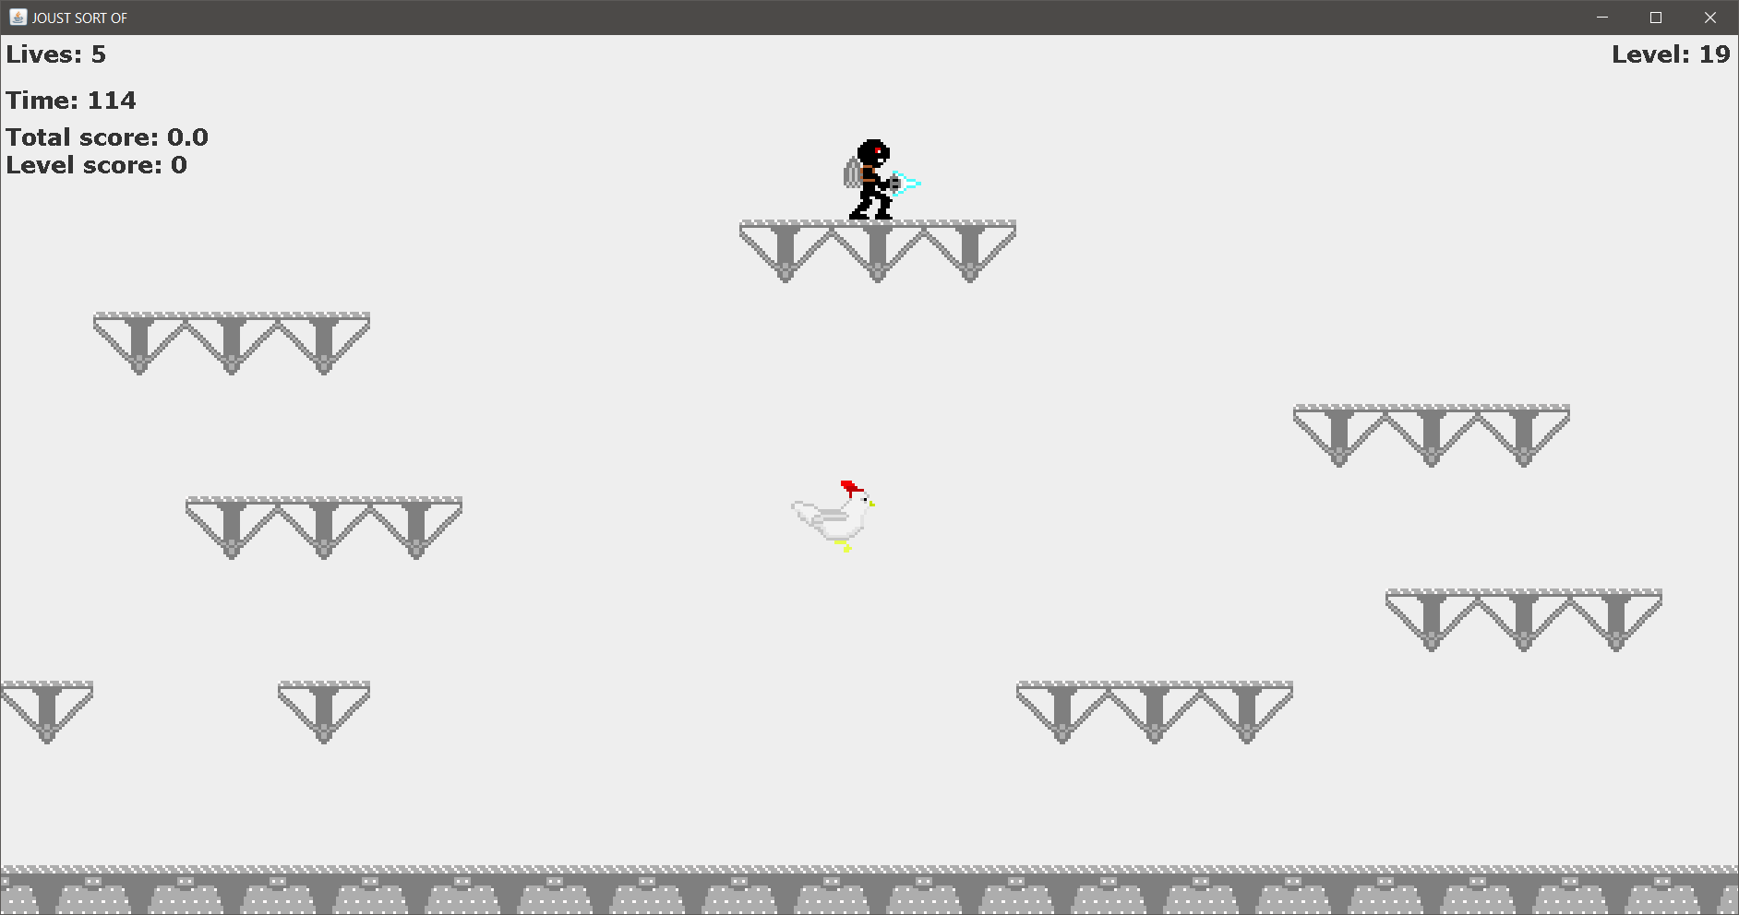

Slide 7
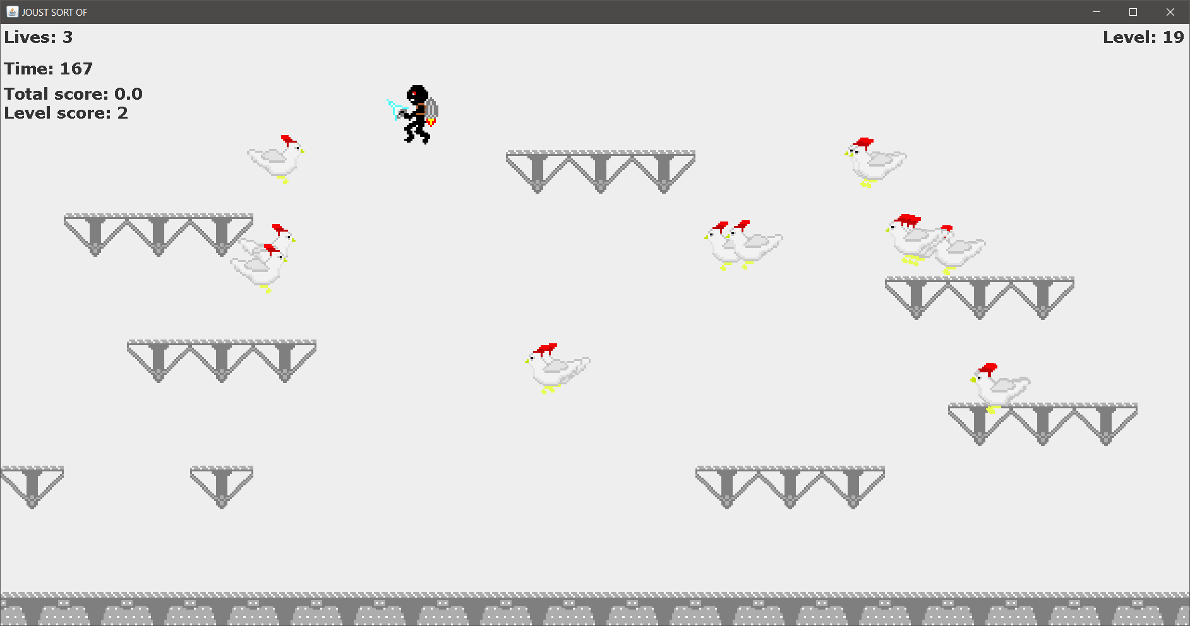

Slide 8
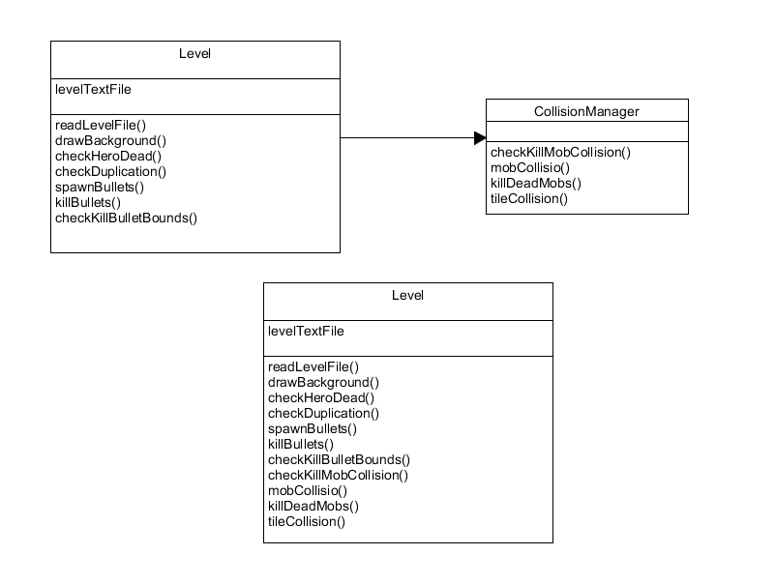
Managing Collisions

Slide 9
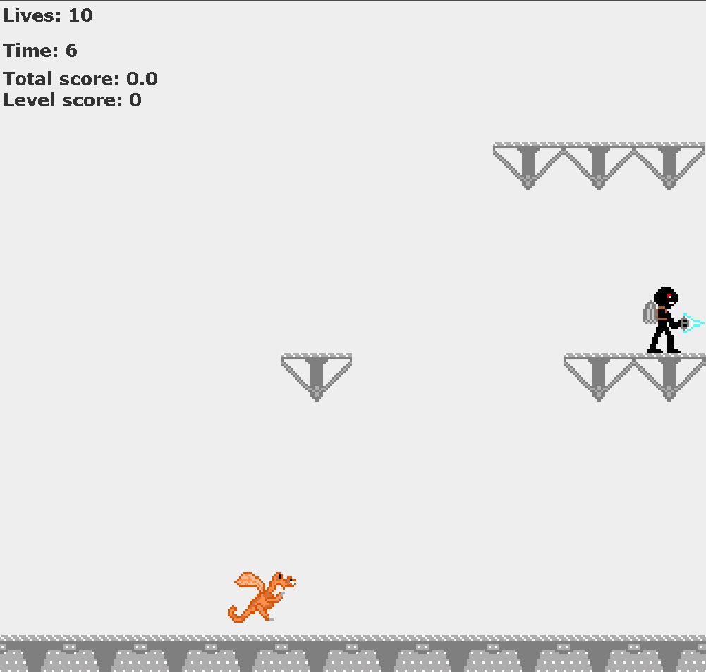

Resulting Glitch
AFTER
BEFORE
Notes:
Fixed by:
Check duplication is set and controlled inside “Multiplier”
Better design because important Multiplier data is no longer controlled by level

