Slide 1
Fine-tuning Vision Transformers
& Knowledge Distillation
DD2424 · Deep Learning in Data Science
Oxford-IIIT Pet Dataset · 37 Breed Classes · ViT + ResNet + Distillation
Matteo Camellini · Bhaswat Raj · Grace Xu

Slide 2
Project overview — two-stage pipeline
01
02
03
04
05
ViT Teacher Fine-tuning
Limited Data & Class Imbalance
ViT vs ResNet Comparison
Knowledge Distillation
Distillation Extensions
• Linear probe baseline
• Stratified subsets: 10% / 25% / 50% / 100%
• ViT-B/16 vs ResNet-RS152
• ViT-Base → ViT-Tiny (15× compression)
• Data efficiency: 10%/25%/100% regimes
• Simultaneous vs gradual unfreeze
• L2 regularisation sensitivity
• Accuracy, training efficiency, LR schedule
• KL + MSE + CE + intermediate feature loss
• Minority class recovery under imbalance
• Augmentation experiments (MixUp, CutMix, erasing)
• 20% cat-breed undersampling — weighted CE, oversampling
• Same augmentation, same dataset
• Ablation: pretrained×gradual configurations
• UMAP embedding analysis
Dataset: Oxford-IIIT Pet · 37 breeds · 3,669 test samples · PyTorch · timm · personal GPU

Slide 3
01
ViT Teacher Fine-tuning
Three strategies · Augmentation pipeline · Oxford-IIIT Pet 37 classes

Slide 4
Three fine-tuning strategies compared
Linear Probe
Simultaneous
Unfreeze (2,4,6 Blocks)
Gradual
Unfreeze (1-6 Blocks)
All blocks frozen.
Head trained only.
LR = 1e-3
Fast · Low VRAM
Last l blocks + head
unfrozen together.
All unfrozen params train
from epoch 1.
One block exposed per
phase (LR decays).
13-phase schedule.
Slower · More stable.
Best result
Best result
Best result
92.04% best
91.20 – 92.04% Range
92.97% best
92.07 – 92.97% Range
93.16% best
92.26 – 93.16% Range
✓ Gradual unfreeze is the best strategy — 93.16% accuracy. The phased schedule acts as built-in regularisation: each newly exposed block adapts before the next opens, protecting pretrained representations and preventing catastrophic forgetting.

Slide 5
Learning Rate Strategy & Training Engine
6 / 12
Learning Rate Schedule
TrainingEngine Features
Start
LR
Plateau
Detect
LR × 0.1
Min LR
Floor
⚡ Mixed Precision (AMP)
→
→
→
1e-3
(LP/Phase 1)
3 epochs
no improve
reduce by
factor 10
1e-6
(stop decay)
torch.autocast + GradScaler for CUDA. Scheduler step skipped on overflow.
Gradual Unfreeze Phase Scheduling
📊 sklearn Macro Metrics
Phase 1: Train head only — LR 1e-3, up to 20 epochs
Precision, Recall, F1 computed end-of-epoch over full prediction set.
Phase 2+: Unfreeze next block group — LR 1e-4, up to 20 epochs each
Early Stopping
🔀 Batch Augmentation
Patience = 6 epochs (no val_loss improvement)
CutMix / MixUp applied after DataLoader yields. Soft one-hot labels for mixed samples.
Delta threshold = 1e-4 (minimum meaningful gain)
Best checkpoint saved on every improvement
⏱ tqdm Progress Bars
Applied per training phase in gradual unfreeze
Live loss + acc tracking per batch. Separate colour per phase (green=train, blue=eval).

Slide 6
Augmentation Experiment Configurations
5 / 12
Experiment
Spatial Augs
Erasing
Jitter
Batch Aug
no_augs
—
—
—
—
basic_augs
Flip+Rot+Crop+Gray
—
—
—
erasing_only_low_prob
Flip+Rot+Crop+Gray
p=0.2
—
—
erasing_only_high_prob
Flip+Rot+Crop+Gray
p=0.5
—
—
jitter_only
Flip+Rot+Crop+Gray
—
Color Jitter
—
mixup_only_low_alpha
Flip+Rot+Crop+Gray
—
—
α=0.2
mixup_only_moderate_alpha
Flip+Rot+Crop+Gray
—
—
α=0.4
cutmix_only_low_alpha
Flip+Rot+Crop+Gray
—
—
α=0.5
cutmix_only_moderate_alpha
Flip+Rot+Crop+Gray
—
—
α=1.0
mixup_cutmix
Flip+Rot+Crop+Gray
—
—
Both α=0.4/1.0
erasing_jitter_mixup_cutmix_low
Flip+Rot+Crop+Gray
p=0.2
Color Jitter
p=0.2
erasing_jitter_mixup_cutmix_high
Flip+Rot+Crop+Gray
p=0.5
Color Jitter
p=0.5

Slide 7
Results — Simultaneous Unfreeze
8 / 12
Key Stats
Best Accuracy
92.97%
Best Experiment
erasing_low_prob
(2 layers)
Range
92.07 – 92.97%
vs Linear Probe
+0.93 pp
Avg (2 blocks)
92.61%
Avg (4 blocks)
92.40%
Avg (6 blocks)
92.38%
Sweet spot
L = 2 blocks

Slide 8
Results — Gradual Unfreeze
9 / 12
Key Stats & Observations
Best Accuracy
93.16%
Best Config
no_augs + 5 block groups
Runner-Up
93.00% (erasing+jitter low)
Range
92.26 – 93.16%
vs Linear Probe
+1.96 pp
vs Sim Unfreeze
+0.19 pp
Sweet spot blocks
3 blocks (avg 92.53%)
Worst config
mixup_low_alpha

Slide 9
Augmentation Impact Analysis
11 / 12
LP is most sensitive to aug type — range of 0.84pp. Best: combined erasing+jitter+cutmix (high prob).
Sim Unfreeze benefits most from spatial augs (erasing, basic). Batch augs (MixUp alone) are less helpful.
Gradual Unfreeze is surprisingly robust — even no_augs hits 93.16%, the overall best result.
MixUp alone tends to underperform across all methods. CutMix and combined strategies are more reliable.

Slide 10
Augmentation pipeline & key results
Augmentation experiments
Augmentation findings
Spatial: RandomResizedCrop, HorizontalFlip
LP most sensitive — 0.84pp range across aug configs
Colour: ColorJitter (brightness/contrast/sat/hue)
Sim Unfreeze benefits most from spatial+erasing
Erasing: RandomErasing (patch occlusion)
Gradual robust — even no_augs hits 93.16% (best overall)
Batch: MixUp (α=0.4) and CutMix (α=1.0)
MixUp alone less helpful; combined with erasing is optimal
Early stopping patience=6 · ReduceLROnPlateau
Combined: erasing + jitter + CutMix = best for LP
92.04%
92.97%
93.16%
+0.84pp
Linear probe
best accuracy
Sim unfreeze
best accuracy
Gradual unfreeze
best accuracy
Aug sensitivity
range (LP)

Slide 11
02
Limited Data & Class Imbalance
Stratified subsets 10–100% · L2 regularisation · 20% cat undersampling

Slide 12
Limited Data Study — Setup & Key Numbers
2 / 12
Stratified subsets preserve class proportions at every fraction
~5,900
~1,472
~736
294
Full train set (100%)
50% subset
25% subset
10% subset
Experimental Design
Key Drops (avg accuracy 100%→10%)
Data fractions
100%, 50%, 25%, 10%
Linear Probe
L2 regimes
wd_standard (1e-4), wd_strong (1e-2)
91.61% → 87.50%
−4.11 pp
Methods
Linear Probe, Sim Unfreeze, Gradual (3 blocks)
Sim Unfreeze
92.46% → 85.64%
−6.83 pp
Aug experiments
4 selected per fraction (no_augs, basic, erasing_jitter_low/high)
Val / Test
Always full unmodified splits
Gradual (3 blk)
92.30% → 87.15%
−5.15 pp
Stratification
StratifiedShuffleSplit on breed labels (37 classes)
⚡ Sim Unfreeze is most sensitive to data size (−6.83 pp)

Slide 13
Augmentation Benefit Across Data Fractions
4 / 12
Does augmentation matter more when data is scarce?
Method
Frac
no_augs
basic_augs
Best aug acc
Best config
Gain (no→best)
Linear
100%
91.20
91.61
92.04
erasing+jitter+cutmix_high
+0.84 pp
Linear
50%
90.19
90.43
91.47
erasing+jitter+cutmix_low
+1.28 pp
Linear
25%
88.66
89.53
89.53
basic_augs
+0.87 pp
Linear
10%
87.16
87.74
88.44
erasing+jitter+cutmix_high
+1.28 pp
Gradual
100%
91.50
92.26
93.16
no_augs (no aug wins!)
+1.66 pp
Gradual
50%
91.85
91.82
91.85
no_augs
+0.00 pp
Gradual
25%
90.65
90.65
90.65
no_augs
+0.00 pp
Gradual
10%
86.64
86.45
87.54
erasing+jitter+cutmix_low
+0.90 pp
Linear Probe: augs consistently help (+0.84–1.28 pp). Benefit roughly stable across fractions.
Gradual: no_augs wins at 100%–25% (pretrained features + phased unfreezing already regularises). Augs help only at 10%.
Augmentation becomes critical for all methods only at 10% data, where the model is most at risk of overfitting.

Slide 14
L2 Regularisation: Standard (1e-4) vs Strong (1e-2)
5 / 12
Does stronger weight decay help when training data is limited?
✓ Strong L2 helps
Linear @ 25%: +0.46 pp
Linear @ 50%: +0.44 pp
Sim @ 25%: +0.18 pp
Gradual @ 10%: +0.24 pp
✗ Strong L2 hurts
Gradual @ 25%: −0.77 pp
Gradual @ 50%: −0.42 pp
Sim @ 50%: −0.47 pp
Linear @ 10%: −0.33 pp
⚡ Verdict
Benefits are small and inconsistent. Gradual Unfreeze already regularises through phased unfreezing — extra L2 is mostly redundant or harmful.

Slide 15
Limited data study — accuracy vs training data fraction
Gradual most robust
Best at 10% (87.2%) and 25% (90.1%). Phased schedule acts as built-in regularisation.
Sim steepest drop
Highest at 100% (92.5%) but sharpest degradation to 10% — sensitive to data volume.
L2 strong (1e-2) helps
LP +0.46pp at 25%, Gradual +0.24pp at 10%. Stronger regularisation beneficial when data scarce.
Augmentation value
Benefit is consistent but not amplified under low data — architecture choice matters more.

Slide 16
9 / 13
Class imbalance — 20% cat undersampling · compensating strategies
Aug: basic_augs_rnd_erase_jitter only · 20% cat data
Cat / Dog F1 Gap (aug only)
Method
Cat F1
Dog F1
Gap
Lin/Base
0.795
0.936
0.141
Lin/WCE
0.799
0.934
0.134
Lin/OS
0.815
0.938
0.123
Sim/Base
0.832
0.939
0.106
Sim/WCE
0.819
0.940
0.121
Sim/OS
0.842
0.930
0.088
Grad/Base
0.828
0.936
0.109
Grad/WCE
0.822
0.931
0.109
Grad/OS
0.837
0.938
0.101
★ Best overall accuracy: Gradual+Oversampling (90.68%) ★ Smallest cat-dog gap: Sim+Oversampling (0.088)

Slide 17
Effect of Augmentation on Imbalanced Training
8 / 13
no_augs vs basic_augs_rnd_erase_jitter · All strategies · 20% cat data
Aug Δ (aug − no_aug)
Method
No Aug
+ Aug
Lin/Base
88.9
89.2
+0.28
Lin/WCE
88.4
89.2
+0.74
Lin/OS
90.2
89.9
-0.32
Sim/Base
88.6
90.6
+1.94
Sim/WCE
89.6
90.2
+0.55
Sim/OS
89.3
90.3
+1.04
Grad/Base
91.1
90.3
-0.79
Grad/WCE
89.5
89.6
+0.13
Grad/OS
90.3
90.7
+0.38
Key finding: Augmentation most benefits Sim Unfreeze (up to +1.94pp for baseline) and has mixed effects on Gradual (−0.79pp for baseline, which already regularises via phased unfreezing). Linear Probe sees modest gains.

Slide 18
Individual Cat Breed F1: Sim Unfreeze (aug only)
11 / 13
Aug: basic_augs_rnd_erase_jitter · Baseline 90.57% WCE 90.19% Oversampling 90.30%
Ragdoll and Bengal remain lowest across all strategies. Oversampling helps Bengal (+0.024) most. WCE helps Siamese (+0.038) and Birman (+0.044) but hurts Bengal (−0.101).

Slide 19
03
ViT vs ResNet Fine-tuning
ViT-B/16 vs ResNet-RS152 · same augmentation · accuracy, efficiency, LR sensitivity

Slide 20
ViT-B/16 vs ResNet-RS152 — accuracy, efficiency, LR schedule
92.59%
90.46%
+2.13pt
−18%
ViT-B/16
accuracy
ResNet-RS152
accuracy
ViT advantage
(consistent across F1/P/R)
ResNet faster
(41.8 vs 49.4 min)
ViT — 4-phase schedule
Phase 0: head (LR 1e-3) → Phases 1–3: one block group each (LR 1e-4 decaying). Requires structured unfreezing with LR decay.
ResNet — 2 phases
Converges faster with simpler schedule. Less sensitive to LR choice — more forgiving architecture.
ViT global attention
Captures inter-patch breed patterns ResNet misses. Global receptive field from layer 1 — key advantage for fine-grained classification.
Recommendation
Choose ViT when accuracy is paramount. Choose ResNet-RS when compute is bottlenecked and 90%+ suffices.

Slide 21
04
Knowledge Distillation
ViT-Base (86M) → ViT-Tiny (5.7M) · 15× compression · four-loss training

Slide 22
Distillation architecture — shared projection space & composite loss
TEACHER
ViT-Base
STUDENT
ViT-Tiny
Shared Space 256-dim
Blocks 0–4
cosine similarity loss
Blocks 0–4
Feat loss gated off until block 5 is unfrozen — prevents projector learning stale representations
Block 5 ◀ hook
JL Projector
768 → 256
Projector (trainable)
192 → 256
Block 5 ◀ hook
Blocks 6–11
Blocks 6–11
MSE Loss
Norm + Head
Norm + Head
KL Div Loss (KL(teacher, student))
Logits
Logits
Out Probabilities
CE loss (CE(student, teacher))
Out Probabilities
L_total = 0.3·L_CE + 0.5·L_KL (T=4) + 0.1·L_MSE + 0.1·L_feat (cosine, gated until block 5 unfrozen)
CE loss (CE(student, labels))

Slide 23
Ablation: four distillation configurations — pretraining is the key factor
pretrained
+ gradual
pretrained
+ full
87.54%
F1: 87.35%
59.36%
F1: 58.90%
Best overall
Representations degraded early
accuracy
accuracy
scratch
+ gradual
scratch
+ full
17.58%
F1: 16.46%
16.84%
F1: 15.87%
Distillation ≠ pretraining
Worst config
accuracy
accuracy
~70pt gap between pretrained and scratch — distillation is a fine-tuning technique, not a training-from-scratch technique

Slide 24
Per-class F1 across 37 breeds — four distillation configurations

Slide 25
Distilled student vs all baselines — model comparison
Model
Params
Type
Accuracy
Macro F1
Time (min)
Epochs
ViT-Tiny (gradual All-layers)
5.7M
Baseline
84.46%
84.23%
142.6
191
ResNet-10t (gradual All-layers)
5.4M
Baseline
82.31%
82.07%
48.5
63
ResNet-10t (gradual 1-layer)
5.4M
Baseline
81.82%
81.48%
16.4
36
ViT-Tiny (gradual 3-layer)
5.7M
Baseline
78.20%
77.95%
40.9
80
ViT-Tiny (distilled, best)
5.7M
Distilled
87.54%
87.35%
111.2
136
We distil only 1 layer of resnet10t to compare to 3 layers of ViT-Tiny to match parameter counts.

Slide 26
Accuracy and macro F1 — all models

Slide 27
Per-class F1 — distilled ViT-Tiny vs all baselines

Slide 28
05
Distillation Extensions
Data efficiency · Minority class recovery · UMAP embedding analysis

Slide 29
Data efficiency — distillation vs direct finetuning across data fractions
+9.4pt
gain at 10%
Distillation's biggest advantage
+8.8pt
gain at 25%
+3.1pt
gain at 100%
Data equivalences
Distilled 25% (83.1%) ≈ Direct 100% (84.5%) → 4× less data needed
Distilled 10% (75.0%) ≈ Direct 25% (74.3%) → 2.5× less data needed
Distilled 100% (111 min) faster AND better than Direct 100% (143 min)

Slide 30
Per-class F1 — distillation across data fractions

Slide 31
Imbalanced Cat Data: Setup — what makes this experiment meaningful
Teacher · ViT-Base (86M)
Student · ViT-Tiny (5.7M)
Trained on FULL balanced dataset
(100% of cat samples + 100% of dogs)
Has seen every cat breed extensively.
Its soft labels carry complete knowledge of cat breed similarity structure — knowledge the student's training data does not contain.
Trained with ONLY 20% of cat samples
(severe underrepresentation)
Without distillation: oversampling used to partially compensate.
With distillation: teacher soft labels provide implicit knowledge of full cat distribution.
The key question
Can the teacher's soft labels — which encode full knowledge of the minority cat classes — compensate for the student's training data deficit?
Does distillation provide a larger benefit to underrepresented (cat) classes than to well-represented (dog) classes?

Slide 32
Minority class recovery — balanced teacher rescues underrepresented cat breeds
79.48%
85.31%
+5.83pt
Direct (oversampling)
accuracy
Distillation
accuracy
Accuracy gain
no class regresses
Soft labels encode minority knowledge
Teacher assigns non-zero prob to similar cat breeds from full training — transferring intra-species similarity the student never saw.
Direct F1 (mean)
Distilled F1
Gain
🐱 Cats (minority)
0.711
0.805
+0.094
KL divergence is the vehicle
Loss weight 0.5 at T=4. Forces student to match teacher's calibrated uncertainty across cat breeds, not just the hard label.
🐶 Dogs (majority)
0.828
0.873
+0.046
Outperforms oversampling
Oversampling repeats existing examples; distillation synthesises new knowledge. +5.83pt over the best standard correction.

Slide 33
Per-class F1 — direct (oversampling) vs distillation across all 37 breeds
Classes 0–11 (cats) show the largest gaps — distillation lifts nearly all cat classes significantly
Classes 12–36 (dogs) also improve uniformly — teacher knowledge benefits majority classes too

Slide 34
Per-class F1 gain (distillation − direct) — minority classes gain most
Mean gain = +0.094
Mean gain = +0.046
Hardest minority classes — biggest gains from distillation:
Class Ragdoll Cat: +0.178
direct 0.503 → distil 0. 681
Class Abyssinian cat: +0.158
direct 0.685 → distil 0.843
Class Russian Blue cat: +0.129
direct 0.612 → distil 0.741

Slide 35
UMAP embedding analysis — teacher vs distilled student
3,143
269
69
188
Both correct
85.7% of test set
Teacher ✓ Student ✗
7.3% — boundary cases
Student ✓ Teacher ✗
1.9% — soft label benefit
Both wrong
5.1% — dataset difficulty
37 distinct clusters — both models
Every class is cleanly separated in both teacher and student UMAP spaces. Distillation successfully transferred the teacher's representational topology despite 15× compression.
Student clusters appear tighter — dimensionality artefact
192-dim space forces higher intra-class cosine similarity. This is not evidence of better representations — it reflects compression, not quality. What matters is between-class margin.
Student failures cluster at boundaries
The 269 teacher-only correct samples concentrate at class boundaries and in intrinsically hard breeds (2, 34, 10) — not random failures. The teacher's larger margin in 768-dim resolves these.
69 student-only correct samples
The student learned complementary knowledge from soft labels beyond the teacher's own hard predictions — distillation does not simply compress, it reshapes the learned distribution.

Slide 36
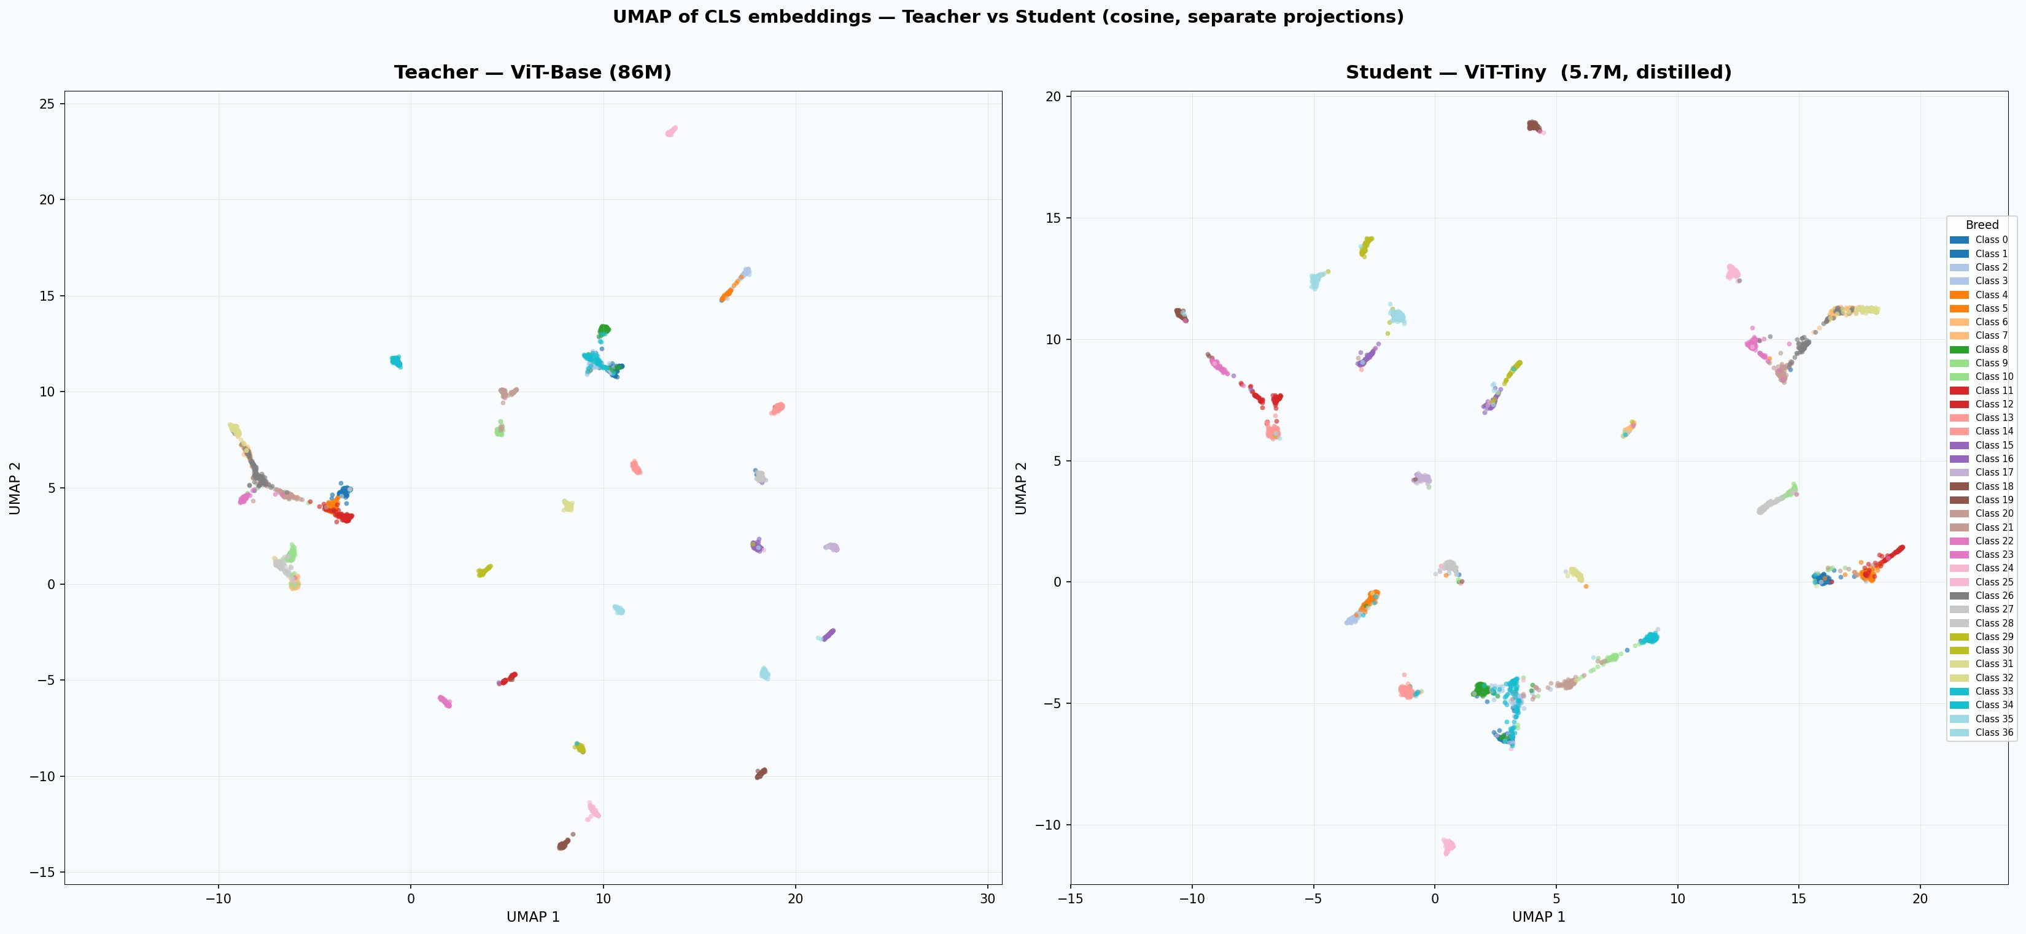
UMAP of CLS embeddings — teacher vs student (37 classes)

Slide 37
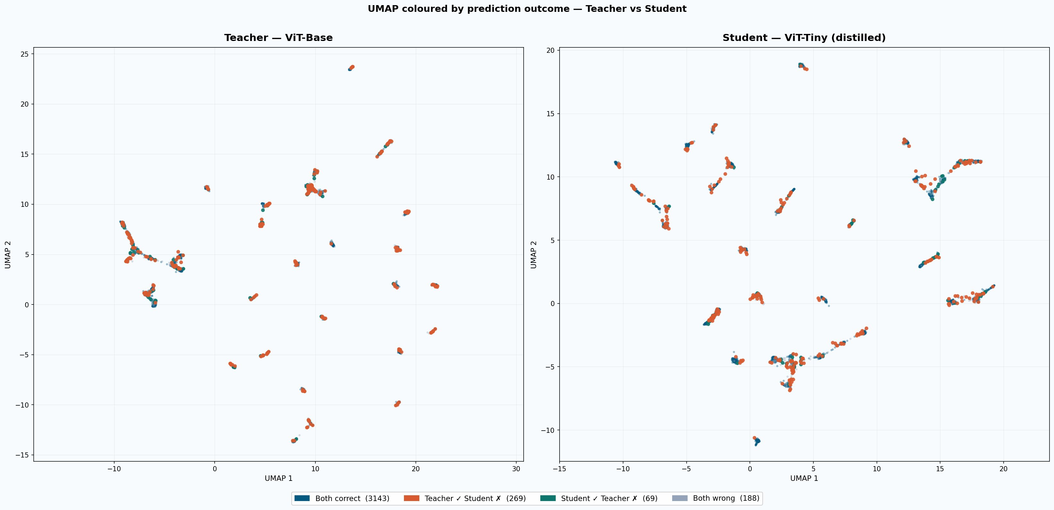
UMAP coloured by prediction outcome — teacher vs student

Slide 38
Model Comparison — parameters, FLOPs, and disk footprint
Metric
Teacher (ViT-Base)
Student (ViT-Tiny)
Ratio
15.2×
Parameters
86.0M
5.6M
15.2×
fewer parameters
FLOPs (BS=1)
16.87G
1.08G
15.6×
15.6×
Disk size
344 MB
23 MB
15.2×
fewer FLOPs
(16.87G → 1.08G)
15.2×
GPU memory
361.7 MB
35.6 MB
10.2×
smaller on disk
(344 MB → 23 MB)
10.2×
less GPU memory
(361.7 → 35.6 MB)

Slide 39
Key findings
1
Gradual unfreeze is the best fine-tuning strategy — 93.16% on ViT-Base, most robust to data reduction. Phased LR decay acts as built-in regularisation.
2
ViT-B/16 outperforms ResNet-RS152 by 2.13pt (92.59% vs 90.46%). ResNet trains 18% faster — pragmatic choice when compute is limited.
3
No standard imbalance correction (WCE / oversampling / augmentation) fully closes the cat-dog F1 gap (~0.09–0.14). This motivates distillation from a balanced teacher.
4
Distilled ViT-Tiny (87.54%) outperforms ALL baselines including its teacher (84.46%) — 15× fewer parameters. Distillation with gradual unfreezing exceeds direct finetuning.
5
Distillation at 25% data matches direct finetuning at 100% — 4× data efficiency. The gap peaks at 10% data (+9.4pt), confirming distillation is most valuable when labels are scarce.
6
Balanced teacher recovers minority cat classes by 1.65× more than majority dogs. Soft labels transfer implicit minority class knowledge that oversampling cannot replicate.

