Slide 1
Embedding Space Analysis
Teacher vs Student
ViT-Base (86M) · ViT-Tiny Distilled (5.7M) · Oxford-IIIT Pet Test Set

Slide 2
01
UMAP Overview
CLS token embeddings projected to 2D — separate spaces, cosine metric

Slide 3
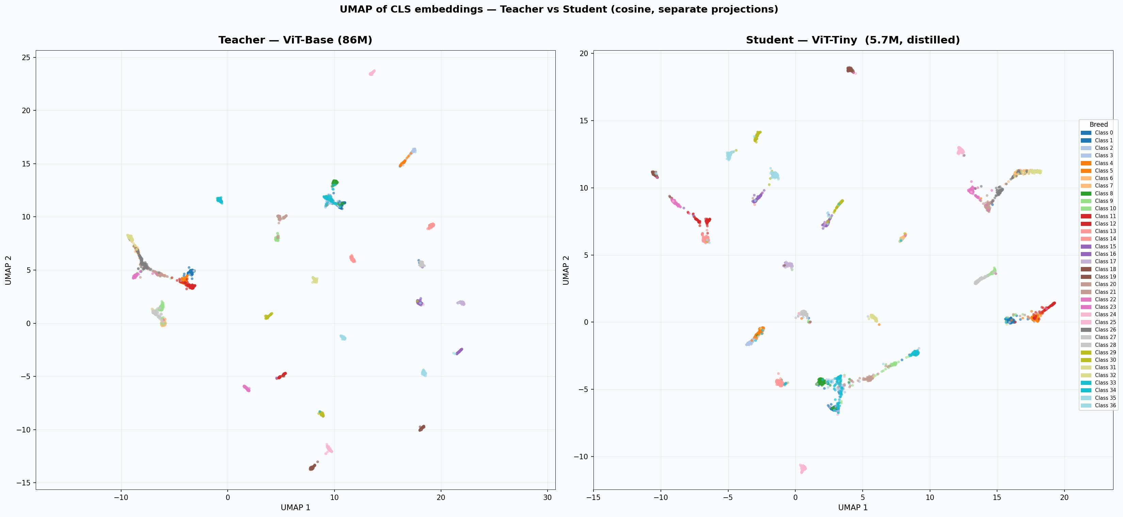
UMAP of CLS embeddings — teacher vs student (37 classes)

Slide 4
What the UMAP structure tells us
Both models form 37 distinct clusters
Every class is cleanly separated in both teacher and student embedding spaces — the student has successfully learned to discriminate all 37 breeds despite having 15× fewer parameters.
Cluster topology is structurally preserved
The relative neighbourhood structure (which classes are near each other) is similar in both plots, showing the distillation successfully transferred the teacher's global representation geometry.
Student clusters appear tighter — but this is a dimensionality artefact
192-dim space has fewer directions to spread points out, so cosine similarity is naturally higher. This does not mean the student has better representations — it reflects compression.
Some cluster pairs remain proximal in both models
Classes near each other in UMAP are visually similar breeds. These are the hard cases — boundary ambiguity exists in the raw visual data, not just the model.

Slide 5
02
Prediction Outcome Analysis
Where does the student succeed, fail, and outperform the teacher?

Slide 6
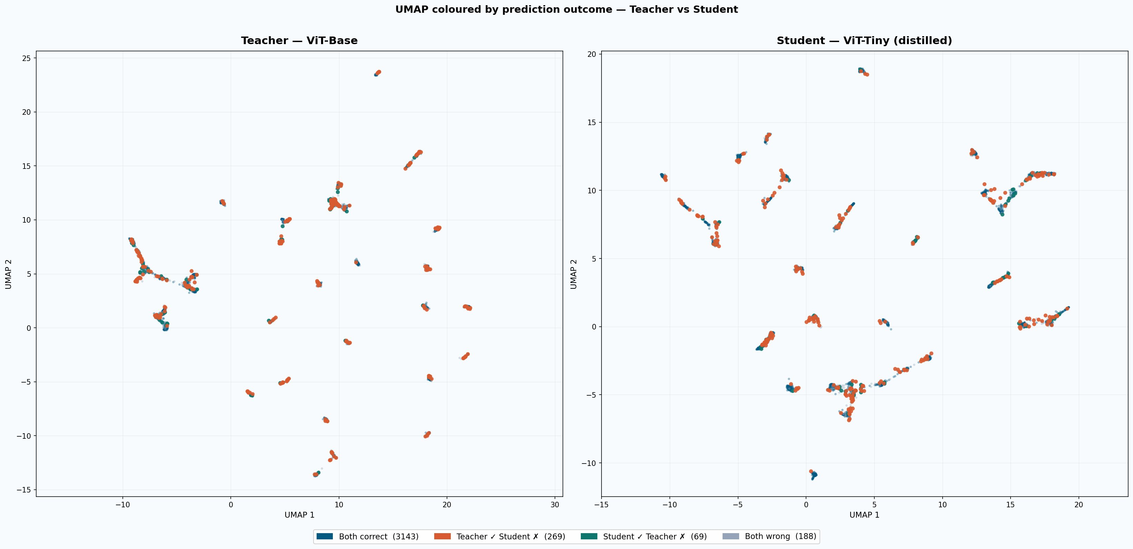
UMAP coloured by prediction outcome — teacher vs student

Slide 7
Prediction outcome breakdown — 3,669 test samples
3,143
269
69
188
Both correct
85.7% of test set
Teacher ✓ Student ✗
7.3% — student gaps
Student ✓ Teacher ✗
1.9% — student edges
Both wrong
5.1% — dataset difficulty
Key insight
The student fails on only 269 samples where the teacher succeeds (7.3%). Of these, the UMAP shows they are not random — they cluster at class boundaries and in the hardest per-class clusters (2, 10, 34). Crucially, 69 samples are correct by the student but wrong by the teacher, confirming the student learned complementary signal from soft labels beyond what the teacher's direct predictions encode.
Hardest classes (most teacher-only errors)
Class 34 · 21 teacher-only · 37 both-wrong · 47 both-correct · 89 total
Class 2 · 16 teacher-only · 37 both-wrong · 38 both-correct · 100 total
Class 10 · 18 teacher-only · 5 both-wrong · 74 both-correct · 100 total

Slide 8
03
Embedding Compactness
Intra-class cosine similarity — do tighter clusters mean better representations?

Slide 9
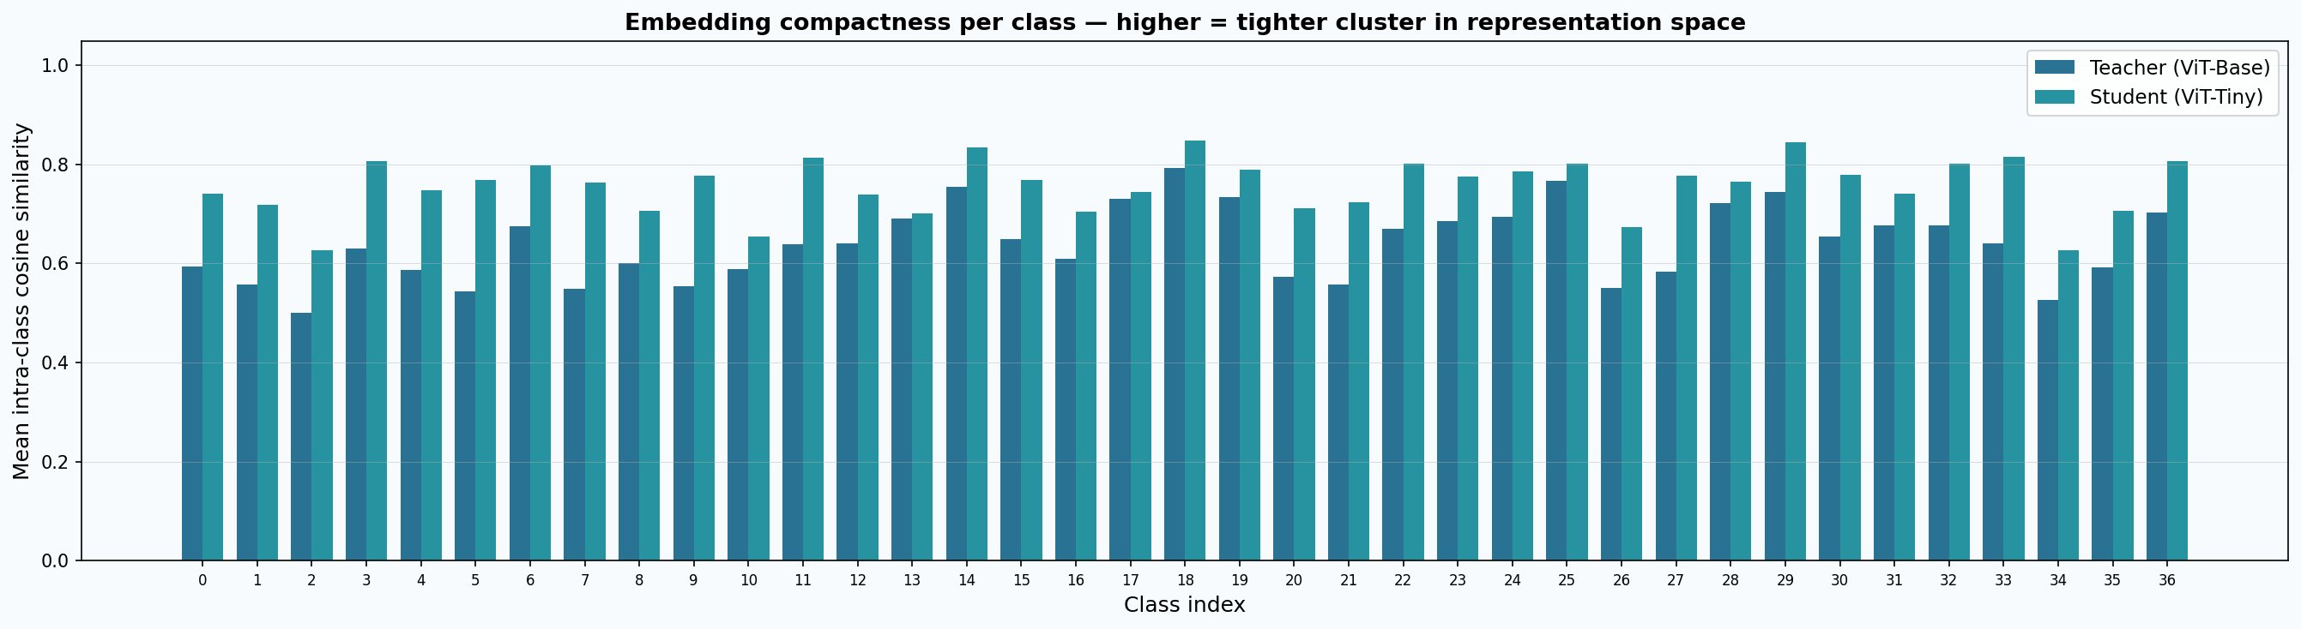
Per-class embedding compactness — teacher vs student
Student higher on most classes
Teacher lower = not worse, just richer
192-dim compression forces tighter angular packing
768-dim has room for fine-grained between-class margin

Slide 10
Why the student has higher intra-class similarity — and why that matters
The dimensionality effect
What actually matters: between-class margin
In 192-dim space there are fewer orthogonal directions available. Class embeddings are packed into a smaller cone on the unit hypersphere, so mean pairwise cosine similarity is structurally higher — not because the student learned better features, but because it has less room to spread out.
This is analogous to PCA: projecting 768-dim vectors to 192-dim always increases apparent compactness. The metric is confounded by dimensionality.
Classification accuracy depends on between-class separation, not within-class compactness. The 5.5pt accuracy gap (teacher 93% vs student 87.5%) reflects the teacher's ability to maintain larger angular margins between similar breeds in its 768-dim space.
The 269 student failures are precisely the samples where the teacher's larger margin is enough to pull the correct class to the top, but the student's compressed representation does not have room for that margin.
Exception — classes where student compactness is genuinely lower than teacher (classes 0, 2, 5, 26, 34): these are the breeds where even 192 dimensions are insufficient for compact representation. They correspond directly to the hardest per-class F1 scores in both models.

Slide 11
Summary
1
Both models produce well-separated cluster structure for all 37 breeds. The distilled student has successfully transferred the teacher's representational topology despite having 15× fewer parameters.
2
85.7% of test samples are classified correctly by both models. The student fails on only 269 samples where the teacher succeeds — these cluster at class boundaries and in intrinsically hard breeds (2, 34, 10).
3
Student intra-class similarity is higher than the teacher on most classes, but this is a dimensionality compression artefact, not evidence of superior representations. The real gap is between-class margin.
4
69 samples are correct by the student but wrong by the teacher — evidence that soft-label distillation transferred complementary knowledge beyond the teacher's own hard predictions.

