Slide 1
Finding Correlation between “Way of Life” and Alzheimer's
Project #1 Group #4
By: Alexander Mortillite, Chris Metz and Christian McGee

Slide 2
Outline
Background
Research questions (Project objectives)
Timeline/Division of Labor
Methodology
Implementation
Technical Challenges
Conclusion
Conclusion Visualization
References

Slide 3
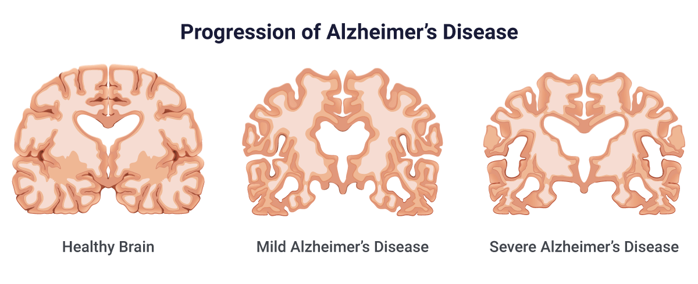
Background
What is Alzheimer’s?
Alzheimer's disease (AD) is a progressive neurodegenerative disorder that primarily affects the elderly, causing cognitive decline, memory loss, and impaired daily functioning.
Do the different ways people live affect their risk of developing AD?
Using our knowledge of Data Mining, we set out to find an answer.

Slide 4
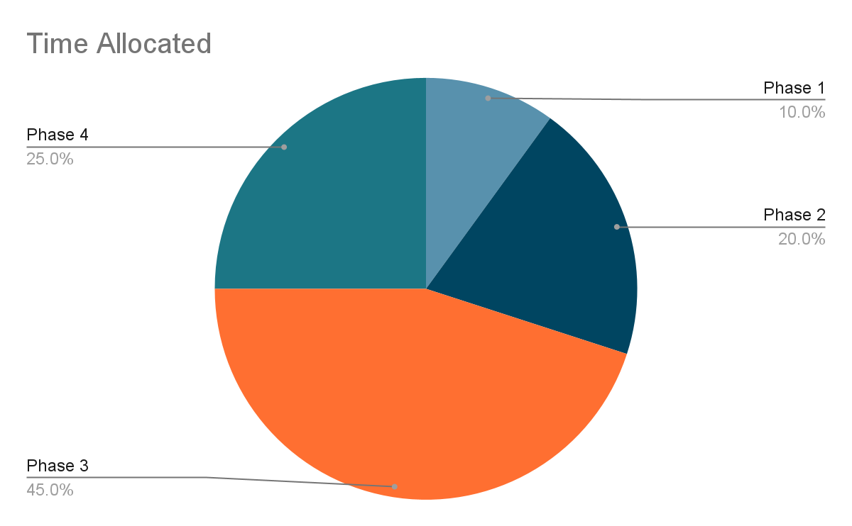
Timeline/Division of Labor
Project Phase 1: Development of Goals
Project Phase 2: Initial Data Cleaning
Project Phase 3: Reformed Data Cleaning, Cultivation of Data
Project Phase 4: FInalizing Essay and Documentation

Slide 5
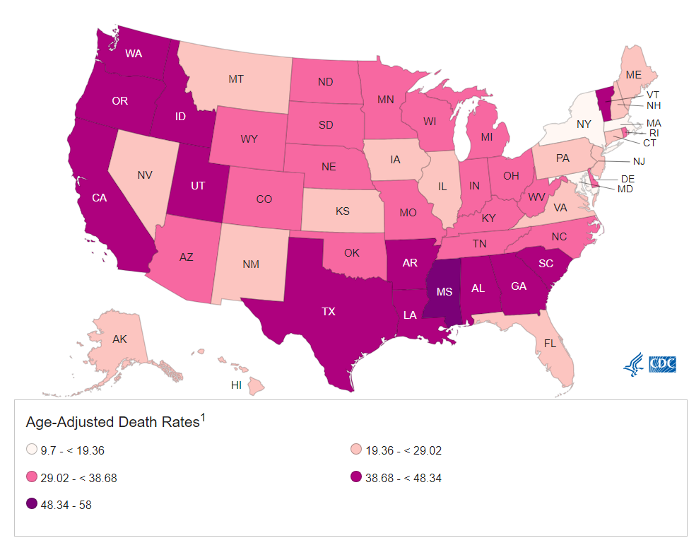
Methodology
If we have survey data based from every state, then we can isolate states to see the differences between the two states.
If we can see the differences between each state then if we can find the states with the highest rates of Alzheimer's Disease then any differences are possible correlations between the two.
Using Data from the CDC’s Mortality rate we determined that New York and Mississippi had the lowest and highest rates of Alzheimer’s per capita we can examine the differences.

Slide 6
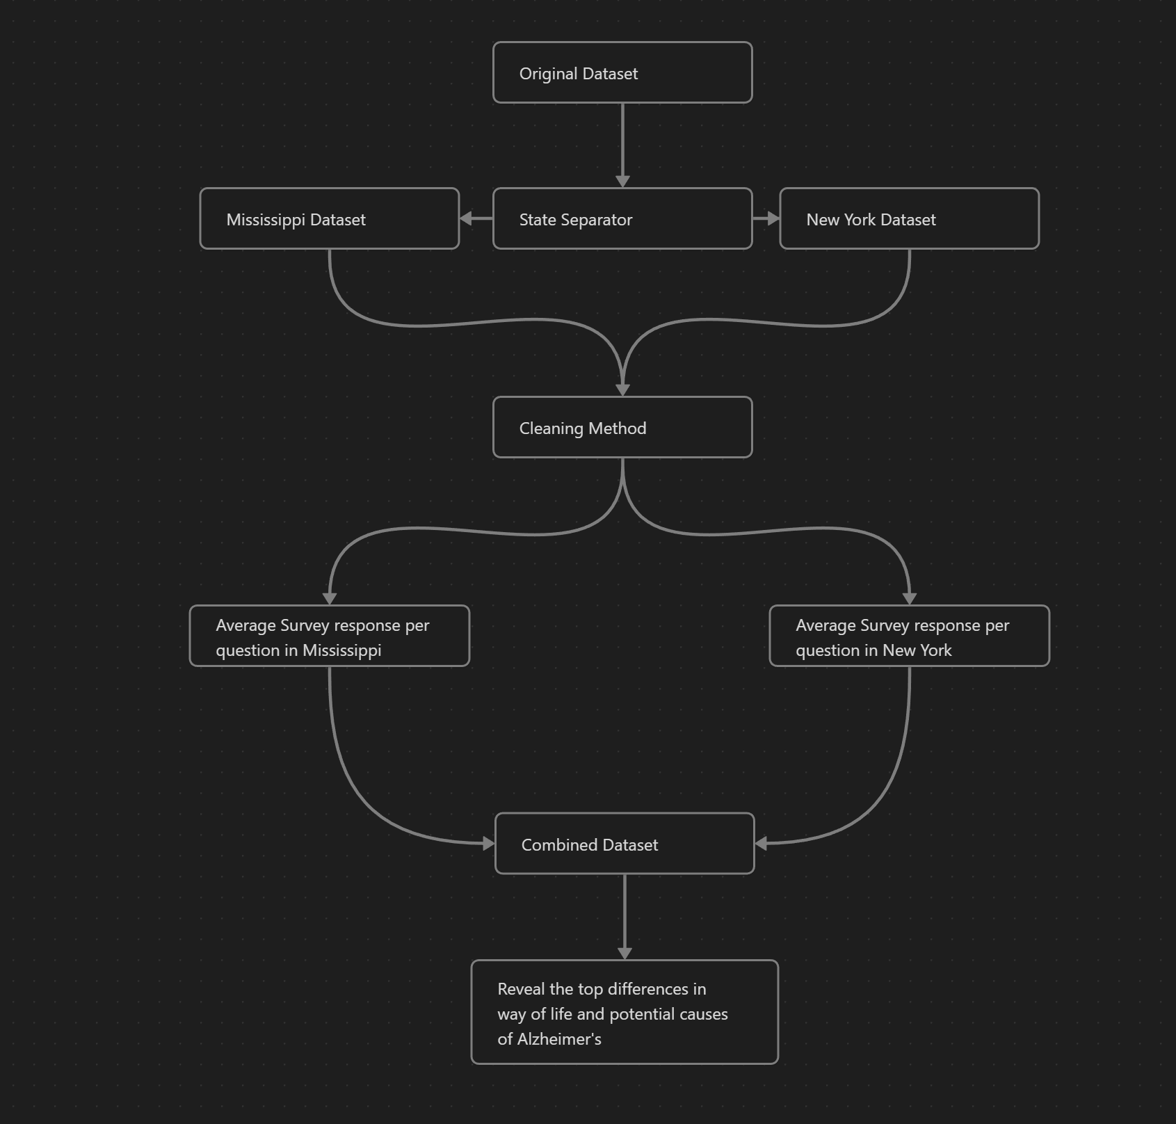
Implementation
Separate the states into two groups.
Clean question by question algorithm for maximum accuracy.
Find the individual averages for each of the 47 survey questions by state.
Combine all the new information into a CSV file for visualization.

Slide 7
Challenges Faced
Throughout the course of the project our methodology changed as we came to better understand the data we were sampling.
Initially we misinterpreted the data on CSV file to be a surveying of people with Alzheimer’s disease on various classes of questions.
Throughout the course of the project, we came to realize that the file didn’t contain direct links to Alzheimer's rather just surveys regarding healthy aging.
When we originally cleaned the data, we didn’t take into account that that the values used to fill in missing values before the states were separated would yield different results.
However throughout the project, we discovered that the CSV file didn’t contain anything related to rates of Alzheimer's Disease just statistics from all aging people throughout the nation.

Slide 8
Conclusions
We’re confident in our findings as they coincide with the complementary CDC data regarding Alzheimer's disease.
There is a 11% difference in adults who reported cognitive decline interfering with their ability to engage in social activities or household chores between New York and Mississippi.
Additionally, our findings revealed preventative measures are the best option to further combat the disease. For example, limiting trans-fats and daily vitamin intake showed a significant increase of brain tissue reformation.
A healthy lifestyle showed in our data greatly increased chances of early forming dementia.
Lastly, the data showed in adults diagnosed with Alzheimer’s shared high percentage rates of having lost teeth due to gum disease, high blood pressure due to diabetes, and blood sugar testing rates in higher increasing within the past three years.
Additionally our results reveal more than just possible causes for Alzheimer’s; They reveal a stark difference between differences in health between different states.
According to our data Mississippi is 10% more obese
Older adults in Mississippi 9% more likely to not have physical leisure time in the last month

Slide 9
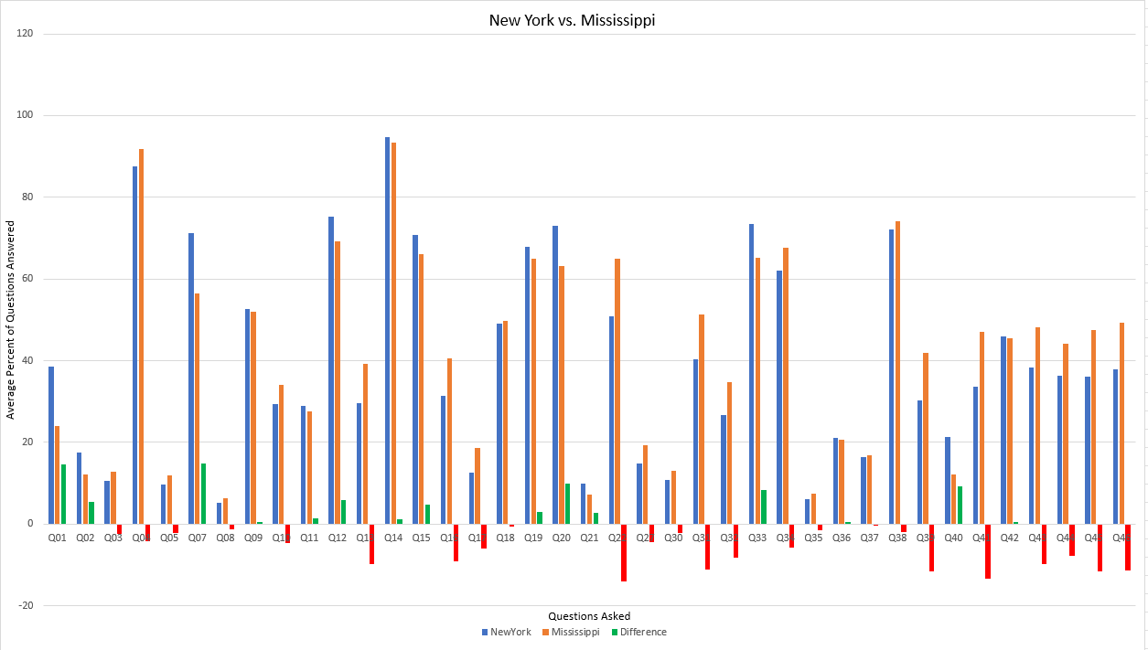
Visualization of our Findings

Slide 10
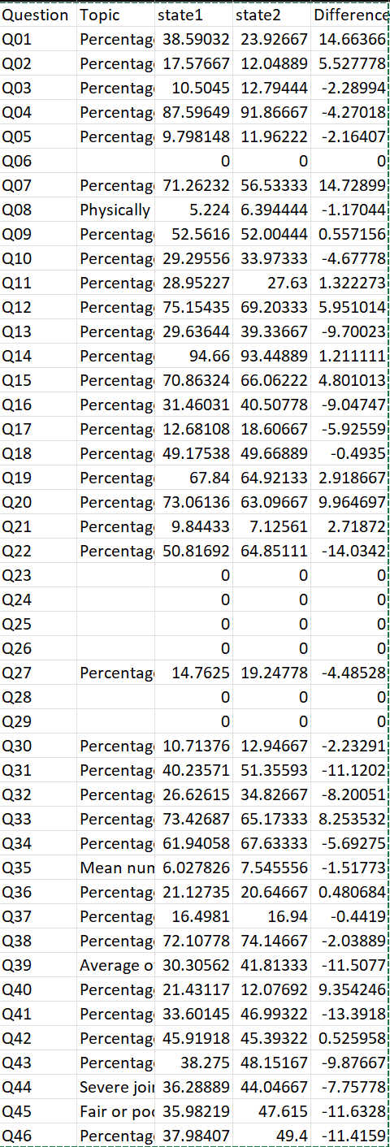
Alternative Visualization
This Graphic here is small, but it shows the completed product from our Algorithms.
Warning, Not all questions have a positive connotation, meaning a negative difference may not be a bad thing
Headers:
Question ID
Question asked per question
State1 which in our case represents New York
State2 which in our case represents Mississippi
Difference Value between the two(Percentage)

Slide 11
References
Centers for Disease Control and Prevention. (2019, September 9). Alzheimer’s disease and Healthy Aging Data Portal. Centers for Disease Control and Prevention. https://www.cdc.gov/aging/agingdata/index.html
Centers for Disease Control and Prevention. (2022, February 28). Stats of the states - alzheimer’s disease mortality. Centers for Disease Control and Prevention. https://www.cdc.gov/nchs/pressroom/sosmap/alzheimers_mortality/alzheimers_disease.htm
Barnard, N. D., Bush, A. I., Ceccarelli, A., Cooper, J., de Jager, C. A., Erickson, K. I., ... & Squitti, R. (2014). Dietary and lifestyle guidelines for the prevention of Alzheimer's disease. Neurobiology of Aging, 35, S74-S78. https://doi.org/10.1016/j.jalz.2014.03.009

