Slide 1

Creativity Chapter 4

Slide 2
Learning Objectives
By the end of this section, you should:
Understand the importance of creativity, innovation, concept generation, and critical evaluation in engineering design.
Be familiar with barriers that hinder creativity.

Slide 3
Motivation
Creativity is part of being an engineer.
We often start with a single solution to a problem and then pursue it as the only possibility.
Need to be creative and generate a variety possible designs.

Slide 4
Defining Creativity
Creativity is a difficult word to define
We usually say someone is “creative” when they produce an outcome or a product that is both unusual and appropriate (or meaningful or useful or particularly good)
Thus, creativity is defined by two aspects of its consequence (novelty and quality), and not the process that led to the consequence.

Slide 5
Creativity in Science & Engineering
Creativity in Science and Engineering: A mental process involving the generation of new ideas or concepts, or new associations between existing ideas or concepts.
Creativity is one of the essential attributes we would like our graduates to have – all others are useless without creativity.
Innovation and Invention are impossible without creativity.

Slide 6
Ingredients of Creativity
According to social psychologist Teresa Amabile (Harvard Professor and author on Creativity), there are three basic ingredients to creativity:
Domain skills - Domain skills are developed as one becomes an expert in a field. To be a creative engineer, one must first master the fundamentals of the discipline.
Creative thinking skills - Creative thinking skills include seeking novelty and diversity, being independent, being persistent, and having high standards.
Intrinsic motivation - Intrinsic motivation implies that the reasons for doing things come from within - from passion and pleasure, not as a result of external demands, pressures, or rewards.
Everyday Creativity: Principles for Innovative Design. Dr. Larry G. Richards

Slide 7
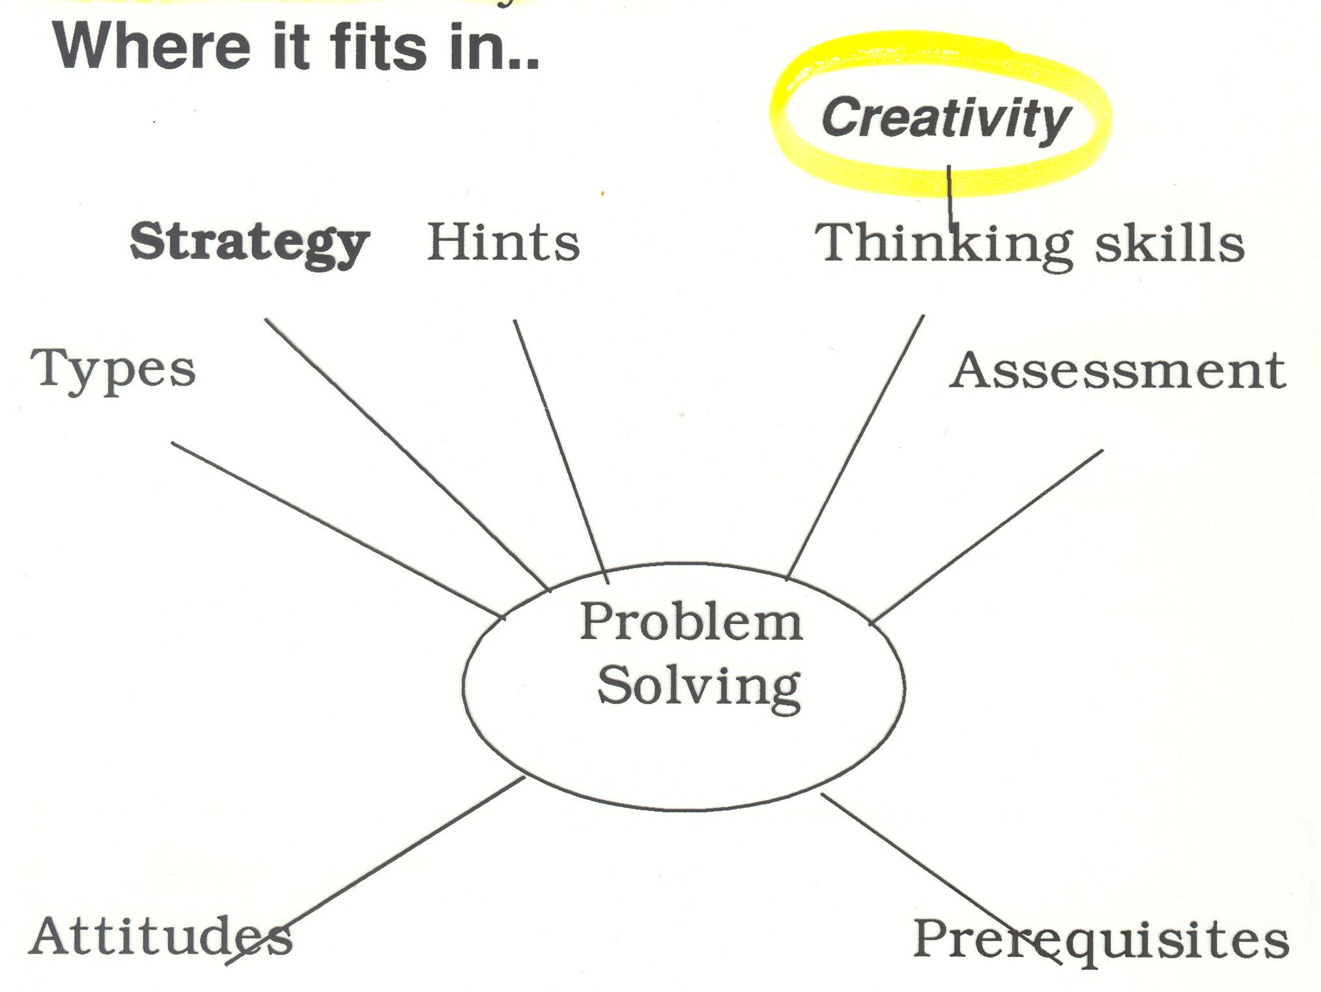
Creativity

Slide 8
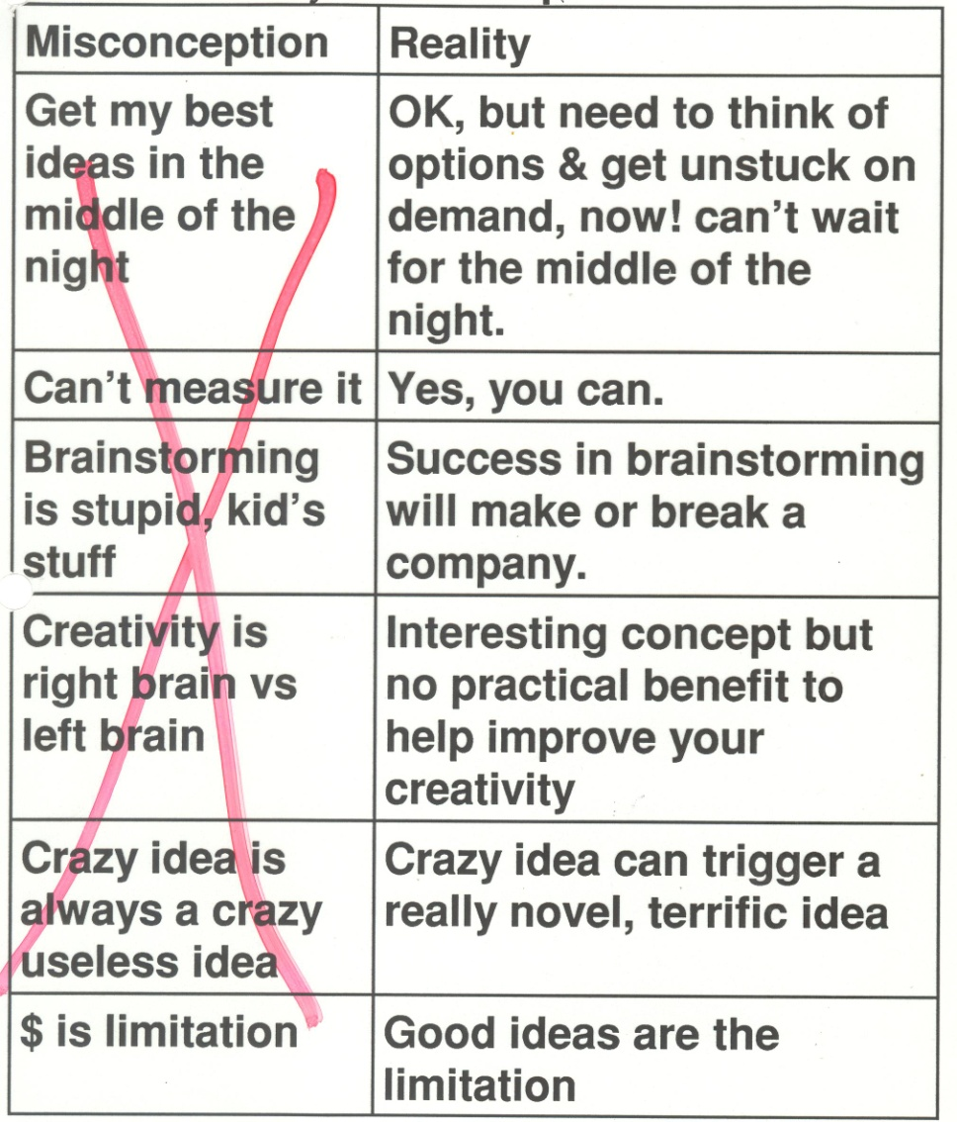
Creativity

Slide 9
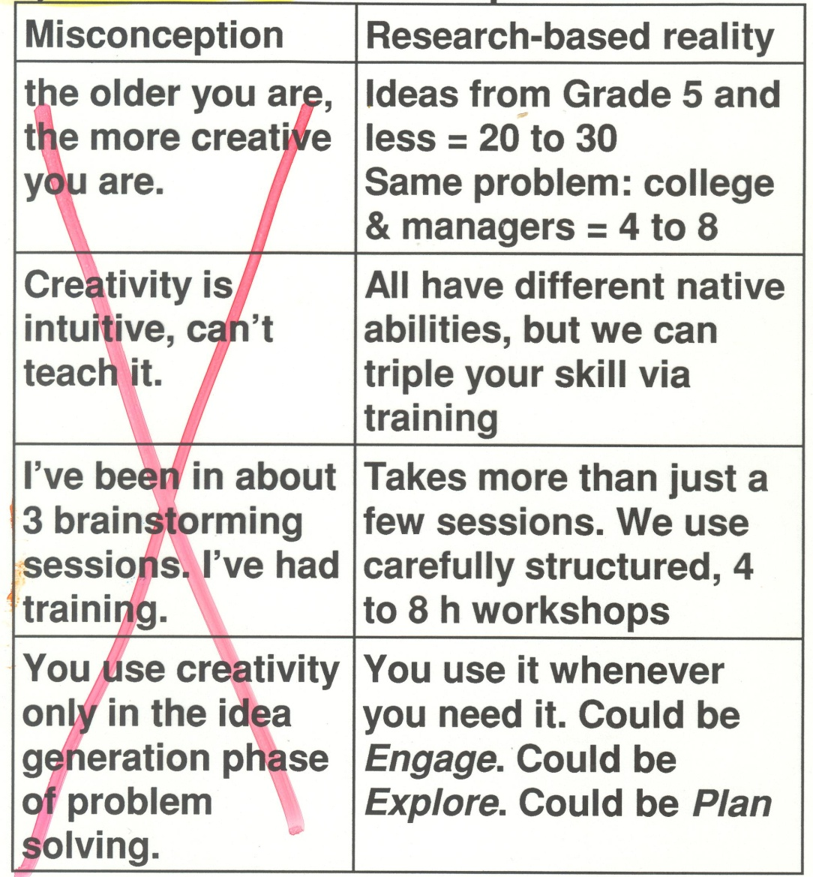
Creativity

Slide 10
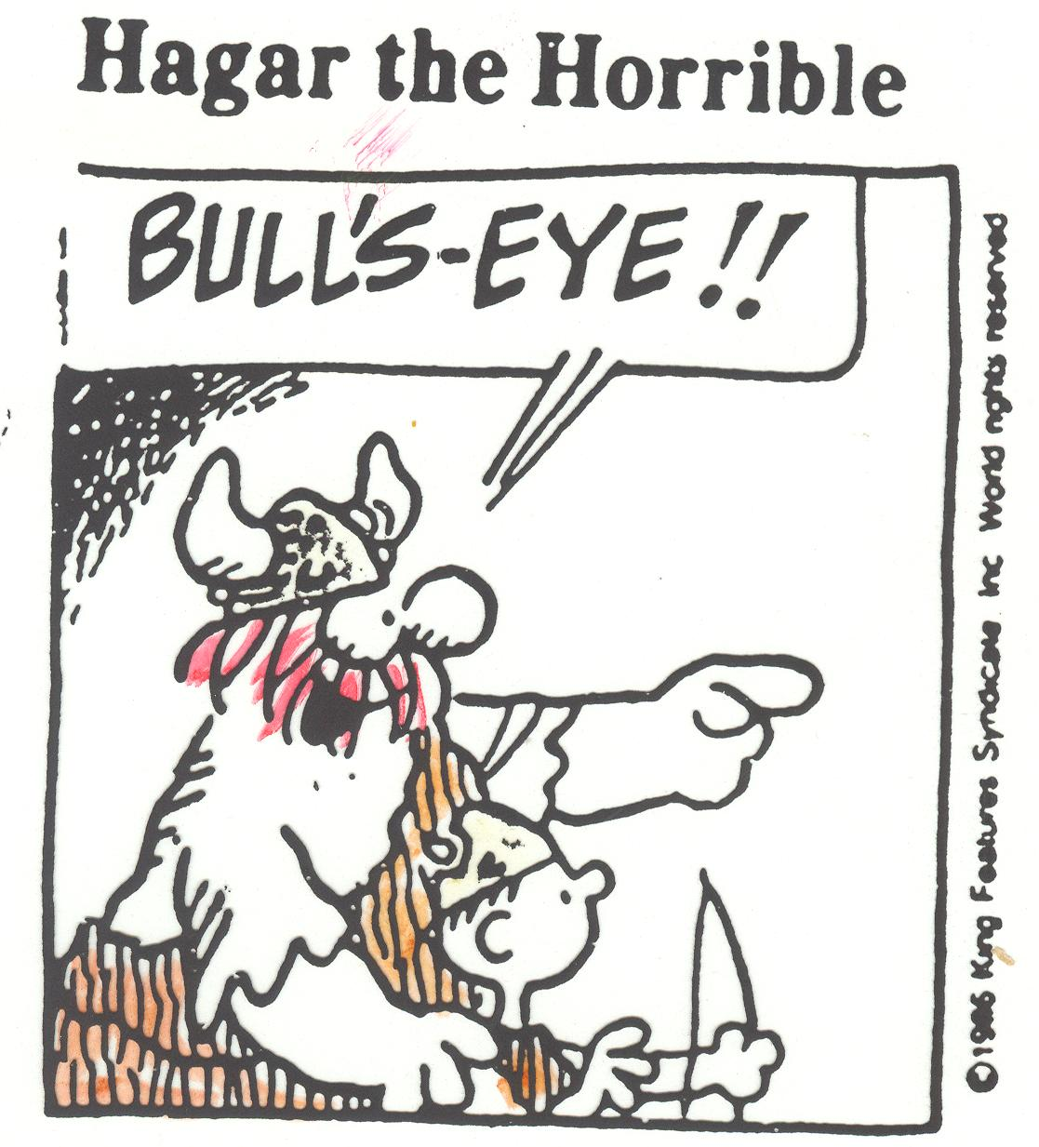

Slide 11
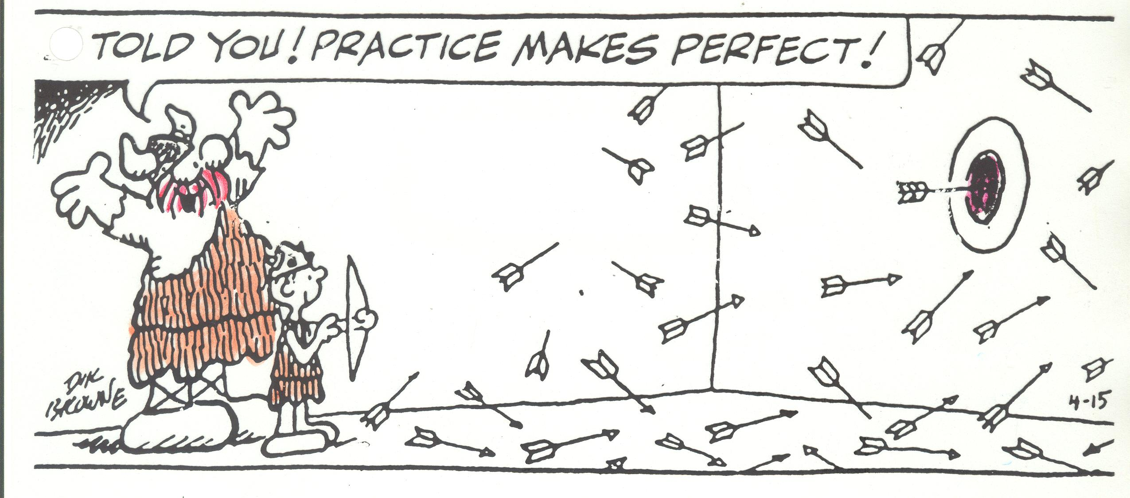

Slide 12
Convergent vs. Divergent Thinking
Divergent thinking: the creative generation of multiple solutions to a given problem.
In Science and Engineering, this is followed by evaluation of the answers and a choice of optimal solution.
Convergent thinking: the deductive generation of the optimum solution to a given problem, usually where there is a compelling inference.
Scientists and Engineers typically prefer convergent thinking while artists and performers prefer divergent thinking.

Slide 13
Barriers to Creativity
Perceptual:
Detecting what you expect
Difficulty in isolating the problem
Inability to see the problem from different perspectives
Emotional:
Fear of taking a risk
Need for order – but data may be missing or imprecise
Judging, not generating ideas
Cultural:
Taboos
Math/analysis is better than intuition
Expressive:
Choosing the wrong language to express/solve problem
Notes:
Perceptual blocks
Emotional blocks
Cultural blocks
Intellectual and expressive blocks

Slide 14

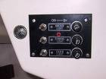
Use the Right Language For Problem
Three light bulbs in room A are connected independently to three switches in room B. The lights are not visible from room B. The problem is to determine which switch is which being allowed just one visit to room A from B.
A
B
Logic Mathematics Words Visualization Sensory

Slide 15
Use the Right Language For Problem
Best solved with sensory thinking:
Number switches 1,2 and 3.
Turn 1 on for five minutes; turn it off and turn on and leave on number 2.
Visit room A.
The bulb that is off and warm is connected to 1.
The bulb that is on is connected to 2.
The remaining bulb is connected to 3.

Slide 16
Use the Right Language For Problem
Burlington is part French and part English.
If 70% of the population speaks English and 60% of the population speaks French.
What percentage of the population speaks both languages?

Slide 17
Use the Right Language For Problem
Best solved with Mathematics:
Pr(A∨B) = Pr(A) + Pr(B) - P(A∧B)‏
Let A = event that a random person speaks English
Let B = event that a random person speaks French
Pr(A) = .7
Pr(B) = .6
Pr(A ∧B) = 1
Hence Pr(A ∨ B) = 1.3 – 1 = .3

Slide 18
Use the Right Language For Problem
Can a stack of pennies as high as the Empire State Building fit into a 10' by 15' room?
Logic Mathematics Words Visualization Sensory

Slide 19
Use the Right Language For Problem
Best solved with common sense logic:
Empire state building is less than 150 floors.
The 10' by 15' room is 1 floor tall.
Hence the stack of pennies can be divided into 150 single floor stacks and all these easily fit into the room –
e.g. 10 rows of 15 one floor stacks which would easily fit on a desk!

Slide 20
Use the Right Language For Problem
A man and a woman standing side by side begin walking so that their right feet hit the ground at the same time.
The woman takes three steps for every two steps the man takes.
How many steps does the man take before their left feet hit the ground at the same time?

Slide 21
Use the Right Language For Problem
Best solved visually!
M R L R L R L R L R L R
W R L R L R L R L R L R L R L R L ...
time

Slide 22
Thinking Styles!
Vertical thinking is thinking that is logical and straightforward
It is used in the refinement and development of ideas
Lateral thinking is thinking “around” a problem
It is used to generate new ideas and is sometimes used as a synonym for creative thinking

Slide 23
Characteristics of Lateral Versus Vertical Thinking
LATERAL THINKING
VERTICAL THINKING
Finds new ways to view things; concerned with change and movement.
Looks for what is different rather than “right” or “wrong.”
Analyzes ideas to generate new ideas.
Tries to find absolutes; concerned with stability.
Seeks justification for each step; tries to find what is “right.”
Analyzes ideas for faults.

Slide 24
Characteristics of Lateral Versus Vertical Thinking (continued)
LATERAL THINKING
VERTICAL THINKING
Uses free association thinking.
Welcomes chance intrusions of information; considers the irrelevant.
Progresses by avoiding the obvious.
Seeks continuity.
Selectively chooses information to consider; rejects irrelevant information.
Progresses using established patterns, considers the obvious.
Source: Based on de Bono, E. Lateral Thinking: Creativity Step by Step. New York: Harper & Row, 1970; de Bono, E. Six Thinking Hats. Boston: Little, Brown, 1985.

Slide 25

Brainstorming Methods
Brainstorming is one of the most important techniques to generate and develop new ideas
Lateral Thinking
Vertical Thinking
RANDOM STIMULATION
OSBORN’S CHECKLIST
UNRELATED IDEAS
RELATED IDEAS
OTHER PEOPLE’S VIEWS
FUTURING
The
Brainstorming Process
Free Association
(Unstructured Idea Generation)

Slide 26
Vertical Thinking: SCAMPER
SCAMPER is an acronym for a useful list of active verbs that can be applied as stimuli to make you think differently about the problem.
SCAMPER was defined by Robert Eberle, after an initial list from Brainstorming originator Alex Osborn.

Slide 27
Vertical Thinking: SCAMPER
SCAMPER (Osborn’s Checklist)
Substitute
Combine
Adapt
Modify (Magnify, Minify)
Put to other uses
Eliminate
Rearrange
Rerraange
Mag
Com
bine
nify
Minify

Slide 28
Vertical Thinking: SCAMPER
Substitute? ..... Who else, where else, or what else? Other ingredient, material, or approach?
Combine? ...... Combine parts, units, ideas? Blend? Compromise? Combine from different categories?
Adapt? .......... How can this (product, idea, plan, etc.) be used as is? What are other uses it could be adapted to?
Modify? ........ Change the meaning, material, color, shape, odor, etc.?
Magnify? ...... Add new ingredient? Make longer, stronger, thicker, higher, etc.?
Minify? ........ Split up? Take something out? Make lighter, lower, shorter, etc.?

Slide 29
Vertical Thinking: SCAMPER
Put to other uses? ..... How can you put the thing to different or other uses? New ways to use as is? Other uses if it is modified?
Eliminate? ..... What can you eliminate? Remove something? Eliminate waste? Reduce time? Reduce effort? Cut costs?
Rearrange? ..... Interchange parts? Other patterns, layouts? Transpose cause and effect? Change positives to negatives? Reverse roles? Turn it backwards or upside down? Sort?

Slide 30
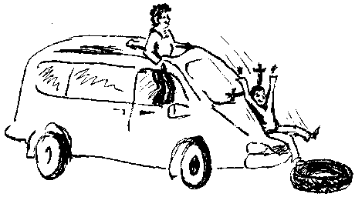
Vertical Thinking: Example
Suggested Uses of Old Cars as Equipment for a Children's Playground

Slide 31


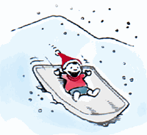

Vertical Thinking: SCAMPER
Substitute: Use the car seats in swings.
Combine: Use the side panels or roof to make a huge canopy or fort.
Adapt: Take the hood off and use it as a toboggan in winter.
Modify: Crush the cars into cubes and allow the kids to climb on the blocks.

Slide 32


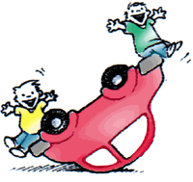
Vertical Thinking: SCAMPER
Put to other uses: Remove the engines and side panels and make go-carts.
Eliminate: Throw away the rims and use the tires for a "romper room"/jumping pit.
Rearrange: Turn the car upside down and use it as a teeter-totter.

Slide 33
Lateral Thinking: Example
Suggested Uses of Old Cars as Equipment for a Children's Playground

Slide 34
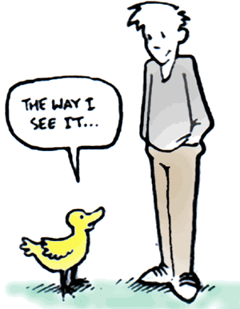
Lateral Thinking: Other People’s View
Think about walking around on your knees.
How would this change your perspective--that is, imagine the playground from a child's height.
What was your favorite playground toy?
How could this be mimicked with used auto parts?
Example: From a child's viewpoint, the intact car would be an exciting change to pretend to be a "grown-up." Just take off the doors and remove other equipment (electrical, etc.) and let the kids pretend to drive. Just leave the car as it is!

Slide 35
Random Entry Idea Generating Tool
The thinker chooses an object at random, or a noun from a dictionary, and associates it with the area they are thinking about.
For example, if they are thinking about how to improve a website, an object chosen at random from the environment around them might be a fax machine.
A fax machine transmits images over the phone to paper.
Fax machines are becoming rare.
People send faxes directly to phone numbers.
Perhaps this could suggest a new way to embed the website's content in emails and other sites.

Slide 36
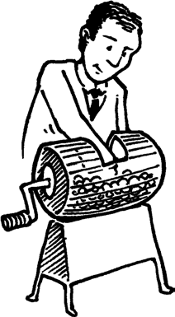
Lateral Thinking: Random Simulation Words
all, albatross, airplane, air, animals, bag, basketball, bean, bee, bear, bump, bed, car, cannon, cap, control, cape, custard pie, dawn, deer, defense, dig, dive, dump, dumpster, ear, eavesdrop, evolution, eve, fawn, fix, find, fungus, food, ghost, graph, gulp, gum, hot, halo, hope, hammer, humbug, head, high, ice, icon, ill, jealous, jump, jig, jive, jinx, key, knife, kitchen, lump, lie, loan, live, Latvia, man, mop, market, make, maim, mane, notice, needle, new, next, nice, open, Oscar, opera, office, pen, powder, pump, Plato, pigeons, pocket, quick, quack, quiet, rage, rash, run, rigid, radar, Scrooge, stop, stove, save, saloon, sandwich, ski, simple, safe, sauce, sand, sphere, tea, time, ticket, treadmill, up, uneven, upside-down, vice, victor, vindicate, volume, violin, voice, wreak, witch, wide, wedge, x-ray, yearn, year, yazzle, zone, zoo, zip, zap

Slide 37
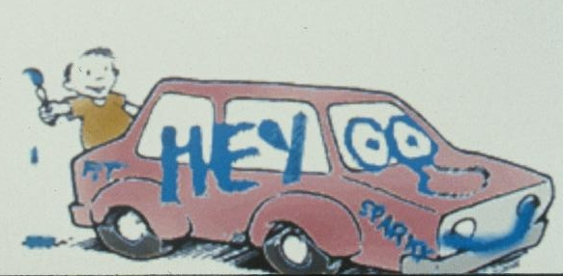
Lateral Thinking: Random Simulation Words
Document
Paper
Art
Colors
Car Paint
Allow kids to paint graffiti on cars

Slide 38
Random Simulation Words
Painting
Let kids paint graffiti on the cars
Paint targets and let kids throw balls at them
Paint the car as a covered wagon and let the kids play cowboys
Turn the car into a teeter-totter (upside down)
Turn the car into a go-kart
Crush the car and make blocks from it
Let kids drive the car as is
Open the car’s doors and use them as goals for field hockey
Whole Car
Parts
Use the seats in swings
Use the roof and doors as part of a fort
Use the tire inner tubes as part of an obstacle course (jump on)
Use the car’s hood as a sled
Use the car’s springs for a wobble ride

Slide 39
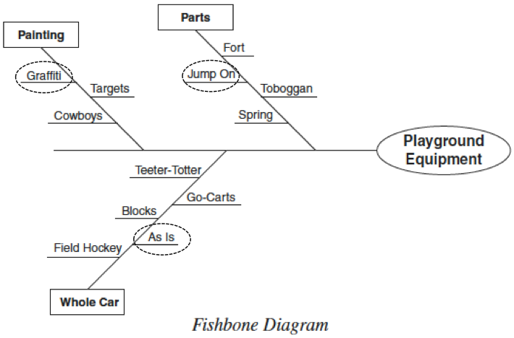
Lateral Thinking: Random Simulation Words

Slide 40
Portrait of a Creative Person
“Creative people pay attention to their world, see things differently, challenge assumptions, take risks, are not afraid to fail, and strive to generate multiple solutions to problems.
They are passionate about creativity and seek opportunities to innovate.”
Everyday Creativity: Principles for Innovative Design. Dr. Larry G. Richards

Slide 41
Six Tips To Help You Enhance Your Creativity
Open Your Mind - Have one new experience every day; no matter how small. New experiences stimulate the brain and help you make new and original connections; critical for boosting breakthroughs.
Diversify - Involve others in your problem-solving efforts who bring a different perspective or cultural experience than yours.
Mental Floss – Relax; Stress, exhaustion, boredom and even pain can block our pathways to creativity.
Stop Looking For the Right Answer - Look for many right answers.
Discover Your Creative Rhythm - Start paying attention to when you get your best ideas.
Health Makes Wealth - Regular exercise not only benefits your body, it boosts brain performance as well.
Innovative Thinking: Six Simple Secrets by Padi Selwyn, M.A.
Notes:
Research has shown that regardless of age or education, everyone has the capacity to become more creative. Here are six tips to help you enhance your creativity and stimulate creativity with your co-workers.
1. Open Your Mind
Have one new experience every day; no matter how small. New experiences stimulate the brain and help you make new and original connections; critical for boosting breakthroughs. Attend new forms of entertainment, read books or magazines you’ve never read before, take a class in a subject you know nothing about, listen to music you profess to hate, go somewhere really different on your next vacation, talk to people you normally don’t have a chance to meet. New experiences become the raw material for new ideas. The cross-pollination of diverse ideas is a primary stimulator for creativity.
2. Diversify
Involve others in your problem-solving efforts who bring a different perspective or cultural experience than yours. In addition to picking the brains of experts and knowledgeable colleagues, talk to people who are unfamiliar about the issue. By using this approach, you’ll be asked “dumb questions” that can often help you question assumptions, and see your challenge from a different angle with fresh eyes and a more open mind.
A few years ago, I worked with a high-tech company to develop and implement a model for innovation that would solicit and reward creative contributions. The CEO assigned an established employee committee to work with me to create a model that fit their particular organizational culture.
It turned out that the committee was made up of the least educated, lowest paid employees in the company; many of whom did not speak English fluently. Yet the program that they designed was brilliantly innovative. Even the CEO was surprised when we presented the final design for his approval. After three years, the system developed by the least likely employees, continues to generate many creative contributions, company wide.
3. Mental Floss
Take time to clean out your “mental plaque” by flossing daily; unplugging and taking time out to relax. Studies have shown that our intelligence and creative problem-solving abilities nosedive about 25% when we’re stressed out. Stress, exhaustion, boredom and even pain can block our pathways to creativity.
Creativity often seeps in through the cracks. By allowing yourself time to quiet your mind each day, the solutions beneath the surface will bubble up and you’ll be available to catch them. Twenty minutes of uninterrupted incubation time daily will produce a plethora of ideas.
4. Stop Looking For the Right Answer
Look for many right answers. Multiple solution thinking can help you strengthen your creative muscle, while generating more ideas, which always leads to better ideas. Setting idea quotas can force you to push the envelope, forging past predictable, obvious solutions.
Thomas Edison died with 1,092 patents to his name as a result of setting quotas for himself and his staff. He quota was as follows: a minor invention every 10 days, a major one every six months.
In gold mining, it takes nearly 200,000 ounces of ore to produce just one ounce of gold. It’s no different with ideas. Mine with perseverance and patience, and you’ll be richly rewarded.
5. Discover Your Creative Rhythm
Everyone has creative performance peaks daily. Some of us get our best ideas during our morning commute, others wake up in the middle of the night with thunderbolts of genius. Unfortunately, most of us don’t honor this fertile idea-harvesting time. Start paying attention to when you get your best ideas. If you aren’t sure, keep a log for a week and jot down what time of day you are most mentally productive.
It’s been said that the difference between creative geniuses and “normal” people is that creatives have more effective capturing techniques. They pay attention to their best ideas and record them before they have a chance to slip away. Once you discover your creative rhythm, make sure you have a tape recorder, laptop, or pad and pencil nearby to capture your ideas.
6. Health Makes Wealth
A wealth of new ideas can be yours if you exercise regularly and eat well. Regular exercise not only benefits your body, it boosts brain performance as well.
One study found that 20-minute aerobic sessions twice weekly, kept up for eight weeks, brought about significant changes in creativity tests in college students who had not previously exercised. A well-oxygenated brain functions more effectively.

Slide 42
… and another one: Find what you love to do
“We know that people do their most creative work when they love doing what they’re doing.
There’s no substitute for intrinsic motivation, that is, motivation that comes from within.
Although such motivation doesn’t guarantee creativity, dislike or lack of interest in work practically guarantees non-creativity.”
Ten Keys to Creative Innovation by Robert J. Sternberg, Ph.D. and Todd I. Lubart, Ph.D.

Slide 43
Nothing is more dangerous than an idea, when it is the only one you have.
- Emile Cartier

Slide 44
Summary
Open your mind to creativity
Innovation is important
There are strategies to apply

