Slide 1

System Design: Behavioral Models Chapter 6

Slide 2
Learning Objectives
By the end of this section, you should:
Have a familiarity with the following modeling tools for describing ECE system behavior: state diagrams, flowcharts, data flow diagrams, entity relationship diagrams, and the Unified Modeling Language.
Understand the intention and expressive power of the different models.
Understand the domains in which the models apply.
Be able to conduct analysis and design with the models.
Understand what model types to choose for a given design problem.

Slide 3
Motivation
Functional Design
Appropriate for function-oriented systems:
inputs,
outputs, and
some transformation between them.
There are other types of system behavior that designers need to be able to understand.
State behavior
Logic and flow
Data flow
Database relationships
…

Slide 4
Models and Properties
Model: a simplified representation or description of a system or complex entity, esp. one designed to facilitate calculations and predictions
A good model should be
Abstract
Unambiguous
Allow for innovation
Standardized
Facilitate good communication
Modifiable
Remove unnecessary details & show important features
Break system into sub-problems
Substitute sequence of actions by a single action
Assist in verification
Assist in validation

Slide 5
Behavioural Models
Behavioural models are used to describe the overall behaviour of a system
Behavioural models include
State machine models that show the systems response to events
Data processing models that show how data is processed as it moves through the system
Entity relationship diagrams (ERD)
Unified Modeling Language (UML) charts
A multiplicity of these models are required for a description of the system’s behaviour

Slide 6
State Machine Models
These model the behaviour of the system in response to external and internal events.
They show the system’s responses to stimuli so are often used for modelling real-time systems.
State machine models show system states as nodes and events as arcs between these nodes.
When an event occurs, the system moves from one state to another.
State charts or diagrams are also an integral part of the UML diagrams.

Slide 7
State Diagrams
Describes the behavior of a system with memory.
Applied to Digital Design (see the example for a Vending Machine on the right).
Can be also used to describe the high-level behavior of complex systems.
The only requirement for their use is that the system must have memory.

Slide 8
State Diagram Example Microwave Oven Model

Slide 9
Microwave Oven State Descriptions

Slide 10
Microwave Oven Stimuli

Slide 11
The Flowchart
A flowchart is used to describe a process or algorithm, including its steps and control.
It is one of the most applicable models for a diverse set of design and analysis domains.
Standard set of symbols used to construct a flowchart:

Slide 12
Flowchart Example: Light Monitoring System
Can you figure out the operation of the system by looking at this?
That is why the flowchart is elegant and not so lowly!

Slide 13
Data Flow Diagrams
Use
Data flow diagrams (DFDs) model the system from a functional perspective.
More specifically, DFDs are used to model the system’s data processing:
They show the processing steps as data flows through a system.
Motivation
Tracking and documenting how the data associated with a process is helpful to develop an overall understanding of the system.
Data flow diagrams may also be used in showing the data exchange between a system and other systems in its environment.

Slide 14
Data Flow Diagrams
DFDs are simple and intuitive.
DFDs can have levels, just like the functional decomposition
Main DFD symbols are as follows:

Slide 15
Example DFD for Order Processing

Slide 16
Example DFD for CASE toolset

Slide 17
DFD Example for Video Browsing System

Slide 18
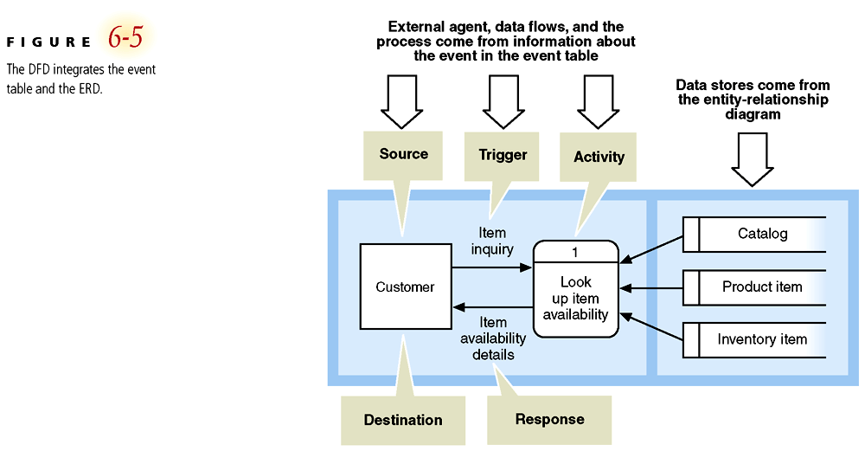
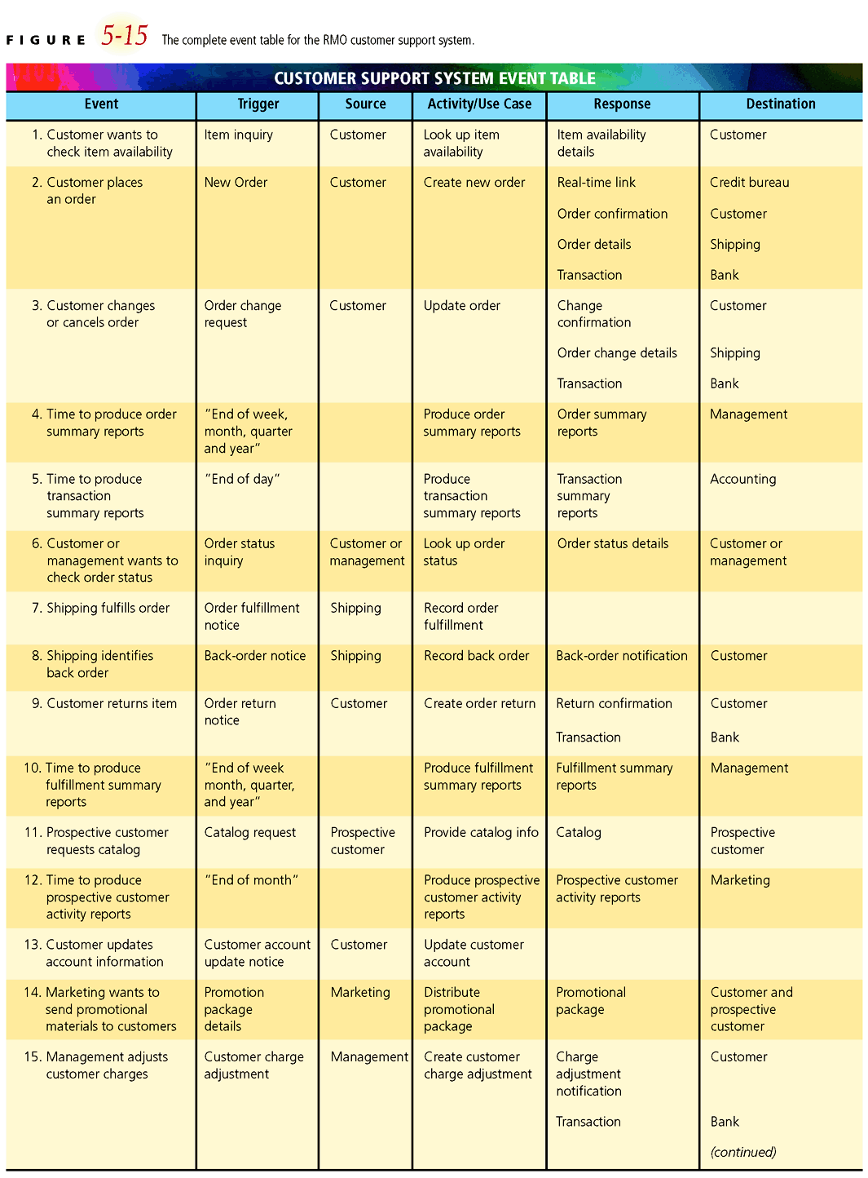
DFD Event Table
An event is an occurrence with a specific time and place.
3 types: temporal, external and state
Temporal events due to system reaching a critical time point.
External event occurs outside the system boundary – typically by a user.
State events are due to “changes” within the system.

Slide 19
DFD – The Event Table
Temporal events due to system reaching a critical time point. In this case, generation of shot boundaries is an example.
External events occur outside the system boundary – typically by a user, such as a request for either storyboard or video preview.
State events are due to “changes” within the system.
Event | Trigger | Process | Source
Annotate Video | New Video Arrival | Shot Boundary Detection | System
View Storyboard | Browse Request | Storyboard Preview | User
View Shot | Shot Preview Request | Shot Preview | User

Slide 20
Entity Relationship Diagrams
A database can be modeled by an Entity Relationship Diagram (ERD).
An ERD can catalog
a set of related objects (entities),
their attributes, and
the relationships between them.
An ERD has 3 elements:
Entities
Relationships
Attributes
An ERD allows for an easy interpretation of the relationships between entities as well as their attributes.

Slide 21
ERD for College Database System
Consider academic scheduling in a college.
Need to store data about 3 entities:
Students,
Courses, and
Departments.
An entity like “Department” may have multiple attributes (with one being the key attribute):
Name, Chairman, and # of students
Need to determine relationships between entities (see the Entity Relationship Table on next slide).
Relationships can be many-to-one (M:1) or many-to-many (M:M).

Slide 22
College Database System Entity Relationship Matrix
 | Student | Course | Department
Student |  | takes many | majors in one
Course | has many | can require many / can be prerequisite for many | is offered by one
Department | enrolls many | offers many
A Student can take many courses and a Course has many Students (M:M)
A Department enrolls many Students, but a Student can only major in one Department (M:1)
A recursive relationship between the Course entity and itself:
A Course can have many other Courses as prereq or serve as prereq for many other Courses.

Slide 23
College Database ERD
 | Student | Course | Department
Student |  | takes many | majors in one
Course | has many | can require many / can be prerequisite for many | is offered by one
Department | enrolls many | offers many

Slide 24
Unified Modeling Language An Object Model
Object models describe the system in terms of object classes.
An object class is an abstraction over a set of objects with common attributes and the services (operations) provided by each object
Object-oriented software design routinely employs UMLs.
UML has 6 different views of a system (unified!) and 14 different diagrams.
Only an overview is provided here.

Slide 25
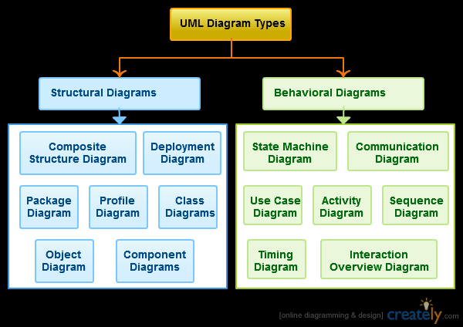

Slide 26
UML - Scenario
Consider “web ordering of groceries followed by home delivery.”
The “v-Grocer” system.
User has a barcode scanner connected to home computer.
They can scan a used item and automatically order it from the grocery store.
Place the order and groceries delivered at pre-arranged time.

Slide 27
UML Diagrams: Static View
Emphasizes the static structure of the system using
objects,
attributes,
operations and
relationships.
The structural view includes class diagrams and composite structure diagrams.
Classes represent
Data
Methods (functions) that operate on the data
Objects

Slide 28
UML Diagrams: Static View Class Diagram
is a type of static structure diagram that describes the structure of a system by showing the system's classes, their attributes, operations (or methods), and the relationships among the classes.

Slide 29
UML Diagram: Use-Case View
Use-case diagram
Captures the overall behavior of the system from the user’s perspective and
Describes cases in which the system will be used.

Slide 30
Example: Web Order Use-Case Description
Use-Case | WebOrder
Actors | Customer, Database, and WebServer
Description | This use-case occurs when a customer submits an order via the WebServer. If it is a new customer, the WebServer prompts them to establish an account and their customer information is stored in the Database as a new entry. If they are an existing customer, they have the opportunity to update their personal information.
Stimulus | Customer order via the GroceryCart.
Response | Verify payment, availability of order items, and if successful trigger the AssembleOrder use-case.

Slide 31
UML Diagrams: State Machine View

Slide 32
UML Diagrams: Activity View
Describes a sequence of activities needed to complete a task.

Slide 33
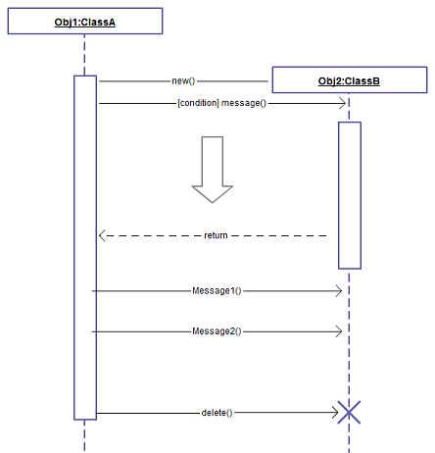
UML Diagrams: Interaction View
Emphasize the flow of control and data among the things in the system being modeled.
As an example, you can use sequence diagrams to describe:
How the main components of the system interact to fulfill the goal of each use case.
How the internal parts of the component interact to achieve the result required for each incoming message.

Slide 34
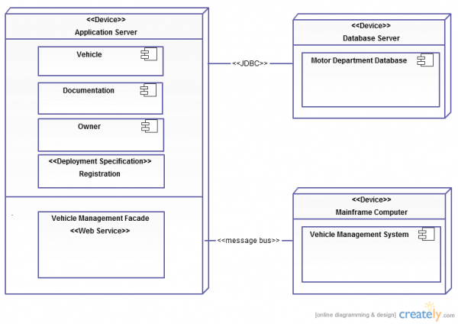
UML Diagrams: Physical View
Show the physical components that constitute the system.
File system
Server
Clients
RAID
Can think of this much more generally than presentation in UML.

Slide 35
Selecting Models for Your Own Project
Model | Intended Use
Functional Decomposition | Describes input, output, and functional transformations in a system.
State Diagrams | Describes behavior of systems with memory. Useful for behavior modeling of complex systems with memory.
Flowchart | Describes the control flow and steps for a process or algorithm
Data Flow Diagram | Models the processing, transformation, and flow of data inside a system. Supplemented by an event table.
Entity Relationship Diagram | Used to catalog a set of related object (entities), their attributes, and the relationships between them. Highly relevant for Database models.
UML Diagrams | Describes complex software systems. Certain views can be used for any system (not just software). A must for documentation of a complex software design.

Slide 36
Summary
Models are an abstraction of system.
Models can be thought of as a design specification.
Models have different intentions for describing behavior.
Models should
encourage innovation and
provide for clear documentation.

