Slide 1
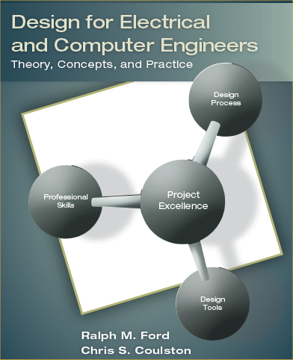
Testing Chapter 7

Slide 2
Motivation
Development is accompanied by “bugs.”
Catching bugs early saves money
The further a bug progresses the more impact it has on the system
A bug fix requires all related modules to be retested.
A bug fix may require redesigning related modules.
For example
PCB design flaw
VLSI layout error
Subtle coding flaw
Testing doesn’t remove bugs, it just makes it less likely they exist.

Slide 3
Testing Principles
Testing proceeds with design process
Write tests while designing modules
Perform tests while implementing modules
The Test-Vee illustrates this process

Slide 4
Developing Test Cases The Rationale
Test cases define exactly what the module must do.
Testing prevents feature creep, since the development of a module is complete when its test is passed.
Test cases motivate developers by providing immediate feedback.
Test cases force designers to think about extreme cases.
Test cases are a form of documentation.
Test cases force the designer to consider the design of the module before building it.

Slide 5
Testing
Quality design documents
Requires you to reason about system behavior
Gives your design clear goals
Enables you to look at your system from the tester’s perspective
How should we perform testing?
Tradeoff
Apply every possible input, or
Apply selected inputs which might yield errors
Test should be chosen to increase likelihood of finding an error.

Slide 6
Types of Testing
Black box testing
No knowledge of internal organization
Only access input and outputs
Change inputs and observe outputs
White box testing
Knowledge of internal organization
Might have expectation of fault model
Create test instances which reveal physical or logical errors
Gray box Testing (relevant for software testing)
Combination of black box and white box testing

Slide 7
Black-, Gray-, & White-Box Testing
Result
Input determined by
Actual output
compared
with
required output
Black box
… requirements
Gray box
As for black- and white box testing
… requirements &
key design elements
White box
…design
elements
Confirmation
of expected
behavior
Adapted from Software Engineering: An Object-Oriented Perspective by Eric J. Braude (Wiley 2001), with permission.

Slide 8
Black-box Testing

Slide 9
White Box Testing – Software Paths to be Checked
The objective of path testing is to ensure that the set of test cases is such that each path through the program is executed at least once.
Parameter & settings make
sense?
N
Y
Set _name to
“defaultName"
N
Parameter name too long?
Y
Decision Coverage
Set _name
to parameter
Truncate
name
Adapted from Software Engineering: An Object-Oriented Perspective by Eric J. Braude (Wiley 2001), with permission.

Slide 10
Design for Testability
A major goal in engineering is to design systems with high testability.
A testable design is easier to
Debug
If a design is “testable” then a failure of a component can be
Quickly detected
Quickly located
Manufacture, and
Service in the field
Design with high testability is possible if both the “Controllability” and “Observability” of system are also high.
Controllability
When any node of the system can be accessed to set the associated variable of interest (i.e. voltage) to a desired value
Observability
When measurements of interest can be made at any node of the system.

Slide 11
Stubs for Testing
A placeholder for future functionality
A device which mimics subsystem
Simulates input or monitors outputs
For a unit under test (UUT)
Insure good behavior
before wreaking havoc on the rest of the system
Examples of A Stub:
A function generator for an audio input
A printf() instead of a file write
DIP switch instead of a bus connection

Slide 12
Stub A Hardware Example

Slide 13
Stubs (and Drivers) Isolating the Module UUT
Test
Results
cases
Driver
Module to
Test
Stub
Stub
Stub

Slide 14
Test Case Properties
Accurate - The test should check what it is supposed to and exercise an area of intent.
Economical - The test should be performed in a minimal number of steps.
Limited in complexity - Tests should consist of a moderate number (10-15) of steps.
Repeatable - The test should be able to be performed and repeated by another person.
Appropriate - The complexity of the test should be such that it is able to be performed by other individuals who are assigned the testing task.
Traceable - The test should verify a specific requirement.
Self cleaning - The system should return to the pre-test state after the test is complete.

Slide 15
Constructing Tests
There are many types of testing and several taxonomies to classify testing procedures or methodologies.
We will focus on four types as
Debugging
Unit Testing
Integration Testing
Acceptance Testing

Slide 16
Debugging
There are two types of bugs:
Bohrbugs
Bohrbugs are reliable bugs
The error is always in the same place and the same way
Example: accessing the incorrrect element of an array
Example: incorrect connection for a logic gate input
Solution: set a good trap that causes the associated error, and reveals the source of error.
Heisenbugs
Innocuous changes of input yield buggy behavior
May not be reproducible
They seemingly move around within a system
Example: a pointer error that occasionally writes the system stack!
Example: a circuit that operates incorrectly at random times (a floating ground line?)
Solution: not trivial, must think outside the box!

Slide 17
Debugging Process
Observe the problem under different operating conditions
Form a hypothesis as to what the potential problem is
Conduct experiments to confirm or eliminate the hypothesized source of the problem
Repeat until the problem is eliminated

Slide 18
Debugging Common Problems
Check easiest problems first
You can perform more in a given time
Start at lowest levels of abstraction
Upper levels rely on lower level
Examples
Is the system powered up?
Is the testing equipment adjusted properly?
Are the bus lines being correctly manipulated?
Have you initialized the system?
Are you printing out the right variable/type?

Slide 19
Unit Testing
A unit test is a COMPLETE test of the functionality of a system module in isolation.
Should be traceable to the detailed design.
Consists of a set of test cases.
Each test case establishes that a subsystem performs a single unit of functionality to some specification.
Test cases should be written with the express intent of uncovering undiscovered defects.

Slide 20
Unit Testing Example Robot Electro-mechanical Architecture

Slide 21
Unit Testing Qualifying Subsystems or Modules
MCU (hardware)
LCD
Switches
Digital Compass
Range finder
H-bridge
Motors
Chassis
MCU (software)

Slide 22
Unit Test: The Digital Compass Functional Requirements
Module | Digital Compass – Geosensor version 2.3
Inputs | Earth’s magnetic field: An orientated field of magnetic force beginning and ending at the earth’s magnetic poles. SClk – Clock signal to clock data through the module. Maximum Frequency is 10Mhz. SDIn – Serial data input to send data into the compass module. Date is valid on positive SClk edges.
Outputs | SDOut – Serial data output from the compass module. Data is valid on negative clock edges.
Functionality | Senses the earth’s magnetic field and determines the orientation of the compass with respect to the field. This orientation is stored in an internal register and can be retrieved through the SPI interface.
Test | Comp-UT-01

Slide 23
Unit Test: The Digital Compass Matrix Test
Test Writer: Sue L. Engineer
 | Test Case Name: | Compass unit test #1 |  |  |  |  | Test ID #: | Comp-UT-01
 | Description: | Checks that the compass returns correct angular measurements to the MCU. Test program is in ./test/compass_unit_test_1.c |  |  |  |  | Type: | □ white box ☑ black box
Tester Information
 | Name of Tester: |  |  |  |  |  | Date:
 | Hardware Ver: | Compass Module - Geosensor version 2.3 |  |  |  |  | Time:
 | Setup: | Compass module should be wired to the MCU through the SPI interface pins. The MCU should be connected to an RS232 terminal through its SCI interface. The terminal should be configured to run at 9600 baud. Cardinal directions map should be aligned using the magnetic compass.
Step | Action | Expected Result | Pass | Fail | N/A | Comments
1 | Compile compass.c in /test directory | IDE should generate no warnings or errors.
2 | Download | MCU should report “download successful”
3 | Execute | MCU should display compass splash screen on terminal interface.
4 | Orientate compass to 0 degrees. | Terminal interface should display 0 degrees +/- 10 degrees.
5 | Orientate compass to 30 degrees. | Terminal interface should display 30 degrees +/- 10 degrees.
6 | Orientate compass to 45 degrees. | Terminal interface should display 45 degrees +/- 10 degrees.
… | … | …
12 | Orientate compass to 315degrees. | Terminal interface should display 315 degrees +/- 10 degrees.
 | Overall test result:

Slide 24
Unit Testing Methods
Matrix Test
Automated Scripts Tests
Step-by-step Test
Note: these can be applied to any level of test: unit, integration, acceptance, etc.

Slide 25
Matrix Test
Appropriate for cases where the inputs are structurally the same and differ only in their values.
Consider a test for the analog-to-digital (ADC) (temperature measurement system).
Assuming that ADC’s clock frequency is 10 KHz and the input ranges from 0 to 5 V.
The Unit Test will entail applying different inputs to the ADC and verifying the outputs.
The applicable text matrix is presented next.

Slide 26
Matrix Test Test Template for ADC
Test Writer: Sue L. Engineer
 | Test Case Name: |  |  | ADC unit test |  |  | Test ID #: |  |  | ADC-UT-01
 | Description: |  |  | Verify conversion range and clock frequency. Output goes to 0 in presence of null clock. |  |  | Type: |  |  | □ white box ☑ black box
Tester Information
 |  | Name of Tester: |  |  |  |  | Date:
 |  | Hardware Ver: |  | 1.0 |  |  | Time:
 |  | Setup: |  | Isolate the ADC from the system by removing configuration jumpers. Connect the CLK input to 10 KHz clock source and the Din input to a high-precision voltage source. Connect the output from the ADC to a logic analyzer.
Test |  | V_{T} | Clock |  | Expected output |  | Pass | Fail | N/A | Comments
 |  |  |  |  | Decimal | Hexadecimal
1 |  | 0.0V | 10 KHz |  | 0 | 0x000
2 |  | 2.0 V | 0 Hz |  | 0 | 0x000
10 |  | 2.502 V | 10 KHz |  | 512 | 0x200
 |  | Overall test result:

Slide 27
Unit Testing Step-by-Step Tests
A step-by-step test case follows a prescribed approach to generate the test and checking the results.
Appropriate for complex test cases.
The test template has an additional column in comparison the same for the Matrix Test.
Specific action the tester must perform at each step in the test process is defined in that column.
Consider the vending machine state diagram that accepts nickels and dimes and dispenses candy when total is $0.25 (or more).
Its state machine has multiple processing paths.
A test case can be written for each processing path.

Slide 28
Unit Testing Step-by-Step Test for Vending
Test Writer: Sue L. Engineer
 | Test Case Name: | Finite State Machine Path Test #1 |  |  |  |  | Test ID #: | FSM-Path-01
 | Description: | Simulate insertion of money with a mix of nickels and dimes. Verifies FSM, outputs candy in response to a total deposit of $0.25. |  |  |  |  | Type: | ☑ white box □ black box
Tester Information
 | Name of Tester: |  |  |  |  |  | Date:
 | Hardware Ver: | 1.0 |  |  |  |  | Time:
 | Setup: | Make sure that the system was reset sometime prior and is in state $0.00.
Step | Action | Expected Result | Pass | Fail | N/A | Comments
1 | Strobe Nickel | State should go to $0.05
2 | Strobe Dime | State should go to $0.15
3 | Wait | State should remain $0.15
4 | Strobe Nickel | State should go to $0.20
5 | Strobe Dime | State should go to $0.25
6 | Nothing | State should go to $0.00
 | Overall test result:

Slide 29
Unit Testing Automated Test Scripts
A sequence of commands provided to the UUT to facilitate testing without human intervention.
The generated outputs can be compared to expected outputs to determine if there is an error: this can be automated as well.
Useful for regression testing phase
The process of retesting a module after a modification to make sure no new errors were introduced.
Developing testing scripts require significant up-front cost.

Slide 30
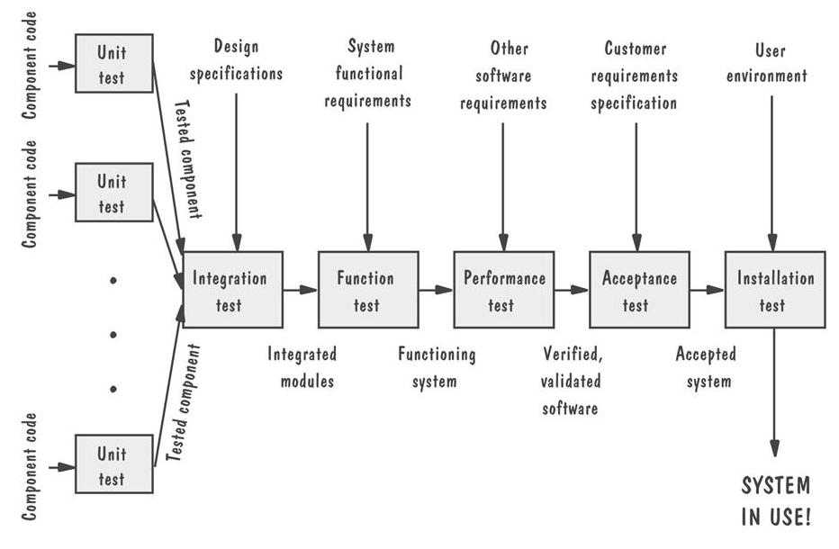
Complete Testing Process for Software Illustrated

Slide 31
Integration Testing
Checks that major modules work correctly.
Write the integration test during Level 1 design:
Help insure requirements are being met.
Help to firm-up design
Requires the designer think about the expected behavior of the subsystems.
Requires designer to think about extreme behaviors of subsystems.

Slide 32
Integration Testing Formulation of Test Cases
Following questions can be the bases for formulating the test cases:
What are the different paths of execution through the system?
Are all modules exercised at least once during integration testing?
Have all the interface signals been tested?
Have all the interface modes been exercised?
Does the system process information at the required rate and meet timing requirements?

Slide 33
Integration Testing Software Design Perspective
The entire system is viewed as a collection of subsystems (sets of classes) determined during the system and object design.
The order in which the subsystems are selected for testing and integration determines the testing strategy
Big bang integration (Non-incremental)
Bottom up integration
Top down integration
Sandwich testing
Variations of the above

Slide 34
Integration Testing Software Example: Three Layer Call Hierarchy
A
Layer I
B
C
D
Layer II
E
F
G
Layer III

Slide 35
Integration Testing Big-Bang Approach
Unit Test
A
Don’t try this!
Unit Test
B
Unit Test
C
System Test
Unit Test
D
Unit Test
E
Unit Test
F

Slide 36
Integration Testing Bottom-Up
A
Layer I
B
C
D
Layer II
Test E
E
F
G
Layer III
Test B, E, F
Test F
Test
A, B, C, D,
E, F, G
Test C
Test D,G
Test G
Special program needed to do the testing, namely a “Test Driver”: A routine that calls a subsystem and passes a test case to it.

Slide 37
Integration Testing Pros and Cons of Bottom-Up
Bad for functionally decomposed systems:
Tests the most important subsystem (UI) last
Useful for integrating the following systems
Object-oriented systems
real-time systems
systems with strict performance requirements

Slide 38
Integration Testing Top-Down Methodology
A
Layer I
B
C
D
Layer II
E
F
G
Layer III
Test
A, B, C, D,
E, F, G
Test A
Test A, B, C, D
Layer I
Layer I + II
All Layers
Special program is needed to do the testing, Test Stub:
A program or a method that simulates the activity of a missing subsystem by answering to the calling sequence of the calling subsystem and returning back fake data.

Slide 39
Integration Testing Pros and Cons of Top-Down
Test cases can be defined in terms of the functionality of the system (functional requirements)
Writing stubs can be difficult: Stubs must allow all possible conditions to be tested.
Possibly a very large number of stubs may be required, especially if the lowest level of the system contains many modules/methods.
One solution to avoid too many stubs: Modified top-down testing strategy
Test each layer of the system decomposition individually before merging the layers
Disadvantage of modified top-down testing: Both, stubs and drivers are needed

Slide 40
Integration Testing Sandwich Testing Strategy
Combines top-down strategy with bottom-up strategy
The system is viewed as having three layers
A target layer in the middle
A layer above the target
A layer below the target
Testing converges at the target layer
How do you select the target layer if there are more than 3 layers?
Heuristic: Try to minimize the number of stubs and drivers

Slide 41
Integration Testing Sandwich Testing Strategy
A
Layer I
B
C
D
Layer II
Test E
E
F
G
Layer III
up
Test B, E, F
Bottom
Layer
Tests
Test F
Test
A, B, C, D,
E, F, G
Test D,G
Test G
Test A,B,C, D
Top
Layer
Tests
Test A
down

Slide 42
Integration Testing Pros and Cons of Sandwich Testing
Top and Bottom Layer Tests can be done in parallel
Does not test the individual subsystems thoroughly before integration.

Slide 43
Integration Testing Possibilities
MCU + motors + bridge + switches
Chassis + digital compass + MCU + motors + bridge +LCD
Chassis + range finder + MCU + motors + bridge

Slide 44
Integration Testing Step-by-Step Testing
Test Writer: Sue L. Engineer
 | Test Case Name: | Robot integration test #1 |  |  |  |  | Test ID #: | Robot-IT-01
 | Description: | Checks interaction of DC motors on the magnetic compass. |  |  |  |  | Type: | □ white box ☑ black box
Tester Information
 | Name of Tester: |  |  |  |  |  | Date:
 | Hardware Ver: | Robot 1.0 |  |  |  |  | Time:
 | Setup: | A wooden turn-table should be placed on top of the cardinal direction map. This map should be aligned with a magnetic compass. There should be no metal present while the alignment is being performed. Next, the partially assembled robot should be placed on the turn-table. The MCU should be connected to a terminal to observe and record data.
Step | Action | Expected Result | Pass | Fail | N/A | Comments
1 | Write program to spool compass readings while simultaneously driving motors. | Program should be statically tested to verify accuracy. Should sample compass at a sufficient rate depending on speed.
2 | Run acceptance test | Test program should prompt user to turn the robot to an orientation and then spin the motors will then spin up and down.
3 | Plot spooled data in spreadsheet program. | Plots should be analyzed to see if compass deviated any more than 10 degrees from set point.
 | Overall test result:

Slide 45
System Testing
There are 5 stages for System Testing:
Functional Testing
Structure Testing
Performance Testing
Acceptance Testing
Installation Testing
Impact of requirements on system testing:
The more explicit the requirements, the easier they are to test.
Quality of use cases determines the ease of functional testing
Quality of subsystem decomposition determines the ease of structure testing
Quality of nonfunctional requirements and constraints determines the ease of performance tests.

Slide 46
Structure Testing
Self reading
Essentially the same as white box testing.
Goal: Cover all paths in the system design

Slide 47
Functional Testing
.
Essentially the same as black box testing
Goal: Test functionality of system
Test cases are designed from the requirements analysis document (better: user manual) and centered around requirements and key functions (use cases)
.

Slide 48
Performance Testing
Timing testing
Evaluate response times and time to perform a function
Environmental testing
Test tolerances for heat, humidity, motion, portability
Quality testing
Test reliability, maintain- ability & availability of the system
Recovery testing
Tests system’s response to presence of errors or loss of data.
Human factors testing
Tests user interface with user
Stress Testing
Stress limits of system (maximum # of users, peak demands, extended operation)
Volume testing
Test what happens if large amounts of data are handled
Configuration testing
Test the various software and hardware configurations
Compatibility testing
Test backward compatibility with existing systems
Security testing
Try to violate security requirements

Slide 49
Acceptance Testing
Might be formal legal document
Written along with requirements
Traceable to engineering requirements
Identifies
Scope – how much of the system is tested?
Level – how deep will testing be performed?

Slide 50
Acceptance Testing Software Design Perspective
Goal: Demonstrate system is ready for operational use
Choice of tests is made by client/sponsor
Many tests can be taken from integration testing
Acceptance test is performed by the client, not by the developer.
Majority of all bugs in software is typically found by the client after the system is in use, not by the developers or testers. Therefore two kinds of additional tests:
Alpha test:
Sponsor uses the software at the developer’s site.
Software used in a controlled setting, with the developer always ready to fix bugs.
Beta test:
Conducted at sponsor’s site (developer is not present)
Software gets a realistic workout in target environ- ment
Potential customer might get discouraged

Slide 51
Application: Autonomous Robot
Autonomous navigating robot
Engineering requirements
The robot’s center must stay within 12 to 18 centimeters of the wall over 90% of the course, while traveling parallel to a wall over a 3 meter course.
The robot’s heading should never deviate no more than 10 degrees from the wall’s axis, while traveling parallel to a straight wall over a 3 meter course.

Slide 52
Acceptance Test Robot
Test Writer: Sue L. Engineer
 | Test Case Name: | Robot acceptance test #1 |  |  |  |  | Test ID #: | Robot-AT-01
 | Description: | Checks the engineering requirement: The robot’s center must stay within 12 to 18 centimeters of the wall over 90% of the course, while traveling parallel to a wall over a 3 meter course. |  |  |  |  | Type: | □ white box ☑ black box
Tester Information
 | Name of Tester: |  |  |  |  |  | Date:
 | Hardware Ver: | Robot 1.0 |  |  |  |  | Time:
 | Setup: | Completed robot should be fully charged and placed on 3 meter test track.
Step | Action | Expected Result | Pass | Fail | N/A | Comments
1 | Write a program to monitor the robot’s position from the wall. | Program should be statically tested to verify accuracy. Should sample wall at a sufficient rate depending on speed.
2 | Put robot on test track, run test, and download data. | The robot should travel down the entire length of the test track and then stop.
3 | Plot test data in a spreadsheet program. | Plot of position vs. time should be within 12 – 18 cm 90% of the time.
 | Overall test result:

Slide 53
Testing has its Own Life Cycle
Establish the test objectives
Design the test cases
Write the test cases
Test the test cases
Execute the tests
Evaluate the test results
Change the system
Do regression testing

Slide 54
Test Team
Professional
Tester
too familiar
Programmer
with code
Analyst
Test
System
Designer
User
Team
Albert Einstein –”We can't solve problems by using the same kind of thinking we used when we created them.”
Configuration
Management
Specialist

Slide 55
Conclusion on Testing
Reasons to develop and conduct tests
Testing reduces the number of bugs in existing and new features.
Tests are good documentation.
Tests improve design.
Tests allow you to redesign.
Tests constrain features.
Tests defend against other designers.
Testing is fun.
Testing forces you to slow down and think.
Testing makes development faster.
Tests reduce fear.

