Slide 1
Automated Multi-dog feeder
Slaton Bird, Brian Grahmann, Kelby Lang

Slide 2
Background:
25-30% of dog population in the US is obese.
40-45% of dogs, aged 5-11 years old weigh above a healthy weight range.
20% of all dogs show signs of food aggression.
Current dog feeding products fail to solve these issues.
Becoming more prevalent as dog ownership has increased by 13% since 1988.

Slide 3
Needs:
Product that feeds multi-animal homes remotely.
Prevent dog obesity and promote dog health.
Maintain safe environment for both dogs and humans.
Keep food fresh.
Measure how much a dog has consumed, what remains, and act on that information to ensure proper feeding amounts.

Slide 4
Objectives:
Produce fully automated, self-training, dog food dispenser that does not overfeed or underfeed pets.
Service multi-dog homes.
Provide remote feeding capabilities.
User programmable options.
Must feed each dog the correct amount and food brand to meet individual dog’s dietary needs.
Specific sound used for each dog for feeding time alerting.
Prevent dogs from stealing or fighting over food.

Slide 5
Marketing Requirements:
Low cost.
Easily portable when food storage is empty.
User-friendly.
Should maintain a healthy diet for canines.
Should be safe and usable for multi-dog applications.
Be able to feed any size of dog for a minimum of 1 week.
Excellent sound quality for food-time alerting.
Keeps food sealed and fresh.

Slide 6
Engineering requirements:
Production cost should not exceed $60.
Dimensions should not exceed 3’x3’x2’.
Power source:120v, 15amp receptacle.
Operate for a minimum of 28 feeding cycles in absence of power.
Operate 24/7, 365 days a year given power source.
Operating temperature range: 60 degrees F to 80 degrees F.
Should be programmable for food proportions for dogs weighing 3-12lb, 13-20lb, 21-35lb, 36-50lb, 51-75lb, 76-100lb, and 100lb+.

Slide 7
Engineering requirements continued:
Provide 1.8 gallons of food storage for each dog.
Owner should be able to select a unique sound per dog to be used for the alerting process.
System should alert dog(s) based on users inputted schedule.
Average feeding-time should not exceed a specified time, chosen by the user.
Compartments will open or close when dog is at 1m from apparatus.
Feeding amount accuracy will be within 90% with a resolution of ¼ cup.

Slide 8
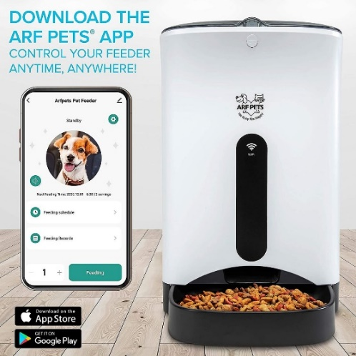
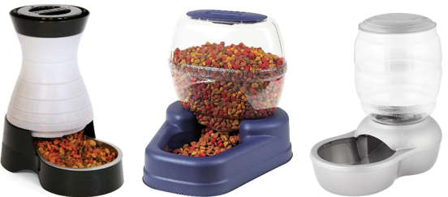
Market research:

Slide 9
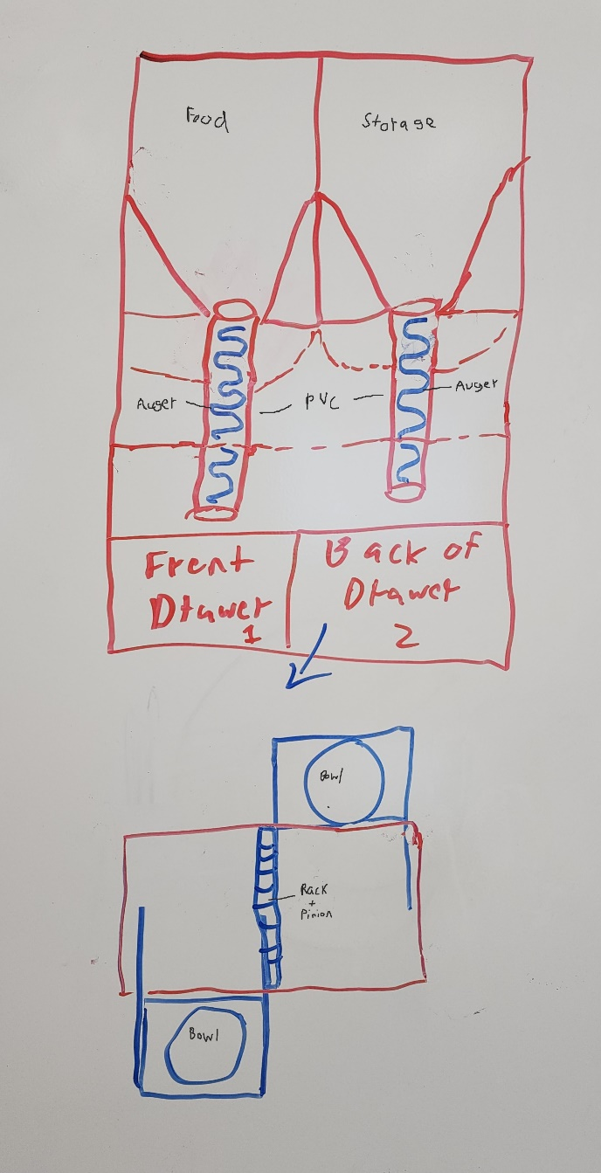
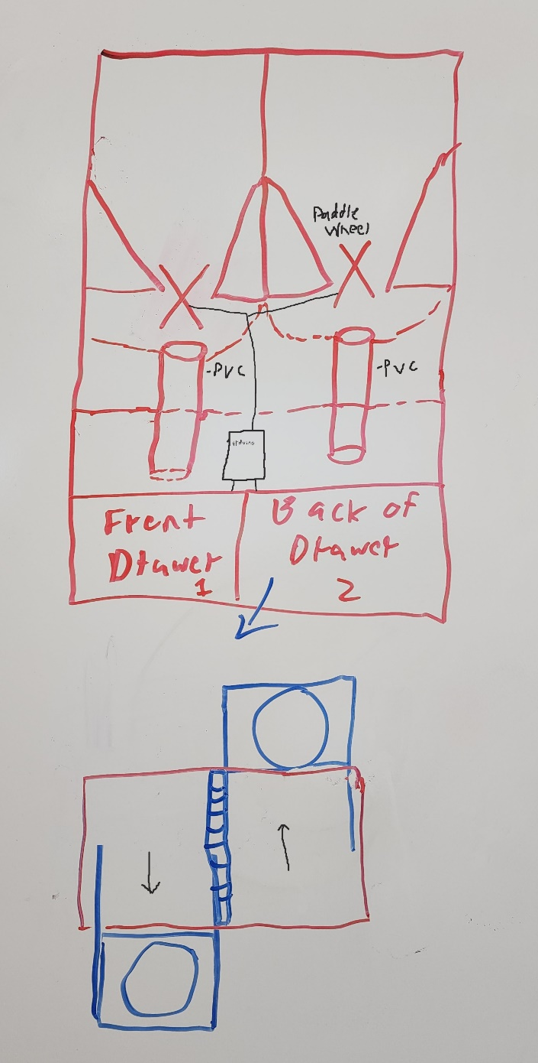
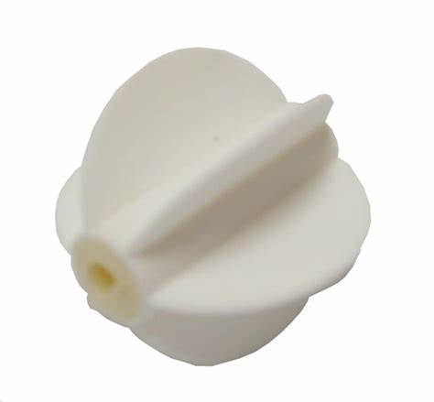
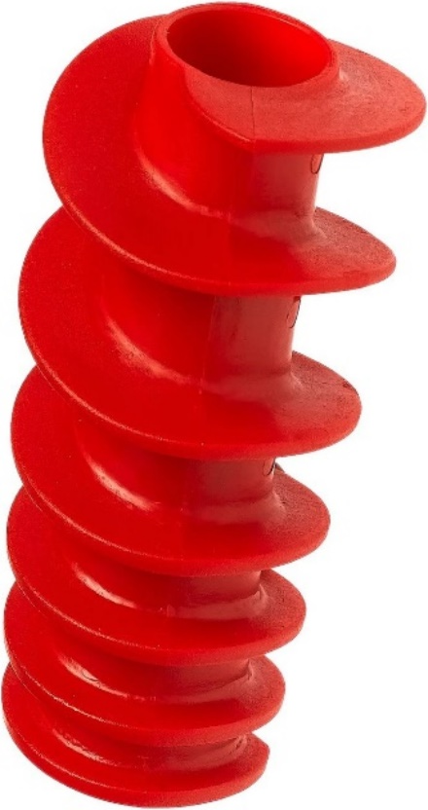
Preliminary designs

Slide 10
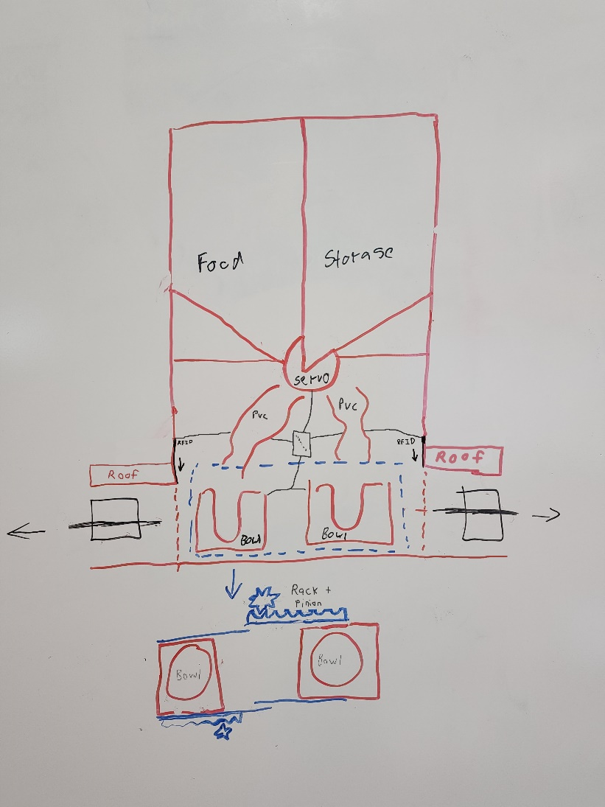
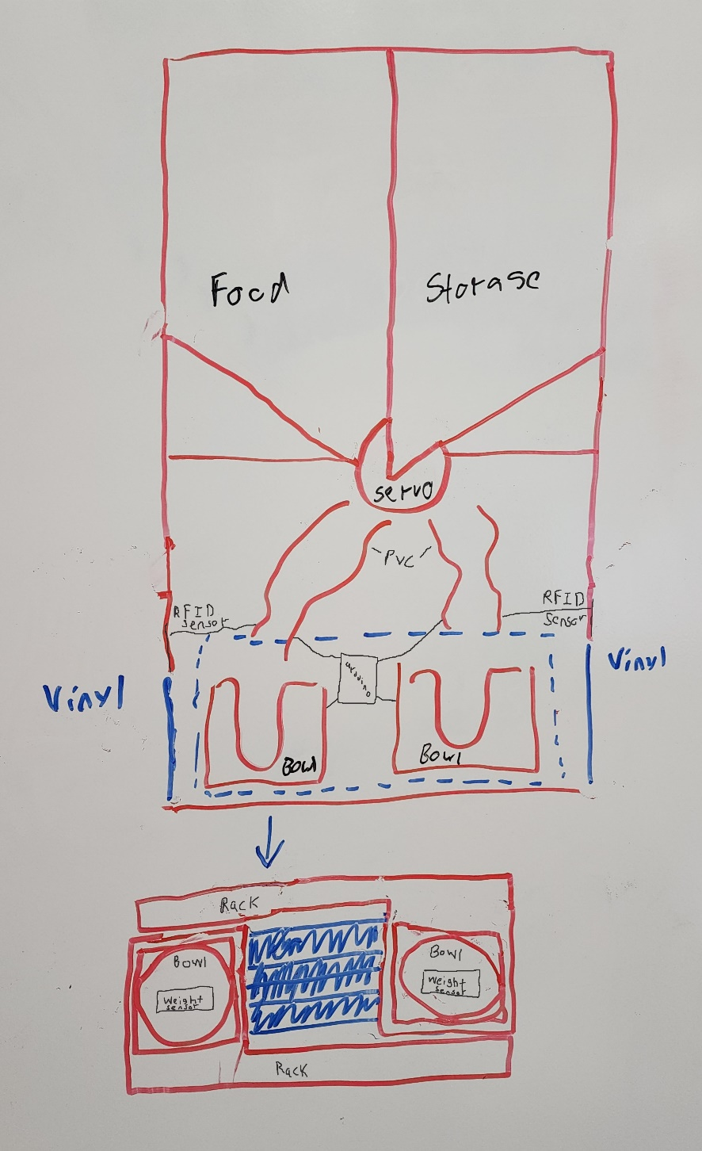
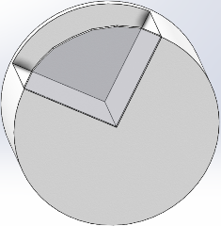
Preliminary designs Continued:

Slide 11
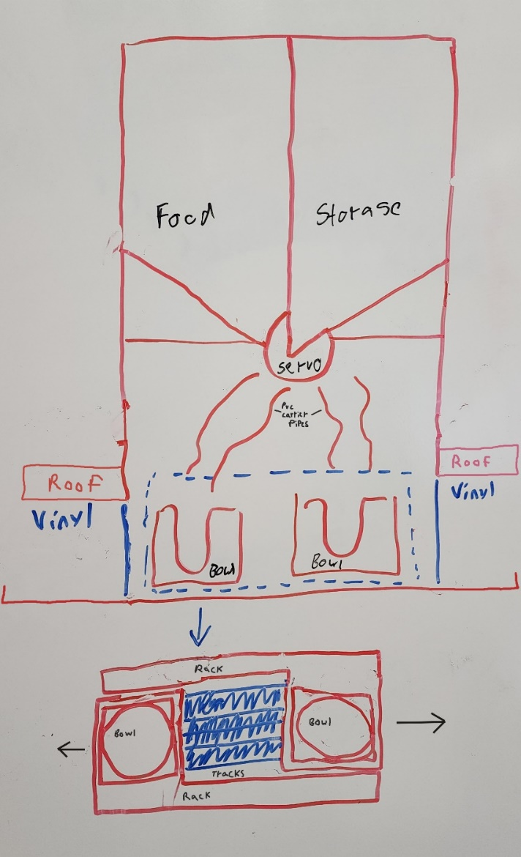
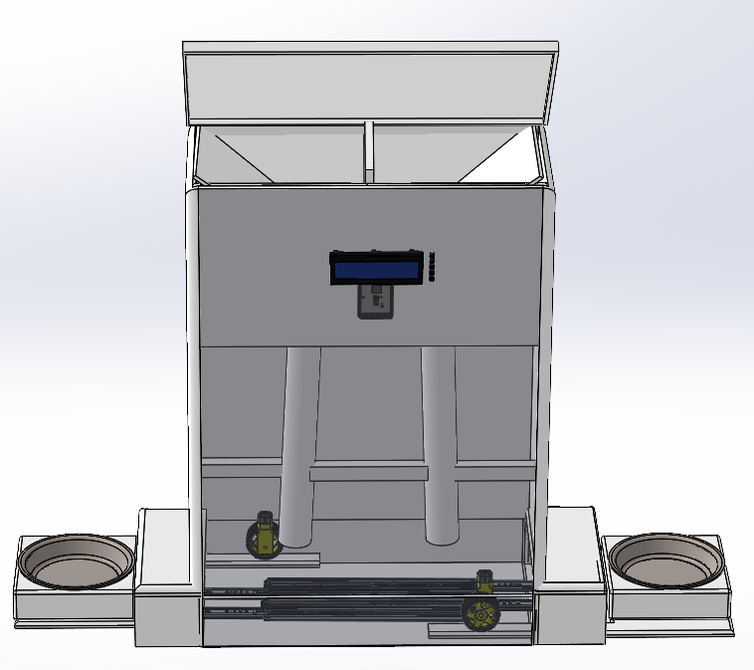
Prototype Design
SLS food dispenser design
Rack and pinion operated feeding Platforms
Hopper integrated into structure

Slide 12
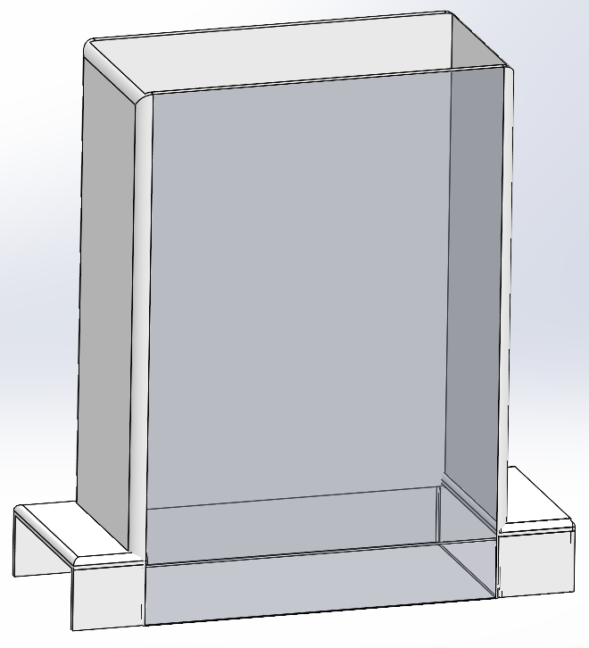
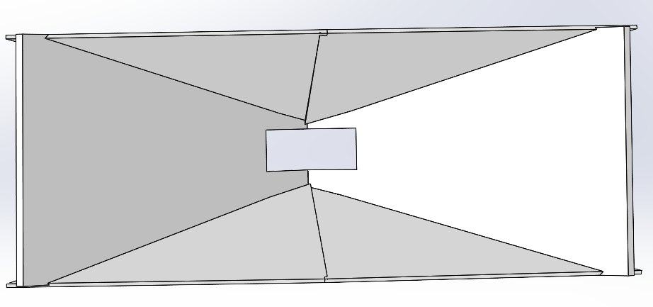
Frame and Hopper:

Slide 13
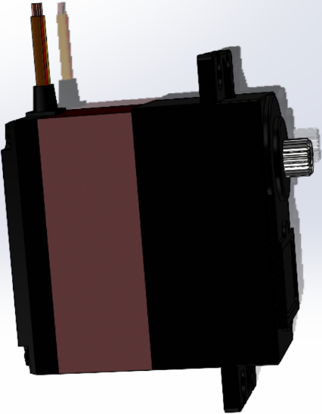
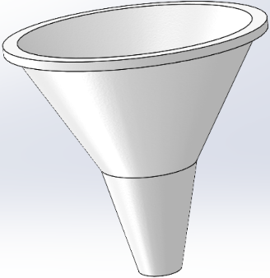
Servo Motor, SLS, Funnel:

Slide 14
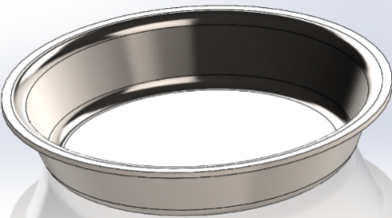
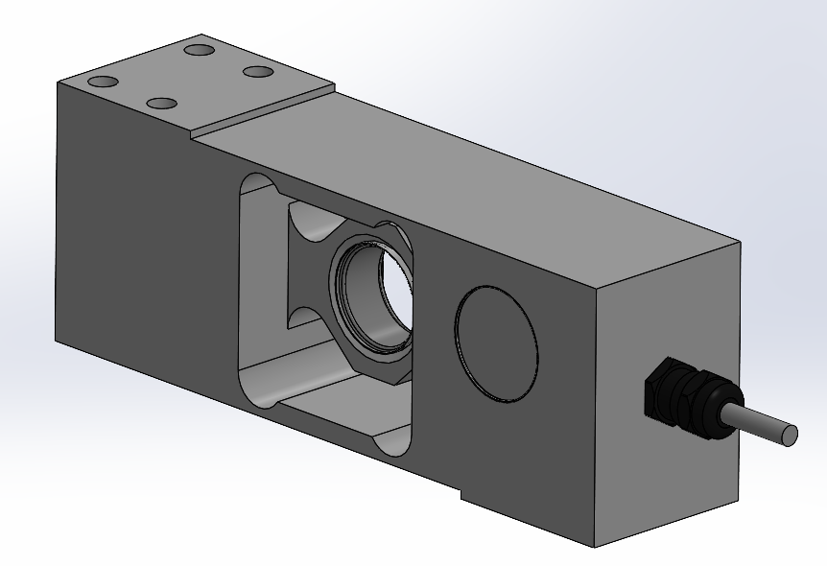
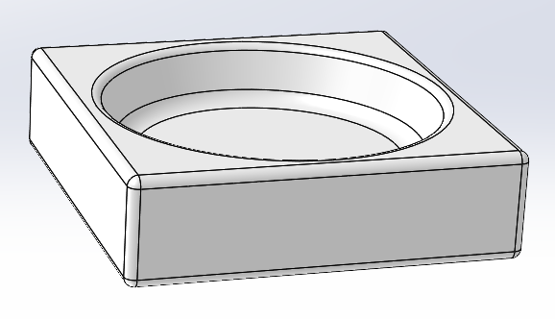
Bowl, Holder, Weight sensor:

Slide 15
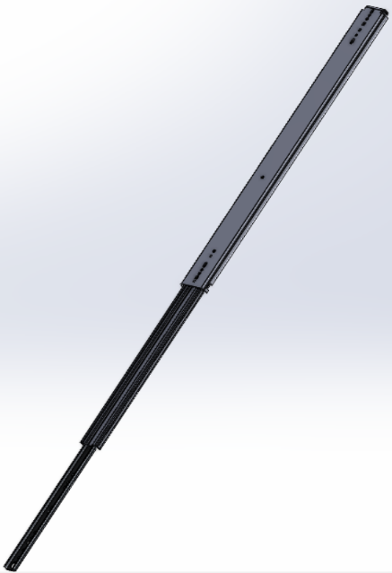

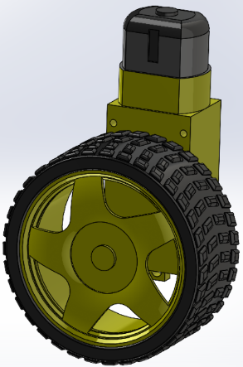
Telescoping rail, Platform, motor & Wheel:

Slide 16
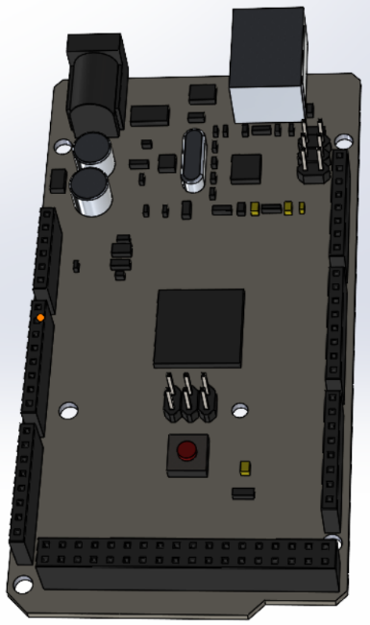

Arduino, LCD, & buttons:

Slide 17
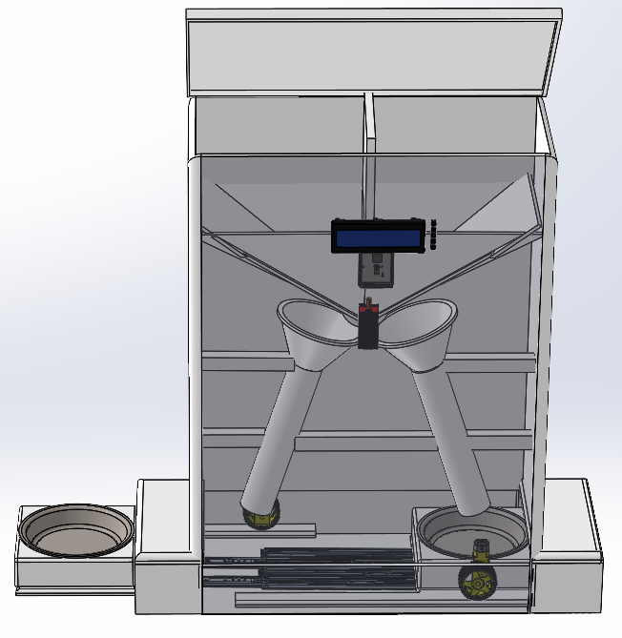
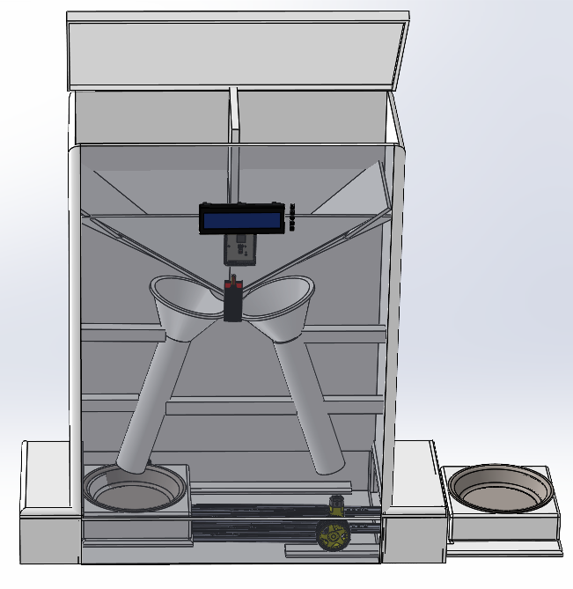
assembled:

Slide 18
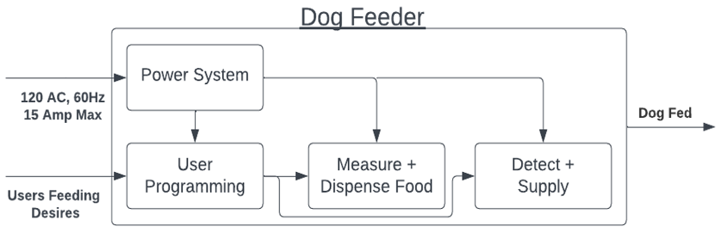
Level 0
Module | Dog Feeder
Inputs | Users Feeding Desires Power: 120 volts AC rms, 60Hz
Outputs | Dog is Fed
Functionality | Dog is fed according to users input settings. System should be able to feed a large dog for a week, contained within the design is space for 2 gallons of kibble.

Slide 19
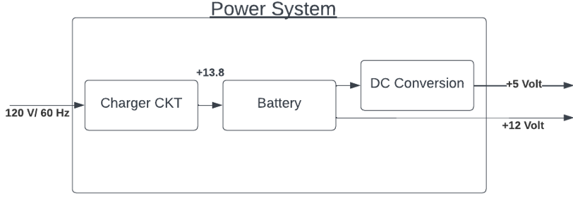
Level 1 - Power System
Module | Power System
Inputs | Power: 120 AC rms, 60HZ
Outputs | +5 Volt DC.
Functionality | Rectify 120 AC into +13.8 Volts which is supplied into a 12-volt battery. This battery is stepped down to 5 volts for use throughout the system.

Slide 20
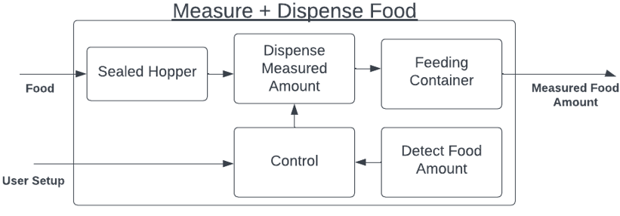
Level 1 - Food Measurement and dispensation
Module | Measure + Dispense Food
Inputs | Dog food. User setup input.
Outputs | Measure food amount
Functionality | Measures food in bowl currently and based on user’s setup options dispenses set food amounts from storage containers to bowl.

Slide 21
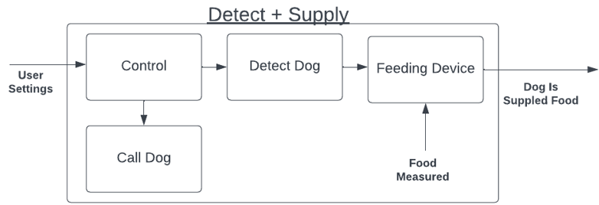
Level 1 - Dog detection and food supply
Module | Detect + Supply Food
Inputs | User settings. Food measured.
Outputs | Dog is supplied food. Call upon dog.
Functionality | System will supply set amount of food, then will call the dog when it is time to eat. It will also detect when the correct dog arrives at the system and extend the correct bowl.

Slide 22
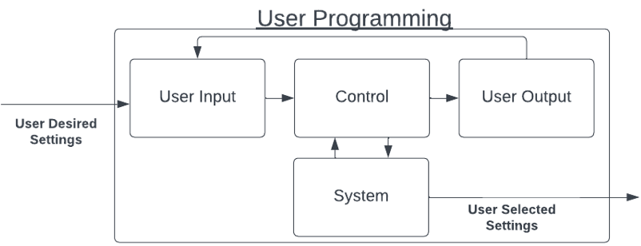
Level 1 - User Programmability
Module | User Programming
Inputs | User desired settings
Outputs | User selected settings
Functionality | User should be able to select the amount and frequency in which their pet is fed. The system should be easily usable by the owner.

Slide 23
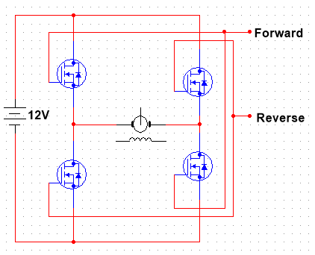
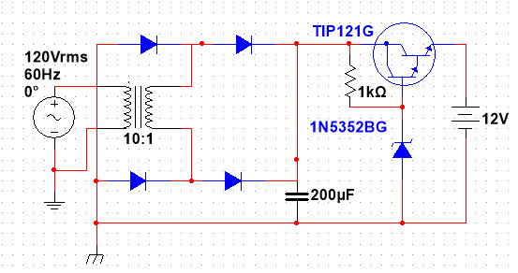
Electrical design
Motor Driver
Battery Charger

Slide 24
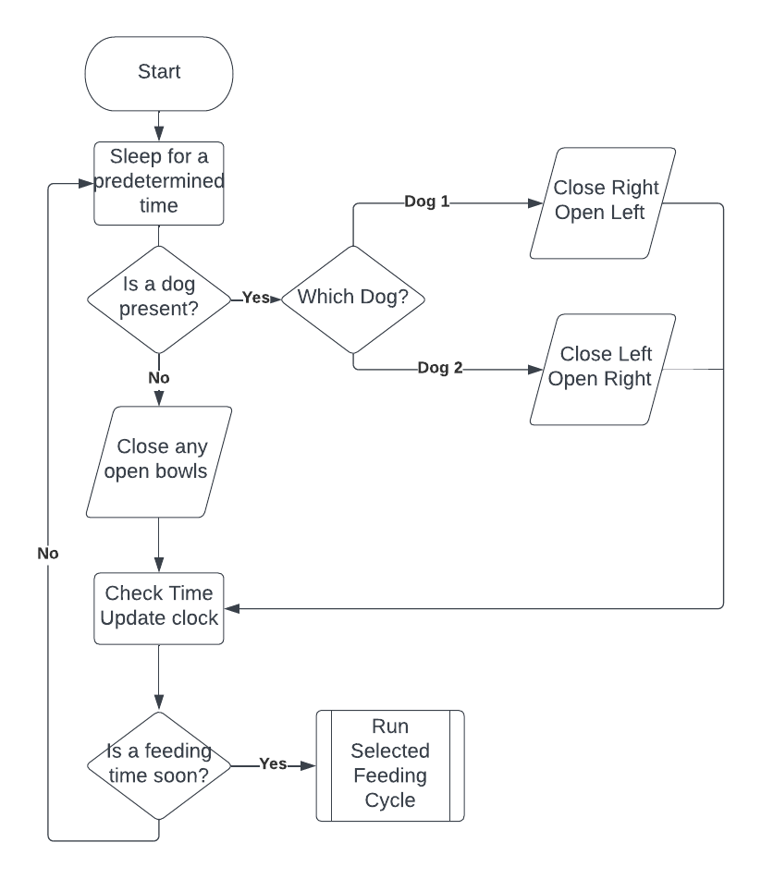
Software – Central loop

Slide 25
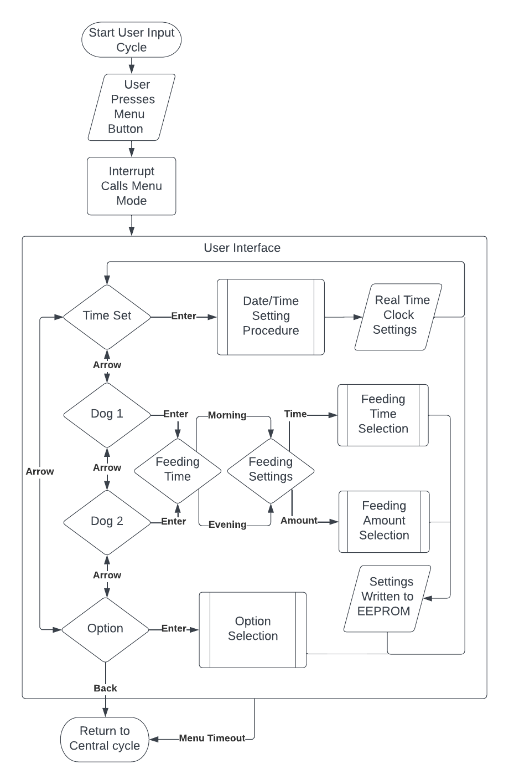
Software – User Interface

Slide 26
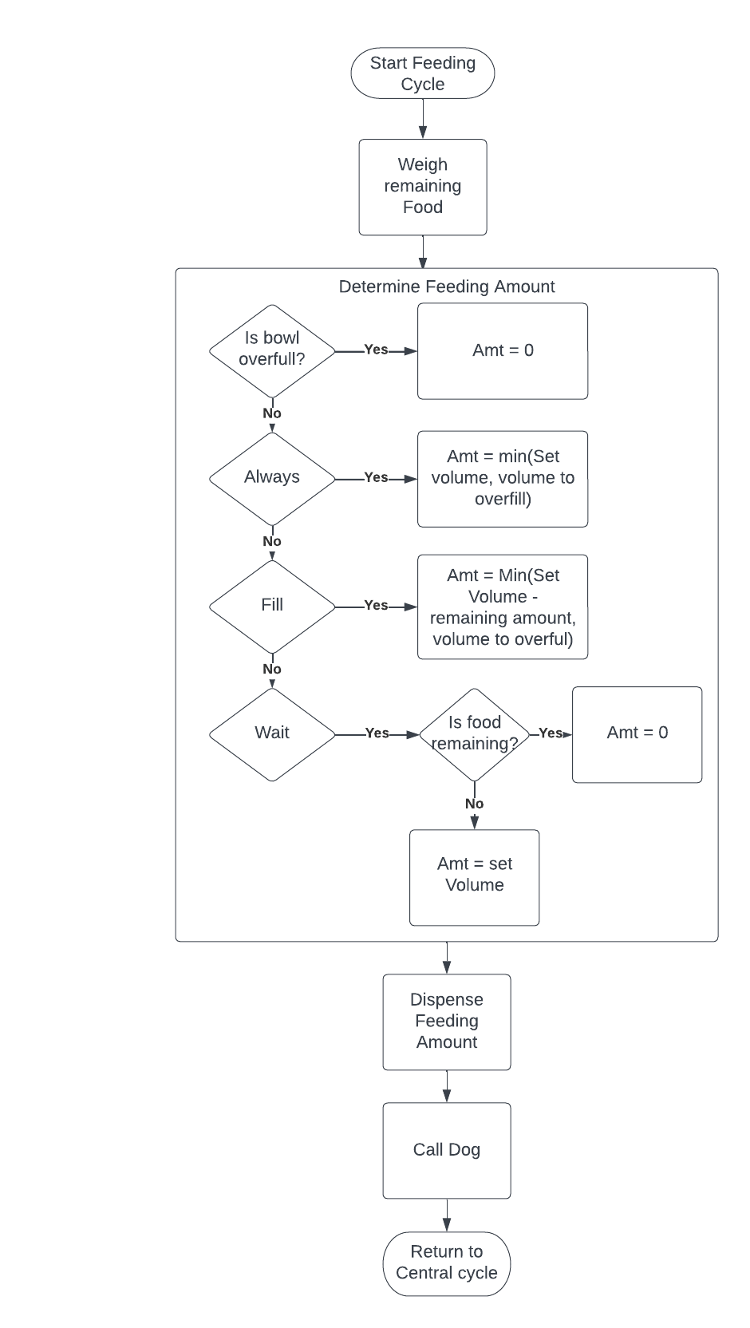
Software – Feeding Cycle

Slide 27
Bill of Materials

Slide 28
Management of project:
Team Members | Responsibilities
Kelby Lang | Project management. Delegating tasks. Technical report writing and formatting. Mechanical design. Prototype construction. Testing plan. Implementation of testing.
Brian Grahmann | Software selection, integration, & implementation. Coding and configuring. Technical report writing and formatting. Testing plan. Implementation of testing.
Slaton Bird | System flow diagrams and explanations. Virtual representation of proposed product. Design changes. Physical design software. Software and coding design. Technical report writing and formatting. Testing plan. Implementation of testing.

Slide 29
Prototyping Schedule:
Schedule | Responsibility | Task
Feb 18-19 | Kelby Lang | Frame built. Rails mounted. Bowl platforms cut and mounted. First version of Super Lazy Susan (SLS) construction.
March 11-12 | Slaton Bird Brian Grahmann Kelby Lang | Bowl holders constructed. Weight sensors mounted. Bowl holder mounted to platform. Side wall cutouts for bowl extension. Transforming circuit constructed. Initial coding started.
March 13-19 | Slaton Bird Brian Grahmann Kelby Lang | SLS improved and reconstructed. Mounting SLS and servo motor. Location picked for Arduino. Additions to programming and coding. Side roofs constructed and attached to frame. Food compartments constructed and installed. DC rail motors and RFID sensors installed. Instillation of step-down circuit.
March 25-29 | Slaton Bird Brian Grahmann Kelby Lang | Funnels installed. Physical component operation testing. Program download. Software input & output testing. Implemented necessary changes.
March 31-April 2 | Slaton Bird Brian Grahmann Kelby Lang | Testing continued. Step-by-step operation. Scenario change testing. Making alterations and improvements.
April 14-16 | Slaton Bird Brian Grahmann Kelby Lang | Finish simulations and alterations. Prototype finished and operable.

Slide 30
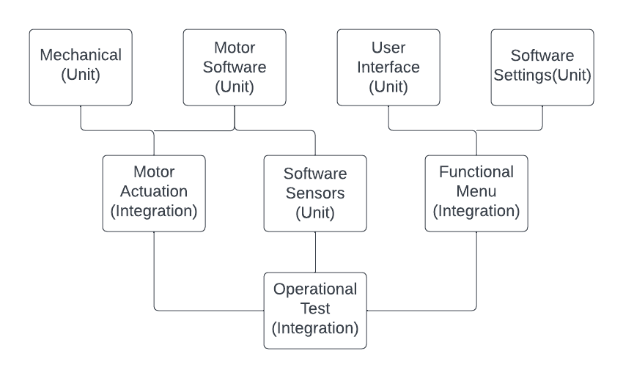
Testing Plan
Separate unit tests of Mechanical, UI, Software for Settings, Motor control, and Sensors
Integration Testing for Motor Actuation of mechanical parts and a functioning user Menu
All-up operational integration testing

Slide 31
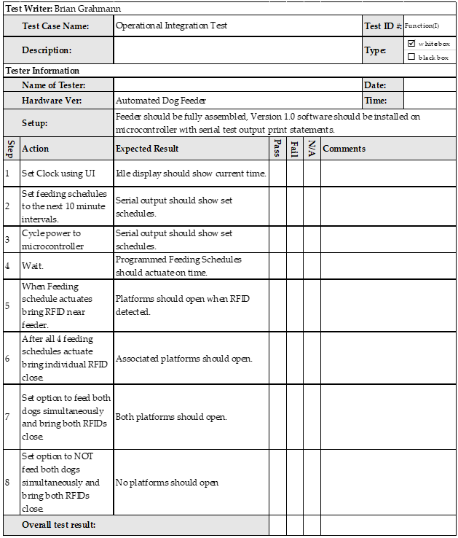
Example Test

Slide 32
Questions?

Slide 33
References:
“Obesity in dogs: VCA Animal Hospital,” Vca. [Online]. Available: https://vcahospitals.com/know-your-pet/obesity-in-dogs. [Accessed: 25-Jan-2023].
[Online]. Available: https://rawbistro.com/blogs/raw-bistro/food-aggression-in-dogs#:~:text=Try%20these%20seven%20steps%20to%20help%20put%20a,eat%20food%20from%20a%20bowl%20on%20the%20floor. [Accessed: 25-Jan-2023].
“Pet ownership statistics [2022]: U.S pet population,” Spots.com, 07-Dec-2022. [Online]. Available: https://spots.com/pet-ownership-statistics/. [Accessed: 25-Jan-2023].
R. M. Ford and C. S. Coulston, “Chapter 3.5: Advanced Requirements Analysis,” in Design for electrical and computer engineers: Theory, concepts, and Practice, Boston, MA: McGraw-Hill, 2008, pp. 57–58.
R. M. Ford and C. S. Coulston, “Chapter 3.5: Advanced Requirements Analysis,” in Design for electrical and computer engineers: Theory, concepts, and Practice, Boston, MA: McGraw-Hill, 2008, pp. 58–59.
R. M. Ford and C. S. Coulston, “Chapter 3.5: Advanced Requirements Analysis,” in Design for electrical and computer engineers: Theory, concepts, and Practice, Boston, MA: McGraw-Hill, 2008, pp. 60–61.
Rotary livestock feeder with gravity flow feed openings. (n.d.). Retrieved February 17, 2023, from https://www.mysciencework.com/patent/show/rotary-livestock-feeder-gravity-flow-feed-openings-US20150359191A1
Google. (n.d.). US5363805A - Automatic Pet Feeder. Google Patents. Retrieved February 17, 2023, from https://patents.google.com/patent/US5363805A/en
Google. (n.d.). US4181037A - lazy Susan Assembly having an adjustable alignment mechanism. Google Patents. Retrieved February 17, 2023, from https://patents.google.com/patent/US4181037
R. M. Ford and C. S. Coulston, “Chapter 3.5: Advanced Requirements Analysis,” in Design for electrical and computer engineers: Theory, concepts, and Practice, Boston, MA: McGraw-Hill, 2008, pp. 57–58.
G. Reviews, “What is the difference between kidney-shaped and Pie Cut lazy susans?,” Woodworker Express. [Online]. Available: https://www.woodworkerexpress.com/kidney-shaped-vs-pie-cut-lazy-susans/. [Accessed: 04-Mar-2023].
“Arf Pets Automatic Dog & Cat Feeder, white, 18-Cup,” ARF PETS Automatic Dog & Cat Feeder, White, 18-cup - Chewy.com. [Online].
“Arf Pets Automatic Dog & Cat Feeder, white, 18-Cup,” ARF PETS Automatic Dog & Cat Feeder, White, 18-cup - Chewy.com. [Online]. Available: https://www.chewy.com/arf-pets-automatic-dog-catfeeder/dp/139369?utm_id=401602544&msclkid=5e8d17609b1b1c69c335748f6fd17c0b&utm_source=bing&utm_medium=cpc&utm_campaign=Shopping_NC_Dog_HG_Technology&utm_term=4584826056283813&utm_content=Automation%2BProducts-Dog%2BFeeders%2BWaterers. [Accessed: 04-Mar-2023].

Slide 34
References Continued:
/282948797_Solar_Charger_Sizing. [Accessed: 04-Mar-2023].
“Norpro ‘the original’ grape spiral - amazon.com.” [Online]. Available: https://www.amazon.com/Norpro-The-Original-Grape-Spiral/dp/B000LNU006. [Accessed: 04-Mar-2023].
“PaddleWheelImage.” [Online]. Available: https://www.manomano.co.uk/p/relaxdays-dual-muesli-dispenser-with-paddle-wheel-cereal-candy-container-hwd-41x325x19-cm-black-49830208. [Accessed: 04-Mar-2023].
“Newagepet vinyl flap door - medium,” The Home Depot Canada. [Online]. Available: https://www.homedepot.ca/product/newagepet-vinyl-flap-door-medium/1000723600. [Accessed: 04-Mar-2023].
“Black Scissors Vector Image,” Black scissors | Public domain vectors. [Online]. Available: https://publicdomainvectors.org/en/free-clipart/Black-scissors/72397.html. [Accessed: 04-Mar-2023].
E. Ahmed, “Free CAD designs, Files & 3D models: The grabcad community library,” Free CAD Designs, Files & 3D Models | The GrabCAD Community Library. [Online]. Available: https://grabcad.com/library/servo-motor-35-kg-cm-aluminum-mid-shell-ft5835m-1. [Accessed: 04-Mar-2023].
I. Milan, “Free CAD designs, Files & 3D models: The grabcad community library,” Free CAD Designs, Files & 3D Models | The GrabCAD Community Library. [Online]. Available: https://grabcad.com/library/funnel-12. [Accessed: 04-Mar-2023].
W. Rogers, “Free CAD designs, Files & 3D models: The grabcad community library,” Free CAD Designs, Files & 3D Models | The GrabCAD Community Library. [Online]. Available: https://grabcad.com/library/zemic-load-cell-1. [Accessed: 04-Mar-2023].
J. Heulin, “Free CAD designs, Files & 3D models: The grabcad community library,” Free CAD Designs, Files & 3D Models | The GrabCAD Community Library. [Online]. Available: https://grabcad.com/library/ball-bearing-telescopic-slide-1. [Accessed: 04-Mar-2023].
S. Reddioui, “Free CAD designs, Files & 3D models: The grabcad community library,” Free CAD Designs, Files & 3D Models | The GrabCAD Community Library. [Online]. Available: https://grabcad.com/library/motor-wheel-for-robot-1#! [Accessed: 04-Mar-2023].
A. Aelevanthara, “Free CAD designs, Files & 3D models: The grabcad community library,” Free CAD Designs, Files & 3D Models | The GrabCAD Community Library. [Online]. Available: https://grabcad.com/library/arduino-mega-2560--1#! [Accessed: 04-Mar-2023].
M. Ewing, “Free CAD designs, Files & 3D models: The grabcad community library,” Free CAD Designs, Files & 3D Models | The GrabCAD Community Library. [Online]. Available: https://grabcad.com/library/tactile-switch-short-1. [Accessed: 07-Mar-2023].
Zawisza, “Free CAD designs, Files & 3D models: The grabcad community library,” Free CAD Designs, Files & 3D Models | The GrabCAD Community Library. [Online]. Available: https://grabcad.com/library/lcd1602-4. [Accessed: 07-Mar-2023].

