Slide 1
Introduction to computers
  Overview
•Γrading Policy
  Cheating Rules (serious concern)
  Assignment
  We shall be having assignments at the end of every lecture; and each assignment shall have to carry some marks.
  We shall try to make the assignments to be practical as much as possible.
  We shall have one TEST.
  All assignment to handed in must be typed.
Syllabus and Course Coverage Overview
Introduction to Computing

Slide 2
Syllabus and Course Content
Overview of Computers and Computing.
Introduction to a Typical Programming Language,. Such as JAVA
Basic Data Types and operators.
Basic obect-orianted concepts.
Wrapper classes.
Console input/output.
Logical expressions and Control Structures .
Memory models methods
Arrays and Strings.
More object-oriented concepts

Slide 3
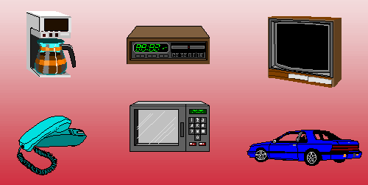
Introduction to computers
Computer Exist Everywhere

Slide 4
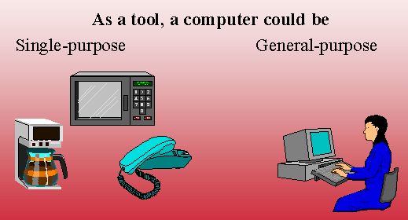
Introduction to computers – Cont’d
Computers Could be For single purpose or for General purpose

Slide 5

Computers
What is a computer?
It is an information transformer. It transforms information from one form to another.
Computers are composed mainly of two parts
1) Hardware
2) Software

Slide 6
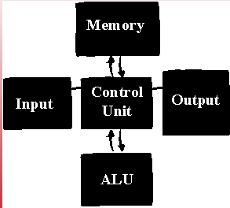
Computer Hardware
Structure and Components
Computer Hardware includes the following components
1) Memory
2) CPU= ALU + CU
3) I/O devices

Slide 7
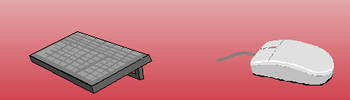
Input Devices
Computer Accepts information from the outside world through an input device
Examples
1) Keyboard
2) Mouse
3) Scanner
4) Camera

Slide 8
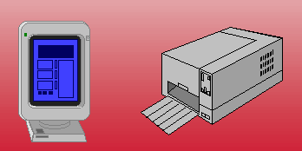
Output Devices
Computers produces information and sends it to the outside world through an output device
Examples:
1) Screen (CRT-LCD)
2) Printer ( dot-matrix, ink-jet, Laser)
3) speakers

Slide 9
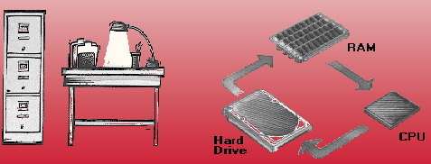
Storage (Memory)
For computer to process information. It should be able to store that information and retrieve it when needed
Two main types of memory
1) Primary : information processed by the computer should be stored in primary memory
2) Secondary: secondary memory acts as extension/archive for primary memory.
The information to be processed by the computer should exist in the primary memory

Slide 10
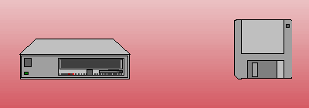
Storage
Two main types of Primary memory
1) RAM : volatile
2) ROM : permanent and stores startup information
Secondary Storage:
1) Magnetic Media ( Hard-disks / diskettes)
2) Optical Disks

Slide 11
CPU
CPU is the brain of the computer. It is composed of
1) Control unit:
Coordinates the operation of all other components
2) Arithematic Logic Unit:Performs all arithmetic and logical operations
Factors influencing the CPU
1) Compatibility
Not all software is compatible with any CPUs
No processors of the same family run old software
New Software is not usually compatible with old CPUs
2) CPU families
Intel and Mac for personal computers
SPARC for workstations
3) CPU Speed
1) Speed in determined by the internal clock
2) the architecture of the CPU determines its speed

Slide 12
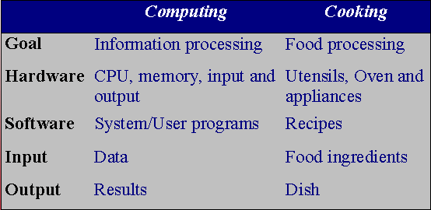
Software
Software is a set of instructions that directs computers to do a specific task.
Software to computing is what a recipe to cooking
Software is classified into two main categories:
Systems Software
Applications Software

Slide 13
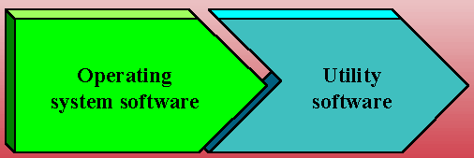
System Software
Software is the programs that manage the computer hardware and allow applications to use it seemingly
Examples of System software
1) Assemblers
2) Linkers
3) Compilers
4) Operating System

Slide 14
Applications Software
Applications are programs that people use to get their work done. Computers mostly exist because people want to run these programs.
Word processors
Game programs
Spreadsheets
Data base systems
Graphics programs
Telecommunication and networking
Multimedia applications

Slide 15
Analog & Binary Signals
Everyone knows that computers are "digital" and that they use "binary" numbers. We need to be clear about their precise meaning and to be clear about why computers are digital.
Binary means "two states." The two states are sometimes called "1" and "0", "true" and "false", or called "on" and "off“.
A bit is a single "on"/"off" value.
A good example is a toggle switch, such as a light switch. You can turn it "on" or "off" but not anything else. A light switch holds one bit of information.
There are many advantages to binary. Here are some (somewhat overlapping) important reasons for using binary:
  Simple; easy to build.
  Unambiguous signals (hence noise immunity).
  Flawless copies can be made.
  Anything that can be represented with some sort of pattern can be represented with patterns of bits.

Slide 16
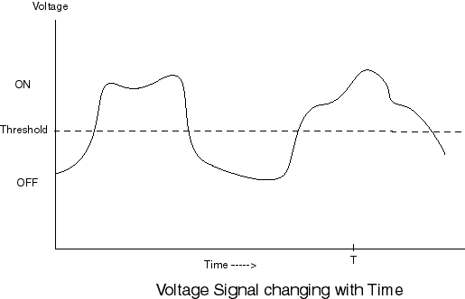
Analog Signal
An analog signal is (usually) continuously changing in value, its values can be anything within a range of values, and its exact value at any time is important.
If the signal shown below is an audio signal, the exact value at each time is part of the information it contains. For example, the value at time "T" must be measured exactly.
It is obvious that any distortion on the signals could lead to corruption of the information it is carrying.

Slide 17
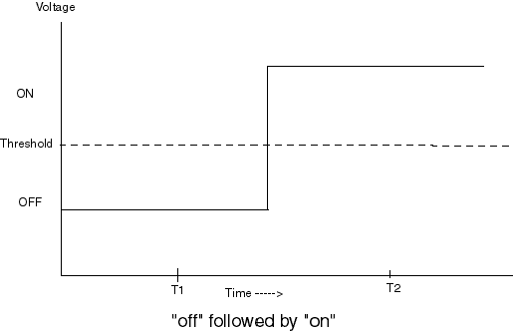
Digital Signal
It is easy and fast (for electronics, as well as humans) to tell if something is above a threshold or below the threshold.
Here is the voltage signal we might send down our wire to transmit the data "off" followed by "on". (The wire is examined at times t1 and t2.)
The above signal is clear enough. However, the wire is long, and someone nearby turns on a vacuum cleaner and the signal get distorted as shown in the next slide.

Slide 18
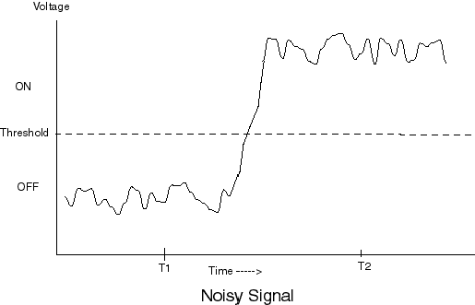
Digital Signal –Contd.
Even though the signal is noisy (at the analog level), the binary values are transmitted perfectly. You (and the electronics) can still tell that at time "t1" the signal represents "off" and that at time "t2" the signal represents "on" The receiving end just needs to get the binary values.
The receiving end of the signal is only interested in the binary values. All it has to do it check if the signal is above or below the threshold. This can be done perfectly (as long as the noise is not too great.). Thus, binary signals are said to be flawless.

Slide 19
Bits & Bytes
A bit is a single "on"/"off" value. Only these two values are possible.
One bit of information is so little that usually computer memory is organized into groups of eight bits. Each eight bit group is called a byte.
When more than eight bits are required for some data, a whole number of bytes are used. One byte is about enough memory to hold a single character.
Often very much more than eight bits are required for data, and thousands, millions, or even billions of bytes are needed. These amounts have names, as seen in the table:
Any system of symbols can be translated into bit patterns. An example is how English characters have been translated into eight-bit patterns called ASCII. (You will learn more about this later.)
Name
Number of Bytes
Power 2
Byte
1
2⁰
kilobyte
1024
2¹⁰
megabyte
1,048,576
2²⁰
gigabyte
1,073,741,824
2³⁰

