Slide 1
Programming & Programming Languages
Overview
Machine operations and machine language.
Example of machine language.
Different types of processor chips.
High level programming languages.
Language translators (compilers.)
Language interpreters.
Java compiler, Java bytecode and Java virtual machine.
Format of a basic java program.

Slide 2
Machine Operations & Machine Language
When a program is running on a computer, the processor is constantly performing very detailed electronic operations. E.g:
  Reading a byte of data from main memory into a part of the processor.
  Testing if one of the bits in the byte is a "1" bit.
Most processors can perform several hundred types of small operations like these.
A large number of these small operations can add up to a large and useful action.
This is similar to what happens with a car. A "big operation" such as "accelerate", involves the valves on the engine's cylinders opening and closing 24,000 times per minute.
Each tiny electronic operation that a processor can perform is called a machine operation. A processor (a "machine") performs these one at a time, but millions of them in a second.

Slide 3
Machine Operations & Machine Language
A machine instruction consists of several bytes in main memory that tells the processor to perform one machine operation.
The electronics of the computer system is designed so that the processor looks at machine instructions in main memory one after another, and performs a machine operation for each machine instruction.
The collection of machine instructions in main memory is called a machine language program or (more commonly) an executable program.
Luckily for us, with a programming language like Java, we can program a computer without knowing any of these electronic details.
Point-to-Point
Shared Line

Slide 4

Example of Machine Language
Let us assume that an electric toothbrush has a processor and main memory. The processor can rotate the bristles left and right, and can check the on/off switch.
The machine instructions are one byte long, and correspond to the following machine operations:
Machine Instruction
Machine Operation
0000 0000
Stop
0000 0001
Rotate bristle left
0000 0010
Rotate bristle right
0000 0100
Go back to start
0000 1000
Skip next instruction is switch is off

Slide 5
Different Processors
There are many types of processors used in computer systems. Examples:
  Intel processors (486, Pentium, Pentium II & III)
  The processors used in Apple computers.
A computer system is designed around its processor..
The fundamental difference between (say) an Apple Power Macintosh and a Dell Corporation computer is their processors
Different processors have different machine operations. A machine program for a Dell computer (with a Pentium processor) would make no sense to an Apple computer.

Slide 6
High Level Programming Languages
It is very rare for programmers to write programs in machine language .
The executable files for most applications contain hundreds of thousands of (if not millions) of machine language instructions.
Most programs are created using a high level programming language such as Java, C, C++, or BASIC. --- Why are they called High Level?
With a high level language, a programmer creates a program using powerful, "big" operations which will later be converted into many little machine operations.
For example, here is a line from a program in the language "C":
int sum = 0;
The machine operations that correspond to this line will set up a small part of main memory to hold a number, store the number zero there, and arrange things so other parts of the program can use it.
It might take a hundred machine operations to do all this. Clearly, it is easier for a programmer to ask for all these operations using "C".

Slide 7
Source Program
Programmers create programs by writing commands in a high level language.
A high level language program consists of lines of text that have been created with a text editor and are kept in a file on the hard disk.
For example, here is a complete program in "C" (Java will be discussed later):
    #include <stdio.h>
    main(){
    int sum = 0;
    sum = 2 + 2;
    printf( "%d\n", sum );
    }
This program could be saved on the hard disk in a file called addup.c. Like all files, it consists of a sequence of bytes.
However, since it is a text file, these bytes contain character data and not machine instructions.
If the bytes are copied into main memory, they cannot run as a program without some extra work being done.
Thus, A source program (or source file) is a text file that contains instructions written in a high level language.

Slide 8
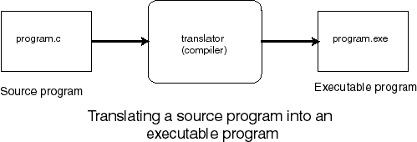
Compilers/Interpreters
An application program called a translater or Compiler takes a source file as input and produces an executable program (machine language program) as output.
For example, the "C" program addup.c could be translated into an executable program. The executable program might be called addup.exe and can be saved on the hard disk. Now this executable version of the program can be copied into main memory and executed.
Here is a picture that shows what usually happens with programs written in "C" (Java is different; it will be discussed in the next chapter.)
The above is what goes on with most languages: Ada, Pascal, C, C++, FORTRAN and others. Java adds a few more steps, which will be discussed next.

Slide 9
Portability
Ideally, only one program needs to be written in the high level language.
The source file can then be translated into several executable files, each containing the correct machine instructions for its intended processor.
This idea is called software portability.
Unfortunately, things do not work out that nicely. It takes a substantial amount of human effort to get a program running on a new system.
One of the big advantages of Java is that it is automatically portable between computer systems that have Java support. No human effort is involved at all.
To understand how Java achieved this, we need to understand one more thing, an Interpreter or a Virtual machine.

Slide 10
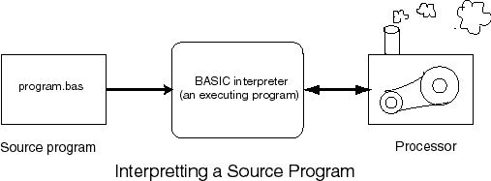
Interpreter/Virtual Machine
Another way to make a source program to run on a computer is through the use of an interpreter
An interpreter is a program that acts like a processor that can directly execute a high level language.
In this figure, the source program "program.bas" has been written in BASIC.
It is being interpreted by the BASIC interpreter, which is running on the processor. The BASIC interpreter will read each command in the source program and do what it says.

Slide 11
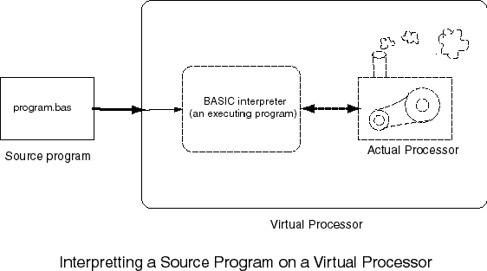
Interpreter/Virtual Machine –Contd.
From the perspective of the BASIC program, it looks like the commands in BASIC are being directly executed by some sort of machine.
Here is the figure, modified to show this:
The word "virtual" is used in situations where software has been used to make something look like the real thing. In this case it looks like we have a machine that can directly execute BASIC, so we can say that we have a BASIC virtual machine.

Slide 12
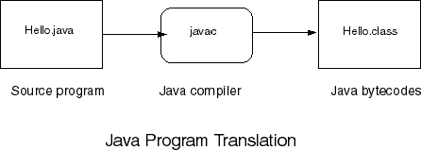
Java Virtual Machine
The following is a simple Java program (Saved in a file, Hello.java). It consists of a class called Hello which contains one method called main.
class Hello
{
public static void main (String[] args)
{
System.out.println("Hello World!");
}
}
We shall explain this program in detail in the lab and in subsequent lectures. The important thing to understand for now is the process involved in executing the program.
To get the sample program running, it is first translated into bytecodes, a machine instruction for a Java processor chip.
‘

Slide 13
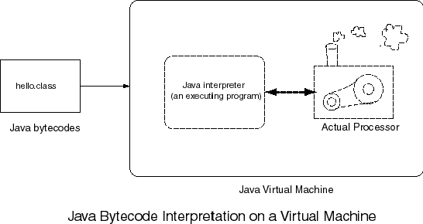
Java Virtual Machine - Contd.
The important idea introduced by Java is that the Java compiler will produce exactly the same bytecodes no matter what computer system is used.
The Java bytecode interpreter (or Virtual machine) executes the bytecode file.
Notice that each type of computer system has its own Java interpreter that can run on that system. The "Actual processor" is the actual, hardware, processor chip of that computer system.
This is how Java achieved Compatibility. It does not matter on what computer system a Java program is compiled, provided the target computer has a Java Virtual machine.

Slide 14
Java Applets and Application
Java can be used to create two types of programs:
Applications and Applet
Application:
An application is a program that runs on your computer just like any other programs created with C or C++.
Applet:
An applet is an application gesigned to be transmitted over the internet and executed by the java compatible web browsers.
This ability of java to create applets makes it more important than any other programming language.

Slide 15
Format of a Java Application
A Java application consists of one or more classes
A Java class consists of one ore more methods (functions) one of which must be the main method
A method is a collection of instructions (statements) describing how to carry out a particular task..
The following is a simple Java application to print the the message "Hello World!“ on the screen.
public class Hello
{
public static void main ( String[] args )
{
System.out.println("Hello World!");
}
}

Slide 16
Format of a Java Application – Contd.
The Statement: public class Hello starts a new class named Hello
public means the class is accessible to all other objects, we shall encounter private later.
The class containing the main method must be declared as public
It is up to you to give names to your classes provided you follow the following simple rules and conventions. A class name
  must be one word (no spaces)
  must start with a letter
  must not contain special characters (+, &, etc)
  should start with capital letter
  If a class name contains more than one English words, each word should start with a capital letter (e.g. MyFirstClass)
  It should reflect the function of the class
A Java file must be saved with the name of the class it contains with the extension .java
If it contains more than one class, the name of the class containing the main method must be used.

Slide 17
Format of a Java Application – Contd.
The Statement: public static void main starts the main method.
Again the main method must always be declared as public – most methods are private.
The main method must always be declared as static, to be explained later - most methods are not static
The parameter (String[],args) is required for the main method. It is used to pass command line arguments
Naming a method follow the same rule as naming a class, however, by convention, we shall always start a method with a small letter to differentiate it with a class.
If a method contains more than one English word, the subsequent words should start with a capital letter. E.g. myFirstMethod
The Statement: System.out.println(“Hello world”); prints a line of text “Hello world” on the standard output (the screen)

Slide 18
Format of a Java Application – Contd.
The standard output is represented by an object called out contained in the class System and referred to as System.out
println is a method of the System.out object and can be used to print strings and numbers.
e.g. System.out.println(3+4); displays 7
When ever you use a method in Java, you must specify three items:
  The object containing the method (e.g. System.out )
  The name of the method (e.g. println)
  A pair of parenthesis which may contain any other information needed by the method (e.g. “Hello world”)
The println method prints the contents of its argument and move to the next line. E.g. the following prints two lines.
System.out.println(“ICS Department”);
Syetem.out.println(“KFUPM”);
Another method of the System.out object is print. This prints its argument but does not move to the next line. The following statements prints one line.
System.out.print(“ICS Department”);
Syetem.out.print(“KFUPM”);

