Slide 1
Basic Object Oriented Concepts
Overview
What is Object-Orientation about?
What is an Object?
What is a Class?
Constructing Objects from Classes
Problem Solving in OO languages (Java)
Java Class Library
Preview: Introduction to Strings
John Bosco Lubega

Slide 2
What is Object-Orientation about?
One of the key challenges faced by Computer Scientist is how to handle complexity.
Two main concepts used to manage complexity are Modularity and Abstractions.
  Modularity means breaking a large system up into smaller pieces until each peace becomes simple enough to be handled easily.
  Abstraction means hiding implementation details in a module and providing a well-defined interface through which the functionality of the module can be accessed by other modules. Thus, each module in a system is treated as a “black box” by other modules.
Over the years, computer scientists have developed a number of approaches to achieve modularity and abstraction.
The latest of these approaches is Object-Orientation or OO for short.
The key concept in OO is of course Object, so we need to first understand what an object is.
John Bosco Lubega

Slide 3
What is an Object?
An Object is a software entity that models something in the real world. It has two main properties:
  State: the object encapsulates information about itself - attributes or fields.
  Behaviour: the object can do some things on behalf of other objects – methods
Example: In a banking system, a particular bank account is an example of an object.
  Its state consists of attributes like: owner, account number, balance, etc.
  Its behaviours consist of: deposit, withdraw, etc.
Other examples of objects are:
  myself – an instructor object. What are my fields and methods?
  you – a student object
  this room – a room object
  this university
  your car, etc.
In an object-oriented system, objects are created from something called a Class, so next we need to know what a class is.
John Bosco Lubega

Slide 4
What is a class?
A class is a general, abstract representation of an object, that specifies the fields and methods that such an object has.
When we write OO programs we don't define individual objects, we define classes, and then use them as templates for constructing objects. Each individual object is called an instance of its class.
For example, you might have a Tree class that describes the features of all trees (each tree has branches and roots, grows, etc.).
The Tree class serves as an abstract model for the concept of a tree. To reach out and grab, or cut down a tree, you must have a concrete instance of that tree – a tree object.
Of course, once you have a Tree class, you can create lots of different instances of that tree, and each different tree instance can have different features (it can be short, tall, bushy, have fruits, etc), yet still behave like a tree and can be recognized as one – the figure next:
John Bosco Lubega

Slide 5
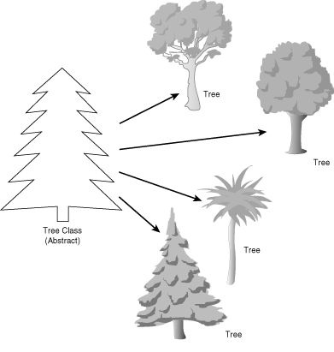
What is a Class? (cont’d)
Diagram showing the relationship between Classes and Objects
Other examples of classes are: Instructor, Student, Room, University, Car, etc.
Notice the difference between these examples and the previous on objects - while these are general, the previous ones are specific.
Class
Objects
John Bosco Lubega

Slide 6
Constructing Objects from classes
Once a class has been defined, it can be used to create any number of objects of that class.
To create an object, we use new operator, the class name, and supply construction parameters (if any) in parenthesis.
For example, the following statement creates and prints an object of the Rectangle class
System.out.println(new Rectangle(5, 10, 20, 30));
Most of the times, we would like to do more with an object than just create it, and print it.
For example, we might want use one of its methods.
To do this, we need to keep the reference (or address) of the object in an object reference variable.
An object reference variable is declared by given the class name followed by the variable as in:
Rectangle myRectangle;
John Bosco Lubega

Slide 7
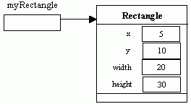
Constructing Objects from classes -Cont’d
Once the variable is declared, it can be used to create an object and store its reference in the variable as follows:
myRectangle = new Rectangle(5, 10, 20, 30);
In fact, the process of declaring an object reference variable and creating an object can be combined in one statement as follows.
Rectangle myRectangle = new Rectangle(5, 10, 20, 30);
The relationship between the reference variable, myRectangle and the Rectangle object created is shown in the following figure:
John Bosco Lubega

Slide 8
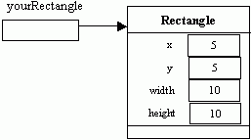
Constructing Objects from classes -Cont’d
We can create any number of objects from the same class. For example, the following defines another object of the rectangle class.
Rectangle yourRectangle = new Rectangle(5, 5, 10, 10);
An object reference can be assigned to another object reference as shown by the following:
myRectangle = yourRectangle;
John Bosco Lubega

Slide 9
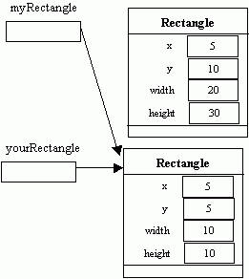
Constructing Objects from classes -Cont’d
The above statement makes both reference variable to point to the same object. Thus, the object previously referenced by myRectangle no longer has any reference.
Once an object is not being referenced by any reference variable it becomes garbage. A Java runtime module called Garbage collector reclaims the memory occupied by the object.
John Bosco Lubega

Slide 10
Problem Solving in OO languages (Java)
In the real world, problems are solved by interaction among objects.
For example, if you have a problem with your car (an object), you take is to a mechanic (another object) for repairs.
Similarly, in Java, problems are solved by interactions among objects.
We create objects that have methods that can solve the problem and then calls the method.
We call a method of an object by using the dot operator. We have been calling the println method of the System.out object in previous examples.
One of the methods of the Rectangle class is translate, which moves a rectangle by a certain distance in the x- and y- direction.
The following statement moves the object being reference by yourRectangle by 15 units along the x-direction and 25 along the y-direction.
yourRectangle.translate(15, 25);
John Bosco Lubega

Slide 11
Java Class Library
JDK comes with thousands of classes that can be used to solve different types of problems.
These classes are organized into related groups called packages.
For example, the System class belongs to the java.lang package, while the Rectangle class belongs to java.awt package.
Except for the classes in the java.lang package, we must import each class we wish to use in our programs using the import statement.
The following program creates a Rectangle object, translate it and then print
import java.awt.Rectangle;
public class MoveRectangle {
public static void main(String[] args) {
Rectangle myRectangle=new Rectangle(5, 5, 10, 10);
myRectangle.translate(15,25);
System.out.println(myRectangle);
}
}
John Bosco Lubega

