Slide 1
More on Applets
Overview
Changing Colors
Changing Fonts & Styles
Applet Life-Cycle
Input using Dialog Window
Input using HTML parameters
Inserting Images
Inserting Sound
Preview: Classes & Objects

Slide 2
Changing Colors
By default, all drawing is done in black pen. However, we can change this by creating an object of class Color and passing it to the setColor method of the Graphics2D object.
Java uses the RGB color model, where colors are specified by giving the amount of the primary colors –Red, Green, and Blue- that make up the color.
The amounts are given in float values and range from 0.0F (no color present) to 1.0F (maximum color present).
The following applet draws three rectangles in 3 different colors, one of which are standard. .

Slide 3
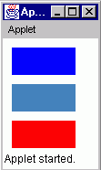
Changing Colors (Cont’d)
import java.applet.Applet;
import java.awt.Graphics;
import java.awt.Graphics2D;
import java.awt.Rectangle;
import java.awt.Color;
public class ColoredRectanglesApplet extends Applet {
public void paint(Graphics g) {
Graphics2D g2 = (Graphics2D)g;
Color myColor = new Color(0.25F, 0.5F, 0.75F);
Rectangle rectangle1 = new Rectangle(10, 10, 70,30);
Rectangle rectangle2 = new Rectangle(10, 50, 70,30);
Rectangle rectangle3 = new Rectangle(10, 90, 70,30);
g2.setColor(Color.blue);
g2.fill(rectangle1);
g2.setColor(myColor);
g2.fill(rectangle2);
g2.setColor(Color.red);
g2.fill(rectangle3);
}
}

Slide 4
Changing Fonts & Styles
By default, strings are drawn using the default font, plain style and default font size.
To change the font, style or size, we need to create an object of class Font and pass it to the setFont method of the Graphics2D object.
To create such object, we need to specify the following parameters:
  The font name
  The Style (Font.PLAIN, Font.BOLD, Font.ITALIC, or Font.BOLD + Fond.ITALIC)
  The point Size

Slide 5
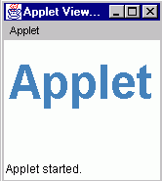
Changing Fonts & Styles (Cont’d)
import java.applet.Applet;
import java.awt.Graphics;
import java.awt.Graphics2D;
import java.awt.Font;
import java.awt.Color;
public class BigFontApplet extends Applet {
public void paint(Graphics g) {
Graphics2D g2 = (Graphics2D)g;
final int size = 48;
Color myColor = new Color(0.25F, 0.5F, 0.75F);
Font myFont = new Font("SansSerif", Font.BOLD, size);
g2.setColor(myColor);
g2.setFont(myFont);
g2.drawString("Applet",5,60);
}
}

Slide 6
Applet Life Cycle
An applets must extend the Applet class defined in the java.applet package. This makes the applet to inherit the methods of the Applet class.
The Applet class provides a set of methods used by any web browser when it runs an applet:
init( ) -This is the first method called when an applet is loaded. Initialization of variables and objects is done in this method.
start( ) - This is called right after the init(), and every time the applet becomes active after it has been inactive. An applet becomes inactive when the browser window is minimized or the user leaves the applet page to another page.
paint(Graphics g) – is called when the applet's display area is covered by a menu, re-sized or when the repaint() method is called.
stop( ) - is called when the applet becomes inactive.
destroy( ) - is called when the browser closes.
By default, these methods do nothing, but we can make them do something by re-writing (overriding) them in our applets – we have been overriding paint method in previous examples.

Slide 7
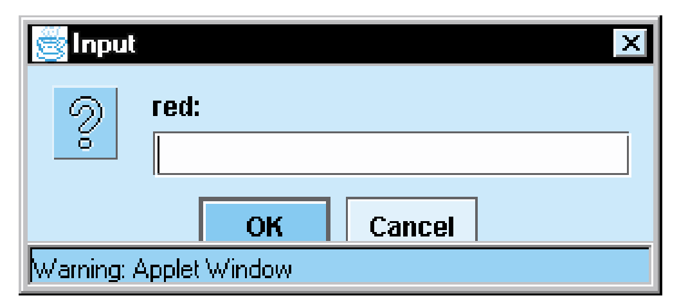
Input using dialog windows
The applets we have written so far are nice, but they aren’t interactive.
Interactive applets allow the user to communicate with them through graphical interfaces such as buttons, text fields, etc.
We can dialog window to pass parameters to our applets.
To display a dialog window, we use showInputDialog() method of the JOptionPane class, which is contained in the javax.swing package. This waits for the user to enter a value and then press the OK button.
.

Slide 8
Input using dialog windows (Cont’d)
The problem with input dialog is that it can only read string input. Thus, if the user enters a numeric value such as 23, it treats it as the string “23”. Thus, we must use the parse method of the appropriate wrapper class to convert to a numeric value.
import java.applet.Applet;
import java.awt.Color;
import java.awt.Graphics;
import java.awt.Graphics2D;
import java.awt.Rectangle;
import javax.swing.JOptionPane;
public class ColorSelect extends Applet {
private float red;
private float green;
private float blue;

Slide 9
Input using dialog windows (Cont’d)
public void init() {
String input;
input = JOptionPane.showInputDialog("red:");
red = Float.parseFloat(input);
input = JOptionPane.showInputDialog("green:");
green = Float.parseFloat(input);
input = JOptionPane.showInputDialog("blue:");
blue = Float.parseFloat(input);
}
public void paint(Graphics g) {
final int SQUARE_LENGTH = 100;
Graphics2D g2 = (Graphics2D)g;
Color fillColor = new Color(red, green, blue);
g2.setColor(fillColor);
Rectangle square = new Rectangle(
(getWidth() - SQUARE_LENGTH) / 2,
(getHeight() - SQUARE_LENGTH) / 2,
SQUARE_LENGTH,
SQUARE_LENGTH);
g2.fill(square);
}
}

Slide 10
Input using parameters
We can also supply input using the <PARAM> tag in the HTML file that loads the applet.
This has the form:<PARAM NAME=”….” VALUE=”….”> where NAME is the parameter name and VALUE is its value.
We can have any number of PARAM tags between the <APPLET> </APPLET> tags.
<HTML>
<HEAD>
<TITLE> A Simple Program </TITLE>
</HEAD>
<BODY>
<APPLET CODE="ColorSelect2.class" WIDTH=400 HEIGHT=400>
<PARAM NAME="Red“ VALUE="0.8">
<PARAM NAME="Green" VALUE="0.7">
<PARAM NAME="Blue“ VALUE="0.1">
</APPLET>
</BODY>
</HTML>
Once parameters are passed using the PARAM tags, the getParameter() method can be used to get the values from within the applet. Again, the getParameter() method returns a string, so it needs to be converted

Slide 11
Input using parameters (cont’d)
import java.applet.Applet;
import java.awt.Color;
import java.awt.Graphics;
import java.awt.Graphics2D;
import java.awt.Rectangle;
public class ColorSelect extends Applet {
private Color fillColor;
public void init() {
float red = Float.parseFloat(getParameter("Red"));
float green = Float.parseFloat(getParameter("Green"));
float blue = Float.parseFloat(getParameter("Blue"));
fillColor = new Color(red, green, blue);
}
public void paint(Graphics g) {
final int SQUARE_LENGTH = 100;
Graphics2D g2 = (Graphics2D)g;
  g2.setColor(fillColor);
Rectangle square = new Rectangle(
(getWidth() - SQUARE_LENGTH) / 2,
(getHeight() - SQUARE_LENGTH) / 2,
SQUARE_LENGTH, SQUARE_LENGTH);
g2.fill(square);
}
}

Slide 12
Inserting Images
Images of type .GIF and .JPEG can be loaded into a java applet by creating an object of class Image as follows:
Image myImage = getImage(baseURL, relativeLocation);
baseURL: This is either the URL of the HTML file which loads the applet, which can be obtained using getDocumentBase() method or the URL of the applet’s .class file, which can be obtained using getCodeBase()
After the image is loaded, we display it by using the drawImage() method of the Graphics object as follows:
  g.drawImage(myImage, x, y, width, height, this);
where x, y specifies the top left corner of the rectangular area to be used in displaying the image, width and height are the width and height to be used in displaying the image and this is the applet reference. If no width and height are specified, the actual width and height of the image are used..

Slide 13
Example Painted House
An image object has two methods getWidth(this) and getHeight(this) which can be used to get the with and height of the image. This is useful if the image need to be centered on the applet display area. this is a reference to the image object.
import java.applet.Applet;
import java.awt.Graphics;
import java.awt.Color;
import java.awt.Image;
public class Images extends Applet {
Image torch;
public void init() {
torch = getImage(getCodeBase(), "images/olympicTorch.gif");
}
public void paint(Graphics g) {
setBackground(Color.white);
g.drawImage(torch, 5, 5, this);
g.drawImage(torch, 200, 200 , 100, 100, this);
}
}

Slide 14
Playing Sound
Audio clips of type .au can be loaded and played in a java applet by creating an object of class AudioClip as follows:
AudioClip myAudioClip = getAudioClip(baseURL, relativeLocation);
An audio clip object can be played by calling its play( ) or loop( ) method.
The play( ) method plays the clip only once, while the loop( ) plays the clip repeatedly until either the stop() method is called or the applet is closed.
import java.awt.Graphics;
import java.awt.Image;
import java.applet.AudioClip;
public class AudioSound extends java.applet.Applet {
Image myImage;
AudioClip music;
public void init() {
myImage = getImage(getDocumentBase(),"images/bashir.jpg");
music = getAudioClip(getDocumentBase(), "audio/spacemusic.au");
}

Slide 15
Playing Sound (Cont’d)
public void paint(Graphics g) {
int iWidth = myImage.getWidth(this);
int iHeight = myImage.getHeight(this);
int xPos = 10;
// 50%
g.drawImage(myImage, xPos, 10 , iWidth/2, iHeight/2, this);
// 100%
xPos += (iWidth/2) + 10;
g.drawImage(myImage, xPos, 10, this);
xPos += iWidth + 10;
g.drawImage(myImage, xPos, 10 , iWidth + 15, iHeight + 15, this);
music.loop();
}
}

