Slide 1

Soldering station with temperature regulation
Pere Rauf 1PBEAI

Slide 2
Table of contents
Project
Motive
Device description
Mechanical design
Discussion

Slide 3
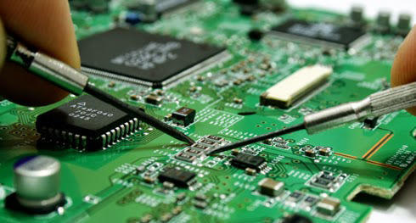
Project
Project
Temperature regulation
OLED Display
50°C – 450°C
Accurate
Data logging
Exchangable soldering tip

Slide 4
Motive
Important tool
Persue electronics
Learn

Slide 5
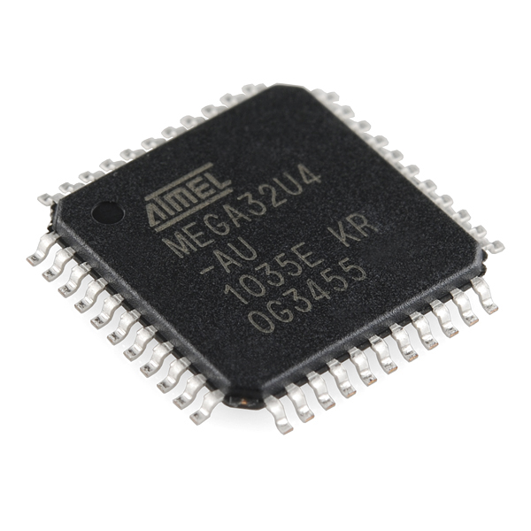
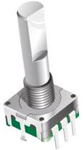
Device description
ATMEGA32U4 microcontroller
Reads input
Pulse Width Modulation
Regulates temperature
Average output value
Transistor gate
12V

Slide 6
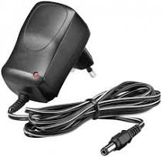
Device description
Power supply
220V AC
12V DC
Cut
Terminal block
Easy
One use

Slide 7
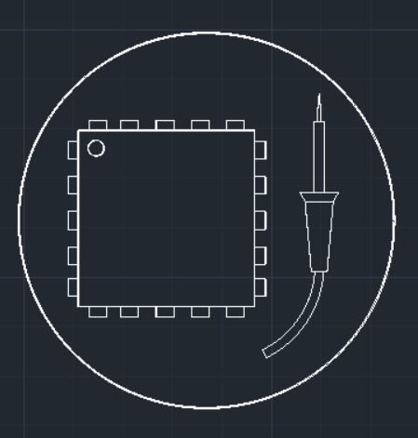
Mechanical design

Slide 8
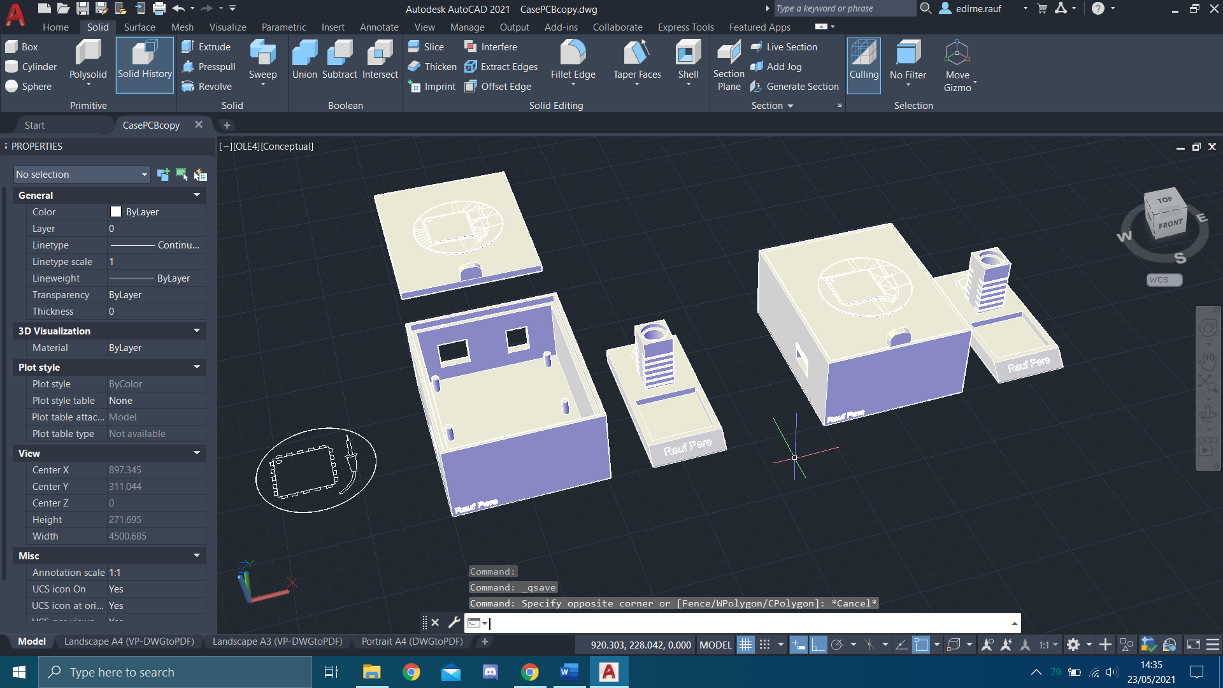
Mechanical design

Slide 9
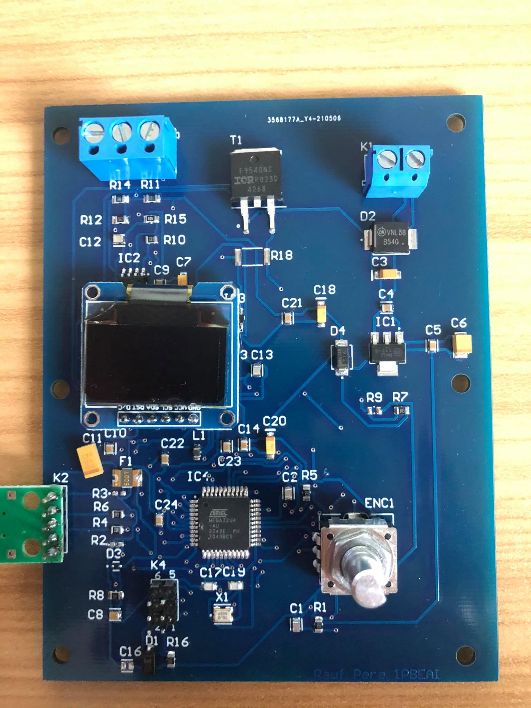
Discussion
Ordering components
Specific
Could’ve gone better
Good first project

Slide 10
End

